Slide 1
K Nearest Neighbours

Slide 2
KNN (TOC)
S.No | Topic | Scope | Objective
1 | Introduction to Knearest Neighbors | What is KNN concept, what is it used for, when is it suitable and when not | Introduction to KNN algorithm for classification and regression
2 | Measures of similarity | How is similarity / dissimilarity between entities represented mathematically , Euclidian and other methods | Understand how and why similarity between data points can be represented by the distance between the points
3 | Data Standardization & Distance | What is data standardization, how is it done and why is it done | Understand how distance calculations get impacted by different scales of attributes and the need to standardize
4 | Similarity Measurement Methods | Minkowski, Mahalanobis conceptually, pointers to other methods | Appreciate the various ways of measuring similarity
5 | KNN methodology | Conditional probability given the K nearest neighbors, Need to find right K that maximizes the probability in training | Understand the KNN logic in training set and the need to find and set optimal K
6 | K as a hyper parameter | How to set optimal value of K and need to be careful in splitting data for finding K | Understand how to find the optimal K

Slide 3
KNN (TOC Contd…)
S.No | Topic | Scope | Objective
7 | Classwork 1 | Use KNN classifier to predict type of cancer given the attribute values | Understand how KNN classifier is implemented
8 | Confusion Matrix | Definitions of True Positives, True Negatives, False Positives, False Negatives, Type I error, Type II error, Classification metrics of Recall, Precision, Overall accuracy | Learn to assess classification models using confusion matrix, interpret the confusion matrix and the associated metrics, Why overall accuracy can be misleading when classes in the data are imbalanced
9 | Advantages / disadvantages of KNN | KNN classifier | Learn the pros and cons of this approach
10 | Interview questions on KNN | Key points in KNN | Interpret the questions, apply the concept and respond accurately
11 | Online Assets | KNN algorithm related topics | Expand horizons beyond what is covered in class in this area
12 | Practice work | Apply KNN classifiers on open source datasets in UCI | Learn to understand data in terms of class distributions on various attributes and assess the suitability of KNN
13 | Appendix A Voronoi regions | Conceptual discussions on Voronoi regions and it’s relation to K value | Appreciate the KNN classifier as algorithm to find homogeneous regions

Slide 4
Introduction to K Nearest Neighbors -
The KNN classifier is also a non parametric and instance-based learning algorithm.
Non-parametric makes no assumptions about the distribution of data and thus avoids the risks of mistaking the underlying distribution of the data. For example, suppose the data is non-Gaussian but the learning model assumes a Gaussian form. In that case, our algorithm would make extremely poor predictions
Instance-based learning means that the algorithm doesn’t explicitly learn a model. It liberally memorizes (keeps in RAM) the training instances which are subsequently used to predict classes of unseen data. Minimal training but high cost in testing!
For classification, the algorithm obtains a majority vote between the K most similar instances to a given “unseen” observation. K is a count
Suited for classification where relationship between features and target classes is numerous, complex and difficult to understand and yet items in a class tend to be fairly homogenous on the values of attributes
Not suitable if the data is noisy and the target classes do not have clear demarcation in terms of attribute values

Slide 5
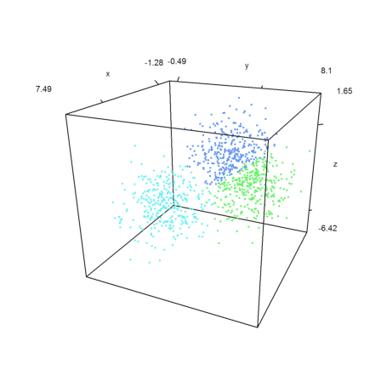
Introduction to K Nearest Neighbors -
The training data is represented by the scattered data points in the feature space
The color of the data points indicate the class they belong to
The grey point is the query point who's class has to be fixed

Slide 6
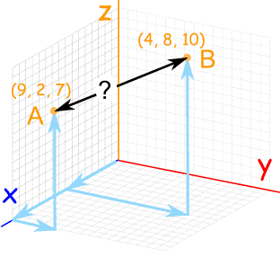

Measures of Similarity
Measuring similarity with distance between the points using Euclidian method
Other distance measurement methods include Manhattan distance, Minkowski distance, Mahalanobis distance, Bhattacharya distance etc.

Slide 7
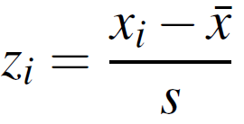
Data Standardization & Distance -
The distance formula is highly dependent on how features / attributes / dimensions are measured.
Those dimensions which have larger possible range of values will dominate the result of the distance calculation using Euclidian formula
To ensure all the dimensions have similar scale, we normalize the data on all the dimensions / attributes
There are multiple ways of normalizing the data. We will use Z-score standardization

Slide 8
Similarity Measurement Methods–
There are many distance calculation formulas in Scikit-learn package-
Minkowski distance
Euclidean distance
Manhattan distance
Mahalanobis distance
Cosine similarity
Pearson correlation
Jaccard similarity
Ref:
http://scikit-learn.org/stable/modules/generated/sklearn.neighbors.DistanceMetric.html
http://dataaspirant.com/2015/04/11/five-most-popular-similarity-measures-implementation-in-python/

Slide 9

K Nearest Neighbors - (Methodology)
Technically, given a positive count K, and unseen observation x and a similarity metric d, KNN algorithm performs two steps -
It computes distance of the data point x from all the other data points in the training set, arranges in ascending order, takes top K observations
It estimates the conditional probability as below
I is a function which returns 1 if the point in set A of k items is from class j. In simple language, what proportion of K belongs to which class. The proportion is probability and sum of all probabilities is 1
The data point x is assigned the class which has max probability
Alternate way of understanding KNN is as a method that calculates decision boundaries in the feature space, a.k.a Voronoi regions or tessellations
?
K=3
P(j = light blue|X=x) = 2/3
P(J= dark blue|X=x)= 1/3
? = light blue

Slide 10
K as a HyperParameter

Slide 11
K Nearest Neighbors - (K the magic)
How to pick the right K? K can range from 1 to number of training data points!
K values can affect the performance of the classifier
K in KNN is a hyper parameter. It has to be discovered through iterations!
Since we will be evaluating a hyper parameter, we need to ensure data is split into three i.e. training, validation and testing.
The iteration to find K should include only training and validation data
We can imagine K as a way of influencing the shape of the boundary between classes

Slide 12
Class Work KNN

Slide 13
K Nearest Neighbors based classifications -
Lab- 3 Model the given data to predict type of cancer
Description – Sample data is available at https://archive.ics.uci.edu/ml/datasets/breast+cancer+wisconsin+(original)
The dataset has 10 attributes listed below
1. Sample code number: id number 2. Clump Thickness: 1 - 10 3. Uniformity of Cell Size: 1 - 10 4. Uniformity of Cell Shape: 1 - 10 5. Marginal Adhesion: 1 - 10 6. Single Epithelial Cell Size: 1 - 10 7. Bare Nuclei: 1 - 10 8. Bland Chromatin: 1 - 10 9. Normal Nucleoli: 1 - 10 10. Mitoses: 1 - 10
Creator: Dr. WIlliam H. Wolberg (physician) University of Wisconsin Hospitals Madison, Wisconsin, USA Donor: Olvi Mangasarian (mangasarian '@' cs.wisc.edu) Received by David W. Aha (aha '@' cs.jhu.edu)
Sol: KNN+Breast+Cancer+Modeling.ipynb

Slide 14
Advantages / Disadvantages of KNN

Slide 15
K Nearest Neighbors based classifications -
Advantages -
Makes no assumptions about distributions of classes in feature space
Can work for multi classes simultaneously
Easy to implement and understand
Not impacted by outliers
Dis-advantages -
Fixing the optimal value of K is a challenge
Will not be effective when the class distributions overlap
Does not output any models. Calculates distances for every new point (lazy learner)
Computationally intensive (O(D(N^2))), can be addressed using KD algorithms which take time to prepare

Slide 16
Confusion Matrix

Slide 17
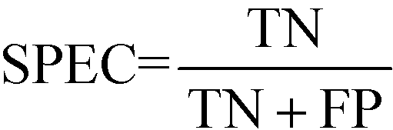
Confusion Matrix
Confusion Matrix – A 2X2 tabular structure reflecting the performance of the model in four blocks
Accuracy – How accurately / cleanly does the model classify the data points. Lesser the false predictions, more the accuracy
Sensitivity / Recall – How many of the actual True data points are identified as True data points by the model . Remember, False Negatives are those data points which should have been identified as True.
Specificity – How many of the actual Negative data points are identified as negative by the model
Precision – Among the points identified as Positive by the model, how many are really Positive
Confusion Matrix | Predicted Positive | Predicted Negative
Actual Positive | True Positive | False Negative
Actual Negative | False Positive | True Negative

Slide 18
Online Assets

Slide 19
K Nearest Neighbors Online Assets -
https://scikit-learn.org/stable/modules/generated/sklearn.neighbors.KNeighborsClassifier.html#sklearn.neighbors.KNeighborsClassifier
https://scikit-learn.org/stable/modules/generated/sklearn.neighbors.DistanceMetric.html

Slide 20
Interview Questions

Slide 21
What are the challenges of using KNN on large datasets?
How can the challenges of large datasets be addressed?
What care should be taken when evaluating K for optimal value in training
What is the minimum and maximum value K can be set to?
What is the impact of using K = 1, explain
What is the impact of using K = number of data points

Slide 22
Practise Work

Slide 23
Project Flow
Seq no | Milestone | Purpose | Key Tasks
1 | Define the project | To be clear on the objective of the project | Name the project, Define the purpose and source of data
2 | Data loading and check | Understand data. Column names and meanings, potential problems, meaning | What do the columns represent How data was collected and when Expected problems
3 | Exploratory data analysis | Understand the data in terms of central values, spread, extreme values, missing values, sampling errors, interactions, mix of gaussians | Univariate analysis using descriptive statistics , Bi-variate analysis Pair plot analysis
4 | Data Preparation | Missing value treatment, Outlier value treatment, analysis of the gaussians (if they exist), Segregating data for training, validation and testing | Decide the appropriate strategy to i and handle both missing values and outliers
5 | Establish reliability of the data | Does it represent the current process? Has the strategy for missing data and outlier handling adversely impacted the data set’s representation , after the split, do the training, validation and test represent the process | Statistical tests such as T-Test, Normal Deviate Z Test, Analysis of variance
6 | Feature engineering and selection | Identify the columns from the given dataset that have the potential for being good features, explore the possibility of creating new powerful features , scale the data | Bi-variate / multi-variate analysis, exploring the pair plot, scaling method
7 | Select ML algorithms | Identify suitable algorithm/s, create base model Identify the hyper parameters to evaluate and set | Given the purpose, given the data distributions, from pair plot, identify suitable algorithms
Exploratory data analysis
Feature engineering and selection
Compare several machine learning models on a performance metric
Perform hyperparameter tuning on the best model
Evaluate the best model on the testing set
Interpret the model results
Draw conclusions and document work

Slide 24
Project Flow
Seq no | Milestone | Purpose | Key Tasks
8 | Explore the model architecture | If using deep neural networks, select the right input and output layer size, number of hidden layers, | Input / ouput layer size Hidden layers and size Activation functions, loss functions, optimizer function and variants
9 | Build and compile the model | Build the models | Build the model in Python with minimal coding (use functions)
10 | Hyper parameter tuning | For the selected algorithms, evaluate the hyper parameters | Use random grid search to identify optimal values of the hyper parameters
11 | Evaluate the models | Assess the reliability of the model and estimate the range of accuracy at 95% confidence for each model | Confusion marrix , Kfold Cross Validation / Bootstrap sampling on test data, Use confusion matrix, classification metrics to ensure model will generalize, PowerTest
12 | Ensemble the model | Select the top few models based on their 95% confidence performance and ensemble | Select appropriate ensemble techniques – Bagging ,Boosting, RandomForest
13 | Create the pipeline | Standardize the steps for data transformation that were employed to create the model | Make pipeline, check the pipeline on test set
14 | Deploy the model | Deploy the model in production environment. | Integrate with existing processes/ re-design the process flows/
15 | Project Report | Document the steps and methodologies | Document the steps taken for every milestone (The documentation should be done in the code to explain the steps and also separately in detail at project level

Slide 25
Project Description
Project Name – Glass identification
Objective – Build a model for classification of types of glass
Purpose - Help in crime investigation by establishing the type of glass correctly
Data Source –publicly available Glass Identification Data Set https://archive.ics.uci.edu/ml/datasets/glass+identification

Slide 26
Appendix A

Slide 27
Voronoi Regions

Slide 28
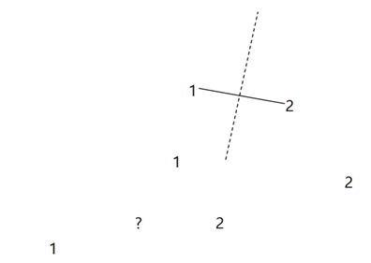
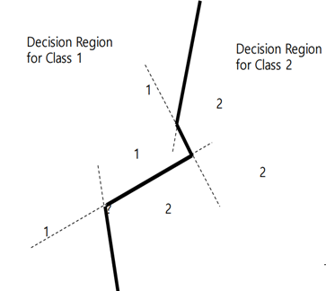
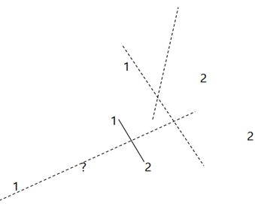
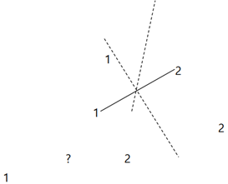
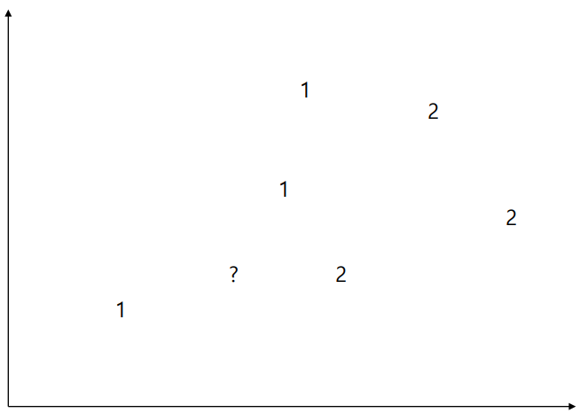
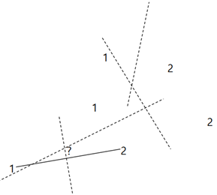
Voronoi Regions
The Voronoi diagram is formed from lines that bisect and are perpendicular to the lines that connect two neighboring vertices
Each point s has a Voronoi cell V(s) consisting of all points closer to s than to any other points
Voronoi boundaries created using nearest neighbor method i.e. K = 1

Slide 29
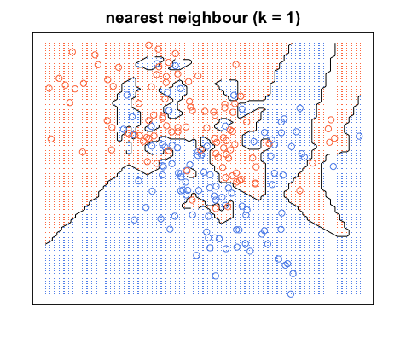
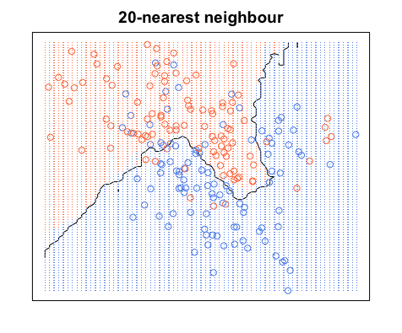
Voronoi Regions – How K impacts the region boundaries
Image Source : https://kevinzakka.github.io/2016/07/13/k-nearest-neighbor/
K = 1 create Voronoi boundaries based on individual point. Each point has a region around itself as it’s domain
The boundaries have sharp bends and there are many islands. The surface represents a complex model likely to suffer from variance error
Large value of K means a larger spread of data points is considered to decide the boundary
The boundary will be relatively smooth with little or no sharp turns. Islands will be minimized and variance error will be low but bias errors increase

Slide 30
Thank You

