Slide 1
Linear Regression

Slide 2
Linear Regression TOC
Introduction to Linear regression
What is linear regression
How is it built
Measuring model accuracy
Structure of Linear Regression model
coefficients
Intercept
error
OLS (Ordinary Least Square Method)
Gradient Descent method
Multivariate Linear Regression
Hypothesis Testing in Linear Regression
Assumptions of Linear Regression
Testing for violations of the assumptions
Advantages and disadvantages of Linear Regression
Applications of Linear Regression

Slide 3
Linear Regression Models -
The term "regression" generally refers to predicting a real number. However, it can also be used for classification (predicting a category or class.)
The term "linear" in the name “linear regression” refers to the fact that the method models data with linear combination of the explanatory variables.
A linear combination is an expression where one or more variables are scaled by a constant factor and added together.
In the case of linear regression with a single explanatory variable, the linear combination used in linear regression can be expressed as:
response = intercept + constant ∗ explanatory
In its most basic form fits a straight line to the response variable. The model is designed to fit a line that minimizes the squared differences (also called errors or residuals.).

Slide 4
Linear Regression Models -
Before we generate a model, we need to understand the degree of relationship between the attributes Y and X
Mathematically correlation between two variables indicates how closely their relationship follows a straight line. By default we use Pearson’s correlation which ranges between -1 and +1.
Correlation of extreme possible values of -1 and +1 indicate a perfectly linear relationship between X and Y whereas a correlation of 0 indicates absence of linear relationship
When r value is small, one needs to test whether it is statistically significant or not to believe that there is correlation or not

Slide 5

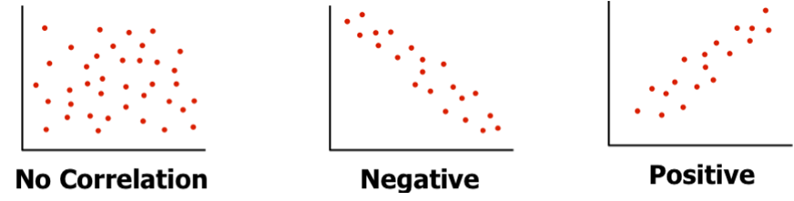
Linear Regression Models -
Coefficient of relation - Pearson’s coefficient p(x,y) = Cov(x,y) / ( stnd Dev (x) X stnd Dev (y) )
Generating linear model for cases where r is near 0, makes no sense. The model will not be reliable. For a given value of X, there can be many values of Y! Nonlinear models may be better in such cases
r is near 0
r is near -1
r is near +1

Slide 6
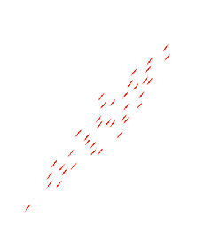
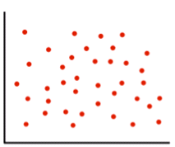
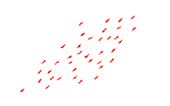
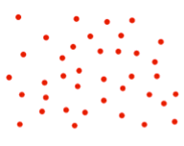
Linear Regression Models (Recap) -
Coefficient of relation - Pearson’s coefficient p(x,y) = Cov(x,y) / ( stnd Dev (x) X stnd Dev (y) )
- ve quad
+ve quad
+ve quad
- ve quad
= 0
> 0
http://www.socscistatistics.com/tests/pearson/Default2.aspx

Slide 7
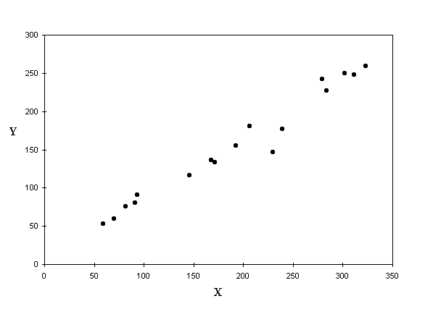
Linear Regression Models -
Given Y = f(x) and the scatter plot shows apparent correlation between X and Y Let’s fit a line into the scatter which shall be our model
But there are infinite number of lines that can be fit in the scatter. Which one should we consider as the model?
This and many other algorithms use gradient descent or variants of gradient descent method for finding the best model
Gradient descent methods use partial derivatives on the parameters (slope and intercept) to minimize sum of squared errors

Slide 8
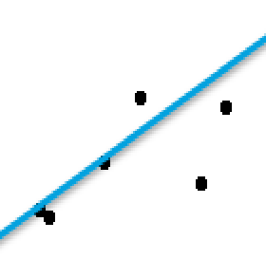
Linear Regression Models (Recap) -
Whichever line we consider as the model, it will not pass through all the points.
The distance between a point and the line (drop a line vertically (shown in yellow)) is the error in prediction
That line which gives least sum of squared errors is considered as the best line
Error = (T – (mx + C)
Sum of all errors can cancel out and give 0
We square all the errors and sum it up. That line which gives us least sum of squared errors is the best fit

Slide 9
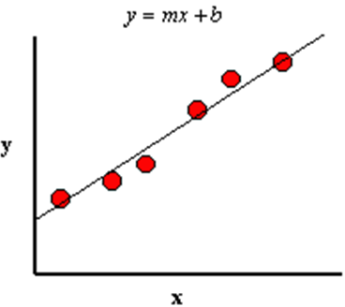
Linear Regression Models -
Coefficient of determinant – determines the fitness of a linear model. The closer the points get to the line, the R^2 (coeff of determinant) tends to 1, the better the model is
Model line always passes through Xbar and Ybar
Ybar
Xbar

Slide 10
Linear Regression Models -
Coefficient of determinant (Contd…)
There are a variety of errors for all those points that don’t fall exactly on the line.
It is important to understand these errors to judge the goodness of fit of the model i.e. How representative the model is likely to be in general
Let us look at point P1 which is one of the given data points and associated errors due to the model
P1 – Original y data point for given x
P2 - Estimated y value for given x
Ybar – Average of all Y values in data set
SST – Sum of Square error Total (SST) Variance of P1 from Ybar (Y – Ybar)^2
SSR - Regression error (p2 – ybar)^2 (portion SST captured by regression model)
SSE - Residual error (p1 – p2)^2
y
P1
SSE
SST
P2
SSR
Ybar
Xbar
x

Slide 11
Linear Regression Models -
Coefficient of determinant (Contd…)
That model is the most fit where every data point lies on the line. i.e. SSE = 0 for all data points
Hence SSR should be equal to SST i.e. SSR/SST should be 1.
Poor fit will mean large SSE. SSR/SST will be close to 0
SSR / SST is called as r^2 (r square) or coefficient of determination
r^2 is always between 0 and 1 and is a measure of utility of the regression model
y
P1
SSE
SST
P2
SSR
Ybar
Xbar
x
Note: SS in all the terms stand for Sum Squared. In the diagram only one point is shown, vertical lines are used to explain the concept. However, these terms make sense only when more than one data points are considered.

Slide 12
Linear Regression Models -
Coefficient of determinant (Contd…) -
Point B
Point B
Point A
Point A
In case of point “A”, the line explains the variance of the point
Whereas point “B” the is a small area (light grey) which the line does not represent.
%age of total variance that is represented by the line is coeff of determinant

Slide 13
Structure of Linear Regression

Slide 14
Structure of Linear Models
Y = m₁X₁ + m₂X₂+ ….. + m_{n}X_{n} + C + e
Y = Dependent / target / predicted variable
X_{i} = Indepenedent / predictor variable
m_{i} = coefficients for the ith independent / predictor variable
C = constant / intercept / bias
e = residual error / unexplained variance / difference between actual and prediction

Slide 15
Ordinary Least Square Method

Slide 16
OLS (Ordinary Least Squares)
Also known as “Linear least squares”, estimates the parameters (coefficients, bias) in a linear regression model by minimizing the sum of the squared errors /residuals.
This method defines the linear regression model as that line which while passing through the distribution of data points, minimizes the sum of the squared differences between the observed values and the predicted value
The combination of coefficients and bias that minimize the sum of squared errors can be found using simple algebraic operations
Let Yp be the predicted value of Y (the actual value) for a given independent variable value of X
Let m and c be the coefficient and the bias respectively
The linear model thus is Yp = mX + c
Error in prediction = Y – Yp = Y – (mX + c)
We have to find the m and c (best m and c) which minimizes the error
Finding the best m –> (corr (X,Y) * stddev_Y ) / stddev_X
Finding the best c -> Ybar – m_best * Xbar
This method is not scalable i.e. with increasing independent variables and increasing data points, this method will take long to find the best fit line. Hence, in data science we use another method called “Gradient Descent”

Slide 17
Gradient Descent method
In this method the error is represented in squared form i.e. E = (Y_{expected} – Y_{pred})²
Expanding Ypred, E = ((Y_{expected} – (mX + C))²
Thus, E is a function of m and c given Y_{expected} and X come from data
The E function being quadratic (raised to power of 2) when plotted against m and c, will acquire a parabolic shape
This guarantees an absolute minima i.e. there will be a unique combination of m and c which will deliver the least error. Let his be the best m and best c
Starting from some random m and c, the Gradient Descent method will automatically discover the best m and best c using a mathematical technique called “Partial Derivatives”
This method can be applied with any number of independent variables. It will be faster than the algebraic method

Slide 18
Multivariate Linear Regression

Slide 19
Multivariate Linear Regression
When more than two predictor variables are used to predict the value in the dependent variable
The structure of the model remains same but gets extended to include all the variables instead of just one as in simple linear regression
Y = m₁X₁ + m₂X₂ + …. + m_{n}X_{n} + c + e
Geometrically, the line in simple linear regression model is replaced with a plane (for two predictor variables) and by a hyper plane (planes in higher than three dimensions) to express the relationship between dependent and independent variables
The predictor variables are expected to be independent of one another i.e not correlate amongst themselves
Mpg_Linear+Regression_statsmodel.ipynb

Slide 20
Multivariate Linear Regression
Model coefficients for car-mpg.csv dataset
Model structure - mpg = 1.86 cyl + 0.01 disp – 0.03 hp - 0.006wt + 0.01 acc + 0.75 yr + 6.6 cr_type – 26.6
The intercept of -26.6 is meaningless and can be eliminated if we scale the data using Zscore (centring data). This does not impact the accuracy but may change the coefficients.
Attributes | Coefficient | Interpretation
cyl | 1.863717834 | one unit increase in cyl, mpg increases by 1.86 units
disp | 0.010066051 | one unit increase in disp, mpg increases by 0.01 units
hp | -0.039229006 | one unit increase in hp decreases mpg by 0.03 units
wt | -0.006414997 | one unit increase in wt decreases mpg by 0.006 units
acc | 0.011723809 | one unit increase in acc increases mpg by 0.01
yr | 0.758818485 | one unit increase in year of manufacture increases mpg by .75 units
car_type | 6.626521339 | Automatic car type increases mpg by 6.6 units
Intercept | -26.69336013 | Meaning less.
Mpg_Linear+Regression_statsmodel.ipynb

Slide 21
Hypothesis Testing In Linear Regression

Slide 22
Hypothesis Testing For Linear Regression
The big question one needs to ask is, are these coefficients really reflecting the relation between the target variable and the independent variable or are they by statistical chance.
Consider the coefficient for the acceleration variable, it is positive 0.01! What it means is, for every increase in acceleration, mpg increases by 0.01 units. Which is absurd!
To establish the reliability of the coefficients, we need hypothesis testing
The Null hypothesis (H0) claims there is no relation between mpg and any of the variables. That means the coefficient is 0 in the universe
Assuming H0 to be true, what is the probability of finding the coefficients found in the sample if the sample is drawn from that universe in which H0 is true
At 95% confidence level if the p value is < .05, we reject the H0 i.e. probability of finding these coefficients in sample if they are 0 in the universe is very low
If p value is >=.05, we do not have sufficient evidence in the data to reject the H0 and hence we do not reject H0. We believe H0 is likely to be true in the universe

Slide 23
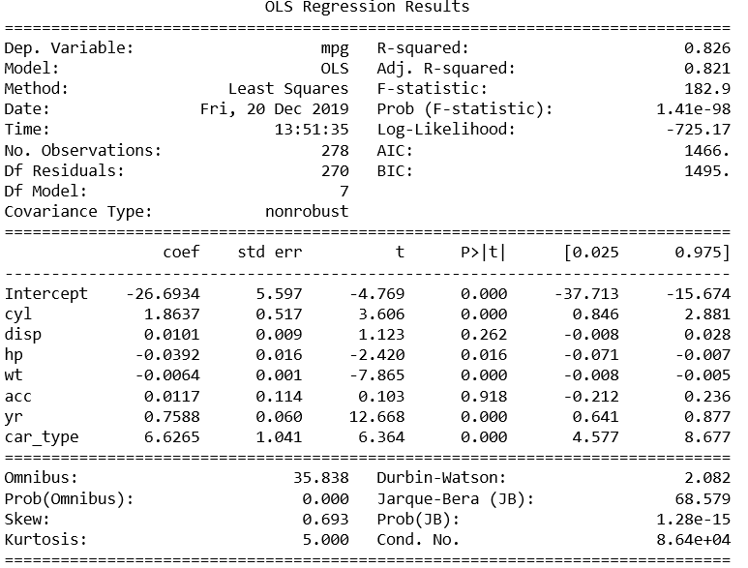
Hypothesis Testing For Linear Regression
R-Squared metric is not reliable as it is does not take into account spurious correlations
Adjusted R-squared metric accounts for the spurious correlations. It decreases when we include attributes into the model that are weak or poor predictors of Y
The statistical analysis is based on T distribution which as mean of 0
Coeff = Std_error * t where std_error is standard deviation and t is zscore in T distribution
P is the conditional probability given H0 is true
Atrributes such as disp, acc have P value > 0.05 and hence statistically their coefficients are not reliable
Overall, model P value is lower than 0.05 which means model is reliable after eliminating the useless attributes

Slide 24
Assumptions In Linear Regression

Slide 25
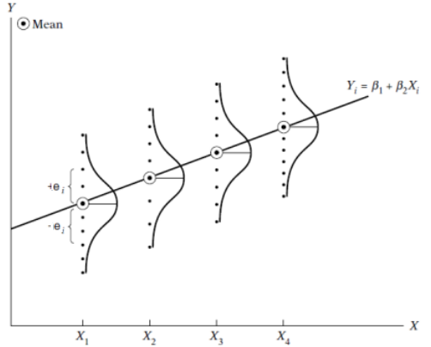
Regression Model Assumptions
Assumption 1
Population Linear Regression Model is linear in the parameters though it may not be linear in the variables i.e. the slope coefficients are always raised to power 1. The variables may be raised to any power. The regression model thus, takes the form y_{i} = m_{i}X_{i} + C + e_{i} (C is intercept, mi is coefficient, X_{i} is variable, e_{i} is disturbance
Assumption 2
The mean value of error e_{i} is zero. Given the value of X_{i}, the means or expected value of the random disturbance E(e_{i} | X_{i}) = 0 i.e. E(e_{i}) = 0
Population of y corresponding to a given X_{i} is distributed around its mean value, implies no specification bias / error in the model indicating that the model is correctly specified.
Assumption 3
The error in prediction of each trial is independent of the value of X.
Error term e_{i}, represents the impact of the variables not considered for the model

Slide 26
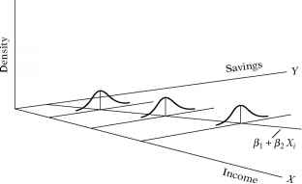
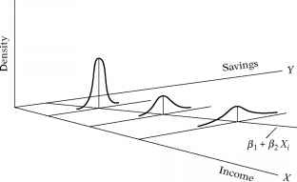
Regression Model Assumptions
Assumption 4
Homoscedasticity or Constant Variance of e_{i}, the variance of the error / disturbance is the same regardless of the value of X
Var(ui) = E[ e_{i} - E(e_{i} | X_{i})]^2 = E(e_{i}² | X_{i}) because of assumption 3 (E(e_{i}) = 0).
= E(e_{i}²) for a given X_{i} = constant variance (representation for homoscedasticity)
The likelihood that the y observations coming from the population with X = X_{i} would be closer to the population regression function than those coming from the populations corresponding to X = X₂, X = X₃ and so on. The reliability of predicted Y will fall
By invoking Assumption 4, we stress equal importance to all y values corresponding to different values of X
Homoscedasticity
Heteroscedasticity
Image source: https://www.rhayden.us/regression-models/the-nature-of-heteroscedasticity.html

Slide 27
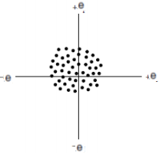
Regression Model Assumptions
Assumption 5
No autocorrelation between disturbances e_{i}. Given any two X values, X_{i} and X_{j} (i <> j), the correlation between any two e_{i} and e_{j} is zero i.e. no serial or auto correlation
This assumption is justified when time is not an attribute i.e.
Assumption 6
The number of observations n must be greater than the number of parameters to be estimated. In data science parlance, the depth should be much greater than breadth i.e. number of records much larger than the number of columns to avoid curse of dimensionality situation.
Assumption 7
The X should have positive variance. The values should not be constant.

Slide 28
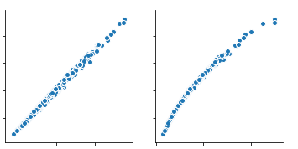
Regression Model Assumptions
Assumption 8
There no perfect collinearity between the predictor variables X
In case of perfect collinearity, the scatter plot will be line
Most often we come across less than perfect collinearity
Assumption 9
The model is correctly specified i.e. positive and negative correlation between X and y is appropriately expressed
Assumption 10
The stochastic term e_{i} is normally distributed. The error term ‘e’ follows the normal distribution with zero mean and (constant) variance
where the symbol ∼ means “distributed as” and N stands for the normal distribution, the terms in the parentheses representing the two parameters of the normal distribution, namely, the mean and the variance. If this assumption is violated, the statistical tests such as t, and F in regression may not be valid.
Note: All the assumptions pertain to population regression function only.

Slide 29
Multi-Collinearity

Slide 30
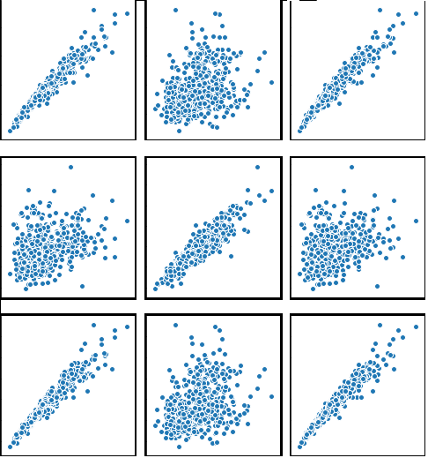
Multi Collinearity – What is it?
Multicollinearity is that situation where the independent variables in the linear model are not truly independent i.e. they are correlated. For e.g. in the Wisconsin Breast Cancer dataset the first three attributes “radius mean”, “perimeter mean” and “texture mean” is shown below. The first two are strongly correlated
Radius mean
Texture mean
Texture mean
Radius worst
Texture Worst
Perimeter Worst

Slide 31
Multi Collinearity – Types of multicollinearity
Structural multicollinearity: This type occurs when we create features from existing features and build a model using all of the features. For example, using “Radius” and “Area” as two variables. When features are generated, ensure the generated feature and the original features do not strongly correlate, if they do, you may want to drop the original feature as long as the generated feature contains all the information from the original
Data multicollinearity: This type of multicollinearity is an artifact of the data itself. The nature of the variables is such that they correlate. For e.g. in auto-mpg.csv, the columns “weight” and “horsepower” of a car will correlate positively. In case there are such correlating variables in the data, they may be combined into a composite variable using techniques such as PCA
The problem with having multi-collinearity is in the inability to understand how one variable influences the target. There is no way to estimate separate influence of each variable on target. Thus no way to estimate the partial regression coefficients

Slide 32
Multi Collinearity – Types of multicollinearity
If multicollinearity is perfect, the regression coefficients of X variables are indeterminate and their standard errors are infinite
If multicollinearity is less than perfect, the regression coefficients, although determinate, posses large standard errors, which means the coefficients cannot be estimated with confidence
High degree of multicollinearity will not take away the property of being best unbiased linear estimators. It violates none of the regression assumptions. The only problem is that it will result in hard to determine coefficients with small standard errors

Slide 33
Multi Collinearity – Testing for multicollinearity with Variation Inflation Factor (VIF)
The variance inflation factor (VIF) identifies correlation between independent variables and the strength of that correlation
VIF = 1 / 1 – r²
As the collinearity between variables increase, r² increases, the denominator approaches 0 and as a result VIF approaches infinity
VIFs start at 1 and have no upper limit
A value of 1 indicates that there is no correlation between this independent variable and any others
VIFs between 1 and 5 suggest that there is a moderate correlation, but it is not severe enough to warrant corrective measures
VIFs greater than 5 represent critical levels of multicollinearity where the coefficients are poorly estimated, and the p-values are questionable.

Slide 34
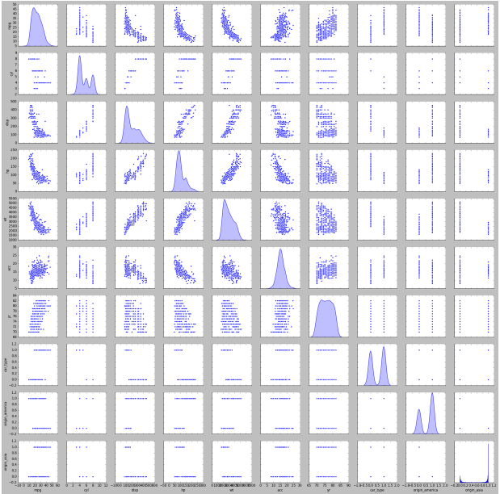
Testing for multicollinearity with Variation Inflation Factor (VIF)
Car-mpg.csv dataset has many attributes that correlate with one another.
from statsmodels.stats.outliers_influence import variance_inflation_factor
vif = [variance_inflation_factor(X.values, ix) for ix in range(X.shape[1])]
i=0
for column in X.columns:
if i < 11:
print (column ,"--->", vif[i])
i = i+1
cyl ---> 172.09167529137474
disp ---> 87.05808335183303
hp ---> 71.23983108333236
wt ---> 139.1665144189037
acc ---> 69.82068667385671
yr ---> 166.95012233353933
car_type ---> 12.993508077923245
Mpg_Linear+Regression_statsmodel.ipynb

Slide 35
Linear Regression
Advantage / Disadvantage

Slide 36
Linear Regression Model -
Advantages –
Simple to implement and easier to interpret the outputs coefficients
Works well even when the relation between independent variable and dependent variable are not linear if we transform the variables
Disadvantages -
Assumes a linear relationships between dependent and independent variables. That is, it assumes there is a straight-line relationship between them
Outliers can have huge effects on the regression
Linear regression assume independence between attributes
Linear regression looks at a relationship between the mean of the dependent variable and the independent variables.
Just as the mean is not a complete description of a single variable, linear regression is not a complete description of relationships among variables

Slide 37
Linear Regression Model -
Lab- 1- Estimating mileage based on features of a second hand car
Description – Sample data is available at https://archive.ics.uci.edu/ml/datasets/Auto+MPG
The dataset has 9 attributes listed below that define the quality
1. mpg: continuous 2. cylinders: multi-valued discrete 3. displacement: continuous 4. horsepower: continuous 5. weight: continuous 6. acceleration: continuous 7. model year: multi-valued discrete 8. origin: multi-valued discrete 9. car name: string (unique for each instance)
Sol : mpg-linear regression_statsmodel.ipynb

Slide 38
Applications of Linear Regression

Slide 39
Applications of Linear Regression-
Retail –
Customer lifetime value analysis – Factoring in customer purchase characteristics to estimate customer value in near future. Model based on history of purchase transactions, customer attributes
Predicting optimal price – factor in characteristics of the object to predict optimal sale price. For e.g. real estate pricing, car re-sale price
Banking & Finance –
Portfolio profit / loss forecasting – use economic factors such as GDP growth rate, Stock market performance, national budgets, national level policies etc
Estimating growth in customer accounts given the economic parameters, sales strategies and promotions etc
Education –
Predict student scores given the attributes such as number of classes attended, past performance, family support etc.
Predict number of seats required in various courses next academic year

Slide 40
Applications of Linear Regression- (Contd…)
Medical –
Predict number of hospital beds required in near future given current demand, season and other social factors
Predict health care cost for insured customers given their attributes such as age, race, gender, previous claims
Manufacturing –
Demand estimation / capacity estimation – predict demand and capacity for a defined period given the socio economic factors, season

Slide 41
Thank You

Slide 42
Regularization

Slide 43
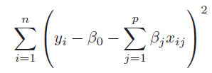
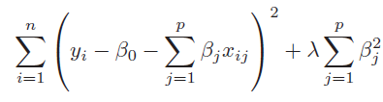
Regularising Linear Models (Shrinkage methods)
When we have too many parameters and exposed to curse of dimensionality, we resort to dimensionality reduction techniques such as transforming to PCA and eliminating the PCA with least magnitude of eigen values. This can be a laborious process before we find the right number principal components. Instead, we can employ the shrinkage methods.
Shrinkage methods attempt to shrink the coefficients of the attributes and lead us towards simpler yet effective models. The two shrinkage methods are :
Ridge regression is similar to the linear regression where the objective is to find the best fit surface. The difference is in the way the best coefficients are found. Unlike linear regression where the optimization function is SSE, here it is slightly different
The term is like a penalty term used to penalize large magnitude coefficients when it is set to a high number, coefficients are suppressed significantly. When it is set to 0, the cost function becomes same as linear regression cost function
Linear Regression cost function
Ridge Regression with additional term in the cost function

Slide 44
Regularising Linear Models (Shrinkage methods)
Why should we be interested in shrinking the coefficients? How does it help?
When we have large number of dimensions and few data points, the models are likely to become complex, overfit and prone to variance errors. When you print out the coefficients of the attributes of such complex model, you will notice that the magnitude of the different coefficients become large
Large coefficients indicate a case where for a unit change in the input variable, the magnitude of change in the target column is very large.
Coeff for simple linear regression model of 10 dimensions
Coeff with polynomial features shooting up to 57 from 10
-9.67853872e-13 -1.06672046e+12 -4.45865268e+00 -2.24519565e+00 -2.96922206e+00 -1.56882955e+00 3.00019063e+00 -1.42031640e+12 -5.46189566e+11 3.62350196e+12 -2.88818173e+12 -1.16772461e+00 -1.43814087e+00 -7.49492645e-03 2.59439087e+00 -1.92409515e+00 -3.41759793e+12 -6.27534905e+12 -2.44065576e+12 -2.32961194e+12 3.97766113e-01 1.94046021e-01 -4.26086426e-01 3.58203125e+00 -2.05296326e+00 -7.51019934e+11 -6.18967069e+11 -5.90805593e+11 2.47863770e-01 -6.68518066e-01 -1.92150879e+00 -7.37030029e-01 -1.01183732e+11 -8.33924574e+10 -7.95983063e+10 -1.70394897e-01 5.25512695e-01 -3.33097839e+00 1.56301740e+12 1.28818991e+12 1.22958044e+12 5.80200195e-01 1.55352783e+00 3.64527008e+11 3.00431724e+11 2.86762821e+11 3.97644043e-01 8.58604718e+10 7.07635073e+10 6.75439422e+10 -7.25449332e+11 1.00689540e+12 9.61084146e+11 2.18532428e+11 -4.81675252e+12 2.63818648e+12
The coefficient for cyl is 2.5059518049385052
The coefficient for disp is 2.5357082860560483
The coefficient for hp is -1.7889335736325294
The coefficient for wt is -5.551819873098725
The coefficient for acc is 0.11485734803440854
The coefficient for yr is 2.931846548211609
The coefficient for car_type is 2.977869737601944
The coefficient for origin_america is -0.5832955290166003
The coefficient for origin_asia is 0.3474931380432235
The coefficient for origin_europe is 0.3774164680868855
Ref: Ridge_Lasso_Regression.ipynb
Very large coefficients!

Slide 45
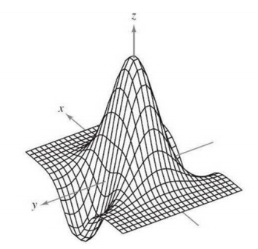
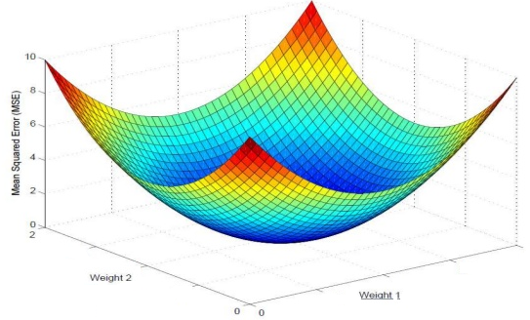
Regularising Linear Models (Shrinkage methods)
Z = f ( x, y)
Curse of dimensionality results in large magnitude coefficients which results in a complex undulated surface / model.
This complex surface has the data points occupying the peaks and the valleys
The model gives near 100% accuracy in training but poor result in testing and the testing scores also vary a lot from one sample to another.
The model is supposed to have absorbed the noise in the data distribution!
Large magnitudes of the coefficient give the least SSE and at times SSE = 0! A model that fits the training set 100%!
Such models do not generalize
= 0

Slide 46
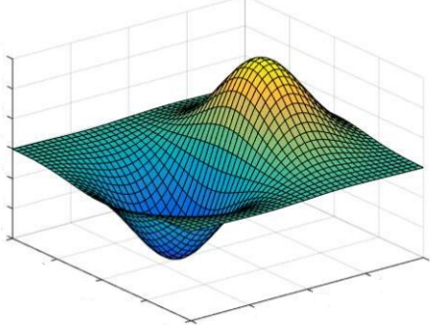
Regularising Linear Models (Shrinkage methods)
In Ridge Regression, the algorithm while trying to find the best combination of coefficients which minimize the SSE on the training data, is constrained by the penalty term
The penalty term is akin to cost of magnitude of the coefficients. Higher the magnitude, more the cost. Thus to minimize the cost, the coefficient are suppressed
Thus the resulting surface tends to be relatively much more smoother than the unconstrained surface. This means we have settled for a model which will make errors in the training data
This is fine as long as the errors can be attributed to the random fluctuations i.e. because the model does not absorb the random fluctuations in the data
Such model will perform equally well on unseen data i.e. test data. The model will generalize better than the complex model
Z = f ( x, y)

Slide 47
Regularising Linear Models (Shrinkage methods)
Impact of Ridge Regression on the coefficients of the 56 attributes
Ridge model: [[ 0. 3.73512981 -2.93500874 -2.13974194 -3.56547812 -1.28898893 3.01290805
2.04739082 0.0786974 0.21972225 -0.3302341 -1.46231096 -1.17221896 0.00856067 2.48054694
-1.67596093 0.99537516 -2.29024279 4.7699338 -2.08598898 0.34009408 0.35024058 -0.41761834
3.06970569 -2.21649433 1.86339518 -2.62934278 0.38596397 0.12088534 -0.53440382 -1.88265835
-0.7675926 -0.90146842 0.52416091 0.59678246 -0.26349448 0.5827378 -3.02842915 -0.36548074
0.5956112 -0.15941014 0.49168856 1.45652375 -0.43819158 -0.20964198 0.77665496 0.36489921
-0.4750838 0.3551047 0.23188557 -1.42941282 2.06831543 -0.34986402 -0.32320394 0.39054656 0.06283411]]
Large coefficients have been suppressed, almost close to 0 in many cases.
Ref: Ridge_Lasso_Regression.ipynb

Slide 48
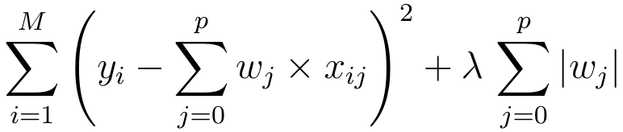
Regularising Linear Models (Shrinkage methods)
Lasso Regression is similar to the Ridge regression with a difference in the penalty term. Unlike Ridge, the penalty term here is raised to power 1. Also known as L1 norm.
The term continues to be the input parameter which will decide how high penalties would be for the coefficients. Larger the value more diminished the coefficients will be.
Unlike Ridge regression, where the coefficients are driven towards zero but may not become zero, Lasso Regression penalty process will make many of the coefficients 0. In other words, literally drop the dimensions

Slide 49
Regularising Linear Models (Shrinkage methods)
Impact of Lasso Regression on the coefficients of the 56 attributes
Lasso model: [ 0. 0.52263805 -0.5402102 -1.99423315 -4.55360385 -0.85285179 2.99044036 0.00711821 -0. 0.76073274 -0. -0. -0.19736449
0. 2.04221833 -1.00014513 0. -0. 4.28412669 -0. 0. 0.31442062 -0. 2.13894094 -1.06760107 0. -0. 0. 0. -0.44991392 -1.55885506 -0. -0.68837902 0.
0.17455864 -0.34653644 0.3313704 -2.84931966 0. -0.34340563 0.00815105 0.47019445 1.25759712 -0.69634581 0. 0.55528147 0.2948979 -0.67289549
0.06490671 0. -1.19639935 1.06711702 0. -0.88034391 0. -0. ]
Large coefficients have been suppressed, to 0 in many cases, making those dimensions useless i.e. dropped from the model.
Ref: Ridge_Lasso_Regression.ipynb

Slide 50
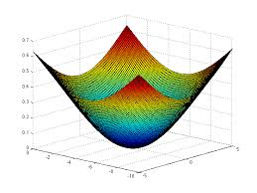
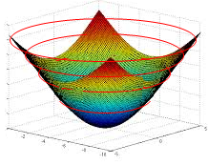

Regularising Linear Models (Comparing The Methods)
To compare the Ridge and Lasso, let us first transform our error function (which is a quadratic / convex function) into a contour graph
Every ring on the error function represents a combination of coefficients (m1 and m2 in the image) which result in same quantum of error i.e. SSE
Let us convert that to a 2d contour plot. In the contour plot, every ring represents one quantum of error.
The innermost ring / bull’s eye is the combination of the coefficients that gives the lease SSE
m2
m1

Slide 51
Regularising Linear Models (Ridge Constraint)
Most optimal combination of m1, m2 given the constraints
Yellow circle is the Ridge constraint region representing the ridge penalty (sum of squared coeff)
Any combination of m1 nd m2 that fall within yellow is a possible solution
The most optimal of all solutions is the one which satisfies the constraint and also minimizes the SSE (smallest possible red circle)
Thus the optimal solution of m1 and m2 is the one where the yellow circle touches a red circle.
Lowest SSE error ring. violates the constraint
m2
Sub-optimal combination of m1, m2. Meets constraint but is not the minimal possible SSE within constraint
Allowed combination of m1, m2 by Ridge Constraints
m1
The point to note is that the red rings and yellow circle will never be tangential (touch) on the axes representing the coefficient. Hence Ridge can make coefficients close to zero but never zero. You may notice some coefficients becoming zero but that will be due to roundoff…

Slide 52

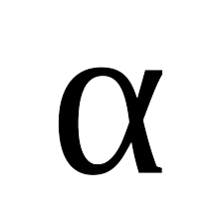
Regularising Linear Models (Ridge Constraint)
As the lambda value (shown here as alpha) increases, the coefficients have to become smaller and smaller to minimize the penalty term in the cost function i.e. the
The larger the lambda, smaller the sum of squared coefficients should be and as a result the tighter the constraint region
The tighter the constraint region, the larger will be the red circle in the contour diagram that will be tangent to the boundary of the yellow region
Thus, higher the lambda, stronger the shrinkage, the coefficients are shrinked strongly and hence more smooth the surface / model
More smoother the surface, more likely the model is going to perform equally well in production
When we move away from a model with sharp peaks and valleys (complex model) to smoother surface (simpler models), we reduce the variance errors but bias errors go up.
Using gridsearch, we have to find the right value of lambda which results in right fit, neither too complex nor too simple a model
m2
m1

Slide 53
Regularising Linear Models (Lasso Constraint)
Most optimal combination of m1, m2 given the constraints
Yellow rectangle is the Lasso constraint region representing the Lasso penalty (sum coeff)
Any combination of m1 nd m2 that fall within yellow is a possible solution
The most optimal of all solutions is the one which satisfies the constraint and also minimizes the SSE (smallest possible red circle)
Thus the optimal solution of m1 and m2 is the one where the yellow rectangle touches a red circle.
Lowest SSE error ring. violates the constraint
m2
Sub-optimal combination of m1, m2. Meets constraint but is not the minimal possible SSE within constraint
Allowed combination of m1, m2 by Lasso Constraints
m1
The beauty of Lasso is, the red circle may touch the constraint region on the attribute axis! In the picture above the circle is touching the yellow rectangle on the m1 axis. But at that point m2 coefficient is 0! Which means, that dimension has been dropped from analysis. Thus Lasso does dimensionality reduction which Ridge does not

