Slide 1
Logistic Regression

Slide 2
Logistic Regression Model -
A classification method built on the same concept as linear regression
The response variable is categorical. It can be two category (binary class) or multi category (multi-class) variable
It is used to predict class given the predictor variable values of an observation
It can also be used to find the propensity (probability) with which an observation belongs to the various classes

Slide 3
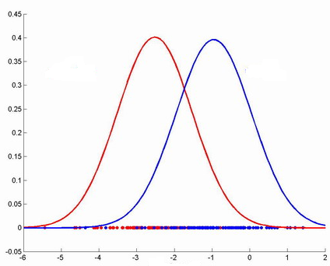
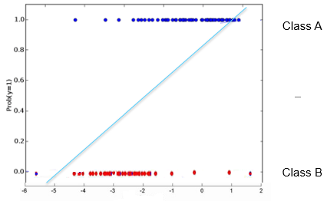

Logistic Regression Model
A new data point (shown with “?”) needs to be classified i.e. does it belong to class A or B.
Given the distribution, closer the point is to the origin, it is unlikely to belong to class A. Farther away it is from the origin, likely it belongs to class A. Let class A be 1 and class B be 0 on the vertical axis
One can try to fit a simple linear model (y = mx +c) where y greater than a threshold means point most probably belongs to class A. for extreme values of x, probability is <0 or >1 which is absurd
Class B
Class A
Probability model
Threshold =.5
?
?
?
Density distribution

Slide 4
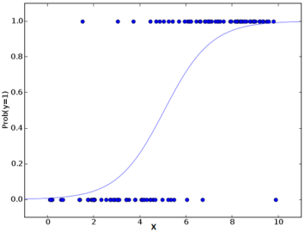

Logistic Regression Model -
The linear model is passed to a logistic function p = 1/ 1 + e^-t the result of which is values between 0 and 1. Thus p represents probability a data point belongs to class “A” given x
Instead of using y of linear model as dependent, it’s function shown as “p” is used as dependent variable This is logistic response function
It is a two step model. In first step, the propensity to belong to class 1 i.e P(1|X), followed by next step of using cut-off to decide the class
Class A
Class B

Slide 5
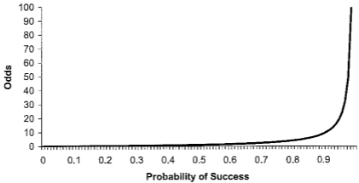

Logistic Regression Model – Building blocks
The output is the probability of belonging to a class. Probability can also be expressed in from of odds.
Odds have a property of ranging from 0 to infinity that makes it easy to map a regression equation to odds. That is why logistic model uses odds
The odds of belonging to class y = 1 is defined as the ratio of probability of belonging to class 1 to probability of belonging to class 0
If probability of belonging to class Y=1 is .5 then Odds(Y=1) = 1

Slide 6

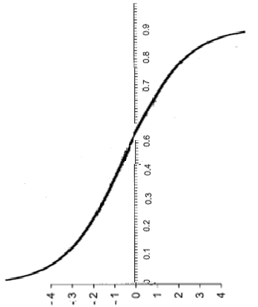

Logistic Regression Model – Building blocks
Thus probability
Probability is also
Therefore = Odds (y = 1)
The expression reflects the relation between predictors and dependent variable
How much predicted value changes for a small change in independent variable
Take log on both sides This is logit function
Steps -
Given x1,x2…xn, in training set , find
This is log(odds)
Find odds by raising it to e
Find the probability using the equation
Probability
Log(Odds)

Slide 7
Logistic Regression Model – Building blocks
Suppose the log(odds) = -17.2086 + (.5934 x)
For a given value of x = 31, log(odds) = -17.2086 + (.5934 * 31) = 1.1868
Odds = exp(log(odds)) = exp(1.1868) = 3.2766
Probability = odds / (1 + odds ) = 3.2766/(1 + 3.2766) = .7662

Slide 8
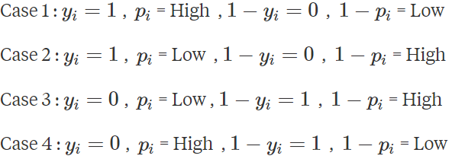
Logistic Regression Model The learning process -
Uses logloss function to find the best fit line from the infinite possibilities where
The objective is to make logLoss small as possible which is done by selecting the appropriate m, c (intercept and coefficients) of the linear model
There can be four difference cases for the value of yi and pi
Incorrect classification contributes significantly to the logloss while correct classification contributes very minimal amount to the logloss
Correct classification
Incorrect classification
Correct classification
Incorrect classification
Note: log to base 2 of any number less than 1 will return a negative value

Slide 9
Logistic Regression Model -
In case1 y = 1 and p = high implies that we have got things right!. Yi * log (Pi) would be close to 0 as log to base 2 of 1 is 0. While the other term in the equation would be zero since 1 - Yi = 1 - 1 = 0.
Correct classification of the blue class (labeled 1) will add very little to the loss function
1
Class A
4
3
2
Class B
log of 1 = 0
log of 0 = - ∞ (approach neg infinity)
log returns –ve numbers between 0 and 1
Yi = 1 or 0 only (numerical labels)
In case2, y = 1 but model is estimating the probability belonging to class label as very low, which is incorrect classification. Thus, Yi * log (Pi) will be a large number as log to base 2 of small number (Pi) is a large negative number. Thus incorrect classification contributes large values to the loss function
Similarly the occurrences of Case 3 which is correct classification will contribute a small amount to the log loss function as (1- yi)* log(1 – pi) will be 1 * a small number. The other expression in the loss function will be 0.
Case 4 first term will be 0 while in second term will be high as 1 – large pi will result in small value and log of small values is large number. This will contribute a large value to the loss function

Slide 10
Logistic Regression Model -
More the correct classifications such as the 1 and the 3, lesser contribution to the loss or error function
More incorrect classifications, more the loss value
The objective is to find the logistic curve that minimizes the loss values
4
1
Class A
2
3
Class B

Slide 11
Logistic Regression Model -
Advantages -
Makes no assumptions about distributions of classes in feature space
Easily extended to multiple classes (multinomial regression)
Natural probabilistic view of class predictions
Quick to train
Very fast at classifying unknown records
Good accuracy for many simple data sets
Resistant to overfitting
Can interpret model coefficients as indicators of feature importance
Dis advantages -
Constructs linear boundaries

Slide 12
Logistic Regression Model -
Lab- 2- Predict diabetes among Pima Indians
Description – Sample data is available at https://archive.ics.uci.edu/ml/machine-learning-databases/pima-indians-diabetes/pima-indians-diabetes.names
The dataset has 9 attributes listed below
Number of times pregnant
Plasma glucose concentration a 2 hours in an oral glucose tolerance test
Diastolic blood pressure (mm Hg)
Triceps skin fold thickness (mm)
2-Hour serum insulin (mu U/ml)
Body mass index (weight in kg/(height in m)^2)
Diabetes pedigree function
Age (years)
Class variable (0 or 1)
Sol: Logistic Regression - Pima Diabetes.ipynb

Slide 13
Variants of Logistic Regression

Slide 14
Variants of Logistic Regcression
Multinomial logistic regression
It is used to predict a nominal dependent variable given one or more independent variables.
It is sometimes considered as extension of binomial logistic regression to allow for a dependent variable with more than 2 categories.
It is used to model nominal outcome variables, in which the log odds of the outcomes are modelled as linear combination of predictor variables.
Eg: If a high school student wants to choose a program among general program, biological program and academic program, then their choice might be modelled using their normal scores and economic status.

Slide 15
Variants of Logistic Regcression
Ordinal logistic regression
This regression is used to predict an ordinal dependent variable given one or more independent variables.
The model only applies to data that meet the proportional odd assumption. In this assumption, the event which is modelled does not have an outcome in a single category as the way it is done in the binary models and multinomial models.
In proportional odds assumption model, each end result has its own intercept but similar regression coefficients which means:
The overall odds of any event can differ.
The effect of the predictors on the odds of an event occurring in very subsequent category is the same for every category. It is often violated.

Slide 16
Applications of Logistic Regression

Slide 17
Applications of Logistic Regression
Predicting weather: you can only have few definite weather types. Stormy, sunny, cloudy, rainy and a few more.
Medical diagnosis: given the symptoms predict the disease patient is suffering from.
If loan has to be given a particular candidate depend on his identity check, account summary, any properties he hold, any previous loan, etc

Slide 18
Logistic Regression Advantage / Disadvantage

Slide 19
Applications of Logistic Regression (Pros and Cons)
Advantages –
Simple to implement and easier to interpret the outputs coefficients
Provides both probabilities and classes as output
Quick to train as the error function (cross entropy) is convex , smooth and continuous
Disadvantages -
Assumes a linear relationships between log odds and independent variables.
Can stop learning (convergence of weights) in presence of good separators of classes as attributes. Such attributes will get a very high magnitude weights. That will need appropriate regularization to make the model learn and generalize
Outliers can have huge adverse impacts on the log odds regression
Assumes the attributes to be independent which is generally not the case

Slide 20
Thank You

