Slide 1
Naïve Bayes Classifier

Slide 2
Naïve Bayes Classifier -
Naive Bayes classiﬁers are linear classiﬁers based on Bayes’ theorem. The model generated is probabilistic
It is called naive due to the assumption that the features in the dataset are mutually independent
In real world, the independence assumption is often violated, but naive Bayes classiﬁers still tend to perform very well
Idea is to factor all available evidence in form of predictors into the naïve Bayes rule to obtain more accurate probability for class prediction
It estimates conditional probability which is the probability that something will happen, given that something else has already occurred. For e.g. the given mail is likely a spam given appearance of words such as “prize”
Being relatively robust, easy to implement, fast, and accurate, naive Bayes classiﬁers are used in many diﬀerent ﬁelds

Slide 3
Naïve Bayes Classifier -
Probability - is the number of trials in which an event of interest occurred by total number of trials. (what is a trial and what is an event?)
If it rained 3 out of 10 days in the past where the days were exactly like today, the probability it will rain today is 30%
In this example, the day is a trial / experiment
The event is rain
Probability that it will rain is P(A) (A denoting rains) = 3/10
Every trial has at least two outcomes (event will P(A) or will not occur P(A”)
The multiple possible events are mutually exclusive i.e. cannot occur simultaneously
Total probability in a trial is sum of probabilities of all events = P(A)+P(A”) = 100% = 1

Slide 4
Naïve Bayes Classifier -
Joint Probability – is the probability of multiple events occurring together (we are not talking of causality here i.e. one event leads to another). For e.g.
probability of drawing a king from a deck of cards is 4/52
Probability of drawing a red colour card from a deck of cards is 26/52
Probability of drawing a red colour king = 2 / 52
Conditional Probability – it is the probability that an event has occurred (not yet observed) given another event has occurred. For e.g.
given the card drawn is red (an event has occurred)
what is the probability it is a king (event not yet observed)?
Since the card is red, there are 26 likely values for red
Of these 26 possible values we are interested in king which is 2 (king of diamonds and heart)
Thus the conditional probability that the card is a king given red card is 2 /26
Compare this with joint probability of red king (2/52).
Given an event has occurred, it increases the probability of the other event

Slide 5
Naïve Bayes Classifier -
Posterior probability – Bayes’ rule can be expressed as
The posterior probability, in the context of a classiﬁcation problem, can be interpreted as: ”What is the probability that a particular object belongs to class given its observed feature values?”

Slide 6

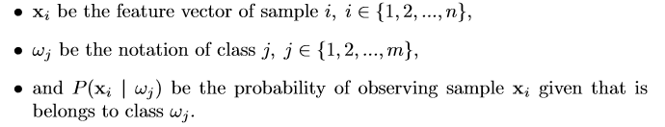
Naïve Bayes Classifier -
Posterior probability – general expression

Slide 7

Naïve Bayes Classifier -
The objective function is to maximize the posterior probability given the training data
person has diabetes if P(diabetes | xi) ≥ P(not-diabetes | xi), else classify person as healthy.

Slide 8

Naïve Bayes Classifier (Assumptions) -
One assumption that Bayes classiﬁers make is that the samples are independent and identically distributed. Samples are drawn from a similar probability distribution.
Independence means that the probability of one observation does not aﬀect the probability of another observation (e.g., time series and network graphs are not independent)
An additional assumption of naive Bayes classiﬁers is the conditional independence of features. Under this naive assumption, the class-conditional probabilities or (likelihoods) of the samples can be directly estimated from the training data instead of evaluating all possibilities of x
Thus, given a d-dimensional feature vector x, the class conditional probability can be calculated as follows:

Slide 9
Naïve Bayes Classifier -
Joint Probabilities -
Imagine you represent all the flight experience you had till date as the blue area in a mathematical space. The dimensions of the boxes and circles are immaterial
Of these experiences, 20% of the time you experienced flight delay
Flight data
Flight data
A 100%
80 %
A 20%

Slide 10

Naïve Bayes Classifier -
P(flight delay given fog) = P (A n B) / P(B)
Flight delayed no fog
Fog but no flight delay
Flight data
B 5%
80 %
A 20%
(A n B) = flight delay and fog
Lesser the overlap, lesser the occurrences of flight delay and fog
More the overlap, more the occurrences of flight delay and fog
P(A| B) = P(A n B) / P(B) → eq 1
P(A n B) = P(A|B) * P(B) (rearranging the terms in eq 1)
Also, P(A n B) = P(B n A) = P(B|A) * P(A)
Therefore eq 1 - P(A|B) = P(B|A) * P(A) / P(B)

Slide 11
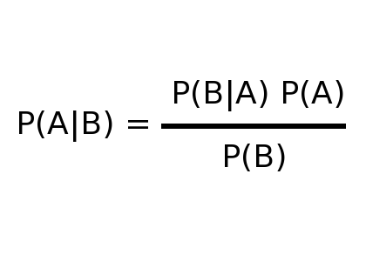
Naïve Bayes Classifier -
Joint Probabilities (Contd…) -
The relationship between events is depicted using Bayes theorem
Probability of event A given that event B has occurred (fog has formed) depends on
Apriori probability of fog occurring whenever there was flight delay – P (B/A)
Apriori probability of flight delay P(A) which is 20% in the example
Apriori probability of flight facing fog P(B) which is 5% in the example
When it is a matter of deciding the class of an output such as whether flight will get delayed or not, we calculate P(A/B) and P(!A/B), compare which is higher. Since in both the denominator is P(B), it is ignored as it has no influence on which class will it be
However, to calculate the updated probability of a class, denominator P(B) is required
Flight data
Likelihood
Prior prob
B 5%
Posterior
Evidence
80 %
A 20%

Slide 12
Naïve Bayes Classifier -
The following two tables reflect the apriori probabilities of the events A and B. Probabilities based on past data of 100 points
In the likelihood table (T2) reveals that P(fog = Yes / flight delayed) = 4/20 = .20 indicating that likelihood is 20 percent that a flight will be delayed given fog
P( ) => P(flight delay | fog) = P(fog / flight delay) * P(flight delay)
P(flight delay | fog) = ( (4/20) * (20 / 100) ) = .04 (maximal probability) (no need to divide by P(B), probability of fog, as it is a constant. This is Naïve Bayes probability.
Joint probability - P( ) = ((20 / 100) * (5/100)) = .01
T1 | FOG
Frequency | Yes | No | Total
Flight delayed | 4 | 16 | 20
Not Delayed | 1 | 79 | 80
Total | 5 | 95 | 100
T2 | FOG
Likelihood | Yes | No | Total
Flight delayed | 4 / 20 | 16 / 20 | 20
Not Delayed | 1 / 80 | 79 /80 | 80
Total | 5 / 100 | 95 / 100 | 100

Slide 13
Naïve Bayes Classifier -
Suppose there are multiple factors that could lead to flight delay (as shown in the likelihood table below)
Probability that the flight will be delayed, given that Fog = Yes, Technical Snag = No :
Treat the event of flight delay as A
Treat the joint event (Fog=Yes, Technical Snag=No) as B
P ( A | B) = P(flight delay / Fog n ! Technical Snag) =
P(B | A) * P(A) divided by P(B)
( P(Fog n ! Technical Snag) | flight delay) * P(flight delay) ) / P(Fog n ! Technical Snag)
( because of the naïve assumption of independence of features, this can be expressed as -
P(Fog n ! Technical Snag) | flight delay) = P(Fog | flight delay) * P(!Technical snag | flight delay)
T2 | FOG |  | Technical Snag |  | Pilot Fatigue |  | Passenger
Likelihood | Yes | No | Yes | No | Yes | No | Yes | No | Total
Flight delayed | 4 / 20 | 16 / 20 | 10/20 | 10/20 | 0/20 | 20/20 | 12/20 | 8/20 | 20
Not Delayed | 1 / 80 | 79 /80 | 14/80 | 66 /80 | 8/80 | 71/80 | 23/80 | 57/80 | 80
Total | 5 / 100 | 95 / 100 | 24/100 | 76/100 | 8/100 | 91/100 | 35/100 | 65/100 | 100

Slide 14
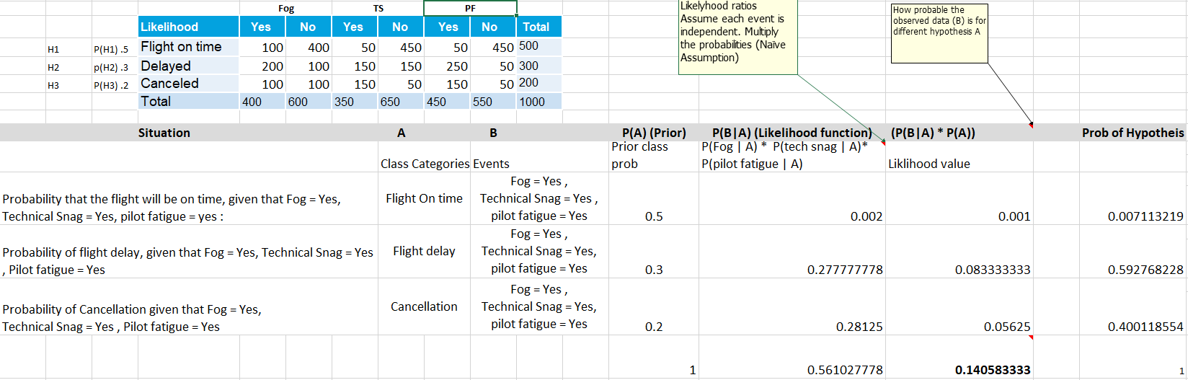
Naïve Bayes Classifier -

Slide 15
Naïve Bayes Classifier -
Note: - | Likelihood function is not a density function hence it will not total to 1
 | Probability of hypothesis i.e. probability of flight delay , probability of flight on time, probability of cancellation is found by dividing P(B|A) *P(A) by the sum of the column O
 | The entries in column O show how much more likely a given hypothesis is compared to other. For e.g. how more likely is the flight delay compared to flight on time - 0.083 / 0.001
 | For classification we need only this comparison and that hypothesis that is more likely than others is the class predicted
 | If we want to express the output as pure probability, then divide each likelihood value with the sum of all likelihood values
 | The P(B) in the denominator of Bayes equation is called the normalization constant and is used to convert the likelihood values into probabilities such that the left side of the equation P(A|B) sums up to 1 for the different hypothesis together

Slide 16
Naïve Bayes Classifier -
Advantages -
Simple , Fast in processing and effective
Does well with noisy data and missing data
Requires few examples for training (assuming the data set is a true representative of the population)
Easy to obtain estimated probability for a prediction
Dis-advantages -
Relies on and often incorrect assumption of independent features
Not ideal for data sets with large number of numerical attributes
Estimated probabilities are less reliable in practice than predicted classes
If rare predictor value is not captured in the ** training set but appears in the test set the probability calculation will be incorrect
** For e.g. input record has fog=“yes”, Technical snag = “yes”, Pilot Fatigue = “Yes” and passenger delay = “yes” .If this combination is not in the training set for delayed flights in the past then the probability calculation in step “a” on previous slide will become 0!

Slide 17
Naïve Bayes Classifier -
Lab- 4 Model to predict diabetes among Pima Indians
Description – Sample data is available at https://archive.ics.uci.edu/ml/datasets/Adult
The dataset has 9 attributes listed below
1. Number of times pregnant 2. Plasma glucose concentration a 2 hours in an oral glucose tolerance test 3. Diastolic blood pressure (mm Hg) 4. Triceps skin fold thickness (mm) 5. 2-Hour serum insulin (mu U/ml) 6. Body mass index (weight in kg/(height in m)^2) 7. Diabetes pedigree function 8. Age (years) 9. Class variable (0 or 1)
Sol: Naive+Bayesian+Pima+Diabetes+.ipynb

Slide 18
ThankYou

