Slide 1
Ensemble Methods

Slide 2
Ensemble Methods - Introduction
Ensemble is a group of models that are used together for prediction both in classification and regression cases
Why do we need ensemble? We wish to build a highly accurate and generalizable model
We employ various methods to achieve this for e.g. tuning hyper parameters, up-sampling/ down-sampling etc.
Ensemble is another way of getting the high accuracy in prediction. Rather than create a single highly accurate model (thru delicate fine tuning), generate a set of models and predict by aggregating the output of all the models
The motivation behind ensemble is the belief that a committee of experts working together are more likely to be accurate than individual experts
The same belief is applied here. A group of predictors (may not be strong predictors), together become strong predictors

Slide 3

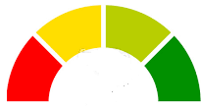


Ensemble Methods - Introduction
Training Data
M-1
M-2
M-3
M-n
Individual models not good predictors
Test Data
Training Data
M-1
M-2
M-3
M-n
Ensemble of models become strong predictors
Test Data
Note: The Ensemble prediction is not some kind of average or max of individual predictors

Slide 4
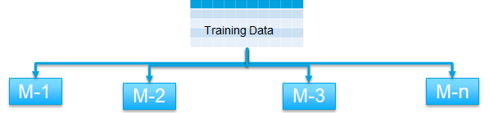
Ensemble Methods – Characteristics
For effective ensemble we have to ensure -
The models are as different from each other as possible
The errors of each model should be independent i.e. should not correlate
Each model can be weak predictor (slightly better than random) but not poor predictor
The models in the ensemble
Are not regularized and hence each model tend to overfit prone to variance errors
The variance errors across all models put together cancel out at the time of aggregation / voting
As a result, ensemble helps hit two birds with same stone! Each model has low bias error and with the variance errors cancelling out at ensemble level lead to low variance and bias errors at ensemble level
Ensemble
Legend
Variance Error
Error
Bias Error
Complexity

Slide 5
Two families of ensemble methods:
Averaging methods, the driving principle is to build several estimators independently and then to average / vote their predictions. On average, the combined estimator is usually better than any of the single base estimator because its variance is reduced.
E.g. Bagging methods, Forests of randomized trees, ...
Boosting methods, base estimators are built sequentially and one tries to reduce the bias of the combined estimator. The motivation is to combine several weak models to produce a powerful ensemble. E.g. AdaBoost, Gradient Tree Boosting, ...

Slide 6
Ensemble Methods – Averaging method - Bagging (Bootstrap Aggregation) :
Designed to improve the stability (small change in dataset change the model) and accuracy of classification and regression models
It reduces variance errors and helps to avoid overfitting at ensemble level
Can be used with any type of machine learning model, mostly used with Decision Tree
Uses sampling with replacement to generate multiple samples of a given size. Sample may contain repeat data points
For large sample size, sample data is expected to have roughly 63.2% unique data points and the rest being duplicates
For classification bagging is used with voting to decide the class of an input while for regression average or median values are calculate
Notes:
Bagging methods come in different flavours but mostly differ by the way they draw random subsets of the training set
When random subsets of the data set are drawn as random subsets of the samples, the algorithm is known as pasting
When samples are drawn with replacement, the method is known as Bagging (Bootstrap Aggregation)
When the random subsets of the dataset are drawn as random subsets of the features, then the method is known as random subspaces
When the base estimators are built on subsets of both samples and features, the method is called random patches
Source: Scikit-learn user guide, chapter 3, page 230
Expected number of data points in a bootstrap sample N. (1-(1-1/n)^n)
As N -> large number (1-(1 – 1/n)^n ) -> ( 1- 1/e) = 63.2

Slide 7
Ensemble Methods – How it should be built – ideal condition
Ideal Condition
Get multiple samples from the universe and train each model separately
Universe
Training Data 1
Training Data 2
Training Data 3
Training Data n
M-1
M-2
M-3
M-n
Create the ensemble of models. Each model is independent and errors are not correlated
M-1
M-2
M-3
M-n
Multi-sampling is usually not an option

Slide 8
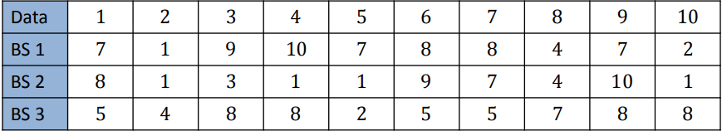
Ensemble Methods – Bootstrap sampling
Need to create different models from the same sample. How ?
Solution – Bootstrap sampling or sampling with replacement
Take original sample of size n number of records / data points. For e.g. n = 10
Create n bootstrap samples of size n from the original sample using random function (sampling with replacement). For e.g. –
Each bootstrap sample BSi (where i is index number) will be different from other bootstrap samples. They will not be mirror images
Each bootstrap sample may have repeating records
Each bootstrap sample represents sample from universe with different variance
Source: http://www.utdallas.edu/~nrr150130/cs7301/2016fa/lects/Lecture_10_Ensemble.pdf
Bootstrapping_introduction.ipynb Bootstrapping_Confidence_Level.ipynb

Slide 9
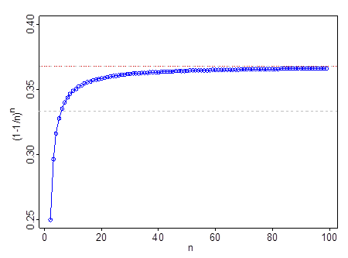
limn→∞(1−1/n)n=e^−1
e−1=1/e≈1/3 = 33% approx

Slide 10
Ensemble Methods – How it is built – Reality (Bagging Methods)
Real situation
Get the original sample
Use bootstrap sampling to create multiple data sets
Universe
Training Data (N)
Bootstrapping
Create the ensemble of models.
Models are not really independent and errors are likely to be correlated
BSample1
BSample2
BSample3
BSample N
M-1
M-2
M-3
M-n
M-1
M-2
M-3
M-n

Slide 11


Ensemble Methods (Bagging) – How does it work
Once an ensemble has been built, each instance is given the test record to work on
If the problem is classification, each instance classifies the record. Some will mis-classify and other will correctly do so
The classifications are sent through a voting process where the majority wins
To prevent ties, the number of models in an ensemble should be odd. If the number is even, a random function will be used to break the tie
Classify
Test Record
Regression
Test Record
M-1
M-2
M-3
M-n
M-1
M-2
M-3
M-n
D
N
N
N
20
15
17
22
Voting
Average
Test Record
N
Test Record
18.5

Slide 12
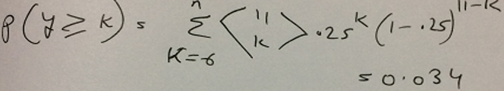
Ensemble Methods (Bagging) – Why ensemble performs better than individual models in classification?
For an ensemble to do incorrect classification, the majority of the models should do incorrect classification.
Let the number of models in an ensemble be n, let each model error rate be e = .25
Assume the model errors to be independent (we know this is not true in reality)
For the ensemble to make mistakes, majority should make mistake. Let k represent simple majority number (For e.g. if we have n = 11 models, simple majority k is 6)
Probability of ensemble making mistake = P( y >= k ) i.e . At least y models make mistake
The ensemble error rate is 0.034 which is much lower than individual model error rate of .25
Binomial coefficient

Slide 13
Ensemble Methods (Bagging)
Atleast 6 instances going wrong = no of ways 6, 7, 8, 9, 10, 11 instances can wrong
All multiplied
Iteration 2
No of ways exactly 7
can go wrong
Iteration 6
No of ways exactly 11
can go wrong
Iteration 1
No of ways exactly 6
can go wrong
+
.25^k
+
.25^k
.75^(11-k)
.75^(11-k)
.25^k
.75^(11-k)
A - The error rate of each incorrect predictor = .25
B - Therefore prob of error in each iteration = no of arrangements X ( .25^ no of reds) X ((1-.25) ^ no of greens )
C - Error rate for at least 6 going wrong will be added across all the grids / iterations

Slide 14
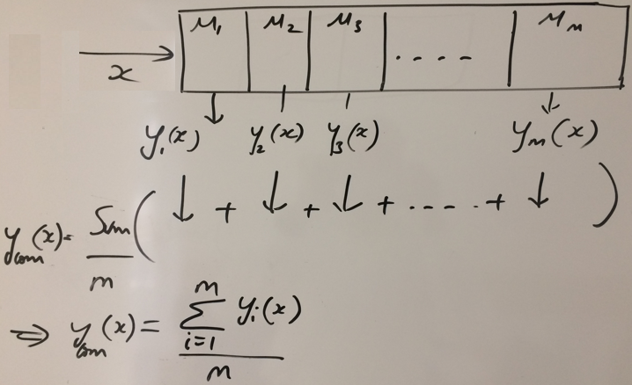
Ensemble Methods (Bagging) – Why ensemble performs better than individual models in regression? (variance error is reduced)
Let x be a test record supplied to all models
Let yi(x) represent individual predictions
Sum up all the predictions and average it over m

Slide 15
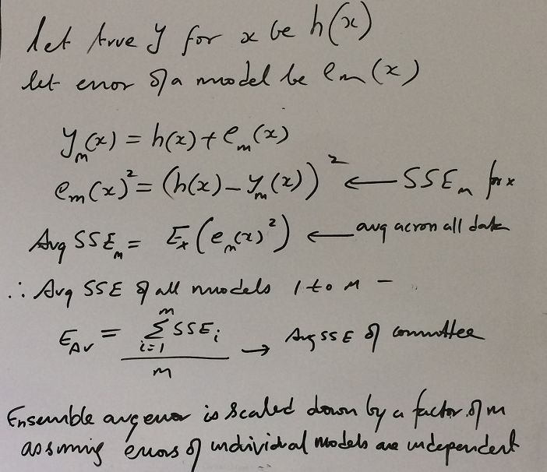
Ensemble Methods (Bagging) – Why ensemble performs better than individual models in regression? (variance error is reduced)
Let h() represent the true function and h(x) true y
Error in regression be e(x) for a model
y(x) = h(x) + e(x)
SSE = (h(x) – y(x))^2
Avg SSE across all data points for a model = SSEm
Avg SSEm for all models put together = sum( SSEm ) / m
Ensemble avg is scaled down by a factor of m because it is avg of avg!
Assuming models are independent

Slide 16
Ensemble Learning (Bagging):
Lab- 6 Improve defaulter prediction of the decision tree using bagging ensemble technique
Description – Sample data is available at local file system as credit.csv
The dataset has 16 attributes described at https://archive.ics.uci.edu/ml/datasets/statlog+(german+credit+data)
or in the notes page of this slide
Sol: DT_Ensemble.ipynb
Notes:
Attribute 1: (qualitative) Status of existing checking account A11 : ... < 0 DM A12 : 0 <= ... < 200 DM A13 : ... >= 200 DM / salary assignments for at least 1 year A14 : no checking account Attribute 2: (numerical) Duration in month Attribute 3: (qualitative) Credit history A30 : no credits taken/ all credits paid back duly A31 : all credits at this bank paid back duly A32 : existing credits paid back duly till now A33 : delay in paying off in the past A34 : critical account/ other credits existing (not at this bank) Attribute 4: (qualitative) Purpose A40 : car (new) A41 : car (used) A42 : furniture/equipment A43 : radio/television A44 : domestic appliances A45 : repairs A46 : education A47 : (vacation - does not exist?) A48 : retraining A49 : business A410 : others Attribute 5: (numerical) Credit amount Attibute 6: (qualitative) Savings account/bonds A61 : ... < 100 DM A62 : 100 <= ... < 500 DM A63 : 500 <= ... < 1000 DM A64 : .. >= 1000 DM A65 : unknown/ no savings account Attribute 7: (qualitative) Present employment since A71 : unemployed A72 : ... < 1 year A73 : 1 <= ... < 4 years A74 : 4 <= ... < 7 years A75 : .. >= 7 years Attribute 8: (numerical) Installment rate in percentage of disposable income Attribute 9: (qualitative) Personal status and sex A91 : male : divorced/separated A92 : female : divorced/separated/married A93 : male : single A94 : male : married/widowed A95 : female : single Attribute 10: (qualitative) Other debtors / guarantors A101 : none A102 : co-applicant A103 : guarantor Attribute 11: (numerical) Present residence since Attribute 12: (qualitative) Property A121 : real estate A122 : if not A121 : building society savings agreement/ life insurance A123 : if not A121/A122 : car or other, not in attribute 6 A124 : unknown / no property Attribute 13: (numerical) Age in years Attribute 14: (qualitative) Other installment plans A141 : bank A142 : stores A143 : none Attribute 15: (qualitative) Housing A151 : rent A152 : own A153 : for free Attribute 16: (numerical) Number of existing credits at this bank Attribute 17: (qualitative) Job A171 : unemployed/ unskilled - non-resident A172 : unskilled - resident A173 : skilled employee / official A174 : management/ self-employed/ highly qualified employee/ officer Attribute 18: (numerical) Number of people being liable to provide maintenance for Attribute 19: (qualitative) Telephone A191 : none A192 : yes, registered under the customers name Attribute 20: (qualitative) foreign worker A201 : yes A202 : no

Slide 17
Ensemble Methods – Boosting Method -
Employ multiple weak learners, which is only a slight improvement over random guessing
Committee based decision makes it powerful, since individual classifiers often are too primitive.
However, with sufficient number of instances, such an approach helps us reduce general bias using many high-bias models.
Two prominent boosting algorithms are AdaBoost, short for Adaptive Boosting and Gradient Descent Boosting

Slide 18
Ensemble Methods (AdaBoosting) -
In AdaBoost, the successive models are created with a focus on the ill fitted data of the previous learner. Each successive model focuses more and more on the harder to fit data i.e. their residuals in the previous model
Model instances are created sequentially; except for the first, each subsequent model is grown from previously grown learners
During voting higher weight is given to the votes of models which perform better in respective training data unlike Bagging where all get equal weight
The trees used in AdaBoost are shallow; they are called “decision stumps” and frequently only have 2 leaves.
Using trees as base learners is not required by the AdaBoost algorithm, but it’s the most common practice.
Boosting slows down learning (because it is sequential) but the model generally performs well

Slide 19
Ensemble Methods (AdaBoosting) -
When creating an AdaBoost model, all training samples have weights assigned to them. Initially, all weights are the same and equal 1/N, where N is the number of samples
After training one tree, the weights of wrongly classified samples are increased. A dataset with updated weights then serves as an input to another tree from the ensemble
This procedure is repeated as long as adding a new tree results in reducing training error or until the maximum number of trees is reached.
Output prediction is the weighted average of predictions from shallow trees
classifier weights reflect their training accuracies. The larger the weights are the more accurate the instance is

Slide 20
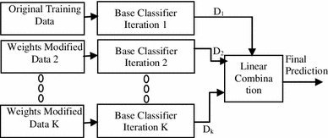
Ensemble Methods (AdaBoosting) -
Training data from base data with focus on instances which were incorrectly classified by earlier model (if any)
Voting could be simple or weighted
K similar classifiers created in sequence with respective training data with focus on addressing the misclassified data, not the usual cost functions
It is called Adaptive Boosting as the weights are re-assigned to each instance, with higher weights to incorrectly classified instance
Source: https://link.springer.com/article/10.1007/s13721-013-0034-x

Slide 21
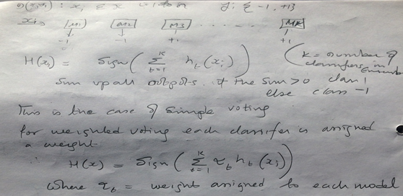
Model Weighted Voting
Sum up all the predictions from all the model instances
If the sum is +ive the ensemble predicted class is +1 else -1
For weighted voting multiply each prediction with model weight alpha

Slide 22
Assigning weights to model instances in an ensemble
Yi is actual value in test data, Ht(xi) is predicted value for test record Xi
Yi * Ht(xi) will always return +ive value for correct prediction and –ve for incorrect
Model weight alpha is function of model’s error rate e. Ln((1-e)/e) .
If error rate is 50% , (1-e) / e = 1 and log of 1 = 0
for higher error rate the Ln((1-e)/e) will return –ve values which will be replaced by 0
If error rate goes to 0, Ln((1-e)/e) becomes large positive values
Error Rate |  | Ln((1-e)/e)
0.1 |  | 2.197225
0.2 |  | 1.386294
0.3 |  | 0.847298
0.5 |  | 0
0.6 |  | -0.40547
0.7 |  | -0.8473
0.8 |  | -1.38629
0.9 |  | -2.19722
1 |  | #NUM!

Slide 23
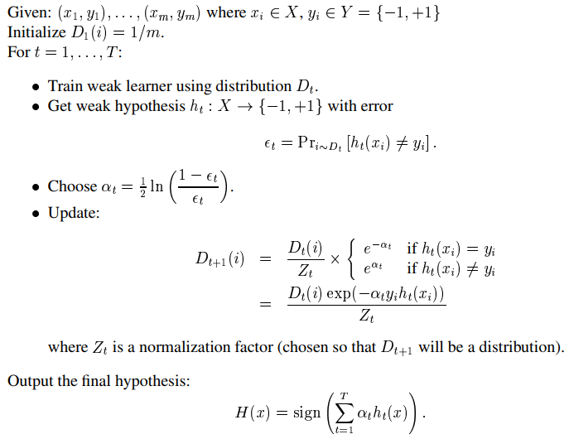
Weight adjustment to prioritize incorrectly classified records

Slide 24
Weight adjustment to prioritize incorrectly classified records
Initialize all records with weight 1/number of recorods (m)
For instance = 1 to T
create a model ht on data Dt
find the error Et in terms of proportion of miss classified records
(note: proportion can range between 0 and 1)
calculate update factor alpha_t as .5 X Ln (( 1- Et) / Et)
update record level weights
current weight X e^-alpha_t X yi(ht(xi) / sum of weights

Slide 25
Weight adjustment to prioritize incorrectly classified records
X1 | X2 | Yi | Wt
 |  | 1 | 1/8 = 0.125
 |  | -1 | 0.125
 |  | 1 | 0.125
 |  | -1 | 0.125
 |  | -1 | 0.125
 |  | 1 | 0.125
 |  | 1 | 0.125
 |  | --1 | 0.125
X1 | X2 | h(xi) | Wt
 |  | 1
 |  | 1
 |  | 1
 |  | -1
 |  | -1
 |  | 1
 |  | -1
 |  | 1
Yi X h(xi)
1
-1
1
1
1
1
-1
-1
H
Weak Predictor
Error rate = 3/8
Alpha = .5 X Ln ((1 - .37) / .37) = .5 X .53 = .26
e^Alpha = e^.26 = 1.29
Updated weight = 1/8 x e^–Alpha X yi(h(xi)
Z = sum(Wt_1) will be 1
X1 | X2 | Y | Wt_1
 |  | 1 | 0.096
 |  | 1 | 0.162
 |  | 1 | 0.096
 |  | -1 | 0.096
 |  | -1 | 0.096
 |  | 1 | 0.096
 |  | -1 | 0.162
 |  | 1 | 0.162

Slide 26
Ensemble Learning (AdaBoosting)-
Lab- 7 Improve defaulter prediction of the decision tree using Adaboosting
Description – Sample data is available at local file system as credit.csv
The dataset has 16 attributes described at https://archive.ics.uci.edu/ml/datasets/statlog+(german+credit+data)
or in the notes page of this slide
Sol: DT_Ensemble.ipynb
Notes:
Attribute 1: (qualitative) Status of existing checking account A11 : ... < 0 DM A12 : 0 <= ... < 200 DM A13 : ... >= 200 DM / salary assignments for at least 1 year A14 : no checking account Attribute 2: (numerical) Duration in month Attribute 3: (qualitative) Credit history A30 : no credits taken/ all credits paid back duly A31 : all credits at this bank paid back duly A32 : existing credits paid back duly till now A33 : delay in paying off in the past A34 : critical account/ other credits existing (not at this bank) Attribute 4: (qualitative) Purpose A40 : car (new) A41 : car (used) A42 : furniture/equipment A43 : radio/television A44 : domestic appliances A45 : repairs A46 : education A47 : (vacation - does not exist?) A48 : retraining A49 : business A410 : others Attribute 5: (numerical) Credit amount Attibute 6: (qualitative) Savings account/bonds A61 : ... < 100 DM A62 : 100 <= ... < 500 DM A63 : 500 <= ... < 1000 DM A64 : .. >= 1000 DM A65 : unknown/ no savings account Attribute 7: (qualitative) Present employment since A71 : unemployed A72 : ... < 1 year A73 : 1 <= ... < 4 years A74 : 4 <= ... < 7 years A75 : .. >= 7 years Attribute 8: (numerical) Installment rate in percentage of disposable income Attribute 9: (qualitative) Personal status and sex A91 : male : divorced/separated A92 : female : divorced/separated/married A93 : male : single A94 : male : married/widowed A95 : female : single Attribute 10: (qualitative) Other debtors / guarantors A101 : none A102 : co-applicant A103 : guarantor Attribute 11: (numerical) Present residence since Attribute 12: (qualitative) Property A121 : real estate A122 : if not A121 : building society savings agreement/ life insurance A123 : if not A121/A122 : car or other, not in attribute 6 A124 : unknown / no property Attribute 13: (numerical) Age in years Attribute 14: (qualitative) Other installment plans A141 : bank A142 : stores A143 : none Attribute 15: (qualitative) Housing A151 : rent A152 : own A153 : for free Attribute 16: (numerical) Number of existing credits at this bank Attribute 17: (qualitative) Job A171 : unemployed/ unskilled - non-resident A172 : unskilled - resident A173 : skilled employee / official A174 : management/ self-employed/ highly qualified employee/ officer Attribute 18: (numerical) Number of people being liable to provide maintenance for Attribute 19: (qualitative) Telephone A191 : none A192 : yes, registered under the customers name Attribute 20: (qualitative) foreign worker A201 : yes A202 : no

Slide 27
Ensemble Methods (Gradient Boosting)-
Similarly to AdaBoost, gradient tree boosting is built from a set of small trees, though usually slightly deeper than decision stumps.
The trees are trained sequentially, just like in AdaBoost, but the training of individual trees is not the same
Each model is fit on a modified version of original data (original data is replaced with the x values and residuals from previous model
By fitting new models to the residuals, the overall model gradually improves in areas where residuals are initially high
The main idea behind the algorithm is to iteratively find new trees that minimize loss function—a measure of telling how bad the model is. This function has to be differentiable, and it’s selected based on the problem that needs solving.

Slide 28
Ensemble Methods (Gradient Boosting)-
The main idea behind the algorithm is to iteratively find new trees that minimize a loss function—a measure of telling how bad the model is
This function has to be differentiable (smooth, continuous, within limits), and it’s selected based on the problem that needs solving
For classification problems, we usually use the log loss function, which is simply the negative mean of log-probabilities where sample xi is classified as its label yi:
Knowing the loss value, we can calculate the so-called “pseudo-residuals.” The greater the residual, the bigger the mistake. Pseudo-residuals are then used instead of labels when training a new tree.

Slide 29
Ensemble Methods (Gradient Boosting)-
By fitting new models to the residuals, the overall model gradually improves in areas where residuals are initially high
The main idea behind the algorithm is to iteratively find new trees that minimize loss function—a measure of telling how bad the model is.
This function has to be differentiable, and it’s selected based on the problem that needs solving
Gradient tree boosting is similar to AdaBoost, but instead of looking only at where it has failed, it also draws your attention to how much it has failed.

Slide 30
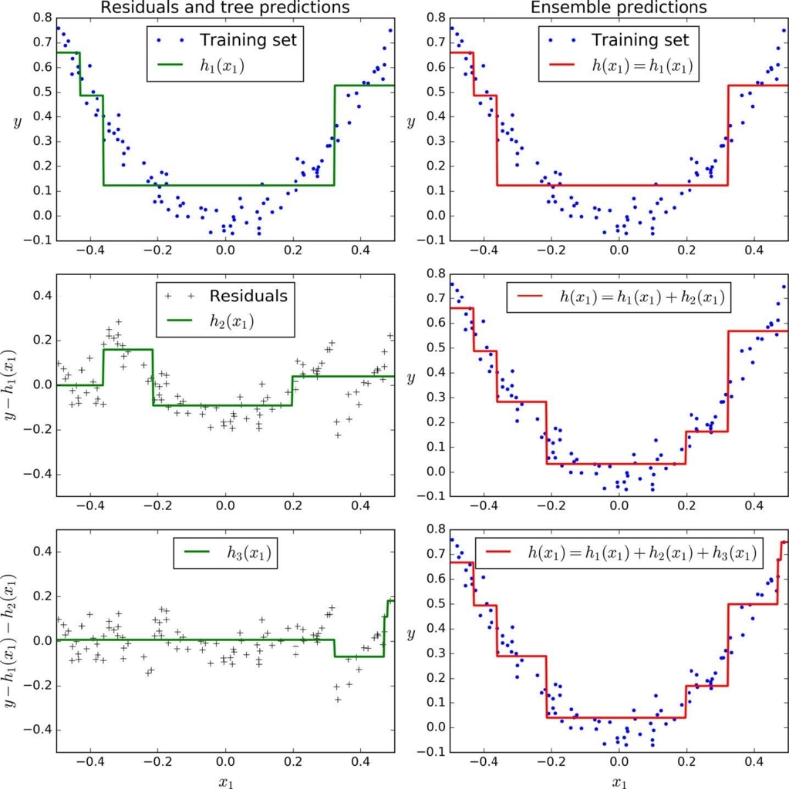
Ensemble Methods (Gradient Boosting)-
First model results in residuals (dots that fall above and below the surface. The result (red) is same as first model
Next model focuses on the residuals of the first model to reclassify them as correctly as possible
The combined effect of this surface and previous model surface is shown in red
The third model focusses on the residuals of the previous ensemble
The combine result of the new surface with the previous surface is shown in red

Slide 31
Ensemble Methods (Gradient Descent Boosting)-
Lab- 8 Improve defaulter prediction of the decision tree using Gradient boosting
Description – Sample data is available at local file system as credit.csv
The dataset has 16 attributes described at https://archive.ics.uci.edu/ml/datasets/statlog+(german+credit+data)
or in the notes page of this slide
Sol: DT_Ensemble.ipynb
Notes:
Attribute 1: (qualitative) Status of existing checking account A11 : ... < 0 DM A12 : 0 <= ... < 200 DM A13 : ... >= 200 DM / salary assignments for at least 1 year A14 : no checking account Attribute 2: (numerical) Duration in month Attribute 3: (qualitative) Credit history A30 : no credits taken/ all credits paid back duly A31 : all credits at this bank paid back duly A32 : existing credits paid back duly till now A33 : delay in paying off in the past A34 : critical account/ other credits existing (not at this bank) Attribute 4: (qualitative) Purpose A40 : car (new) A41 : car (used) A42 : furniture/equipment A43 : radio/television A44 : domestic appliances A45 : repairs A46 : education A47 : (vacation - does not exist?) A48 : retraining A49 : business A410 : others Attribute 5: (numerical) Credit amount Attibute 6: (qualitative) Savings account/bonds A61 : ... < 100 DM A62 : 100 <= ... < 500 DM A63 : 500 <= ... < 1000 DM A64 : .. >= 1000 DM A65 : unknown/ no savings account Attribute 7: (qualitative) Present employment since A71 : unemployed A72 : ... < 1 year A73 : 1 <= ... < 4 years A74 : 4 <= ... < 7 years A75 : .. >= 7 years Attribute 8: (numerical) Installment rate in percentage of disposable income Attribute 9: (qualitative) Personal status and sex A91 : male : divorced/separated A92 : female : divorced/separated/married A93 : male : single A94 : male : married/widowed A95 : female : single Attribute 10: (qualitative) Other debtors / guarantors A101 : none A102 : co-applicant A103 : guarantor Attribute 11: (numerical) Present residence since Attribute 12: (qualitative) Property A121 : real estate A122 : if not A121 : building society savings agreement/ life insurance A123 : if not A121/A122 : car or other, not in attribute 6 A124 : unknown / no property Attribute 13: (numerical) Age in years Attribute 14: (qualitative) Other installment plans A141 : bank A142 : stores A143 : none Attribute 15: (qualitative) Housing A151 : rent A152 : own A153 : for free Attribute 16: (numerical) Number of existing credits at this bank Attribute 17: (qualitative) Job A171 : unemployed/ unskilled - non-resident A172 : unskilled - resident A173 : skilled employee / official A174 : management/ self-employed/ highly qualified employee/ officer Attribute 18: (numerical) Number of people being liable to provide maintenance for Attribute 19: (qualitative) Telephone A191 : none A192 : yes, registered under the customers name Attribute 20: (qualitative) foreign worker A201 : yes A202 : no

Slide 32
Ensemble Methods (Random Forest)-
Each tree in the ensemble is built from a sample drawn with replacement (bootstrap) from the training set
In addition, when splitting a node during the construction of a tree, the split that is chosen is no longer the best split among all the features
Instead, the split is picked is the best split among a random subset of the features
As a result of this randomness, the bias of the forest usually slightly increases (with respect to the bias of a single non-random tree)
Due to averaging, its variance decreases, usually more than compensating the increase in bias, hence yielding overall a better result
Source: scikit-learn user guide , chapter 3 , page 231

Slide 33

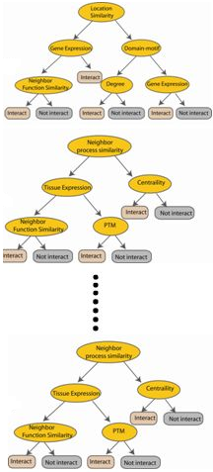



Ensemble Methods (Random Forest)-
Used with Decision Trees. Create different trees by providing different sub-features from the feature set to the tree creating algorithm. The optimization function is Entropy or Gini index
Randomly selected sub feature set
Independent trees created in parallel
N instances
Original number of features

Slide 34
Ensemble Methods (Random Forest)-
Lab- 9 Improve defaulter prediction of the decision tree using Random Forest
Description – Sample data is available at local file system as credit.csv
The dataset has 16 attributes described at https://archive.ics.uci.edu/ml/datasets/statlog+(german+credit+data)
or in the notes page of this slide
Sol: DT_Ensemble.ipynb
Notes:
Attribute 1: (qualitative) Status of existing checking account A11 : ... < 0 DM A12 : 0 <= ... < 200 DM A13 : ... >= 200 DM / salary assignments for at least 1 year A14 : no checking account Attribute 2: (numerical) Duration in month Attribute 3: (qualitative) Credit history A30 : no credits taken/ all credits paid back duly A31 : all credits at this bank paid back duly A32 : existing credits paid back duly till now A33 : delay in paying off in the past A34 : critical account/ other credits existing (not at this bank) Attribute 4: (qualitative) Purpose A40 : car (new) A41 : car (used) A42 : furniture/equipment A43 : radio/television A44 : domestic appliances A45 : repairs A46 : education A47 : (vacation - does not exist?) A48 : retraining A49 : business A410 : others Attribute 5: (numerical) Credit amount Attibute 6: (qualitative) Savings account/bonds A61 : ... < 100 DM A62 : 100 <= ... < 500 DM A63 : 500 <= ... < 1000 DM A64 : .. >= 1000 DM A65 : unknown/ no savings account Attribute 7: (qualitative) Present employment since A71 : unemployed A72 : ... < 1 year A73 : 1 <= ... < 4 years A74 : 4 <= ... < 7 years A75 : .. >= 7 years Attribute 8: (numerical) Installment rate in percentage of disposable income Attribute 9: (qualitative) Personal status and sex A91 : male : divorced/separated A92 : female : divorced/separated/married A93 : male : single A94 : male : married/widowed A95 : female : single Attribute 10: (qualitative) Other debtors / guarantors A101 : none A102 : co-applicant A103 : guarantor Attribute 11: (numerical) Present residence since Attribute 12: (qualitative) Property A121 : real estate A122 : if not A121 : building society savings agreement/ life insurance A123 : if not A121/A122 : car or other, not in attribute 6 A124 : unknown / no property Attribute 13: (numerical) Age in years Attribute 14: (qualitative) Other installment plans A141 : bank A142 : stores A143 : none Attribute 15: (qualitative) Housing A151 : rent A152 : own A153 : for free Attribute 16: (numerical) Number of existing credits at this bank Attribute 17: (qualitative) Job A171 : unemployed/ unskilled - non-resident A172 : unskilled - resident A173 : skilled employee / official A174 : management/ self-employed/ highly qualified employee/ officer Attribute 18: (numerical) Number of people being liable to provide maintenance for Attribute 19: (qualitative) Telephone A191 : none A192 : yes, registered under the customers name Attribute 20: (qualitative) foreign worker A201 : yes A202 : no

Slide 35
Ensemble Methods(Stacking)-
Similar to bagging, but apply several different models to original data
The weights for each model is determined based on how well they perform on the given input data
Similar classifiers usually make similar errors (bagging), so forming an ensemble with similar classifiers may not improve the classification rate
Presence of a poorly performing classifier may cause performance deterioration in the overall performance
Similarly, even on presence of a classifier that performs much better than all of the other available base classifiers, may cause degradation in the overall performance
Another important factor is the amount of correlation among the incorrect classifications made by each classifier
If the consistent classifiers tend to misclassify the same instances, then combining their results will have no benefit
In contrast, a greater amount of independence among the classifiers can result in errors by individual classifiers being overlooked when the results of the ensemble are combined.

Slide 36
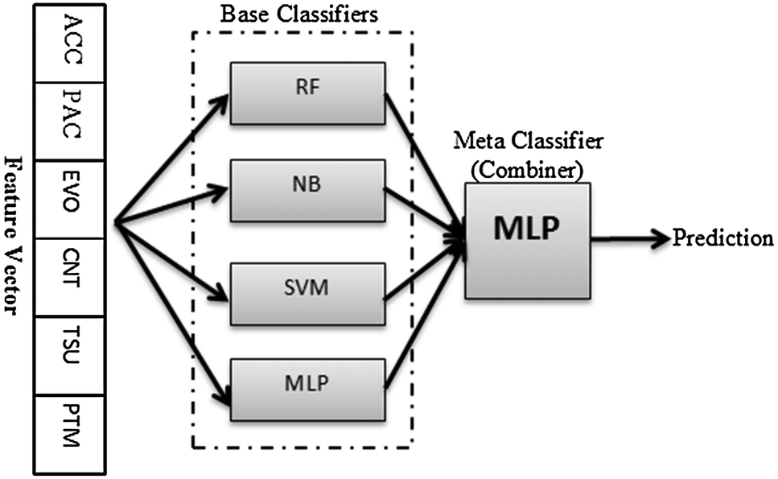
Ensemble Methods(Stacking)-
Source: http://pubs.rsc.org/-/content/articlelanding/2014/mb/c4mb00410h/unauth#!divAbstract

Slide 37
Ensemble Methods(Stacking)-
Lab- 10 Improve defaulter prediction of the decision tree using Stacking
Description – Sample data is available at local file system as credit.csv
The dataset has 16 attributes described at https://archive.ics.uci.edu/ml/datasets/statlog+(german+credit+data)
or in the notes page of this slide
Sol: DT_Ensemble.ipynb
Notes:
Attribute 1: (qualitative) Status of existing checking account A11 : ... < 0 DM A12 : 0 <= ... < 200 DM A13 : ... >= 200 DM / salary assignments for at least 1 year A14 : no checking account Attribute 2: (numerical) Duration in month Attribute 3: (qualitative) Credit history A30 : no credits taken/ all credits paid back duly A31 : all credits at this bank paid back duly A32 : existing credits paid back duly till now A33 : delay in paying off in the past A34 : critical account/ other credits existing (not at this bank) Attribute 4: (qualitative) Purpose A40 : car (new) A41 : car (used) A42 : furniture/equipment A43 : radio/television A44 : domestic appliances A45 : repairs A46 : education A47 : (vacation - does not exist?) A48 : retraining A49 : business A410 : others Attribute 5: (numerical) Credit amount Attibute 6: (qualitative) Savings account/bonds A61 : ... < 100 DM A62 : 100 <= ... < 500 DM A63 : 500 <= ... < 1000 DM A64 : .. >= 1000 DM A65 : unknown/ no savings account Attribute 7: (qualitative) Present employment since A71 : unemployed A72 : ... < 1 year A73 : 1 <= ... < 4 years A74 : 4 <= ... < 7 years A75 : .. >= 7 years Attribute 8: (numerical) Installment rate in percentage of disposable income Attribute 9: (qualitative) Personal status and sex A91 : male : divorced/separated A92 : female : divorced/separated/married A93 : male : single A94 : male : married/widowed A95 : female : single Attribute 10: (qualitative) Other debtors / guarantors A101 : none A102 : co-applicant A103 : guarantor Attribute 11: (numerical) Present residence since Attribute 12: (qualitative) Property A121 : real estate A122 : if not A121 : building society savings agreement/ life insurance A123 : if not A121/A122 : car or other, not in attribute 6 A124 : unknown / no property Attribute 13: (numerical) Age in years Attribute 14: (qualitative) Other installment plans A141 : bank A142 : stores A143 : none Attribute 15: (qualitative) Housing A151 : rent A152 : own A153 : for free Attribute 16: (numerical) Number of existing credits at this bank Attribute 17: (qualitative) Job A171 : unemployed/ unskilled - non-resident A172 : unskilled - resident A173 : skilled employee / official A174 : management/ self-employed/ highly qualified employee/ officer Attribute 18: (numerical) Number of people being liable to provide maintenance for Attribute 19: (qualitative) Telephone A191 : none A192 : yes, registered under the customers name Attribute 20: (qualitative) foreign worker A201 : yes A202 : no

Slide 38
Thank You

Slide 39
Bias-Variance Decomposition

Slide 40
We can decompose the error of the learned model into two parts:
Bias Error :
this class of models can’t fit the training data.
Accuracy is low both in training and testing data
Fix: a more complex model class.
Variance Error :
This class of models could fit the training data well but fail to fit in test because of different distribution of data
Accuracy in test is relatively much lower than in training
Fix: a less complex model class.

Slide 41
Bias – Variance decomposition of error (squared)
Separate the test data set first.
Draw size n sample D=(x₁,y₁),….(x_{n},y_{n})
Train model h_{D} using D
Draw one test example (x, y) (one value of x, corresponding estimate of y)
Predict the value of y for the x using h_{D}
Measure squared error of h_{D} on that example x. SSE = (y - yhat)^2
Notes:
41

Slide 42


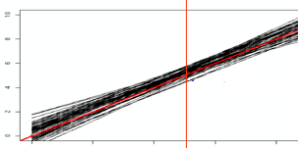
Bias – Variance decomposition of error (squared)
noise
Ensemble function
Model prediction error given dataset D and random error e
True unknown function
Bootstrapped models
h represents avg prediction of y for the data point x from multiple models created from multiple datasets say using bootstrap
Notes:
42

Slide 43
Ouch!!!
Squared difference between best possible prediction for x, f(x), and our “long-term” expectation for what the learner will do if we averaged over many datasets D, E_{D}[h_{D}(x)]
Squared difference between long-term expectation for the learners performance, E_{D}[h_{D}(x)], and what we expect in a representative run on a dataset D (yhat )
VARIANCE
BIAS²
Notes:
43

Slide 44
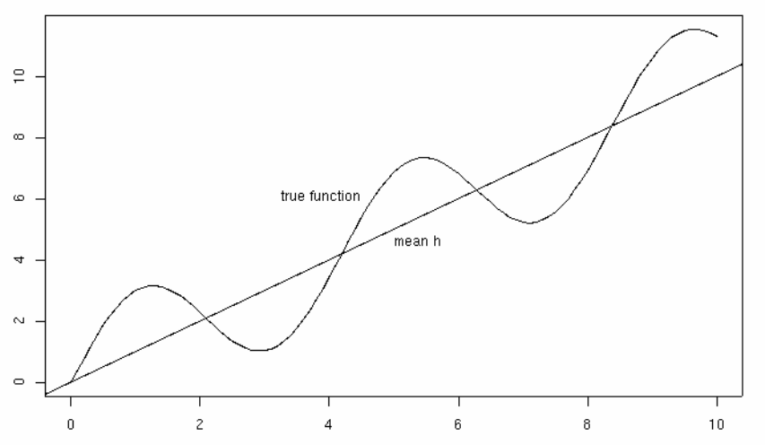
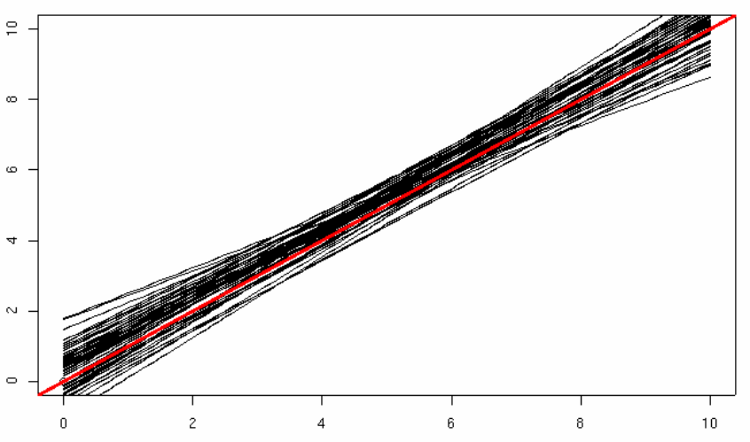
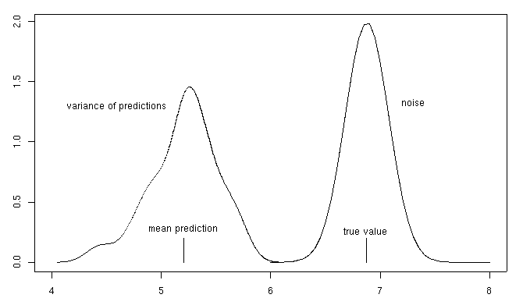
Pictorially ☺
x=5
variance
bias

Slide 45
Bootstrap Sampling
Bias variance errors can be approximately measured from synthetic data. For e.g. we can approximate E_{D}{h_{D}(x)} from bootstrap samples where D represents the different sample sets
Input: dataset D
Output: many variants of D: D₁,…,D_{T}
For t=1,….,T:
D_{t} = { }
For i=1…|D|:
Pick (x,y) uniformly at random from D (i.e., with replacement) and add it to D_{t}
Some examples never get picked (~37%)
Some are picked 2x, 3x, ….

Slide 46
Measuring Bias-Variance with “Bootstrap” sampling
Create B bootstrap variants of D
For each bootstrap dataset
T_{b} is the training dataset; U_{b} are the “out of bag” examples for testing
Train a hypothesis h_{b} on T_{b}
Test h_{b} on each x in U_{b}
Now for each (x,y) example we have many predictions h₁(x),h₂(x), …. so we can estimate (ignoring noise)
variance: ordinary variance of h₁(x),….,h_{n}(x)
bias: average(h₁(x),…,h_{n}(x)) – y
By measuring the bias and variance on a problem, we can determine how to improve our model
If bias is high, we need to allow our model to be more complex
If variance is high, we need to reduce the complexity of the model
Bias-variance analysis can be addressed using ensemble techniques

Slide 47
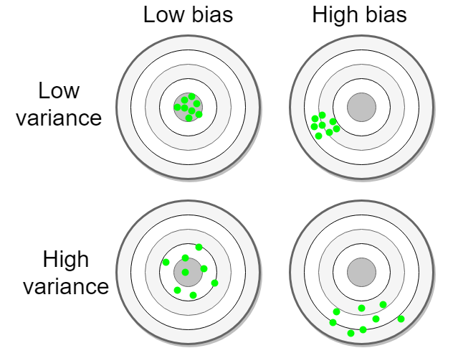
Source : http://www.machinelearningtutorial.net/2017/01/26/the-bias-variance-tradeoff/

Slide 48
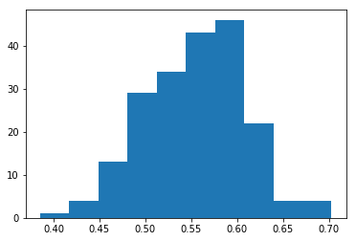
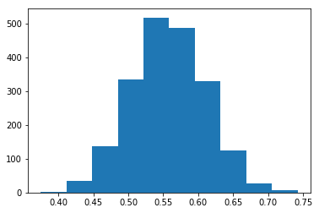
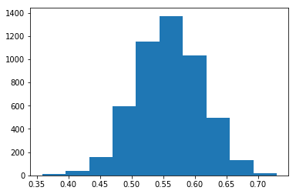
Central Limit Theorem (Sampling Distribution of Means)
Concept – If we draw infinite samples of size n from a distribution and plot the means of those samples, we get sampling distribution of the mean. This is a theoretical concept as drawing infinite samples is not practical.
The sampling distribution of the means of those samples will become approximately normally distributed with mean μ and standard deviation σ/√ N as the sample size (N) and the number of samples taken become larger, irrespective of the shape of the population distribution
The mean value of the distribution will be a close estimate of the population mean μ

