Slide 1
Decision Trees

Slide 2
Decision Trees
S.No | Topic | Scope | Objective
1 | Introduction to decision tree | Discuss use of decision tree in decision making | A tool to handle uncertainties
2 | Mechanics of decision tree | Process of creating a decision tree | How decision trees extract information
3 | Geometry of decision tree | Decision tree as axis parallel boundaries | Impact of axis parallel boundaries
4 | Algorithmic approach for creating decision tree. | Discuss Entropy, Gini and information gain | Quantify uncertainty using Shannon's entropy or Gini index
5 | Preparing data for decision trees | How to handle different types of variables, handling outliers, missing values | Transforming data for decision tree, impact on accuracy of decision tress
6 | Regularizing Decision Tree | Nature of decision trees to become overfit. Pruning of decision trees | Impact of overfitting on generalization as increase in variance errors
7 | Decision trees for regression | Explain how the same algorithm can also be used for regression using median / mean | Predict values using decision trees.
8 | Code walk thru on classification | Data transformation and use of appropriate libraries, hyper parameters | Familiarize with appropriate libraries and function calls to build decision tree classifier
9 | Advantages / disadvantages of decision trees | The axis parallel nature and it’s impact on accuracy of a regularized of decision tree | When is a decision tree right choice and when not

Slide 3
Decision Trees(Contd…)
S.No | Topic | Scope | Objective
11 | Online Assets | Online resources on Decision Tree concepts | Expand horizons beyond what is covered in class in this area
12 | Practice work | Build decision tree models on opensource datasets | Learn decision tree based modeling including regularization on other data sets

Slide 4
Introduction to Decision Trees

Slide 5
Introduction to Decision Trees -
Decision Tree is one of the most commonly used models in data science world
It also is a proven management tool used to take decisions in complex situations
It can be used for regression and classification, more often used for classification
Can be used for binary class classification such as whether an applicant for loan is likely to turn into defaulter or not, whether a customer is likely to churn or not
It can also be used for multi-class classification for e.g. identifying the character in English alphabet

Slide 6
Mechanics of Decision Tree

Slide 7
Introduction to Decision Trees -
Suppose we are given the data about cars as shown
Our objective is to find if any patterns exist that connect the “Horse-Power” and “Weight” to car type (Large or Small)
The independent variables are “Horse-Power” and “Weight” while the target column is “Car Type”
The target column has binary values (L and S) in equal numbers.
Horse-Power | Weight | Car Type
130 | 3500 | L
90 | 2000 | S
90 | 1500 | S
150 | 3000 | L
270 | 2500 | L
200 | 2900 | L
70 | 2530 | S
215 | 2000 | L
80 | 2200 | S
100 | 1700 | S

Slide 8
Introduction to Decision Trees -
Horse-Power | Weight | Car Type
This smaller node on top has “L” in majority in the target column hence gets label “L”
The smaller node on the bottom has “S” in majority in the target column hence gets label “S”
The homogeneity of the target column in both the smaller nodes has increased compared to parent
But both the smaller nodes still have a mix of values in the target column
Let us apply a function on the weight column.
80 | 2200 | S
270 | 2500 | L
70 | 2530 | S
200 | 2900 | L
150 | 3000 | L
Horse-Power | Weight | Car Type
130 | 3500 | L
90 | 2000 | S
90 | 1500 | S
150 | 3000 | L
270 | 2500 | L
200 | 2900 | L
70 | 2530 | S
215 | 2000 | L
80 | 2200 | S
100 | 1700 | S
130 | 3500 | L
Weight > 2000.
Horse-Power | Weight | Car Type
90 | 1500 | S
100 | 1700 | S
90 | 2000 | S
215 | 2000 | L

Slide 9
Introduction to Decision Trees -
Class = L (Majority)
Horse-Power | Weight | Car Type
Horse-Power | Weight | Car Type
The smaller node on the top now is perfectly homogenous in target column and belongs to class “S”
The second node similarly belongs to “L”
The third node belongs to “S”
The fourth node belongs to “L”
There is no further need to split the data as it is perfectly homogenous!
70 | 2530 | S
80 | 2200 | S
80 | 2200 | S
80 | 2200 | S
270 | 2500 | L
70 | 2530 | S
200 | 2900 | L
150 | 3000 | L
HorsePower> 100.
Horse-Power | Weight | Car Type
130 | 3500 | L
150 | 3000 | L
200 | 2900 | L
270 | 2500 | L
Let us apply a function on the Horsepower column
Horse-Power | Weight | Car Type
Horse-Power | Weight | Car Type
90 | 1500 | S
90 | 2000 | S
100 | 1700 | S
90 | 1500 | S
100 | 1700 | S
90 | 2000 | S
215 | 2000 | L
HorsePower> 200.
Class = S (Majority)
Horse-Power | Weight | Car Type
215 | 2000 | L

Slide 10
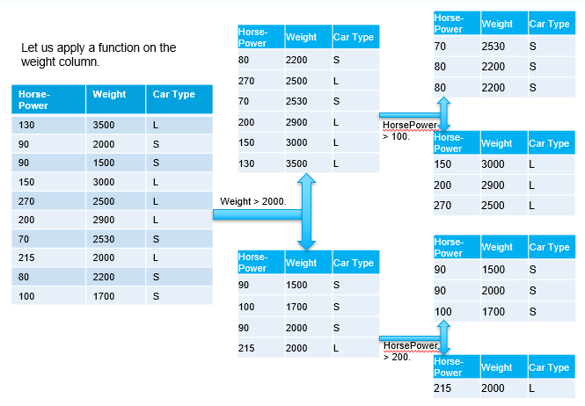
Introduction to Decision Trees -
The tree thus has given us the following relation between “Weight”, “Horse-Power” and “Car Type” as
If wt > 2000
if hp > 100
class = “L”
else
class = “S”
If wt <= 2000
if hp > 200
class = “L”
else
class = “S

Slide 11
Introduction to Decision Trees -
Predicted class of the new data point
Horse-Power | Weight | Car Type
150 | 2500 | ?
Large Car

Slide 12
Decision Trees -
Suppose we come across a combination of “Weight” and “Horse-Power” for any of the classes which was not available in the training data on which the decision tree was built. For e.g. a Small Car with HorsePower of 250 and Weight is 2000. The Decision Tree will classify it as Large Car.
Such classification errors can occur both during the training and testing. They are called training errors and testing errors. This is true for any algorithm
The decision tree algorithm by default will try to build a tree where the smallest child nodes are perfectly homogenous in the target columns. This is called overfit model

Slide 13
Decision Trees -
Sometimes when the algorithm runs out of independent attributes to use to break a node into smaller nodes or it is forced to stop, we may find nodes where the target column is not homogenous
In such case, the label assigned to the node is based on majority class and the ratio of the classes indicates the posterior probability of the two classes at that node. P(s) = ¾ and P(L) = ¼
Small Cars
Horse-Power | Weight | Car Type
90 | 1500 | S
100 | 1700 | S
90 | 2000 | S
215 | 2000 | L

Slide 14
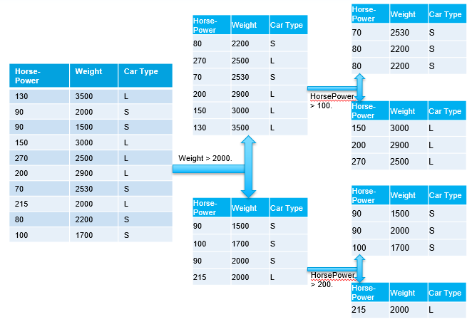
Decision Trees -
Decision trees consist of nodes and branches. Nodes represent a decision function while branch represents the result of the function. Thus it is a flow chart for deciding how to classify a new observation:
The nodes are of three types, Root Node (representing the original data), Branch Node (representing a function), Leaf Node (which holds the result of all the previous functions that connect to it)
Functions on branch nodes
Root Node
Branch Node
Leaf Node
How does decision tree algorithm select the column and the breakpoint in the column to create the tree?

Slide 15
Geometry of Decision Tree

Slide 16
Decision trees create axis parallel boundaries
Entire Data
Dimension 2
< S1
>S1
S2
< S2
>S2
<S3
>S3
S3
S1
Dimension 1

Slide 17
Decision trees create axis parallel boundaries
Dimension 2
S3
S2
In some distributions, decision tree can separate the classes better than simple linear models
S1
Dimension 1

Slide 18
Decision trees create axis parallel boundaries
Simple linear model
S3
Dimension 2
In some distributions, a simple linear model can do better than a complex tree
S2
S1
Dimension 1

Slide 19
Algorithmic Approach For Creating Decision Tree

Slide 20
Decision Trees - Algorithms
ID3 (Iterative Dicotomizer 3) – developed by Ross Quinlan. Creates a multi branch tree at each node using greedy algorithm. Trees grow to maximum size before pruning
C4.5 succeeded ID3 by overcoming limitation of features required to be categorical. It dynamically defines discrete attribute for numerical attributes. It converts the trained trees into a set of if-then rules. Accuracy of each rule is evaluated to determine the order in which they should be applied
C5.0 is Quinlan’s latest version and it uses less memory and builds smaller rulesets than C4.5 while being more accurate
CART (Classification & Regression Trees) is similar to C4.5 but it supports numerical target variables and does not compute rule sets. Creates binary tree. Scikit uses CART

Slide 21
Decision Trees – Loss functions
The decision tree algorithm learns (i.e. creates the decision tree from the data set) through optimization of a loss function
The loss function represents the loss of impurity in the target column. The requirement here is to minimize the impurity in the target column as much as possible at the leaf nodes
For this we need to understand how to measure the purity of the target column

Slide 22
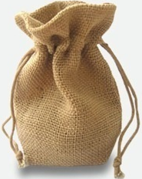
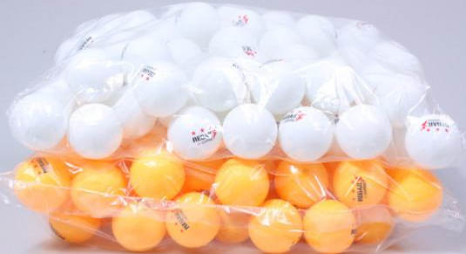

Relation between uncertainty and probability
There is a bag of 50 balls of orange and white respectively
You have to pull out one ball from the bag with closed eyes. If the ball is -
orange, explain the linear regression model
white, nothing to be done
This state where you have to decide and your decision can result in multiple outcomes with equal probability is said to be state of maximum uncertainty
If you have a bag full of balls of only one colour, then there is no uncertainty. You know what is going to happen. Uncertainty is zero.
Thus, the more the homogeneity, lesser the uncertainty and vice versa
Uncertainty is expressed as entropy or Gini index

Slide 23
Entropy … a measure of uncertainty
Given that there are multiple outcomes possible (orange or white) for a given action (picking the ball)
Given that we know the probability of getting each outcome (P(Orange) = .5 and P(White) = 1 - .5 = .5)
We also know that when only one outcome (White or Orange) is possible, there is no uncertainty. P(White = 1) and P(Orange = 1-1 = 0)
We can express the relation between uncertainty and probability of states in a mathematical form and give it a name Entropy or Gini

Slide 24

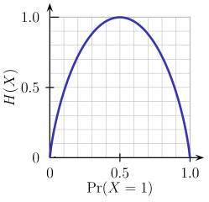
Shannon's Entropy
Imagine a bag contains 6 Orange and 4 White balls.
Let the two classes Orange -> class 0 and White -> class 1
Entropy of the bag (X) will be calculated as per the formula
The index i refers to the number of classes possible
H(X) = - (0.6 * log2( 0.6)) - (0.4 * log2(0.4)) = 0.9709506
Suppose we remove all Orange balls from the bag and then entropy will be
H(X) = - 1.0 *log2(1.0) – 0.0 * log2(0) = 0 ## Entropy is 0! i.e. Information is 100%
This relation between probability and Entropy can be geometrically represented for a two class case as shown here

Slide 25
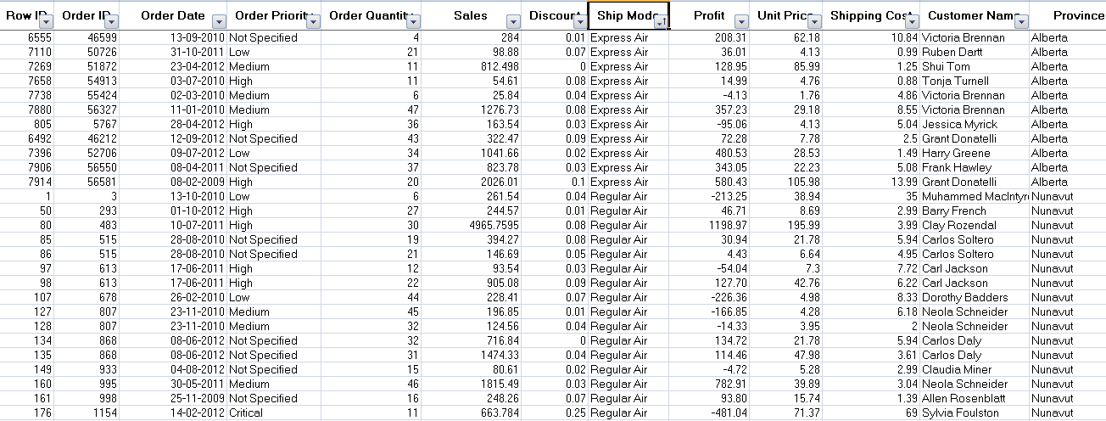
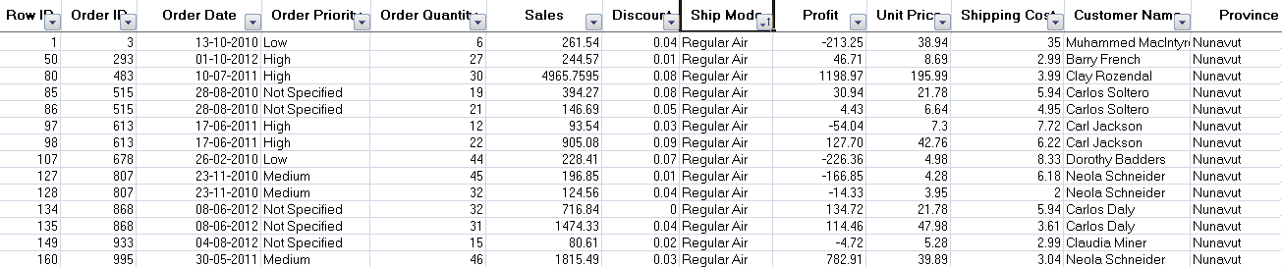
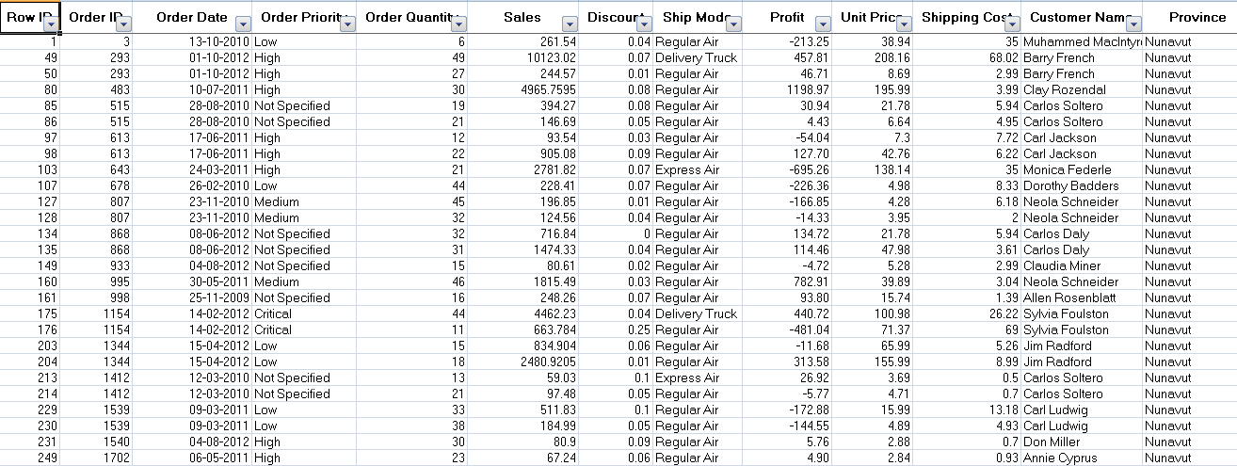
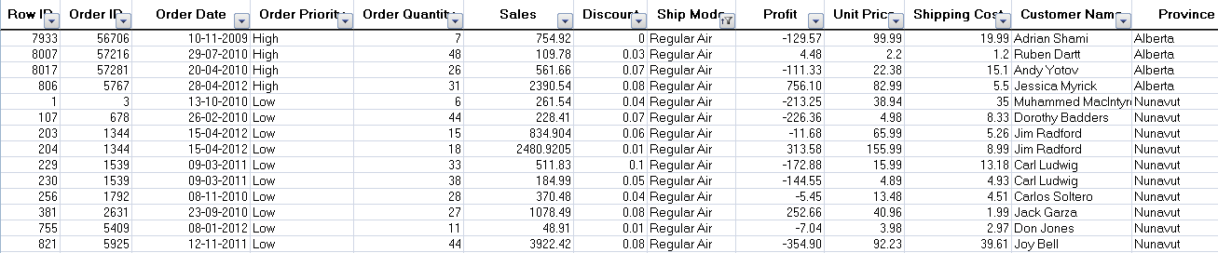
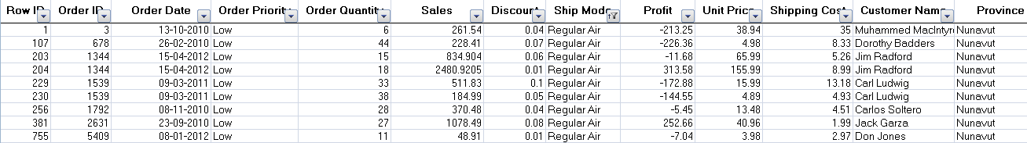
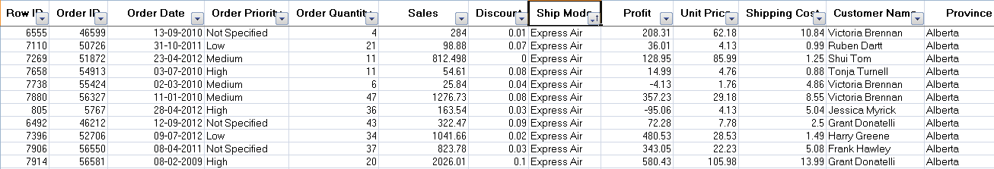
Decision Trees -
Suppose we wish to find if there was any influence of shipping mode, order priority on customer location. Customer location is target column and like the bag of coloured balls
Shipping Mode
Sales
Data
Regular Air
ExpressAir
Low Priority
High Priority
When sub branches are created, the total entropy of the sub branches should be less than the entropy of the parent node. More the drop in entropy, more the information gained

Slide 26
Machine Learning (Decision Tree Classification)
Decision Trees -
Entropy | Info Gain
E0 = max entropy say 1 | 0
E1 = (E1a*700/1000) + (E1b * 300/1000) | E0 – E1
E2 = (E2a * 500/700) + (E2b * 200/700) + (E2c * 100/300) + (E2d * 200/300) | E1 – E2
Shipping
Mode (1000) E0
Regular Air (700), E1a
Express Air (300), E1b
Low Priority (500) E2a
High Priority (200) E2b
Low Priority (100) E2c
High Priority (200) E2d
Tree will stop growing when stop criterion for the splitting is reached which could be -
Tree has reached certain pre-fixed depth (longestt path from root node to leaf node)
Tree has achieve maximum number of nodes (tree size)
Exhausted all attributes to split
Leaf node on split will have less than predefined number of data points

Slide 27
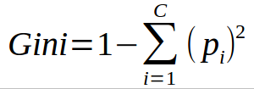
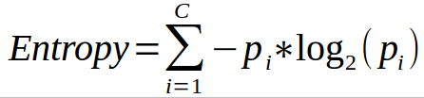
Decision Trees -
Common measures of purity
Gini index – is calculated by subtracting the sum of the squared probabilities of each class from one
Uses squared proportion of classes
Perfectly classified, Gini Index would be zero
Evenly distributed would be 1 – (1/# Classes)
You want a variable split that has a low Gini Index
Used in CART algorithm
Entropy –
Favors splits with small counts but many unique values
Weights probability of class by log(base=2) of the class probability
A smaller value of Entropy is better. That makes the difference between the parent node’s entropy larger
Information Gain is the Entropy of the parent node minus the entropy of the child nodes

Slide 28
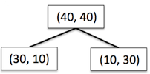




Decision Trees - Information Gain using Entropy
Information Gain = reduction in entropy =

Slide 29



Decision Trees - Information Gain using Gini index
Information Gain = reduction in Gini index =

Slide 30
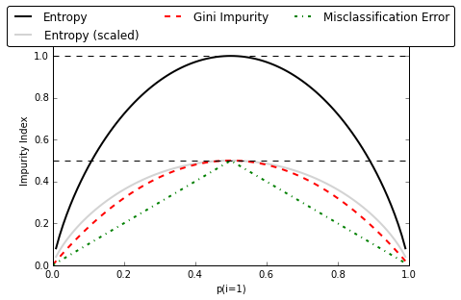
Decision Trees – Gini , Entropy , Misclassification Error
Note: Misclassification Error is not used in Decision Trees

Slide 31
Preparing Data for Decision Tree

Slide 32
Decision Trees -
Common measures of purity
Gini index – is calculated by subtracting the sum of the squared probabilities of each class from one
Uses squared proportion of classes
Perfectly classified, Gini Index would be zero
Evenly distributed would be 1 – (1/# Classes)
You want a variable split that has a low Gini Index
Used in CART algorithm
Entropy –
Favors splits with small counts but many unique values
Weights probability of class by log(base=2) of the class probability
A smaller value of Entropy is better. That makes the difference between the parent node’s entropy larger
Information Gain is the Entropy of the parent node minus the entropy of the child nodes

Slide 33
Regularizing Decision Trees

Slide 34
Decision Trees - Preventing overfitting through regularization
Decision trees do not assume a particular form of relationship between the independent and dependent variables unlike linear models for e.g.
DT is a non-parametrized algorithm unlike linear models where we supply the input parameters
If left unconstrained, they can build tree structures to adapt to the training data leading to overfitting
To avoid overfitting, we need to restrict the DT’s freedom during the tree creation. This is called regularization
The regularization hyperparameters depend on the algorithms used

Slide 35
Decision Trees - Regularization parameters
max_depth – Is the maximum length of a path from root to leaf (in terms of number of decision points. The leaf node is not split further. It could lead to a tree with leaf node containing many observations on one side of the tree, whereas on the other side, nodes containing much less observations get further split
min_sample_split - A limit to stop further splitting of nodes when the number of observations in the node is lower than this value
min_sample_leaf – Minimum number of samples a leaf node must have. When a leaf contains too few observations, further splitting will result in overfitting (modeling of noise in the data).

Slide 36
Decision Trees - Regularization parameters (Contd…)
min_weight_fraction_leaf – Same as min_sample_leaf but expressed in fraction of total number of weighted instances
max_leaf_nodes – maximum number of leaf nodes in a tree
max_feature_size - max number of features that are evaluated for splitting each node

Slide 37
Decision Trees for Regression

Slide 38
Decision Trees for Regression
Decision trees can be use for predicting values such as “mpg” given the attributes of a car
The objective of the decision tree regressor algorithm is to minimize SSE i.e. (yi – f(xi))^2. Where f(x) is a predicted value yhat_i for given xi
Starting with all data, splitting is done on a variable V1 at point s resulting in two regions R1 and R2 where
f(x) = ave(yi | Xi in a region or partition created based on variable and value of an attribute
most of Xi in training set will have very different y compared to the mean of the region they fall into
overall, a very high SSE across the entire data
The algorithm splits the regions further using variable which gives maximum reduction in variance in a region across levels

Slide 39

Decision trees create axis parallel boundaries
The sum of the square of the difference of yi from ave(y) in a region is the SSE of the regions
The total SSE is highest in the root node i.e. for the entire data
Total SSE starts decreasing with splitting
Average of y for R1
Average of y for R2
Y (target variable)
S2
Region 2
Region 1
S1
Dimension 1

Slide 40
Decision trees create axis parallel boundaries
Total SSE (summed across all regions) minimizes with increase in partitions
Total SSE will be zero when every data point is a region. This will lead to over fit
Average of y for R1
Average of y for R2A
Y (target variable)
S2
Average of y for R2B
Region 2B
Region 1
S1
Dimension 1

Slide 41
Decision Trees for Regression
As the tree grows, the regions a.k.a leaf nodes contain less and less variance and hence overall SSE falls
When every region / leaf has one record, the SSE will be the least i.e. 0 but the tree will be over fit!

Slide 42
Code Walkthru on Classification

Slide 43
Decision Tree -
Lab- 5 Model to predict potential credit defaulters
Description – Sample data is available at local file system as credit.csv
The dataset has 16 attributes described at https://archive.ics.uci.edu/ml/datasets/statlog+(german+credit+data)
or in the notes page of this slide
Sol: Regularization+Credit+Decision+Tree.ipynb
Notes:
Attribute 1: (qualitative) Status of existing checking account A11 : ... < 0 DM A12 : 0 <= ... < 200 DM A13 : ... >= 200 DM / salary assignments for at least 1 year A14 : no checking account Attribute 2: (numerical) Duration in month Attribute 3: (qualitative) Credit history A30 : no credits taken/ all credits paid back duly A31 : all credits at this bank paid back duly A32 : existing credits paid back duly till now A33 : delay in paying off in the past A34 : critical account/ other credits existing (not at this bank) Attribute 4: (qualitative) Purpose A40 : car (new) A41 : car (used) A42 : furniture/equipment A43 : radio/television A44 : domestic appliances A45 : repairs A46 : education A47 : (vacation - does not exist?) A48 : retraining A49 : business A410 : others Attribute 5: (numerical) Credit amount Attibute 6: (qualitative) Savings account/bonds A61 : ... < 100 DM A62 : 100 <= ... < 500 DM A63 : 500 <= ... < 1000 DM A64 : .. >= 1000 DM A65 : unknown/ no savings account Attribute 7: (qualitative) Present employment since A71 : unemployed A72 : ... < 1 year A73 : 1 <= ... < 4 years A74 : 4 <= ... < 7 years A75 : .. >= 7 years Attribute 8: (numerical) Installment rate in percentage of disposable income Attribute 9: (qualitative) Personal status and sex A91 : male : divorced/separated A92 : female : divorced/separated/married A93 : male : single A94 : male : married/widowed A95 : female : single Attribute 10: (qualitative) Other debtors / guarantors A101 : none A102 : co-applicant A103 : guarantor Attribute 11: (numerical) Present residence since Attribute 12: (qualitative) Property A121 : real estate A122 : if not A121 : building society savings agreement/ life insurance A123 : if not A121/A122 : car or other, not in attribute 6 A124 : unknown / no property Attribute 13: (numerical) Age in years Attribute 14: (qualitative) Other installment plans A141 : bank A142 : stores A143 : none Attribute 15: (qualitative) Housing A151 : rent A152 : own A153 : for free Attribute 16: (numerical) Number of existing credits at this bank Attribute 17: (qualitative) Job A171 : unemployed/ unskilled - non-resident A172 : unskilled - resident A173 : skilled employee / official A174 : management/ self-employed/ highly qualified employee/ officer Attribute 18: (numerical) Number of people being liable to provide maintenance for Attribute 19: (qualitative) Telephone A191 : none A192 : yes, registered under the customers name Attribute 20: (qualitative) foreign worker A201 : yes A202 : no

Slide 44
Advantages / Disadvantages of Decision Tree

Slide 45
Decision Trees -
Advantages -
Simple , Fast in processing and effective
Can work with missing data
Handles numeric and categorical variables
Interpretation of results is easier when represented as rules
Draws non-linear boundaries thus can handle complex distributions relatively easily
Dis-advantages -
For categorical predictors, it is biased towards features have large number of levels
May not be optimum as modelling some relations on axis parallel basis is not optimal (difficulty in capturing additive structures)
Small changes in training data can result in large changes to the logic
Decision trees tend to become overfit by default creating large complex trees
Large trees can be difficult to interpret

Slide 46
Thank You

