Slide 1
Statistical Methods for Decision Making
How to Assess Uncertainty Using Probability?

Slide 2
Introduction
Managers will have to cope with uncertainty in many decision situations. Concepts of probability will help you measure uncertainty and perform associated analysis that are essential in making effective business decisions.

Slide 3
Probability – Meaning and Concepts
Probability refers to chance or likelihood of a particular event – taking place
An event is an outcome of an experiment.
An experiment is a process that is performed to understand and observe possible outcomes.
Set of all outcomes of an experiment is called the sample space.

Slide 4

Definition of probability
Probability of an event A is defined as the ratio of two numbers m and n. In symbols
Where m = number of ways that are favourable to the occurrence of A and n = the total number of outcomes of the experiment
(All possible outcomes)
Please note that P(A) is always >= 0 and always <=1.
P(A) is a pure number.

Slide 5
Example
When 2 coins are tossed, determine
a) The sample space.
b) Probability of getting 2 Heads

Slide 6
Solution
Let H = Head and T – Tail
Sample space = S = {HH, HT, TH, TT}
Let E denote the event of getting two Heads. E = {HH}. It is easy to see that E is a part of S and commonly called as a subset of S. Hence an event is always a subset of the sample space.
Probability of two Heads = 1 / 4 = 0.25

Slide 7
Portability values
Probability 0 – Impossible event
Probability 1: Certain event
Probability always in the range of 0 to 1

Slide 8
Assessing Probability
A Priori classical probability: Based on knowledge of the process
Empirical probability: Based on data
Subjective probability: Based on experience, analysis of situation and expert opinion

Slide 9
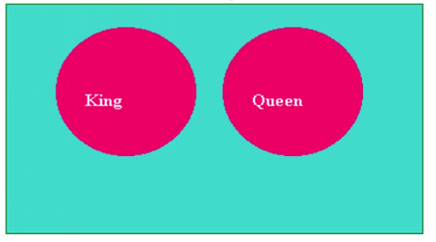
Mutually exclusive events
Two events A and B are said to be mutually exclusive if the occurrence of A precludes the occurrence of B. For example, from a well shuffled pack of cards, if you pick up one card at random and would like to know whether it is a King or a Queen. The selected card will be either a King or a Queen. It cannot be both a King and a Queen. If King occurs, Queen will not occur and Queen occurs, King will not occur.

Slide 10
Rules for computing probability
1) Addition Rule – Mutually exclusive events
P(A U B) = P(A) + P(B)
This rule says that the probability of the union of A and B is determined by adding the probability of the events A and B.
Here the symbol A U B is called A union B meaning A occurs, or B occurs or both A and B simultaneously occur. When A and B are mutually exclusive, A and B cannot simultaneously occur.

Slide 11
Rules for computing probability
1) Addition Rule – Events are not Mutually exclusive events
P(A U B) = P(A) + P(B) – P(A ∩ B)
This rule says that the probability of the union of A and B is determined by adding the probability of the event A and Band then subtracting the probability of the intersection of the events A and B.
The symbol A ∩ B is called A intersection B meaning both A and B simultaneously occur.

Slide 12
Example of Addition Rules:
From a pack of well-shuffled cards, a card is picked up at random.
What is the probability of selected card is a King or a Queen?
What is the probability that the selected card is a King or a Diamond

Slide 13
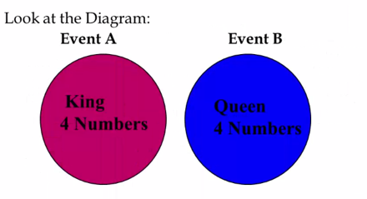
Solution to part 1)
Let A = getting a King
Let B = getting a Queen
There are 4 kings and there are 4 Queens. The events are clearly mutually exclusive. Apply the formula.
P(A U B) = P(A) + P(B) = 4/52 + 4/52 = 8/52 = 2/13

Slide 14
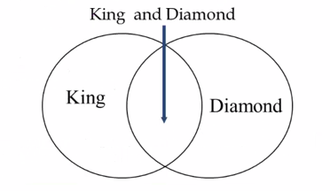
Solution to part 2
Look at the diagram:
There are totally 52 cards in the pack out of which 4 are kings and 13 are diamonds. Let A = getting a King and B = getting a Diamond. The two events here are not mutually exclusive because you can have a a card, which is both king and a Diamond called King Diamond.
P(K U D) = P(K) + P(D) – P(K ∩ D)
= 4/52 + 13/52 – 1/52 = 16/52 = 4/13

Slide 15
Independents events
Two events A and B are said to be independent if the occurrence of A is in no way influenced by the occurrence of B. Likewise occurrence of B is in no way influenced by the occurrence of A.

Slide 16
Multiplication rule
Independent events
P(A ∩ B) = P(A).P(B)
This rule says when the two events A and B are independent the probability of the simultaneous occurrence of A and B (also known as probability of intersection A and B) equals the product of the probability of A and the probability of B.
Of course this rule can be extended to more than two events.

Slide 17
Multiplication rule
Independent Events-Example
Example:
The probability that you will get an A grade in Quantitative Methods is 0.7. The probability that you will get an A grade in Marketing is 0.5. Assuming these two courses are independent, compute the probability that you will get an A grade in both these subjects.
Solution:
Let A = getting A grade in Quantitative Methods
Let B =getting A grade in Marketing
It is given that A and B are independent.
P(A ∩ B) = P(A).P(B) = 0.7.0.5 = 0.35

Slide 18
Multiplication Rule
Events are not independent
P(A ∩ B) = P(A).P(B|A)
This rule says that the probability of the intersection of the events A and B equals the product of the probability of A and the probability of B given that A has happened or known to you. This is symbolized in the second term of the above expression as P(B|A).
P(B|A) is called the conditional probability of B given the fact that A has occured.
We can also write P(A ∩ B) = P(B).P(A|B) if B has already occured.

Slide 19
Multiplication rule
Events are not independent-Example
From a pack of cards, 2 cards are drawn in succession one after the other. After every draw, the selected card is not replaced. What is the probability that in both the draws you will get Spades?
Solution:
Let A = getting spade in the first draw
Let B = getting spade in the second draw.
The cards are not replaced.
This situation requires the use of conditional probability.
P(A) = 13/52 (There are 13 Spades and 52 cards in a pack)
P(B|A) = 12/51(There are 12 Spades and 51 cards because the first card selected
P(A ∩ B) = P(A).P(B|A) = (13/52).(12/51)=156/2652= 1/17.

Slide 20
Marginal Probability
Contingency table consists of rows and columns of two attributes at different levels with frequencies or numbers in each of the cells. It is a matrix of frequencies assigned to rows and columns.
The term marginal is used to indicate that the probabilities are calculated using contingency table (also called joint probability table).

Slide 21
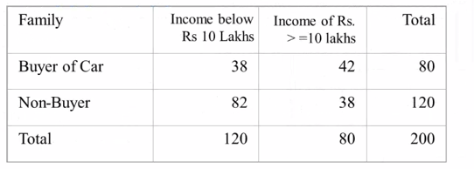
Marginal Probability-Example
A survey involving 200 families was conducted. Information regarding family income per year and whether the family buys a car are given in the following table.
a) What is the probability that a randomly selected family is a buyer of the car?
b) What is the probability that a randomly selected family is both a buyer of car and belonging to income of Rs.10 lakhs and above?
c) A family selected at random is found to be belonging to income of Rs 10 lakhs and above. What is the probability that this family is buyer of car?

Slide 22
Solution
a) What is the probability that a randomly selected family is a buyer of the Car?
80/200 = 0.40.
b) What is the probability that a randomly selected family is both a buyer of car and belonging to income of Rs.10 lakhs and above?
42/200 =0.21
c) A family selected at random is found to be belonging to income of Rs 10 lakhs and above. What is the probability that this family is buyer of car?
42/80 =0.525. Note this is a case of conditional probability of buyer given income is Rs.10 lakhs and above.

Slide 23
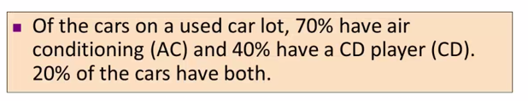
Some interesting problems for discussion
What is the probability that a car has a CD player, given that it has AC?
i.e., we want to find P(CD | AC)

Slide 24
Bayes’ Theorem
Bayes’ Theorem is used to revise previously calculated probabilities based on new information.
Developed by Thomas Bayes in the 18th Century.
It is an extension of conditional probability.

Slide 25
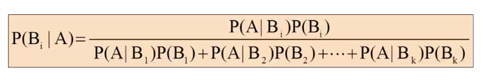
Bayes’ Theorem
Where:
Bi = i^{th} event of K mutually exclusive and collectively exhaustive events.
A = new event that might impact P(Bi)

Slide 26
Bayes’ Theorem
Where:
B’ = Complement of B
A = new event that might impact P(B)

Slide 27
Bayes Theorem Discussion Problem1
ABCD Network has produced a new TV show. Of all the shows they produced, 40% hit shows and 60% flop shows.
They are considering to employ a market research firm to conduct audience view pilot survey. The track record of the market research firm is – the shows that were actually hit, 90% of the times they had positive survey result. While the shows that were actually flop, they 70% of the times negative survey result.
If the market research firm survey is positive, what is the probability that the show will be hit

Slide 28
Bayes Theorem Discussion Problem1
67% probability that the show will be hit, given the survey is positive

Slide 29
Bayes Theorem Discussion Problem1
P(Hit | Survey Positive) = 36 / 54 = 0.67

Slide 30
Practice Problem – Contingency Table
How will marketers change their social media use in the near future? A survey by a social media examiner of B2B and B2C marketers was based on 1331 B2B marketers and 1694 B2C marketers. The survey revealed that
1953 respondents said “Yes” to the question related to “Increase in use of LinkedIn”
293 B2B respondents said “No” to the same question
(Problem 4.22, page 166 – modified)
Suppose you know that a marketer is a B2B marketer. What is the probability that he or she plans to increase the use of LinkedIn?
Suppose you know that a marketer is a B2C marketer. What is the probability that he or she plans to increase the use of LinkedIn?
What is the probability that a randomly selected marketer plans to increase use of LinkedIn?
What is the probability that a randomly selected marketer is a B2B customer and plans to increase use of LinkedIn?

Slide 31
Solution
a) Since the marketer is a B2B marketer, he/she is one the 1331 B2B marketer
P(Increase LinkedIn “Yes” | B2B) = 1038 / 1331 = = 0.7799
b) Since the marketer is a B2c marketer, he/she is one the 1694 B2C marketer
P(Increase LinkedIn “Yes” | B2C) = 915 / 1694 = = 0.5401
c) Since this question is only dealing with use of LinkedIn (and not dealing with business focus), therefore we need not look at the data in Business Focus columns. We will only look at Row Totals
P(Increase LinkedIn “Yes”) = 1953 / 3025 = 0.6456
d) This is a joint probability question. Out of all the marketers, what is the probability that a marketer belongs to top left cell (B2B and Increase LinkedIn=Yes)
P (B2B AND Increase LinkedIn “Yes”) = 1038 / 3025 = 0.3431

