Slide 1


Python for Beginners
Archer Infotech , PUNE
www.archerinfotech.in

Slide 2
What is Azure ?
Azure is a cloud computing platform and an online portal that allows you to access and manage cloud services and resources provided by Microsoft.
These services and resources include storing your data and transforming it, depending on your requirements.
To get access to these resources and services, all you need to have is an active internet connection and the ability to connect to the Azure portal.

Slide 3
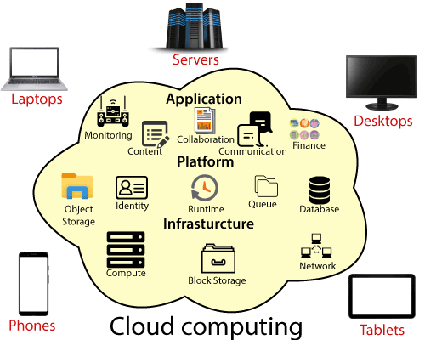
What is Cloud Computing ?
Cloud computing is the delivery of computing services—including servers, storage, databases, networking, software, analytics, and intelligence—over the Internet (“the cloud”) to offer faster innovation, flexible resources, and economies of scale.
You typically pay only for cloud services you use, helping lower your operating costs, run your infrastructure more efficiently and scale as your business needs change.

Slide 4
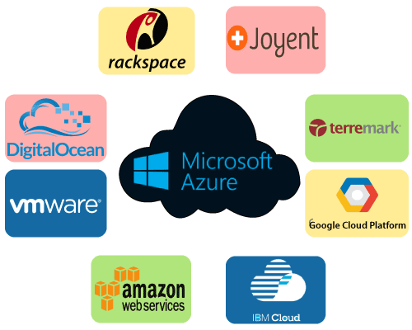
What is Cloud Computing ?

Slide 5
Benefits Of Cloud Computing
Cost: It reduces the huge capital costs of buying hardware and software.
Speed: Resources can be accessed in minutes, typically within a few clicks.
Scalability: We can increase or decrease the requirement of resources according to the business requirements.
Productivity: While using cloud computing, we put less operational effort. We do not need to apply patching, as well as no need to maintain hardware and software. So, in this way, the IT team can be more productive and focus on achieving business goals.
Reliability: Backup and recovery of data are less expensive and very fast for business continuity.
Security: Many cloud vendors offer a broad set of policies, technologies, and controls that strengthen our data security.

Slide 6
Types of Cloud Computing
Public Cloud : Public clouds are owned and operated by a third-party cloud service providers, which deliver their computing resources like servers and storage over the Internet. Microsoft Azure is an example of a public cloud. With a public cloud, all hardware, software and other supporting infrastructure is owned and managed by the cloud provider. You access these services and manage your account using a web browse
Private Cloud : A private cloud refers to cloud computing resources used exclusively by a single business or organisation. A private cloud can be physically located on the company’s on-site datacenter. Some companies also pay third-party service providers to host their private cloud. A private cloud is one in which the services and infrastructure are maintained on a private network
Hybrid Cloud

Slide 7
Types of Cloud Services
Infrastructure as a Service (IaaS): In IaaS, we can rent IT infrastructures like servers and virtual machines (VMs), storage, networks, operating systems from a cloud service vendor. We can create VM running Windows or Linux and install anything we want on it..
Platform as a Service (PaaS): This service provides an on-demand environment for developing, testing, delivering, and managing software applications. The developer is responsible for the application, and the PaaS vendor provides the ability to deploy and run it. Using PaaS, the flexibility gets reduce, but the management of the environment is taken care of by the cloud vendors.
Software as a Service (SaaS): It provides a centrally hosted and managed software services to the end-users. It delivers software over the internet, on-demand, and typically on a subscription basis. E.g., Microsoft One Drive, Dropbox, WordPress, Office 365, and Amazon Kindle. SaaS is used to minimize the operational cost to the maximum extent.

Slide 8
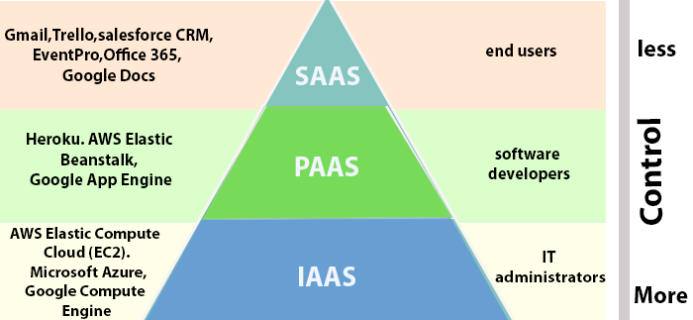
Types of Cloud Services

Slide 9
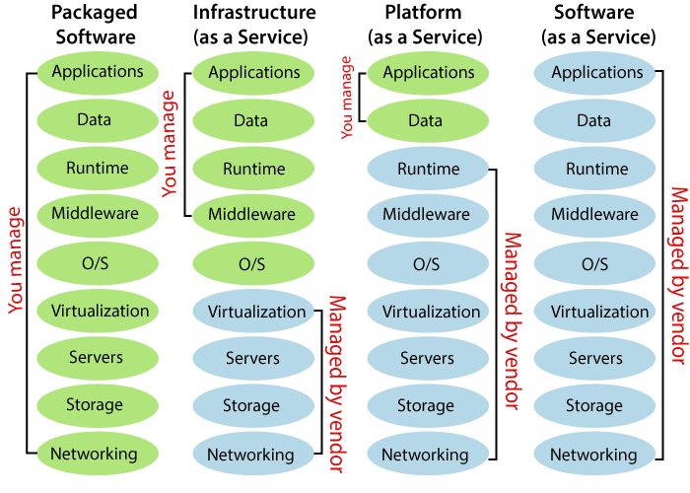
Types of Cloud Services

Slide 10
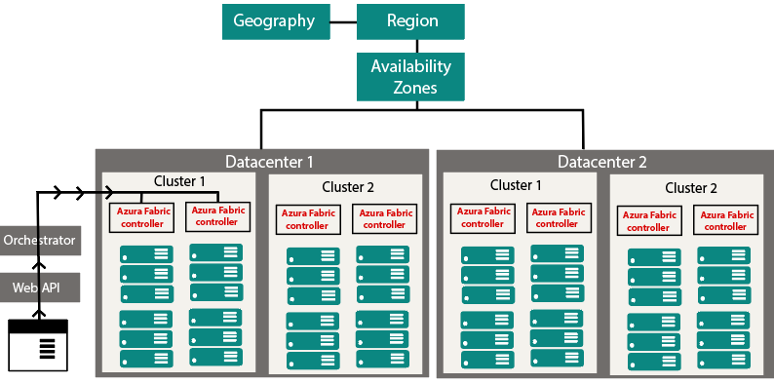
How Azure Works ?

Slide 11
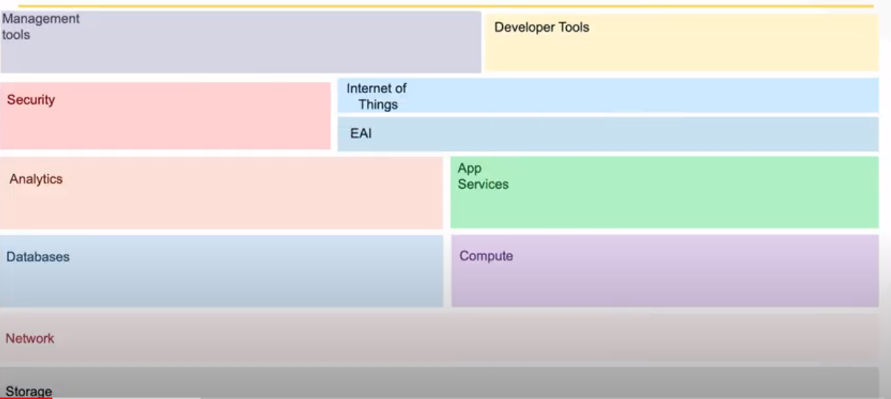
How Azure Works ?

Slide 12
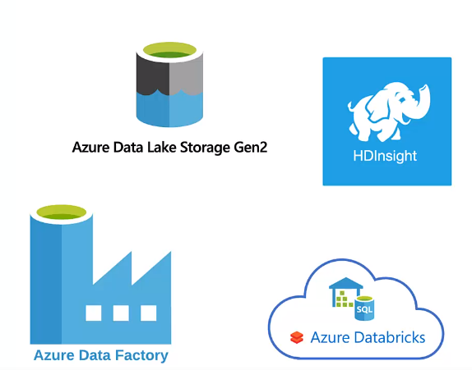
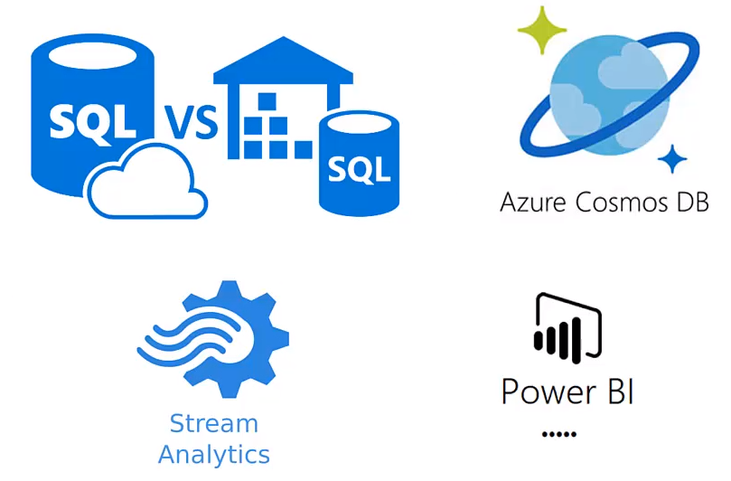
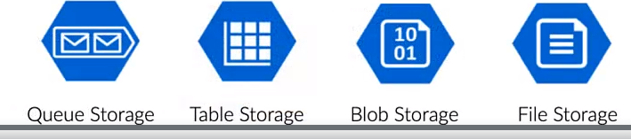
Azure Data Solutions Technologies

Slide 13
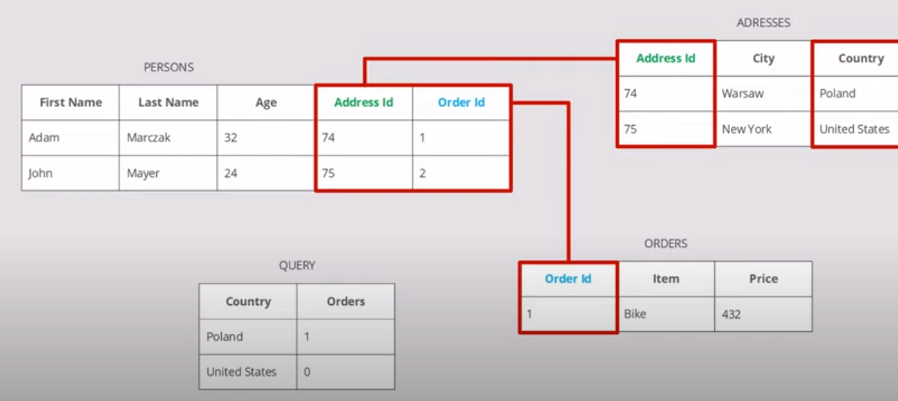
Relational Database

Slide 14
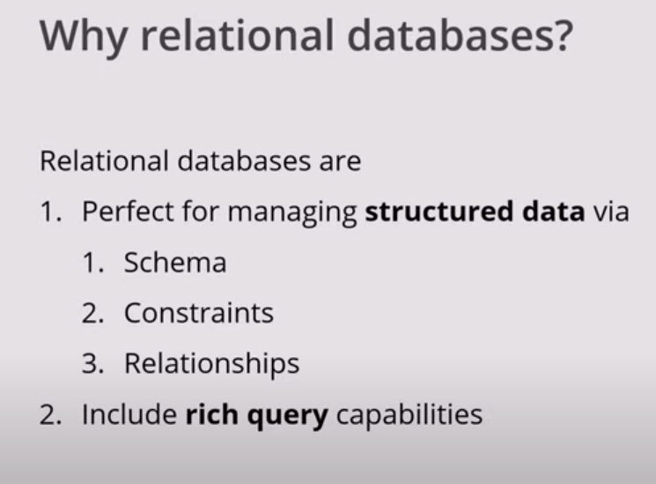
Relational Database

Slide 15
Relational Data On Azure
A database is a collection of data. A database can be as simple as a desktop spreadsheet, or as complex as a global system holding petabytes of highly structured information. The data can be structured in many different ways. A common approach is to store data in a tabular format, with rows and columns. You can define relationships between tables. These databases are called relational databases.

Slide 16
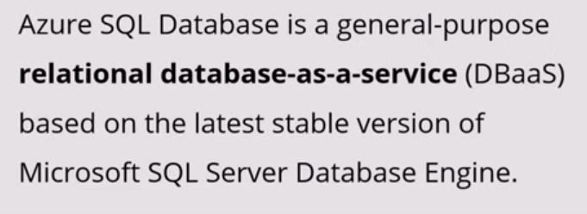
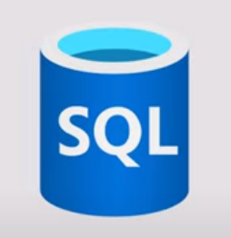
SQL Database

Slide 17
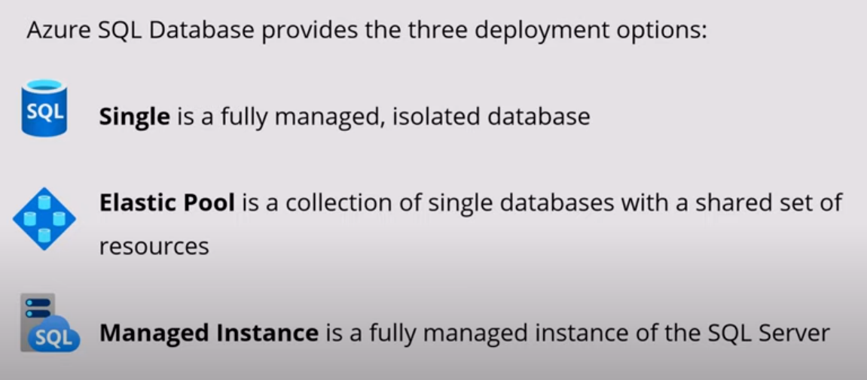
Deployment Models

Slide 18
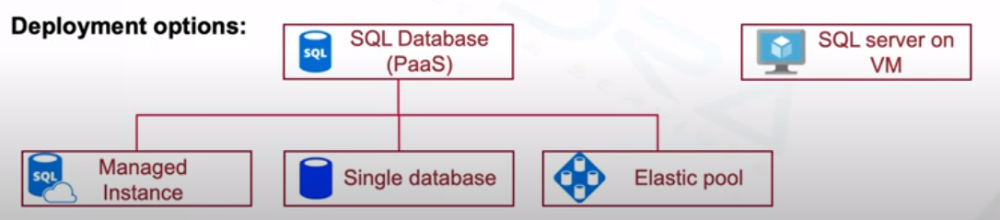
Deployment Models

Slide 19
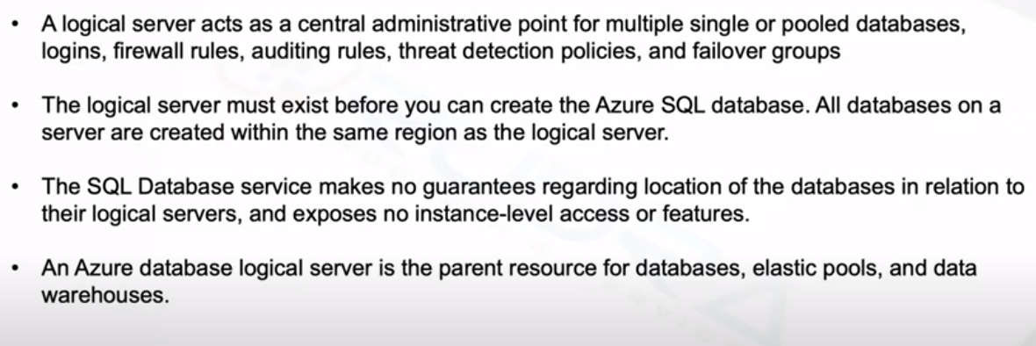
SQL Logical Server

Slide 20
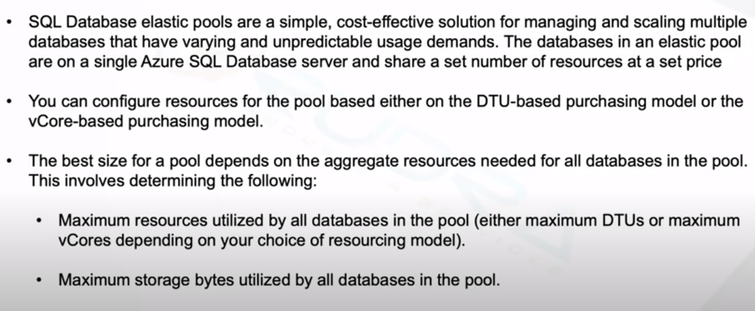
Elastic Pools

Slide 21
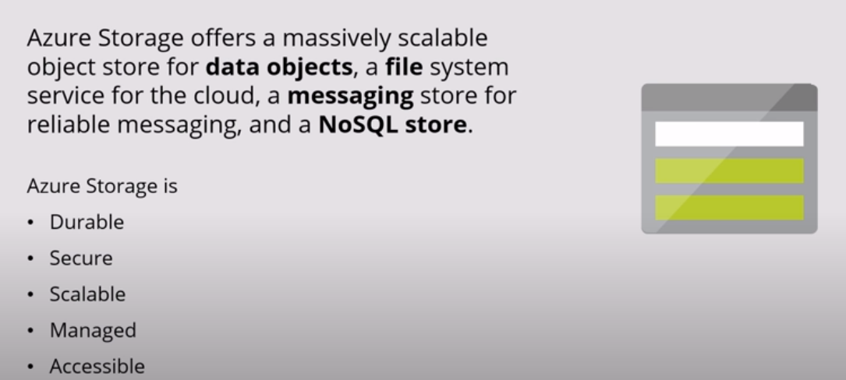
Azure Storage

Slide 22
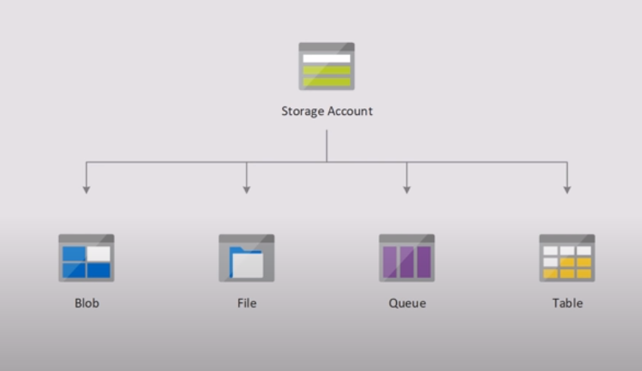
Azure Storage

Slide 23
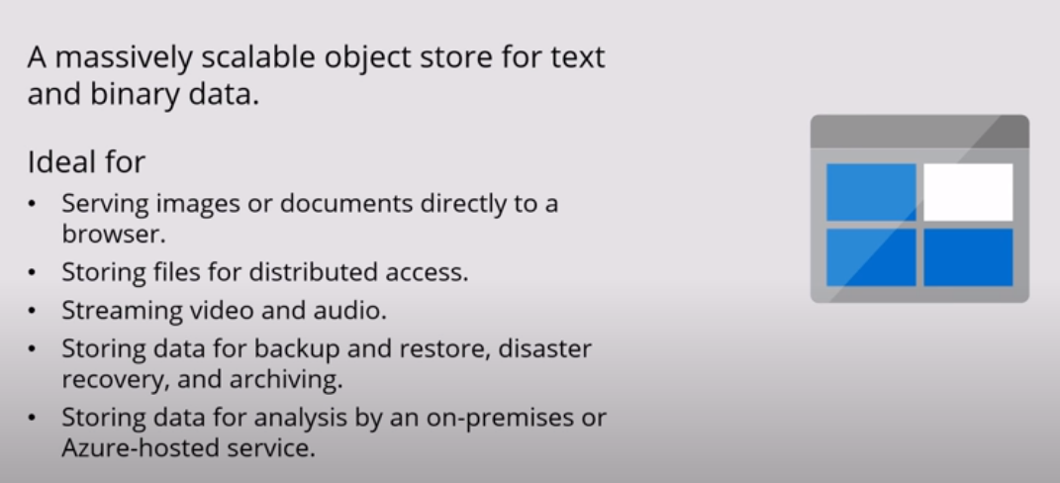
Blob Storage

Slide 24
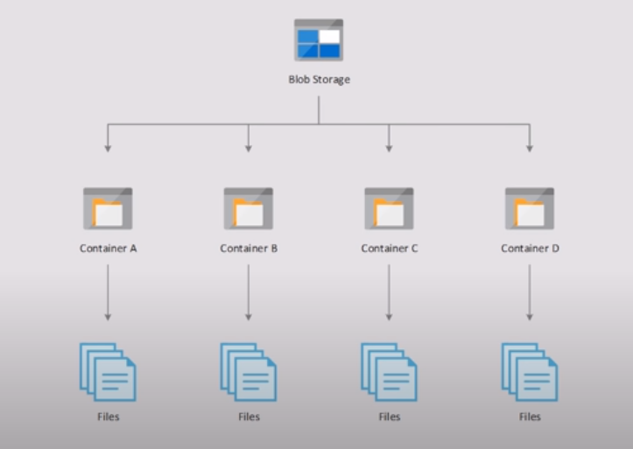
Blob Storage

Slide 25
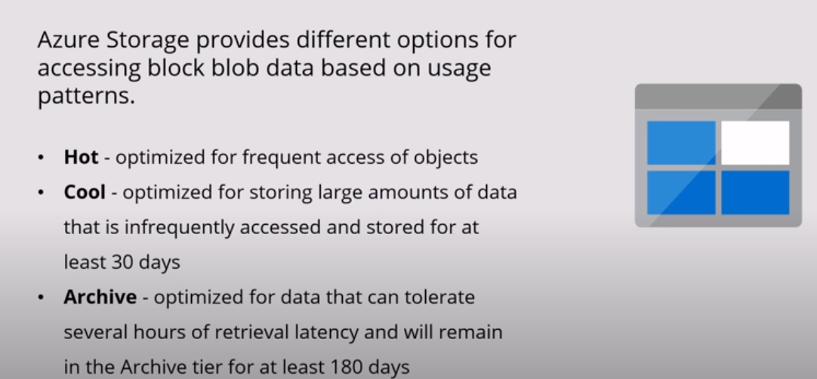
Blob Storage

Slide 26
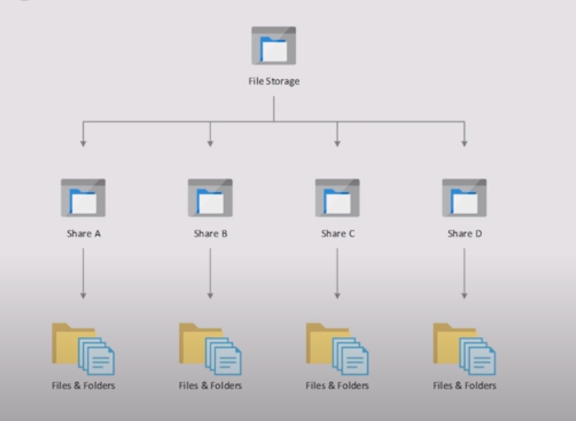
File Storage

Slide 27
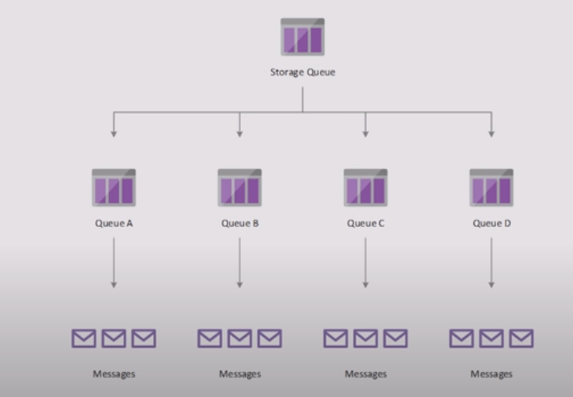
Message Queue

Slide 28
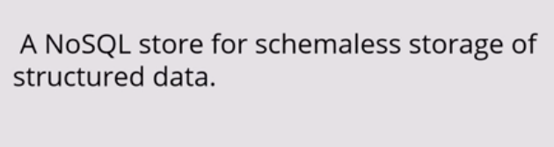
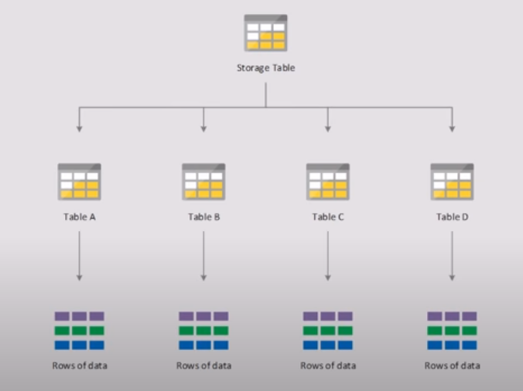
Table Storage

Slide 29
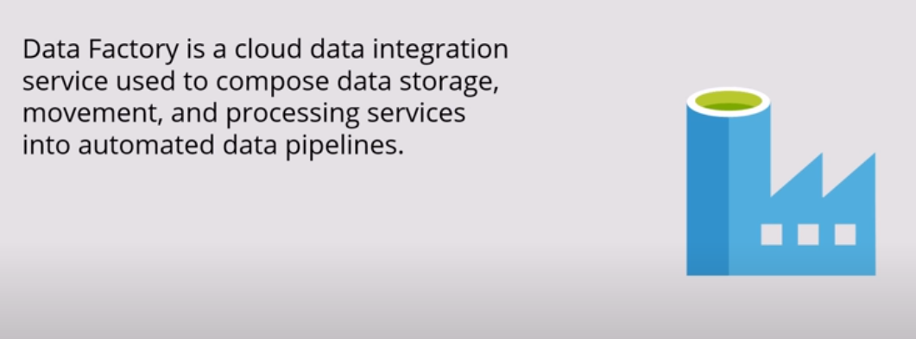
Data Factory

Slide 30
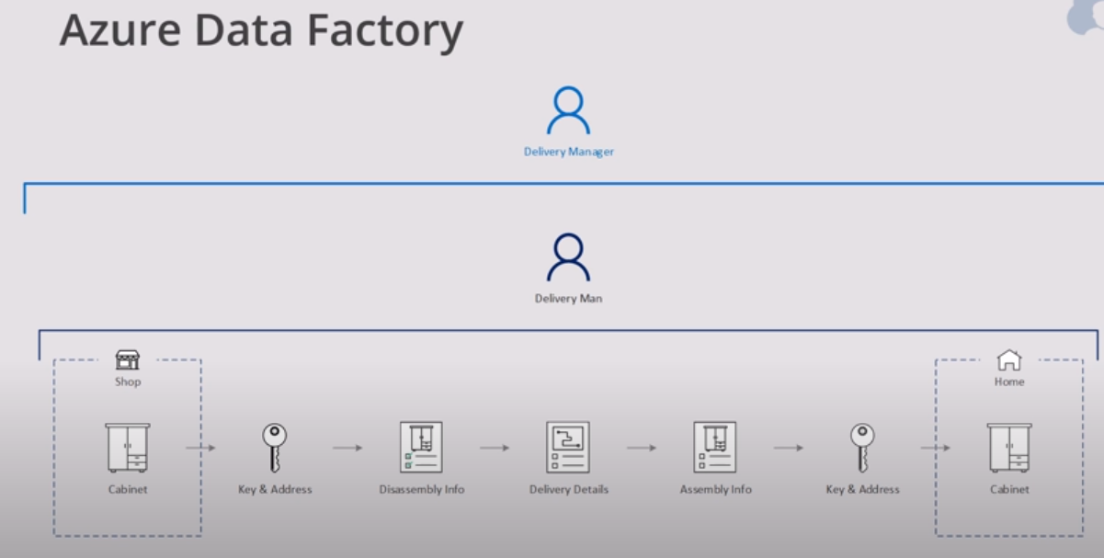
Data Factory

Slide 31
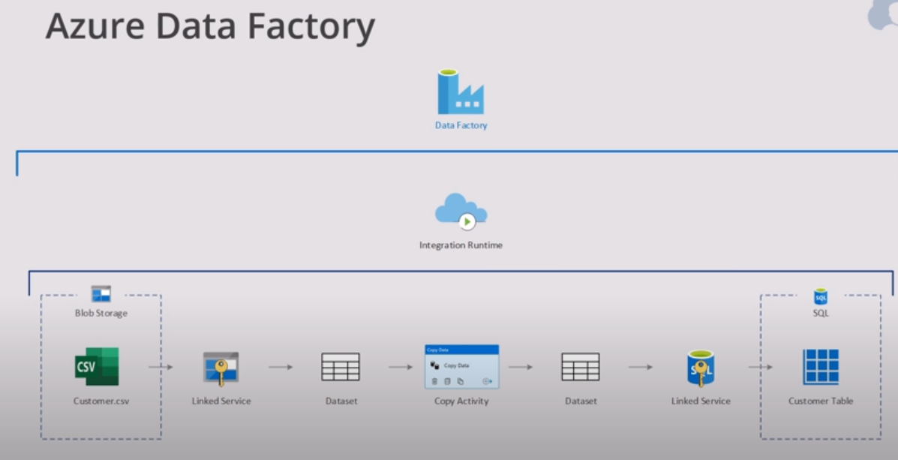
Data Factory

Slide 32
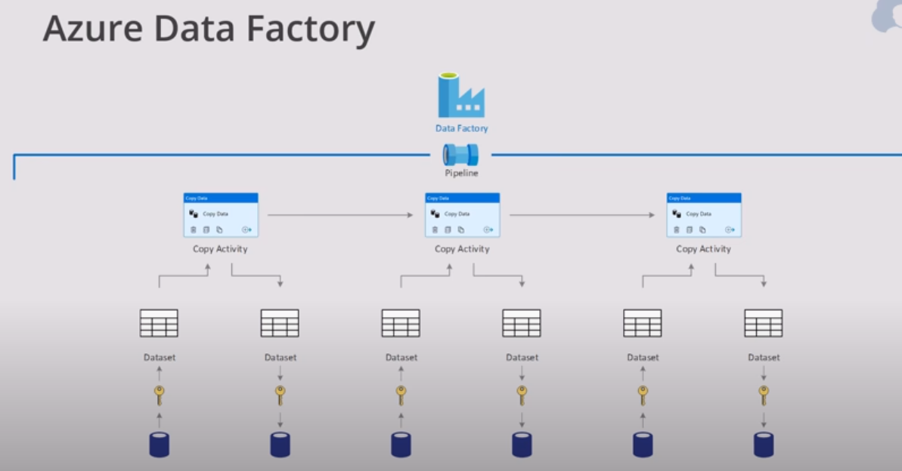
Data Factory

Slide 33
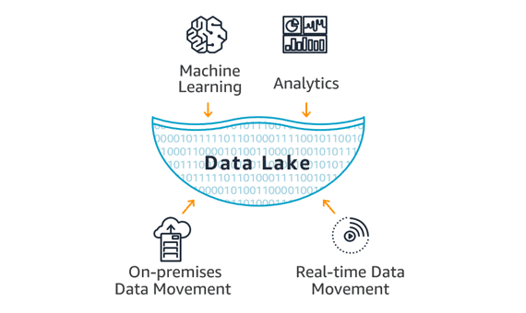
Data Lake Storage
A data lake is a central storage repository that carries big data from many sources of raw data in its native form until it is needed.
It can store structured, unstructured data, or semi-structured, which means data can be kept in a more flexible format for future use.
A data lake is capable of Store and analyzes petabyte-size files and trillions of objects.
It also Develops massively parallel programs easily.

Slide 34
Data Lake Storage
Azure Data Lake Store provides a single repository where small or large organizations upload data of just about infinite size.
It is designed for high-performance processing and analytics from Hadoop Distributed File System tools and applications, including support for low latency workloads.
It allows structured and unstructured data in their native formats.
It allows for huge throughput to boost analytic performance.
It offers high availability, durability, and reliability.
Azure storage services are better than Amazon S3 because it gives an integrated analytics service and places no limits on file volume.
Types of ADLS.
ADLS Gen1.
ADLS Gen2.

Slide 35
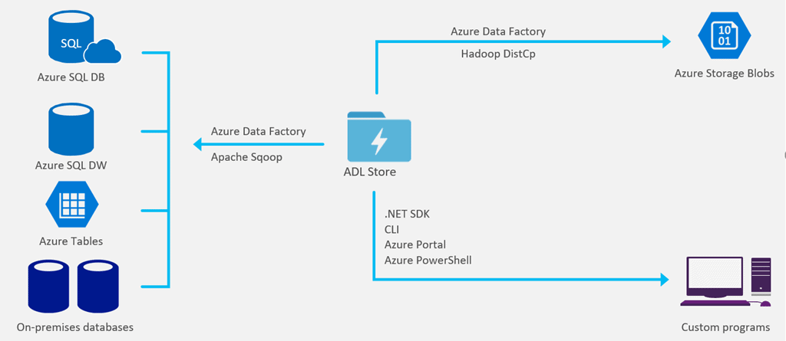
Data Lake Storage

Slide 36
Data Lake Storage
Azure Data Lake includes all the facilities required to make it easy for data scientists, developers, and analysts to store data of any shape, size, and speed.
It does all types of analytics and processing across platforms and languages.
It removes all the difficulties of ingesting and storing all of your data while
making it faster to get up and running with streaming, batch, and interactive analytics.

Slide 37
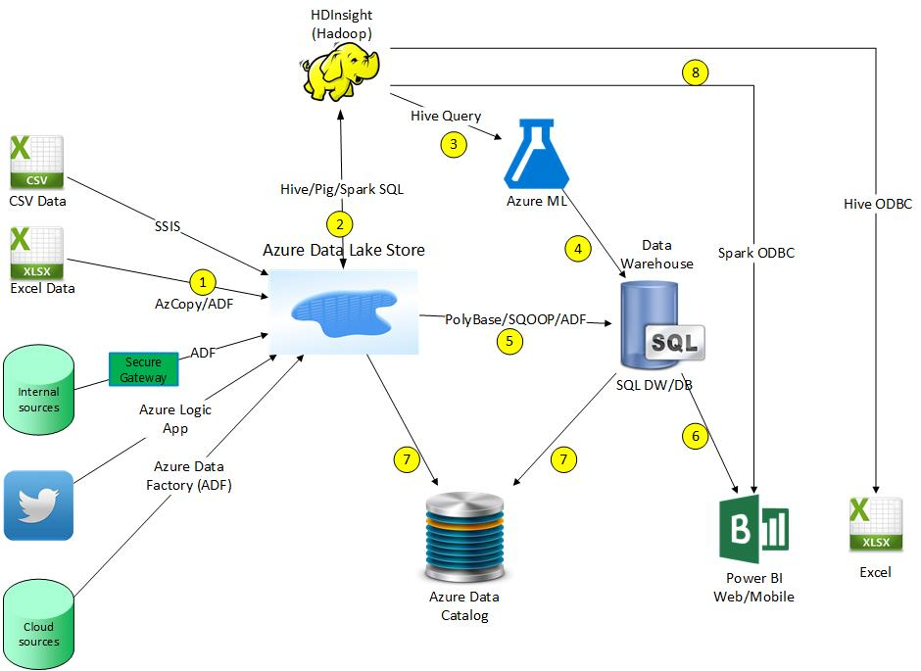
Data Lake Storage

Slide 38
Data Lake Storage

Slide 39
THANK YOU !!!
Amol Patil - 9822291613

