Slide 1


Microsoft Azure AI Fundamentals
Archer Infotech , PUNE
www.archerinfotech.in

Slide 2
Computer Vision

Slide 3

Azure Cognitive Services

Slide 4
Azure Cognitive Services
Azure Cognitive Services are cloud-based artificial intelligence (AI) services that help you build cognitive intelligence into your applications.
They are available as REST APIs, client library SDKs, and user interfaces.
You can add cognitive features to your applications without having AI or data science skills.
Cognitive Services enable you to build cognitive solutions that can see, hear, speak, understand, and even make decisions.
Cognitive Services can be categorized into four main pillars:
Vision
Speech
Language
Decision

Slide 5
What is Computer Vision ?
The Computer Vision service enables software engineers to create intelligent solutions that extract information from images; a common task in many artificial intelligence (AI) scenarios.

Slide 6
Computer Vision
Some potential uses for computer vision include:
Content Organization: Identify people or objects in photos and organize them based on that identification. Photo recognition applications like this are commonly used in photo storage and social media applications.
Text Extraction: Analyze images and PDF documents that contain text and extract the text into a structured format.
Spatial Analysis: Identify people or objects, such as cars, in a space and map their movement within that space.

Slide 7
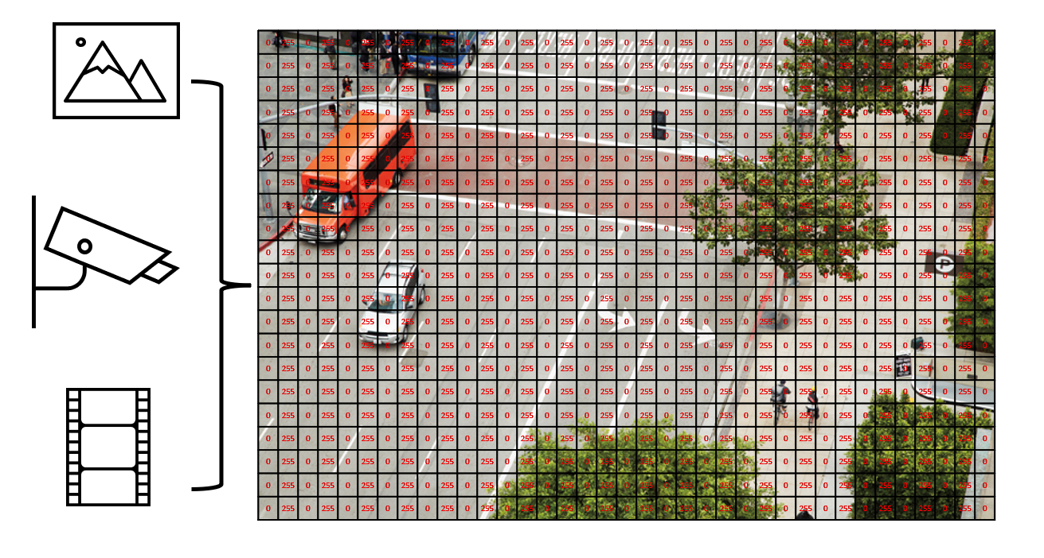
Computer Vision
To an AI application, an image is just an array of pixel values. These numeric values can be used as features to train machine learning models that make predictions about the image and its contents.
Training machine learning models from scratch can be very time intensive and require a large amount of data. Microsoft's Computer Vision service gives you access to pre-trained computer vision capabilities.

Slide 8
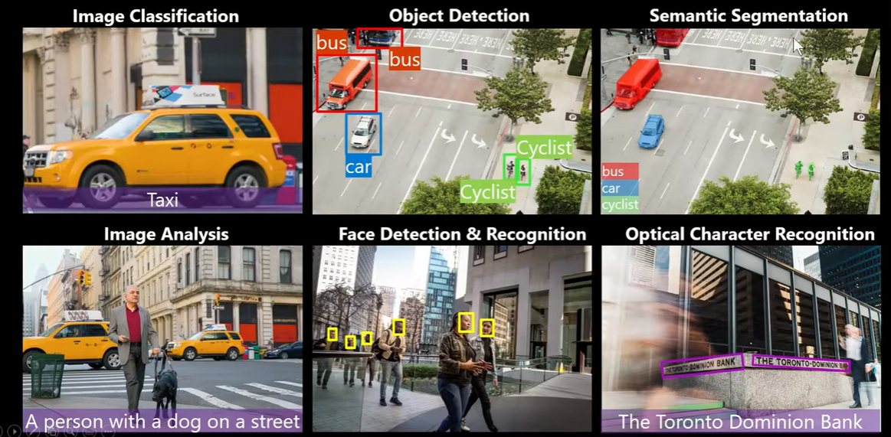
Computer Vision Applications

Slide 9
Azure Computer Vision
The Computer Vision service is a cognitive service in Microsoft Azure that provides pre-built computer vision capabilities. The service can analyze images, and return detailed information about an image and the objects it depicts.
Azure resources for Computer Vision
Computer Vision:
Cognitive Services

Slide 10
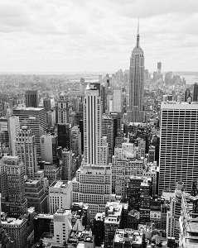
Analyzing Image
Describing an image
A black and white photo of a city
A black and white photo of a large city
A large white building in a city

Slide 11
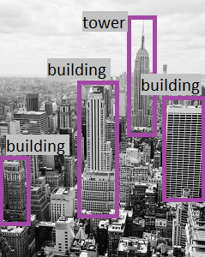
Analyzing Image
Tagging visual features
For example, the tags returned for the Empire State building image include:
skyscraper
tower
building
Detecting objects

Slide 12
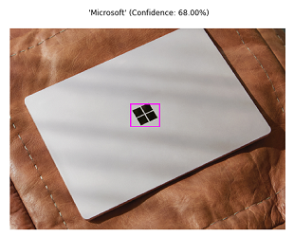

Analyzing Image
Detecting brands
Detecting faces

Slide 13
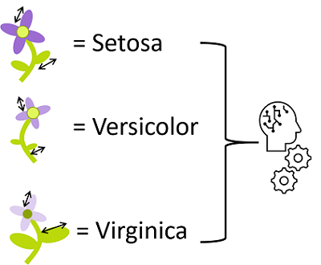
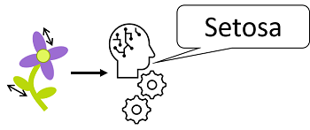
Image Classification
Image classification is a common workload in artificial intelligence (AI) applications. It harnesses the predictive power of machine learning to enable AI systems to identify real-world items based on images.

Slide 14
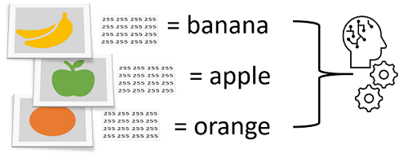
Understand Image Classification
Image classification is a machine learning technique in which the object being classified is an image, such as a photograph.
To create an image classification model, you need data that consists of features and their labels. The existing data is a set of categorized images. Digital images are made up of an array of pixel values, and these are used as features to train the model based on the known image classes.
The model is trained to match the patterns in the pixel values to a set of class labels. After the model has been trained, you can use it with new sets of features to predict unknown label values.

Slide 15
Azure Custom Vision Service
Most modern image classification solutions are based on deep learning techniques that make use of convolutional neural networks (CNNs) to uncover patterns in the pixels that correspond to particular classes.
Training an effective CNN is a complex task that requires considerable expertise in data science and machine learning.

Slide 16
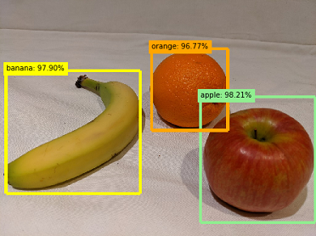
Object Detection
Object detection is a form of machine learning based computer vision in which a model is trained to recognize individual types of objects in an image, and to identify their location in the image.
The class of each object identified in the image.
The probability score of the object classification (which you can interpret as the confidence of the predicted class being correct)
The coordinates of a bounding box for each object.

Slide 17
Optical Character Recognition
Optical character recognition (OCR) enables artificial intelligence (AI) systems to read text in images, enabling applications to extract information from photographs, scanned documents, and other sources of digitized text
Uses of OCR
The ability to recognize printed and handwritten text in images, is beneficial in many scenarios such as:
note taking
digitizing forms, such as medical records or historical documents
scanning printed or handwritten checks for bank deposits

Slide 18
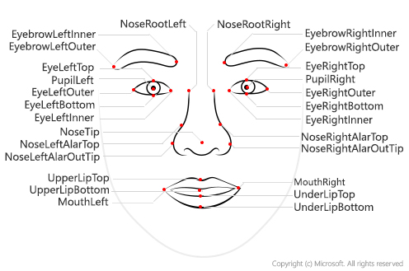
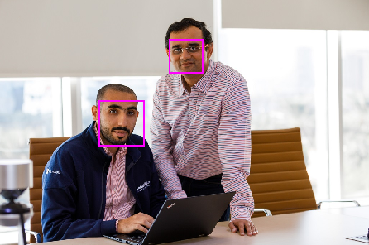
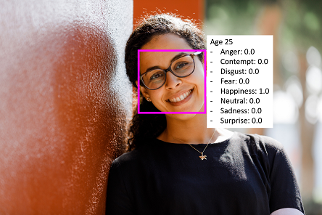
Facial Detection , Analysis , Recognition

Slide 19
THANK YOU !!!

