Slide 1
JDBC
AMOL R PATIL PUNE

Slide 2
JDBC
JDBC refers to the Java Database Connectivity.
It provides java API that allows Java programs to access database management systems (relational database).
The JDBC API consists of a set of interfaces and classes which enables java programs to execute SQL statements.

Slide 3
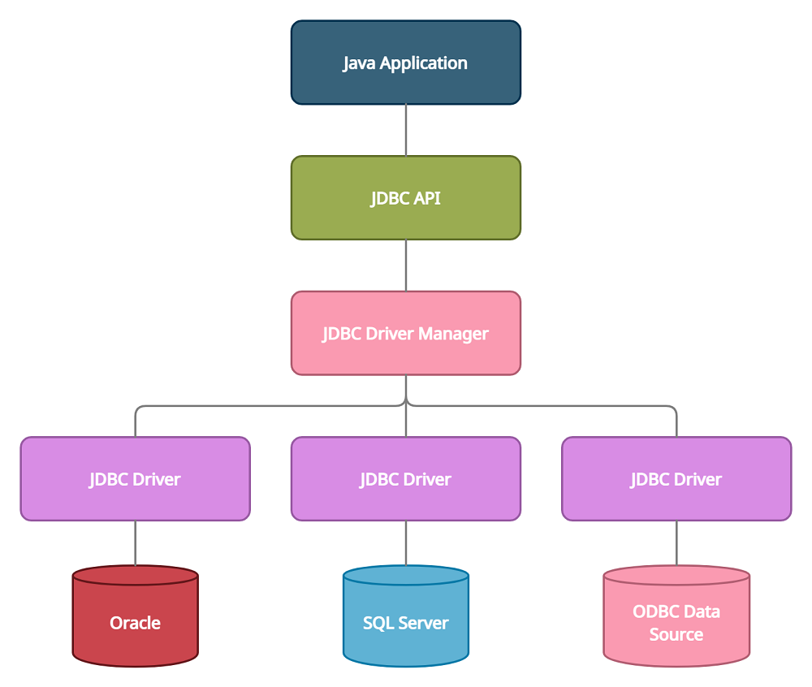

Slide 4
The JDBC API consists of the following core parts:
JDBC Drivers
Connections
Statements
Result Sets

Slide 5
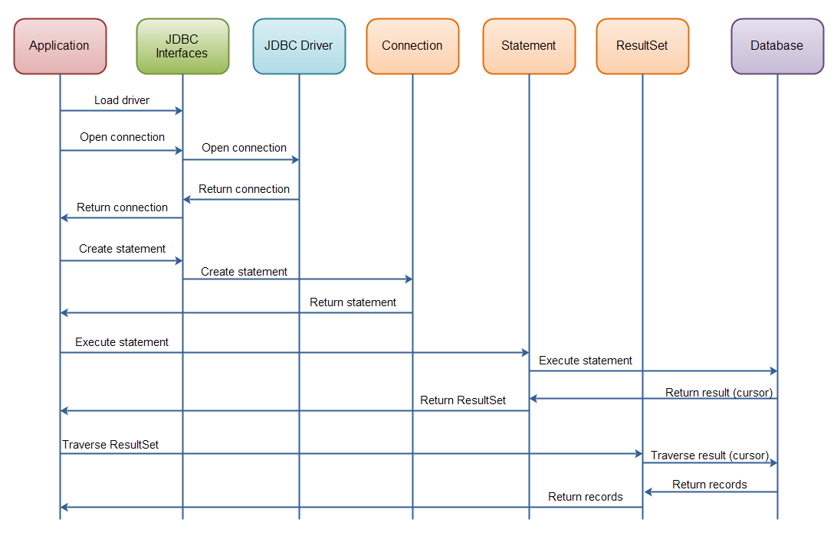

Slide 6
JDBC Driver
JDBC driver is a collection of classes which implements interfaces defined in the JDBC API for opening database connections, interacting with database and closing database connections.

Slide 7
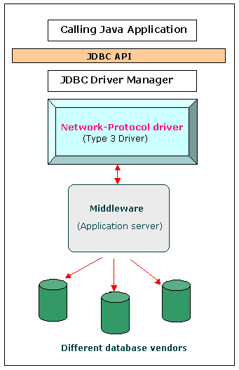
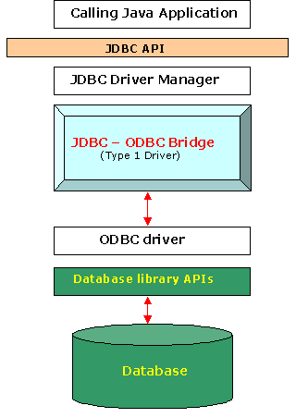
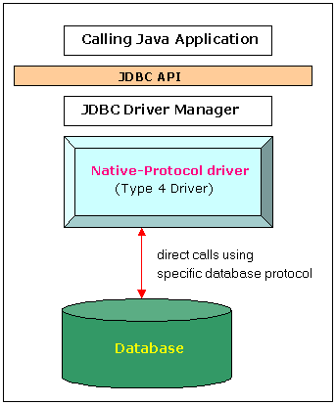
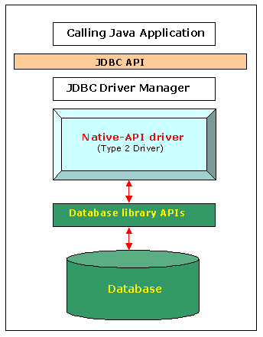
Types Of JDBC Driver

Slide 8
JDBC Steps
Import JDBC packages
Load and register the JDBC driver // This step is not required in Java 6 and in JDBC 4.0
Open a connection to the database.
Create a statement object to perform a query.
Execute the statement object and return a query resultset.
Process the resultset.
Close the resultset and statement objects. // This step is not required because we use a try-with-resource statement to auto-close the resources
Close the connection. // This step is not required because we use a try-with-resource statement to auto-close the resources

