Slide 1
CORE JAVA
AMOL R PATIL - 9822291613NE

Slide 2
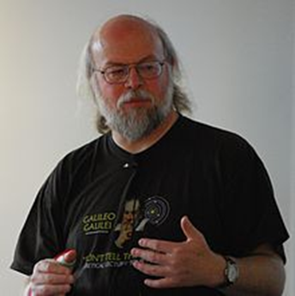

What is Java ?
Java is a high level, robust, object-oriented and secure programming language.
Java technology is both a programming language and a platform.
JAVA was developed by Sun Microsystems Inc in 1991, later acquired by Oracle Corporation.
It was developed by James Gosling and Patrick Naughton

Slide 3
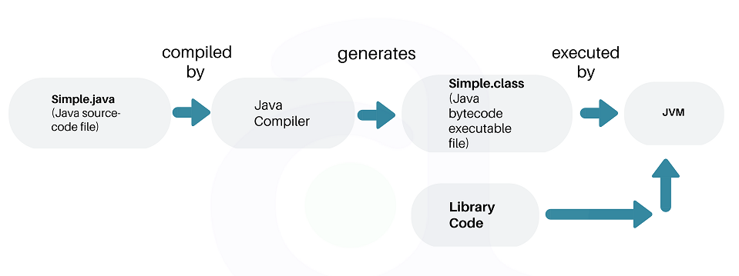
Execution of Java Program

Slide 5
Java Buzzwords
Simple Object oriented
Distributed Multithreaded
Dynamic Architecture neutral
Portable High performance
Robust Secure

Slide 6
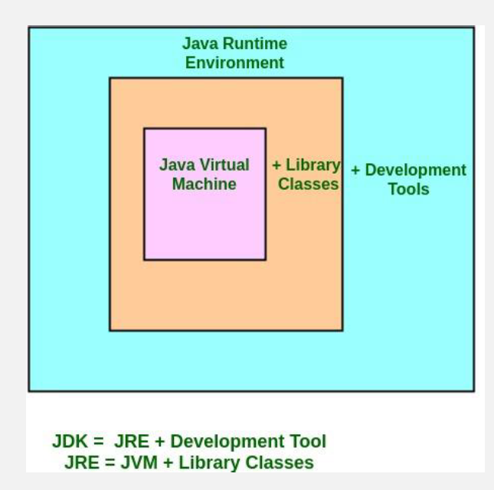
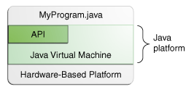
JDK , JRE , JVM

Slide 7
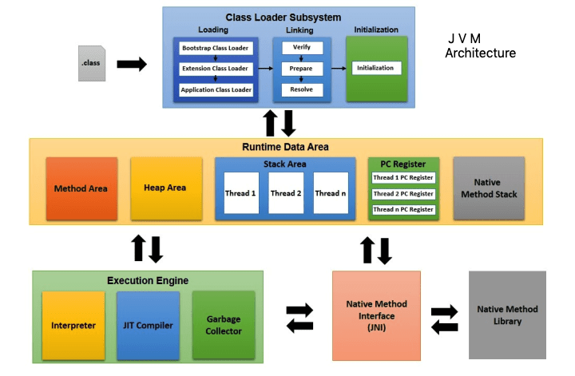

Slide 8
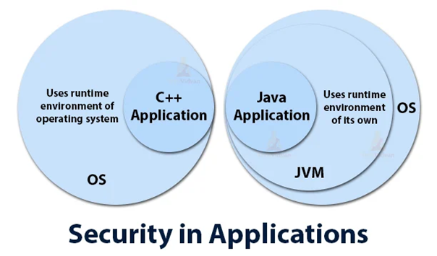
Classloader: Classloader in Java is a part of the Java Runtime Environment (JRE) which is used to load Java classes into the Java Virtual Machine dynamically. It adds security by separating the package for the classes of the local file system from those that are imported from network sources.
Bytecode Verifier: It checks the code fragments for illegal code that can violate access rights to objects.
Security Manager: It determines what resources a class can access such as reading and writing to the local disk.
No explicit pointer
Java Programs run inside a virtual machine sandbox

Slide 9






Java IDE Software's
Top 10 Java IDEs
Eclipse
NetBeans
IntelliJ IDEA
BlueJ
JDeveloper
MyEclipse
Greenfoot
jGRASP
jCreator
DrJava

Slide 10
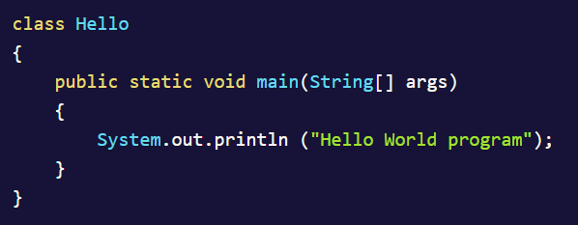
Java First Program

Slide 11
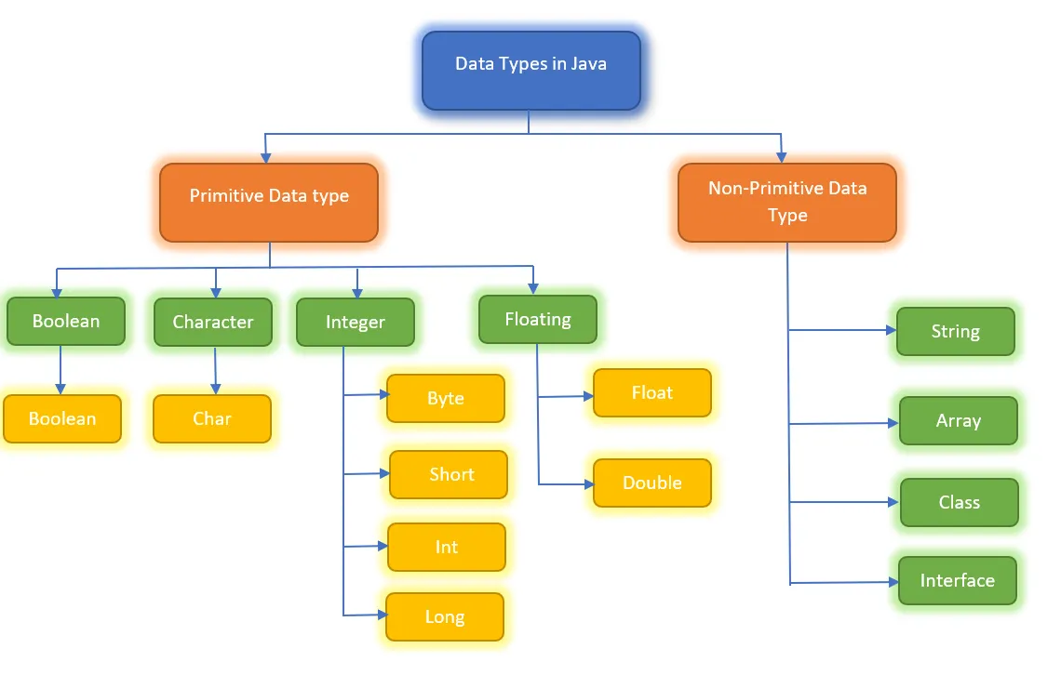

Slide 12
Java Primitive Data Types
Data Type | Size | Description | Default value
byte | 1 byte | Stores whole numbers from -128 to 127 | 0 (zero)
short | 2 bytes | Stores whole number from -32768 to 32767 | 0 (zero)
int | 4 bytes | Stores whole numbers from -2,147,483,648 to 2,147,483,647 | 0 (zero)
long | 8 bytes | Stores whole numbers from -9,223,372,036,854,775,808 to 9,223,372,036,854,775,807 | 0L
float | 4 bytes | Stores fractional numbers up to 6-7 decimal digits | 0.0f
double | 8 bytes | Stores fractional numbers with up to 15 decimal digits | 0.0d
char | 2 bytes | Stores single character/letter | '\u0000'
boolean | 1 bit | Stores true or false | false

Slide 13
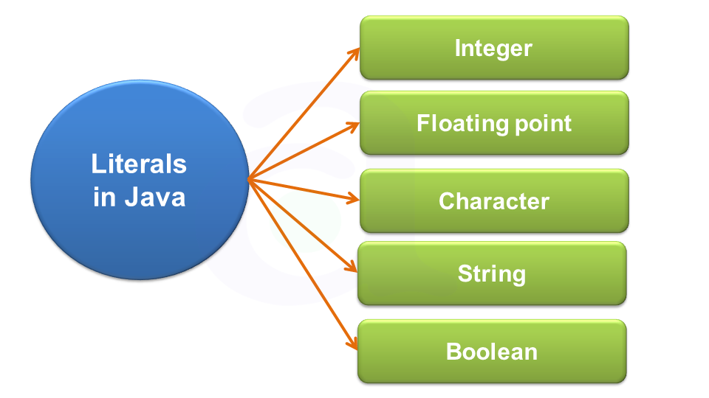
Java Literals
int a = 101;
int b = 0146;
int c = 0x123Face;
int d = 0b1111;
double decimalValue = 101.230
double decimalValue1 = 0123.222;
double hexaDecimalValue = 1.234e2;
boolean boolVar1 = true;
boolean boolVar2 = false;
char ch = 'a';
char c = '\u0061';
String s = "Hello";

Slide 14
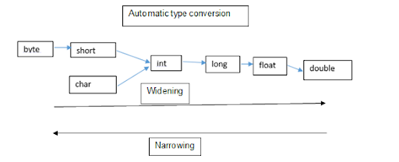
Java Typecasting

Slide 15
Java Operators
Operators | Precedence
postfix | expr++ expr--
unary | ++expr --expr +expr -expr ~ !
multiplicative | * / %
additive | + -
shift | << >> >>>
relational | < > <= >= instanceof
equality | == !=
bitwise AND | &
bitwise exclusive OR | ^
bitwise inclusive OR | |
logical AND | &&
logical OR | ||
ternary | ? :
assignment | = += -= *= /= %= &= ^= |= <<= >>= >>>=

Slide 16
Simple Program Assignment
Temperature of a city in Fahrenheit degrees is input through the keyboard. Write a program to convert this temperature
into Centigrade degrees
If a four-digit number is input through the keyboard, write a program to obtain the sum of the first and last digit of this number
Two numbers are input through the keyboard into two locations C and D. Write a program to interchange the contents of C and D.

Slide 17
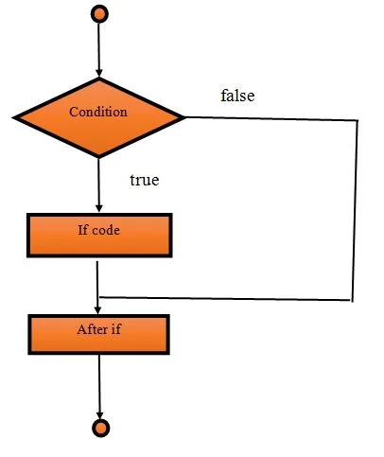
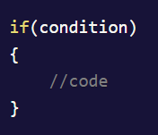
Java Control Statements – if statement

Slide 18
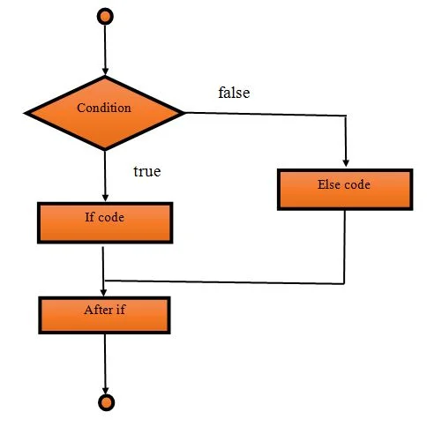
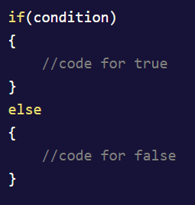
Java Control Statements – if –else statement

Slide 19
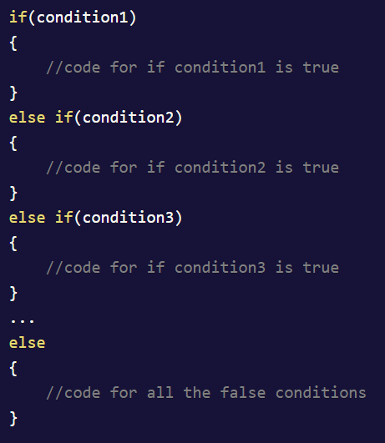
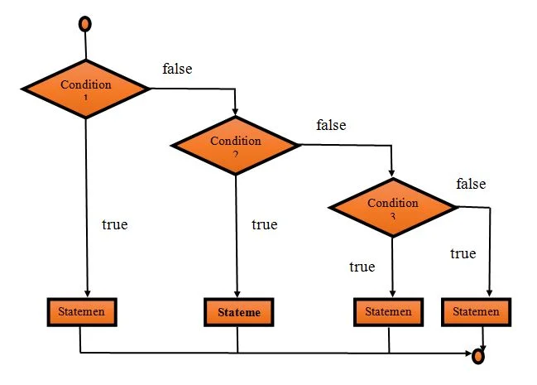
Java Control Statements – if –else statement

Slide 20
If-Else Statements - Assignment
Write a program to accept a coordinate point in a XY coordinate system and determine in which quadrant the coordinate point lies.
Write a program to check whether a triangle is Equilateral, Isosceles or Scalene
Write a program to input electricity unit charges and calculate total electricity bill according to the given condition:
For first 50 units Rs. 0.50/unit
For next 100 units Rs. 0.75/unit
For next 100 units Rs. 1.20/unit
For unit above 250 Rs. 1.50/unit
An additional surcharge of 20% is added to the bill

Slide 21
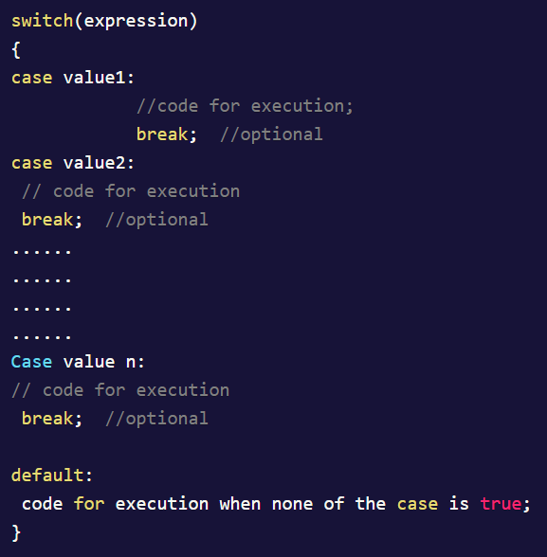
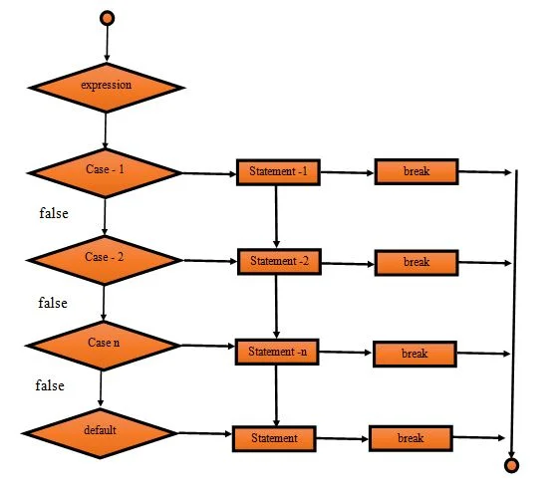
switch-case Statement

Slide 22
Switch-Case Statement - Assignment
Write a program to create simple calculator using switch Statement

Slide 23
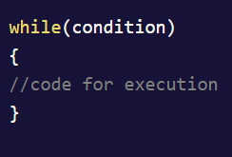
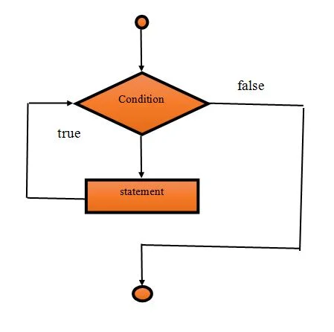
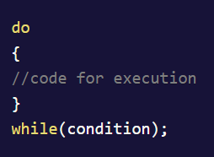
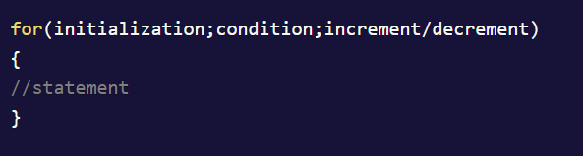
Loop in Java

Slide 24
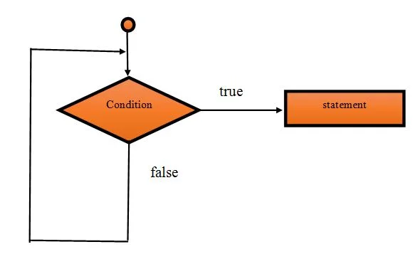
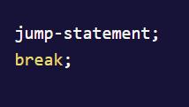
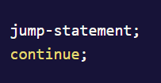
continue, break statements

Slide 25
Loop Assignments
Write a program to check whether a given number is an Armstrong number or not
Write a program to display the first n terms of Fibonacci series.
Write a program to display the sum of the series [ 9 + 99 + 999 + 9999 ...]
Write a program to find the prime numbers within a range of numbers
Write a program to print Pyramid of *

Slide 26
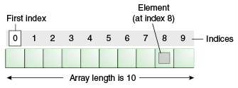
Java Arrays
Java array is an object which contains elements of a similar data type.
It is a data structure where we store similar elements. We can store only a fixed set of elements in a Java array. Array in Java is index-based, the first element of the array is stored at the 0th index, 2nd element is stored on 1st index and so on.
Unlike C/C++, we can get the length of the array using the length member. In C/C++, we need to use the sizeof operator.

Slide 27
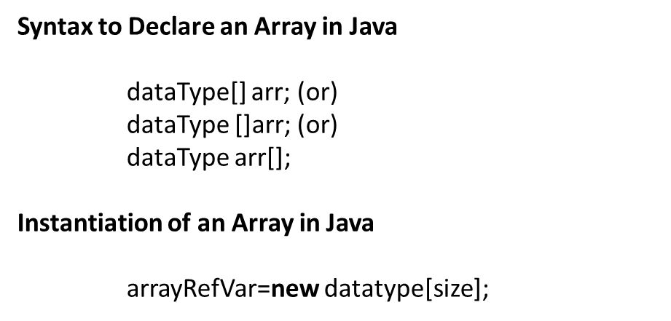
1 D Array
Declaration, Instantiation and Initialization of Java Array
We can declare, instantiate and initialize the java array together by:
int a[]={33,3,4,5};//declaration, instantiation and initialization

Slide 28
Java Single Dim Array - Exs
Write a program to find second largest element in an array.
Write a program to print all unique elements in the array.
WAP to find the intersection of two arrays.
X { 23,-5,89,12,9 }
Y { 9,-34,12,100,-5 }
Intersection: { -5, 12, 9 }

Slide 29
Java Multi Dim Array
dataType[][] arrayRefVar; (or)
dataType [][]arrayRefVar; (or)
dataType arrayRefVar[][]; (or)
dataType []arrayRefVar[];
Example to instantiate Multidimensional Array in Java
int[][] arr=new int[3][3];//3 row and 3 column

Slide 30
Java Multi Dim Array - Exs
Write a program to find sum of diagonal elements of a matrix.
Matrix multiplication

