Slide 1
ANGULAR
AMOL R PATIL PUNE

Slide 2
What is NPM ?
Node package manager
npm is a library and registry for JavaScript packages
npm is a software package manager that is included by default in Node.js.
You can check this out by running npm -v in the command line. An Angular application consists of various libraries, called packages, that exist in a central place called the npm registry. The npm client downloads and installs
the libraries that are needed to run your application from the npm registry to your local computer.
npm -> maven pom.xml -> package.json
https://stackoverflow.com/questions/38388824/is-maven-similar-to-npm

Slide 3
What is Angular CLI ?
The Angular CLI is a command-line interface tool that you use to initialize, develop, scaffold, and maintain Angular applications directly from a command shell

Slide 4
What is Angular ?
Angular is a development platform that is written in the TypeScript language. It consists of smaller sub-systems, including a JavaScript framework, a command-line interface, a language service, and a rich collection of first-party libraries.
Angular enables developers to build scalable web applications with TypeScript, a strict syntactic superset of JavaScript.
Angular was created by a team internally at Google. The first version, 1.0, was released in 2012 and was called AngularJS. AngularJS was a JavaScript framework, and web applications built with it were written in JavaScript.

Slide 5
Why Choose Angular ?
The main pillars of the platform: cross-platform, incredible tooling, and easy onboarding

Slide 6
Cross Platform
Angular applications can run on different platforms: web, server, desktop, and mobile.
Angular can run natively only on the web because it is a JavaScript framework. However, it is open-source and is backed by a vast and incredible community that enables the framework to run on the remaining three using the following integrations:
Angular Universal: Renders Angular applications server-side
Angular Service Worker: Enables Angular applications to run as Progressive Web Applications (PWA) that are customizable and can be installed on a desktop environment
Ionic Framework: Allows us to build mobile applications using Angular

Slide 7
Tooling
The Angular team has built two great tools that make Angular development easy and fun:
• Angular CLI: A command-line interface that allows us to work with Angular projects from creation to deployment.
• Angular DevTools: A browser extension that enables us to debug and profile Angular applications from the comfort of our browser.
The Angular CLI is the de facto solution for working with Angular applications. It allows the developer to focus on writing application code, eliminating the boilerplate of configuration tasks such as scaffolding, building, testing, and deploying an Angular application.

Slide 8
Onboarding
It is simple and easy for a web developer to start with Angular development because when we install Angular, we also get a rich collection of first-party libraries out of the box, including:
Angular HTTP client to communicate with a REST API endpoint over HTTP
Angular forms to create HTML forms for collecting input and data from users
Angular router to perform in-app navigations

Slide 9
Who uses Angular ?
Many companies use Angular for their websites and web applications. The website https://www.madewithangular.com contains an extensive list of those companies, including some popular ones.

Slide 10
Node.js
Node.js is a JavaScript runtime built on top of Chrome’s v8 JavaScript engine. Angular requires an active or maintenance Long Time Support (LTS) version.
If you have already installed it, you can run node -v in the command line to check which version you are running.
The Angular CLI uses Node.js to accomplish specific tasks, such as serving, building, and bundling your application.

Slide 11
Installing npm
npm install -g @angular/cli
install or i: Denotes the installation of a package
-g: Indicates that the package will be installed on the system globally
@angular/cli: The name of the package to install

Slide 12
CLI Commands
ng command [options] -The prefix ng stands for "Angular;"
ng new my-app – will create new Application
ng serve - The Angular CLI compiles the Angular project and starts a web server that watches for changes in project files. This way, whenever you change your application code, the web server rebuilds the project to reflect the new changes.

Slide 13
For TypeScript
npm install –g typescript
tsc –version
tsc tsfile --- will create new file with js extension [ JS file ]
node jsfile -- will give u output.

Slide 14
Components
The Angular Component is the main building block of an Angular application.
The Component contains the data and user interaction logic that define how the View looks and behaves. A view in Angular refers to a template (HTML).
The Angular Components are plain JavaScript classes defined using the @Component Decorator. This Decorator provides the Component with a View to display and Metadata about the Component.
The Component is responsible for providing the data to the View. Angular uses data binding to get the data from the Component to the View and vice versa. The data binding is achieved using special HTML markup, the Angular Template Syntax. The Component can also get notified when the View changes.

Slide 15
Components
The Angular Component is the main building block of an Angular application.
The Component contains the data and user interaction logic that define how the View looks and behaves. A view in Angular refers to a template (HTML).
The Angular Components are plain JavaScript classes defined using the @Component Decorator. This Decorator provides the Component with a View to display and Metadata about the Component.
The Component is responsible for providing the data to the View. Angular uses data binding to get the data from the Component to the View and vice versa. The data binding is achieved using special HTML markup, the Angular Template Syntax. The Component can also get notified when the View changes.

Slide 16
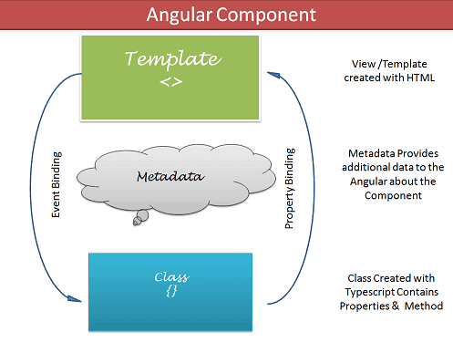
Components
The Components consist of three main building blocks
Template
Class
MetaData

Slide 17
Component Templates
The Template defines the layout and content of the View. Without the template, there is nothing for Angular to render to the DOM.
The Templates are only HTML codes and the Angular-specific special HTML markups (known as the Angular Template Syntax).
There are two ways you can specify the Template in Angular.
Defining the Template Inline
Provide an external Template

Slide 18
Component Class
The Class provides the data & logic to the View. It contains the Typescript code associated with Template (View). We use TypeScript to create the class.
Class Contains the Properties & Methods. The Properties of a class can be bound to the view using Data Binding.

Slide 19
Component Metadata
Metadata Provides additional information about the component of Angular. Angular uses this information to process the class. We use the @Component decorator to provide the Metadata to the Component.
selector - css selector that identifies this component in a template
styleUrls - list of urls to stylesheets to be applied to this component's view
styles - inline-defined styles to be applied to this component's view
template - inline-defined template for the view
templateUrl - url to an external file containing a template for the view

Slide 20
Initial Template
ng new <projectname>
npm install –save bootstrap@3
change angular.json file to add bootstrap style
"styles": [
"node_modules/bootstrap/dist/css/bootstrap.min.css",
"src/styles.css"
],

Slide 21
Creating Component
Create the Component file.
Import the required external Classes/Functions.
Create the Component class and export it.
Add @Component decorator
Add metadata to @Component decorator
Create the Template
Create the CSS Styles
Register the Component in Angular Module

Slide 22
Creating Component
Create folder by name of component [e.g. student] add files student.component.html , student.component.ts
student.component.ts file
import { Component } from "@angular/core";
@Component({
selector:'app-student’, TAG
templateUrl:’./student.component.html’
})
export class StudentComponent
{
}
student.component.html file -- add some html

Slide 23
Creating Component
in app module ts file add new component
declarations: [
AppComponent,
StudentComponent
]
In app component html add new tag
<app-student> </app-student>

Slide 24
Creating Component Using ng Command
ng generate component <name> / ng g c <name>

Slide 25
Data Binding
The data binding kees both component & view in sync with each other.
We use techniques like Interpolation, Property Binding, Event Binding & Two Way Binding to bind data
Data binding is a technique, where the data stays in sync between the component and the view. Whenever the user updates the data in the view, Angular updates the component. When the component gets new data, the Angular updates the view

Slide 26
Data Binding
The data binding in Angular can be broadly classified into two groups. One way binding or two-way binding
One way binding
In one way binding data flows from one direction. Either from view to component or from component to view.
From Component to View
To bind data from component to view, we make use of Interpolation & Property Binding.

Slide 27
Interpolation
Interpolation allows us to include expressions as part of any string literal, which we use in our HTML. The angular evaluates the expressions into a string and replaces it in the original string and updates the view. You can use interpolation wherever you use a string literal in the view
The Angular uses the {{ }} (double curly braces) in the template to denote the interpolation. The syntax is as shown below
{{ templateExpression }}
The content inside the double braces is called Template Expression

Slide 28
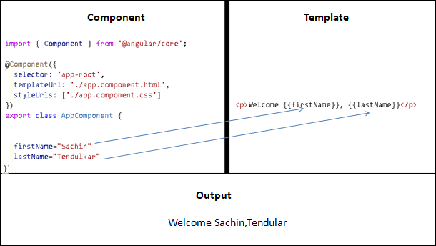
Interpolation

