Slide 1


ANGULAR
Archer Infotech , PUNE
AMOL – 98222 91613
www.archerinfotech.in

Slide 2

Angular Framework

Slide 3

What is Angular ?

Slide 4
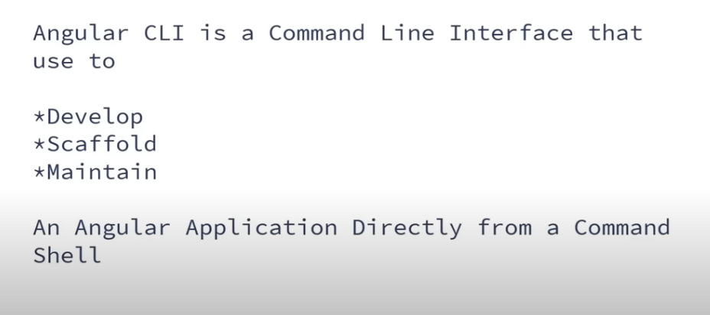
What is Angular CLI ?

Slide 5
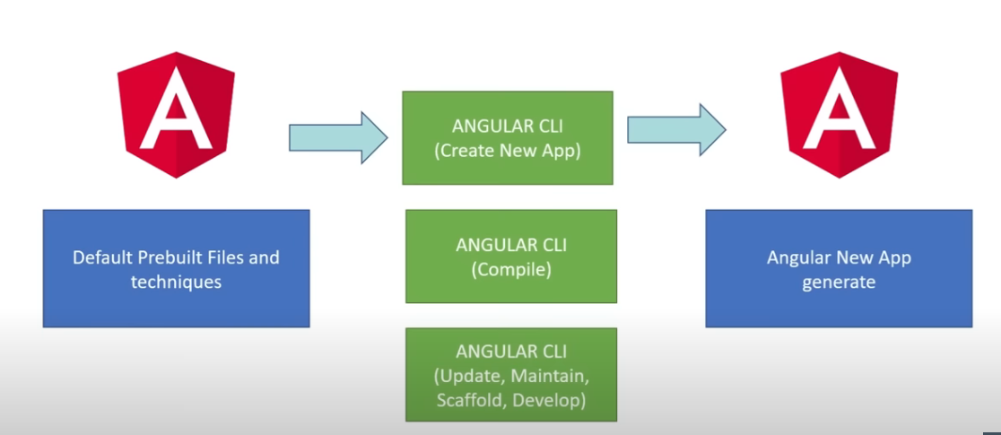
What is Angular CLI ?

Slide 6
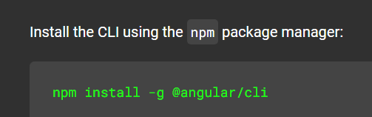
Setup Angular CLI

Slide 7
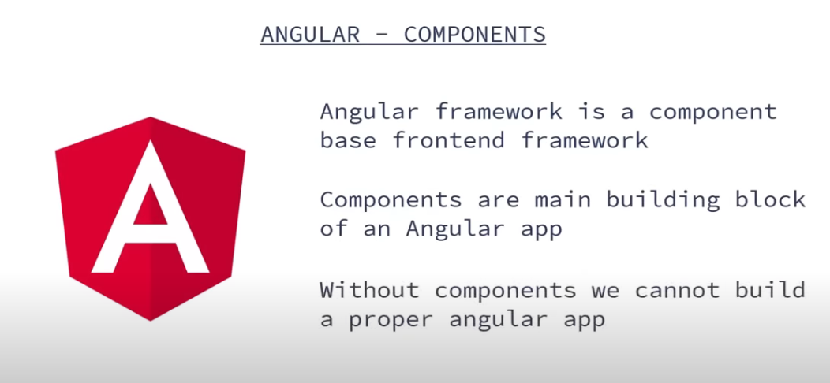
Angular Components

Slide 8
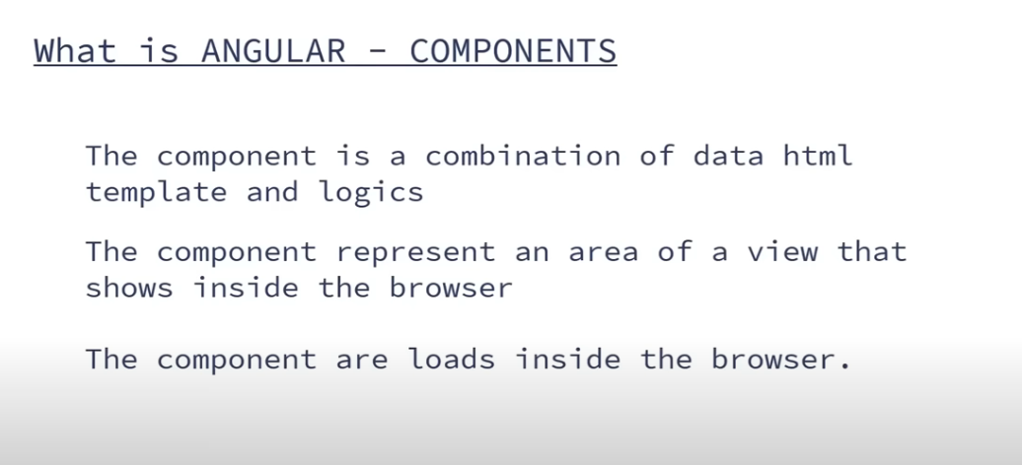
What is Angular Component ?

Slide 9
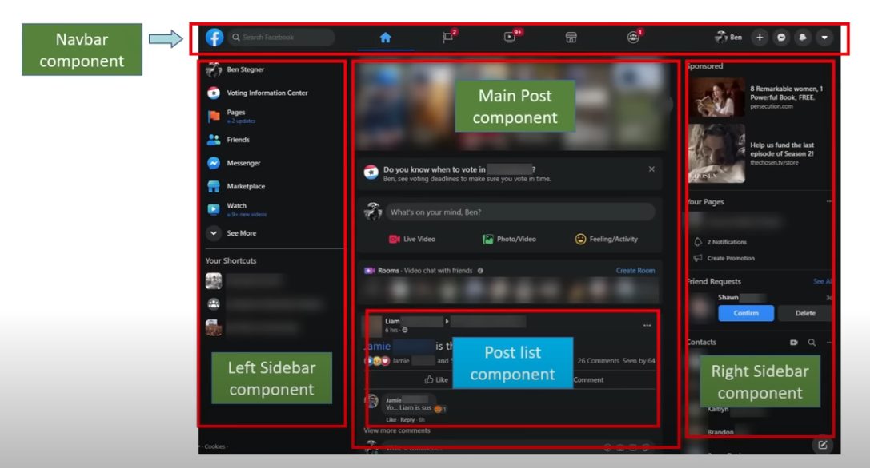
Angular Components

Slide 10
Loose Coupling
1. In Loose-Coupling, when one object is depending on another class object, some external entity will provide that dependency object to the main object that external object we call as a Container.
2. In order to get loose-coupling between objects the following two rules are required
1. The classes should follow POJI/POJO model.
2. Apply dependency injection mechanism.

Slide 11
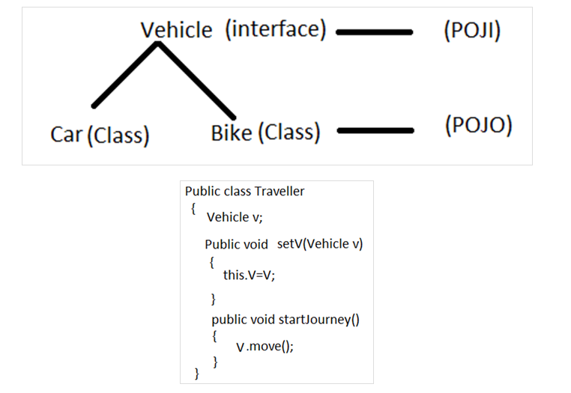
Loose Coupling

Slide 12
Spring IOC Container
The Spring container is responsible for instantiating, configuring, and assembling the Spring beans.
The container gets its instructions on what objects to instantiate, configure, and assemble by reading configuration metadata.
The configuration metadata is represented in XML, Java annotations, or Java code.
The responsibilities of IOC container are:
Instantiating the bean
Wiring the beans together
Configuring the beans
Managing the bean’s entire life-cycle

Slide 13
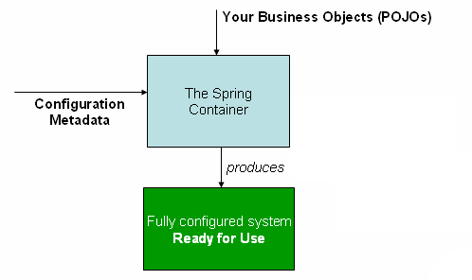
Spring IOC Container

Slide 14
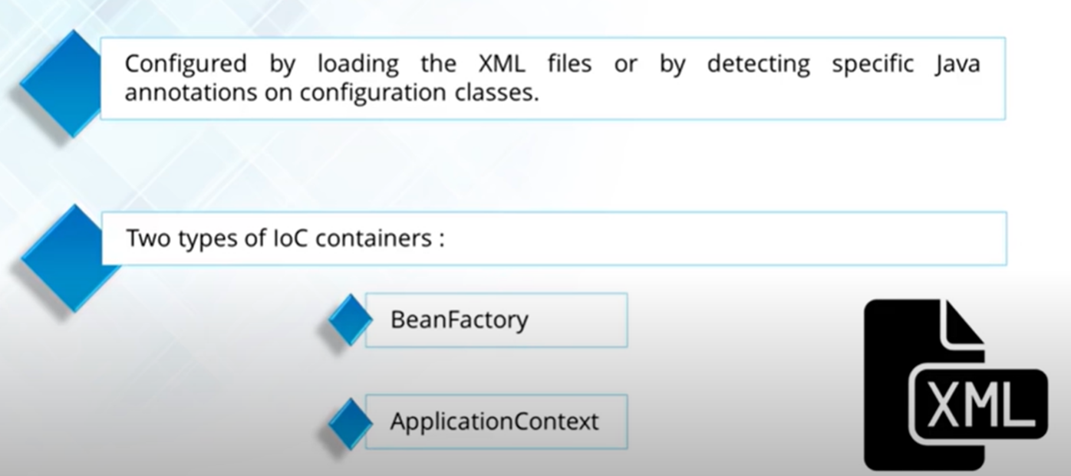
Types of Containers

Slide 15
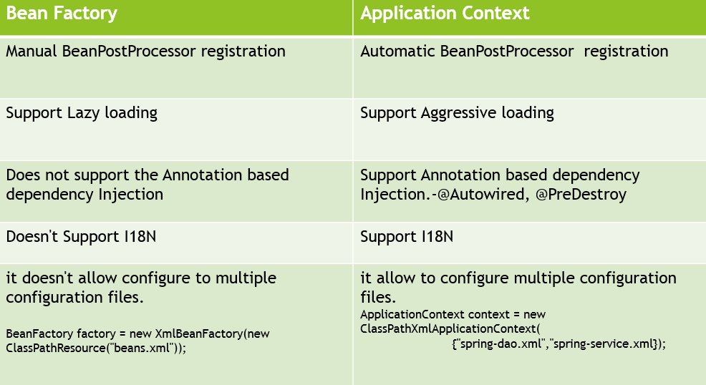
Spring Framework IOC Container

Slide 16
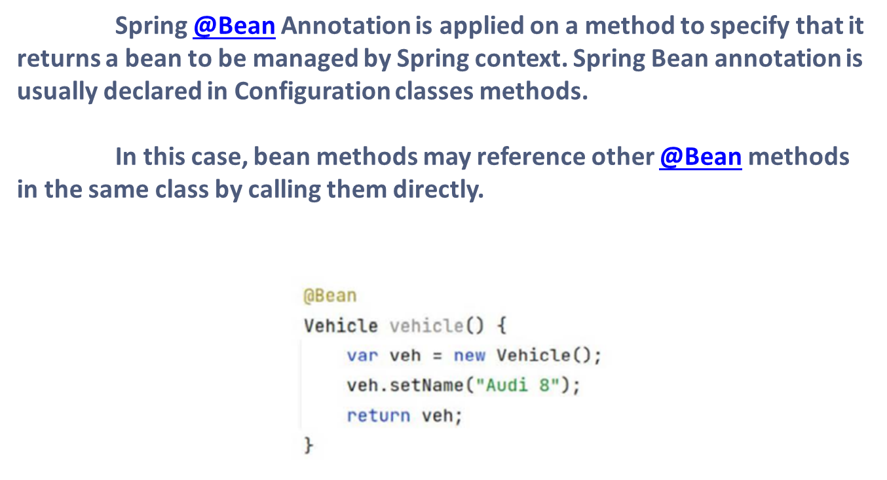
Bean Annotations For DI

Slide 17
Bean Annotations For DI
The @Component annotation indicates that an annotated class is a "component". Such classes are considered as candidates for auto-detection when using annotation-based configuration and classpath scanning.
In short, @Component is a class level annotation. During the component scan, Spring Framework automatically detects classes annotated with @Component
@ComponentScan configures which packages to scan for classes with annotation configuration. We can specify the base package names directly with one of the basePackages or value arguments (value is an alias for basePackages):

Slide 18
Primary and Qualifier Annotations
@Primary annotation is used to set the preference for same types of beans. Bean with @Primary annotation will be autowired when same types of beans are found. @Primary annotation can be used with @Bean, @Service, @Component and @Repository annotations.
@Qualifier annotation is applied on constructor arguments or method parameters and also used with @Autowired annotation to indicate which bean we want to use. This annotation is used as a qualifier for candidate beans when autowiring.

Slide 19
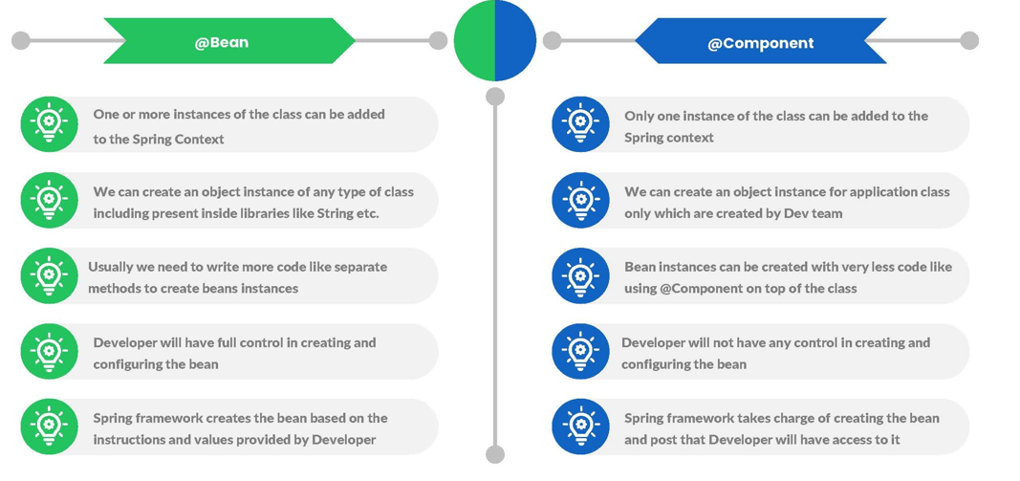
@Bean Vs. @Component

Slide 20
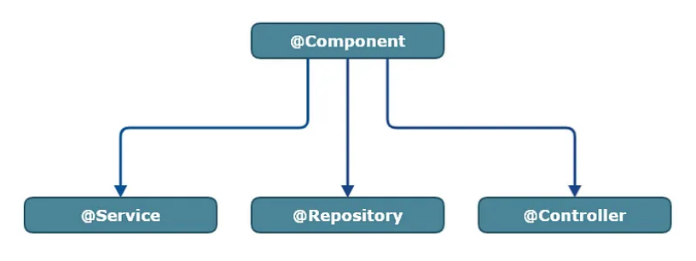
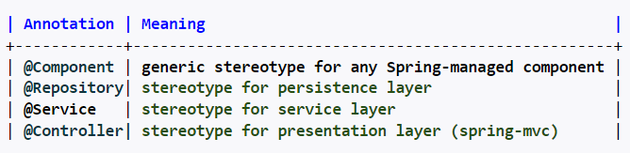
Stereotype Annotations
Stereotype annotations are a set of specialized annotations that are used to indicate the role or purpose of a particular component within the application.

Slide 21
@PostConstruct and @PreDestroy

Slide 22
Spring Bean Scope
Bean Scope refers to the lifecycle of a bean, visibility of a bean, how long does the bean live, how many instances are created, how is the bean shared?
Bean's default scope is a singleton. The spring container will create a single instance of the bean. It is cached in memory. All requests for the bean will return a shared reference of the same bean.
Spring provides @Scope annotation to mark a bean scope.
@Component
@Scope("prototype")

Slide 23
Spring Bean Scope
Scope | Description
singleton | It is the default scope of a bean. It represents a single bean scope for each Spring IoC container.
prototype | It is used to set the scope of a single bean definition to any number of object instances.
request | This bean scope is set for a single HTTP request.
session | This scope is set for a single bean definition to an HTTP session.
application | It sets bean scope to a ServletContext.
WebSocket | It sets bean scope to a WebSocket.

Slide 24
Autowiring
Autowiring is a technique used in Spring to enable automatic dependency injection.
By using it Spring container can autowire relationships between collaborating beans. It is known as Spring Autowiring.
Spring provides @Autowired annotation that enables you to inject the object dependency implicitly
The @Autowired annotation marks on a field, constructor, Setter method
is used to auto-wire the beans that is ‘injecting beans'(Objects) at runtime by Spring Dependency Injection mechanism

Slide 25
THANK YOU !!!
AMOL - 9822291613

