Slide 1


Full Stack : CSS
Archer Infotech , PUNE
www.archerinfotech.in

Slide 2
What is CSS ?
CSS stands for Cascading Style Sheet.
CSS is used to design HTML tags.
CSS was introduced in 1996 by the World Wide Web Consortium (W3C), which also maintains its standard. CSS was designed to enable the separation of presentation and content.
CSS3 is the latest version of the CSS specification

Slide 3
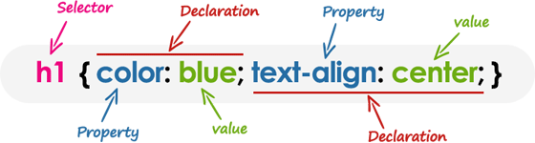
CSS Syntax

Slide 4
CSS Syntax
Selector: Selector indicates the HTML element you want to style. It could be any tag like <h1>, <title> etc.
Declaration Block: The declaration block can contain one or more declarations separated by a semicolon. For the above example, there are two declarations:
color: yellow; font-size: 11 px;
Each declaration contains a property name and value, separated by a colon.
Property: A Property is a type of attribute of HTML element. It could be color, border etc.
Value: Values are assigned to CSS properties. In the above example, value "yellow" is assigned to color property.

Slide 5
CSS in HTML Documents
Inline styles — Using the style attribute in the HTML start tag.
Embedded styles — Using the <style> element in the head section of a document.
External style sheets — Using the <link> element, pointing to an external CSS file.

Slide 6

Inline CSS

Slide 7
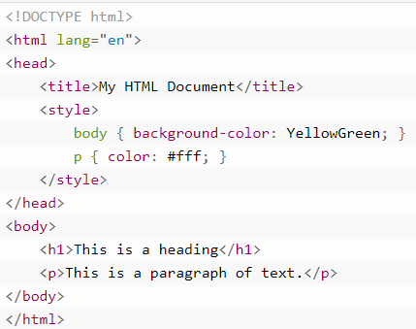
Embedded Style Sheet
Embedded or internal style sheets only affect the document they are embedded in.

Slide 8

External CSS
The external style sheet is generally used when you want to make changes on multiple pages
It uses the <link> tag on every pages and the <link> tag should be put inside the head section.

Slide 9
CSS Selectors
CSS Element Selector
CSS Id Selector
CSS Class Selector
CSS Universal Selector
CSS Group Selector
A CSS selector is a pattern to match the elements on a web page. The style rules associated with that selector will be applied to the elements that match the selector pattern.

Slide 10
CSS Element Selector
An element type selector matches all instance of the element in the document with the corresponding element type name.
p { color: blue; }

Slide 11
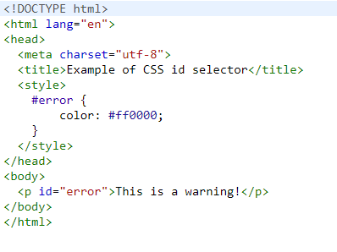
CSS Id Selector
The id selector selects the id attribute of an HTML element to select a specific element. An id is always unique within the page so it is chosen to select a single, unique element.
It is written with the hash character (#), followed by the id of the element.

Slide 12
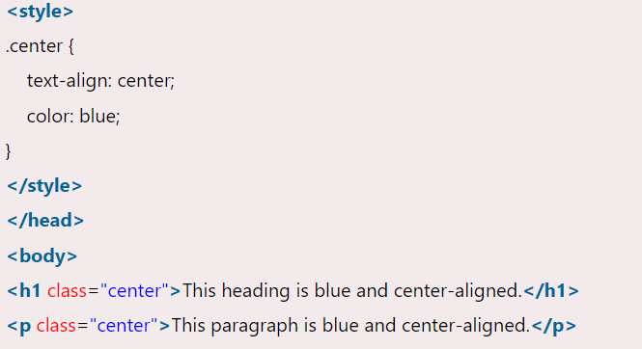
CSS Class Selector
The class selector selects HTML elements with a specific class attribute. It is used with a period character . (full stop symbol) followed by the class name.

Slide 13
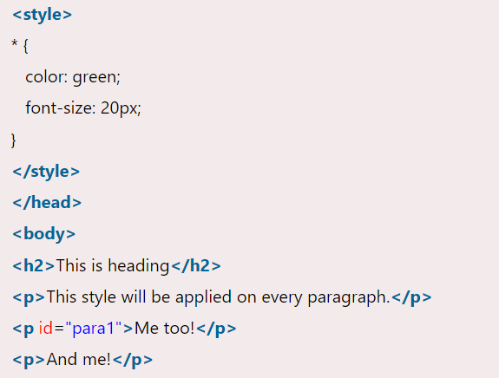
CSS Universal Selector
The universal selector is used as a wildcard character. It selects all the elements on the pages.

Slide 14
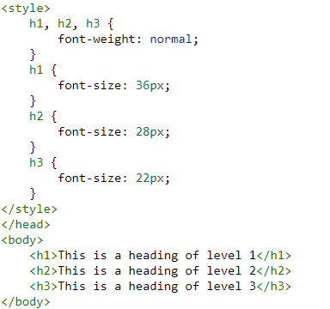
CSS Group Selector
The universal selector is used as a wildcard character. It selects all the elements on the pages.

Slide 15
CSS Combination Selector
lector | Example | Example description
element element | div p | Selects all <p> elements inside <div> elements
element>element | div > p | Selects all <p> elements where the parent is a <div> element
element+element | div + p | Selects the first <p> element that are placed immediately after <div> elements
element1~element2 | p ~ ul | Selects every <ul> element that are preceded by a <p> element

Slide 16
CSS Colors
Colors are specified using predefined color names, or RGB, HEX, HSL, RGBA, HSLA values. CSS Background Color
CSS Background Color
<h1 style="background-color:DodgerBlue;">Hello World</h1>
CSS Text Color
<h1 style="color:Tomato;">Hello World</h1>
CSS Border Color
<h1 style="border:2px solid Tomato;">Hello World</h1>

Slide 17
CSS Font
Font color: This property is used to change the color of the text. (standalone attribute)
Font family: This property is used to change the face of the font.
Font size: This property is used to increase or decrease the size of the font.
Font style: This property is used to make the font bold, italic or oblique.
Font variant: This property creates a small-caps effect.
Font weight: This property is used to increase or decrease the boldness and lightness of the font.

Slide 18
CSS Font Size
Font-size with em
The default text size in browsers is 16px. So, we can say that the default size of 1em is 16px.
Responsive font size
We can set the size of the text by using a vw unit, which stands for the 'viewport width'. The viewport is the size of the browser window.
1vw = 1% of viewport width.

Slide 19
CSS Absolute Units
Unit | Description
cm | centimeters
mm | millimeters
in | inches (1in = 96px = 2.54cm)
px * | pixels (1px = 1/96th of 1in)
pt | points (1pt = 1/72 of 1in)
pc | picas (1pc = 12 pt)

Slide 20
CSS Relative Units
Unit | Description
em | Relative to the font-size of the element (2em means 2 times the size of the current font)
ex | Relative to the x-height of the current font (rarely used)
ch | Relative to the width of the "0" (zero)
rem | Relative to font-size of the root element
vw | Relative to 1% of the width of the viewport*
vh | Relative to 1% of the height of the viewport*
vmin | Relative to 1% of viewport's* smaller dimension
vmax | Relative to 1% of viewport's* larger dimension
% | Relative to the parent element

Slide 21
CSS Text
Property | Description | Values
color | Sets the color of a text | RGB, hex, keyword
line-height | Sets the distance between lines | normal, number, length, %
letter-spacing | Increase or decrease the space between characters | normal, length
text-align | Aligns the text in an element | left, right, center, justify
text-decoration | Adds decoration to text | none, underline, overline, line-through
text-indent | Indents the first line of text in an element | length, %
text-transform | Controls the letters in an element | none, capitalize, uppercase, lowercase

Slide 22
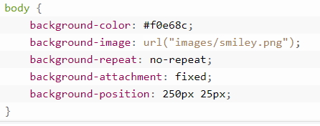
CSS Properties : Background
CSS background property is used to define the background effects on element.
background-color
background-image
background-repeat repeat-x , repeat-y, nor-repeat
background-attachment scroll / fixed
background-position starting position of image
body { background:
#ffffff url("img_tree.png") no-repeat right top; }

Slide 23
CSS Properties : CSS Border
The CSS border is a shorthand property used to set the border on an element.
The CSS border properties are use to specify the style, color and size of the border of an element.
The CSS border properties are given below
border-style
border-color
border-width
border-radius

Slide 24
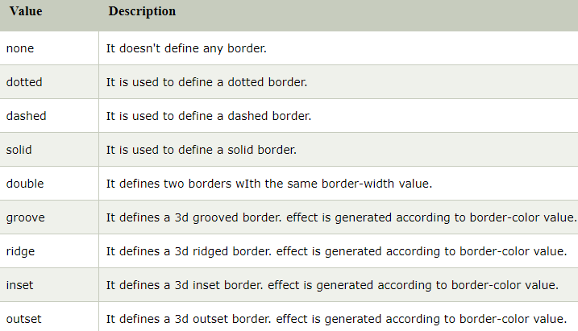
CSS Border - style

Slide 25
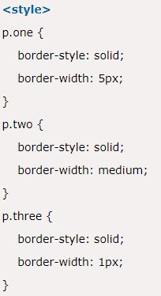
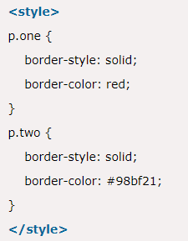
CSS Border – width & color

Slide 26
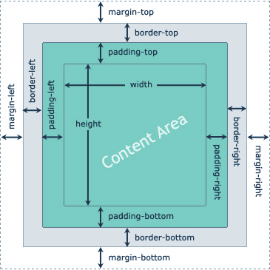
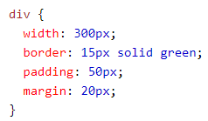
CSS Box Model

Slide 27
CSS height and width
CSS Setting height and width
The height and width properties are used to set the height and width of an element.
The height and width properties do not include padding, borders, or margins. It sets the height/width of the area inside the padding, border, and margin of the element.
CSS height and width Values
auto - This is default. The browser calculates the height and width
length - Defines the height/width in px, cm, etc.
% - Defines the height/width in percent of the containing block
initial - Sets the height/width to its default value
inherit - The height/width will be inherited from its parent value

Slide 28
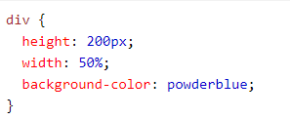
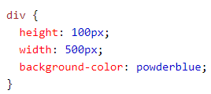
CSS height and width
The max-width property is used to set the maximum width of an element.
The max-width can be specified in length values, like px, cm, etc., or in percent (%) of the containing block, or set to none (this is default. Means that there is no maximum width).
div { max-width: 500px; height: 100px; background-color: powderblue; }

Slide 29
CSS width and max-width
div.ex1 { width: 500px; margin: auto; border: 3px solid #73AD21; } div.ex2 { max-width: 500px; margin: auto; border: 3px solid #73AD21; }

Slide 30
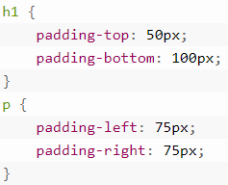
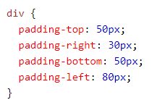


CSS Paddings
The CSS padding properties are used to generate space around an element's content, inside of any defined borders.

Slide 31
CSS Paddings and Width
The CSS width property specifies the width of the element's content area. The content area is the portion inside the padding, border, and margin of an element (the box model).
So, if an element has a specified width, the padding added to that element will be added to the total width of the element. This is often an undesirable result.
Example
Here, the <div> element is given a width of 300px. However, the actual width of the <div> element will be 350px (300px + 25px of left padding + 25px of right padding):
div { width: 300px; padding: 25px; }
Use the box-sizing property to keep the width at 300px, no matter the amount of padding:
div { width: 300px; padding: 25px; box-sizing: border-box; }

Slide 32
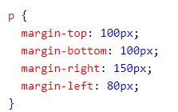
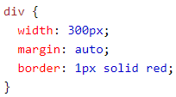


CSS margins
The CSS margin properties are used to create space around elements, outside of any defined borders.

Slide 33
CSS Outline
An outline is a line drawn outside element’s border
The outline property is a shorthand property for setting the following individual outline properties:
outline-width
outline-style (required)
outline-color
p.ex1 {outline: dashed;} p.ex2 {outline: dotted red;} p.ex3 {outline: 5px solid yellow;} p.ex4 {outline: thick ridge pink;}

Slide 34
CSS Position
The position property specifies the type of positioning method used for an element.
There are five different position values:
static default / positioned according to normal flow
relative positioned relative to normal position
fixed fixed relative to viewport
absolute is positioned relative to the nearest positioned ancestor
sticky positioned based on users scroll position
div.fixed { position: fixed; bottom: 0; right: 0; width: 300px; border: 3px solid #73AD21; }
div.relative { position: relative; left: 30px; border: 3px solid #73AD21; }

Slide 35
CSS Z-Index
The z-index property specifies the stack order of an element (which element should be placed in front of, or behind, the others).
An element can have a positive or negative stack order:
There are five different position values:
img { position: absolute; left: 0px; top: 0px; z-index: -1; }

Slide 36
CSS Overflow
The overflow property specifies whether to clip the content or to add scrollbars when the content of an element is too big to fit in the specified area.
The overflow property has the following values:
visible - Default. The overflow is not clipped. The content renders outside the element's box
hidden - The overflow is clipped, and the rest of the content will be
invisible
scroll - The overflow is clipped, and a scrollbar is added to see the rest
of the content
auto - Similar to scroll, but it adds scrollbars only when necessary

Slide 37
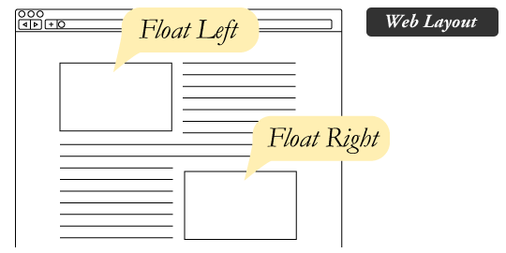
CSS float
The float property is used for positioning and formatting content e.g. let an image float left to the text in a container.

Slide 38
CSS float
The float property can have one of the following values:
left - The element floats to the left of its container
right - The element floats to the right of its container
none - The element does not float (will be displayed just where it occurs in the text). This is default
inherit - The element inherits the float value of its parent
In its simplest use, the float property can be used to wrap text around images.

Slide 39
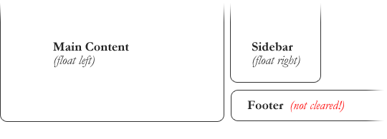
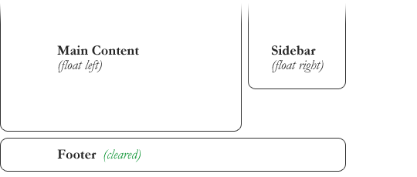
CSS clear
When we use the float property, and we want the next element below (not on right or left), we will have to use the clear property.
The clear property specifies what should happen with the element that is next to a floating element.

Slide 40
CSS clear
The clear property can have one of the following values:
none - The element is not pushed below left or right floated elements. This is default
left - The element is pushed below left floated elements
right - The element is pushed below right floated elements
both - The element is pushed below both left and right floated elements
inherit - The element inherits the clear value from its parent

Slide 41
CSS Links
A link has four different states — link, visited, active and hover. These four states of a link can be styled differently through using the following anchor pseudo-class selectors.
a:link — define styles for normal or unvisited links.
a:visited — define styles for links that the user has already visited.
a:hover — define styles for a link when the user place the mouse pointer over it.
a:active — define styles for links when they are being clicked.
You can specify any CSS property you'd like e.g. color, font, background, border, etc. to each of these selectors to customize the style of links, just like you do with the normal text.

Slide 42
CSS Links
Making Text Links Look Like Buttons
a:link, a:visited
{
color: white;
background-color: #1ebba3;
display: inline-block;
padding: 10px 20px;
border: 2px solid #099983;
text-decoration: none;
text-align: center;
font: 14px Arial, sans-serif;
}
a:hover, a:active
{
background-color: #9c6ae1;
border-color: #7443b6;
}

Slide 43
CSS Lists
CSS provides the several properties for styling and formatting the most commonly used unordered and ordered lists. These CSS list properties typically allow you to:
Control the shape or appearance of the marker.
Specify an image for the marker rather than a bullet point or number.
Set the distance between a marker and the text in the list.
Specify whether the marker would appear inside or outside of the box containing the list items.
list-style-type
list-style-position
list-style-image

Slide 44
CSS Lists
Property | Description | Values
list-style | Sets all the properties for a list in one declaration | list-style-type, list-style-position, list-style-image, inherit
list-style-image | Specifies an image as the list-item marker | URL, none, inherit
list-style-position | Specifies where to place the list-item marker | inside, outside, inherit
list-style-type | Specifies the type of list-item marker | none, disc, circle, square, decimal, decimal-leading-zero, armenian, georgian, lower-alpha, upper-alpha, lower-greek, lower-latin, upper-latin, lower-roman, upper-roman, inherit

Slide 45



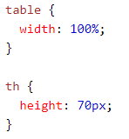




CSS Tables

Slide 46
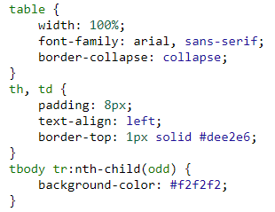
CSS Tables
Creating Zebra-striped Tables

Slide 47

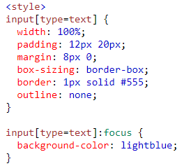
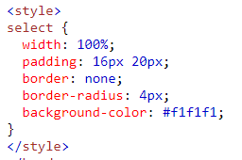
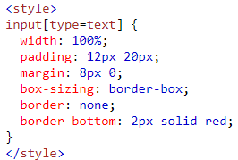
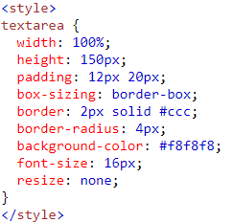

CSS Forms

Slide 48
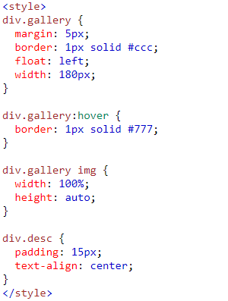
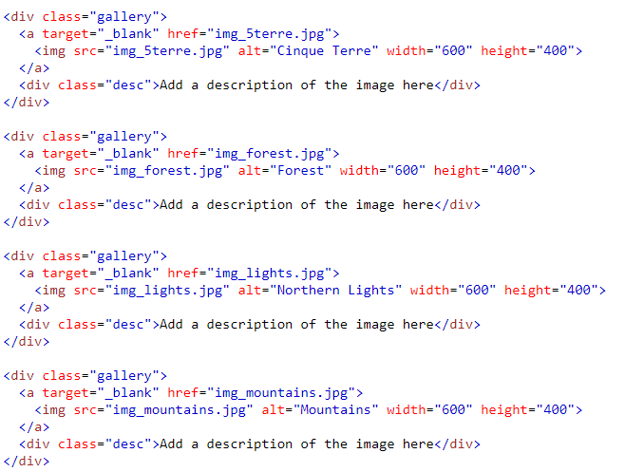
Image Gallery

Slide 49
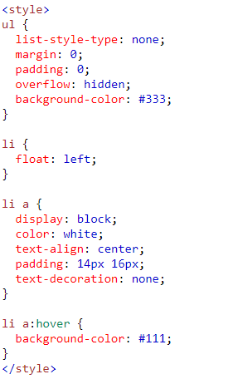
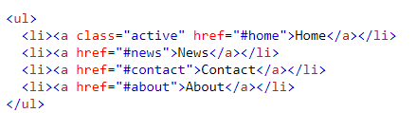
Image Horizontal Navigation

Slide 50
Image Horizontal Navigation

Slide 51
Layout Display Property
Every element on a web page is a rectangular box. The display property in CSS determines just how that rectangular box behaves.
A block-level element always starts on a new line and takes up the full width available e.g. div, h1, p, form
An inline element does not start on a new line and only takes up as much width as necessary. e.g. span, a, img
Commonly Used display values :
display: None
display: inline
display: block
display: inlineblock can specify width & height

Slide 52
Layout z-index Property
When elements are positioned, they can overlap other elements.
The z-index property specifies the stack order of an element (which element should be placed in front of, or behind, the others).
An element can have a positive or negative stack order
img
{ position: absolute; left: 0px; top: 0px; z-index: -1; }

Slide 53
Layout overflow Property
The overflow property specifies whether to clip the content or to add scrollbars when the content of an element is too big to fit in the specified area.
The overflow property has the following values:
visible - Default. The overflow is not clipped. The content renders outside the element's box
hidden - The overflow is clipped, and the rest of the content will be invisible
scroll - The overflow is clipped, and a scrollbar is added to see the rest of the content
auto - Similar to scroll, but it adds scrollbars only when necessary
The overflow property only works for block elements with a specified height.

Slide 54
CSS Pseudo Classes
A pseudo-class is used to define a special state of an element.
pseudo-class | Description
:active | It is used to add style to an active element.
:hover | It adds special effects to an element when the user moves the mouse pointer over the element.
:link | It adds style to the unvisited link.
:visited | It adds style to a visited link.
:lang | It is used to define a language to use in a specified element.
:focus | It selects the element which is focused by the user currently.
:first-child | It adds special effects to an element, which is the first child of another element.

Slide 55
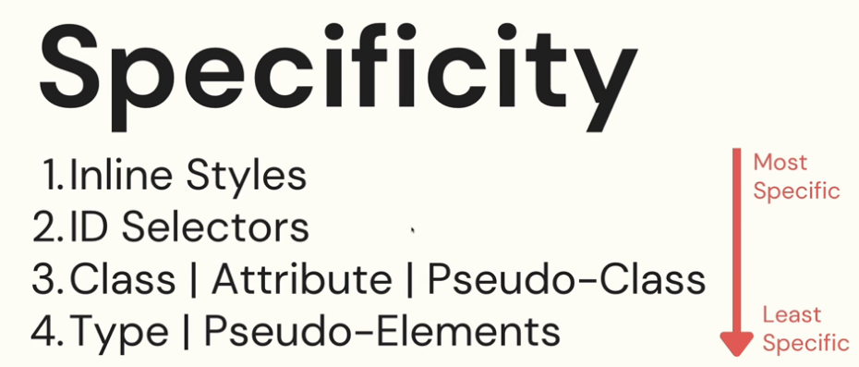
CSS Specificity

Slide 56
CSS ICONS
The simplest way to add an icon to your HTML page, is with an icon library, such as Font Awesome.
Add the name of the specified icon class to any inline HTML element (like <i> or <span>).
<head> <script src="https://kit.fontawesome.com/a076d05399.js" crossorigin="anonymous"></script> </head> <body> <i class="fas fa-cloud"></i> <i class="fas fa-heart"></i> <i class="fas fa-car"></i> <i class="fas fa-file"></i> <i class="fas fa-bars"></i>

Slide 57
CSS Shadow Effects
The CSS text-shadow property applies shadow to text.
In its simplest use, you only specify the horizontal shadow (2px) and the vertical shadow (2px):
h1 { text-shadow: 2px 2px red; }
The CSS box-shadow property is used to apply one or more shadows to an element.
div { box-shadow: 10px 10px lightblue; }

Slide 58
CSS 2D Transforms
Function | Description
matrix(n,n,n,n,n,n) | Defines a 2D transformation, using a matrix of six values
translate(x,y) | Defines a 2D translation, moving the element along the X- and the Y-axis
translateX(n) | Defines a 2D translation, moving the element along the X-axis
translateY(n) | Defines a 2D translation, moving the element along the Y-axis
scale(x,y) | Defines a 2D scale transformation, changing the elements width and height
scaleX(n) | Defines a 2D scale transformation, changing the element's width
scaleY(n) | Defines a 2D scale transformation, changing the element's height
rotate(angle) | Defines a 2D rotation, the angle is specified in the parameter
skew(x-angle,y-angle) | Defines a 2D skew transformation along the X- and the Y-axis
skewX(angle) | Defines a 2D skew transformation along the X-axis
skewY(angle) | Defines a 2D skew transformation along the Y-axis

Slide 59
CSS 2D Transforms
translate()
rotate()
scaleX()
scaleY()
scale()
skewX()
skewY()
skew()
matrix()
div { transform: translate(50px, 100px); }
The matrix() method combines all the 2D transform methods into one

Slide 60
CSS 3D Transforms
Function | Description
matrix3d(n,n,n,n,n,n,n,n,n,n,n,n,n,n,n,n) | Defines a 3D transformation, using a 4x4 matrix of 16 values
translate3d(x,y,z) | Defines a 3D translation
translateX(x) | Defines a 3D translation, using only the value for the X-axis
translateY(y) | Defines a 3D translation, using only the value for the Y-axis
translateZ(z) | Defines a 3D translation, using only the value for the Z-axis
scale3d(x,y,z) | Defines a 3D scale transformation
scaleX(x) | Defines a 3D scale transformation by giving a value for the X-axis
scaleY(y) | Defines a 3D scale transformation by giving a value for the Y-axis
scaleZ(z) | Defines a 3D scale transformation by giving a value for the Z-axis
rotate3d(x,y,z,angle) | Defines a 3D rotation
rotateX(angle) | Defines a 3D rotation along the X-axis
rotateY(angle) | Defines a 3D rotation along the Y-axis
rotateZ(angle) | Defines a 3D rotation along the Z-axis
perspective(n) | Defines a perspective view for a 3D transformed element

Slide 61
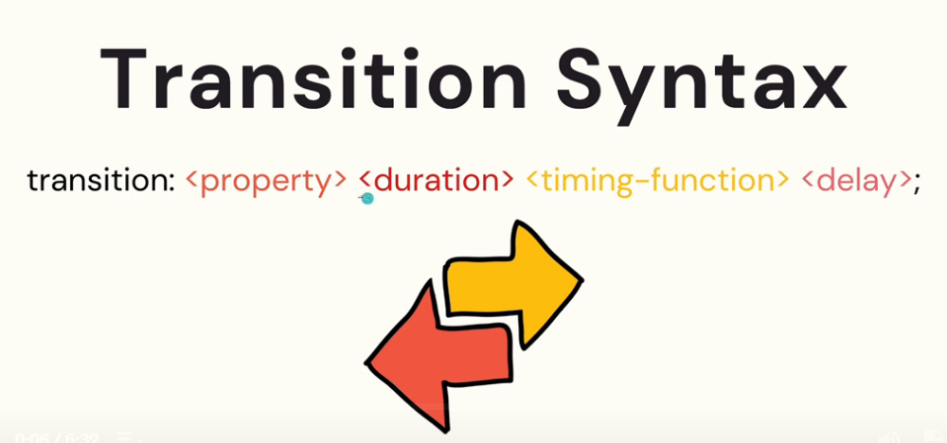
CSS Transition

Slide 62
CSS Transition
Property | Description
transition | A shorthand property for setting the four transition properties into a single property
transition-delay | Specifies a delay (in seconds) for the transition effect
transition-duration | Specifies how many seconds or milliseconds a transition effect takes to complete
transition-property | Specifies the name of the CSS property the transition effect is for
transition-timing-function | Specifies the speed curve of the transition effect

Slide 63
CSS Transition
ease - specifies a transition effect with a slow start, then fast, then end slowly (this is default)
linear - specifies a transition effect with the same speed from start to end
ease-in - specifies a transition effect with a slow start
ease-out - specifies a transition effect with a slow end
ease-in-out - specifies a transition effect with a slow start and end
cubic-bezier(n,n,n,n) - lets you define your own values in a cubic-bezier function

Slide 64
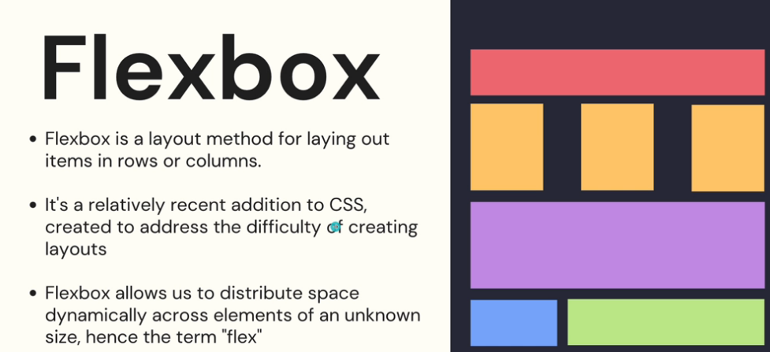
CSS Flexbox

Slide 65
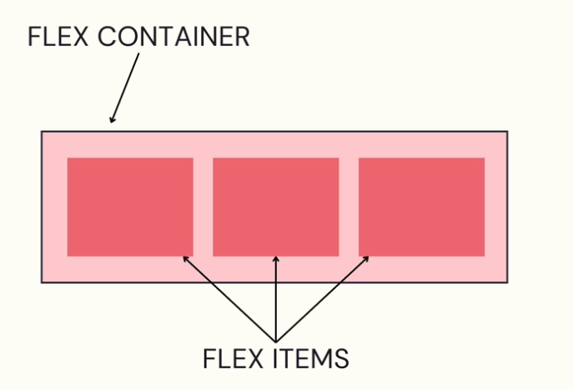
CSS Flexbox

Slide 66
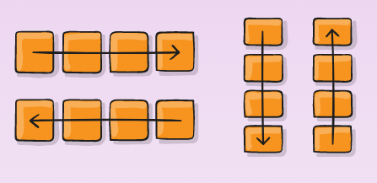
CSS Flexbox Flex Direction
.container {
flex-direction: row | row-reverse | column | column-reverse;
}

Slide 67
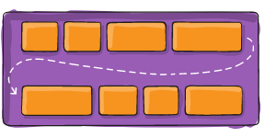
CSS Flexbox Flex Wrap
.container {
flex-wrap: nowrap | wrap | wrap-reverse;
}

Slide 68
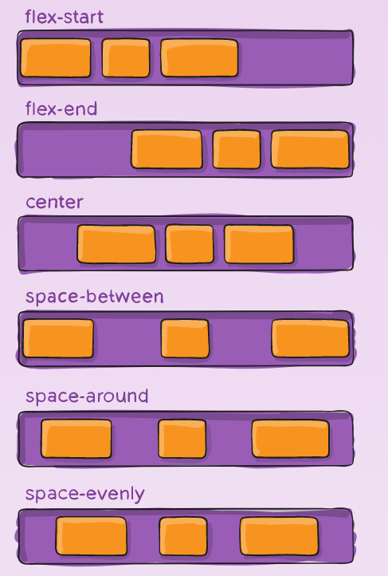
CSS Flexbox Justify Content
.container {
justify-content: flex-start | flex-end | center | space-between | space-around | space-evenly | start | end | left | right ... + safe | unsafe;
}

Slide 69
CSS Flexbox Flex Flow
This is a shorthand for the flex-direction and flex-wrap properties, which together define the flex container’s main and cross axes. The default value is row nowrap.
.container {
flex-flow: column wrap;
}

Slide 70
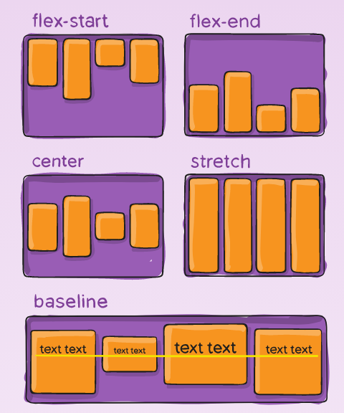
CSS Flexbox Align Items
.container {
align-items: stretch | flex-start | flex-end | center | baseline | first baseline | last baseline | start | end | self-start | self-end + ... safe | unsafe;
}

Slide 71
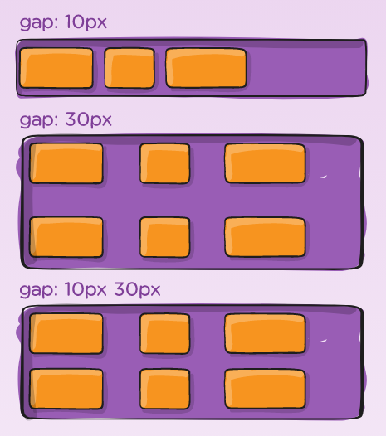
CSS Flexbox Gap
.container {
display: flex;
...
gap: 10px;
gap: 10px 20px; /* row-gap column gap */
row-gap: 10px;
column-gap: 20px;
}

Slide 72
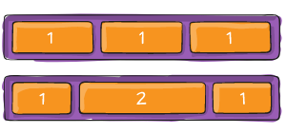
CSS Flexbox flex-grow
This defines the ability for a flex item to grow if necessary. It accepts a unitless value that serves as a proportion. It dictates what amount of the available space inside the flex container the item should take up.
.item {
flex-grow: 4; /* default 0 */
}
.item {
flex-shrink: 3; /* default 1 */
}

Slide 73
CSS Flexbox flex
This is the shorthand for flex-grow, flex-shrink and flex-basis combined.
The second and third parameters (flex-shrink and flex-basis) are optional.
The default is 0 1 auto, but if you set it with a single number value, like flex: 5;, that changes the flex-basis to 0%, so it’s like setting flex-grow: 5; flex-shrink: 1; flex-basis: 0%;.
.item {
flex: none | [ <'flex-grow'> <'flex-shrink'>? || <'flex-basis'> ]
}

Slide 74
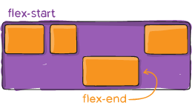
CSS Flexbox align self
This allows the default alignment (or the one specified by align-items) to be overridden for individual flex items.
.item {
align-self: auto | flex-start | flex-end | center | baseline | stretch;
}

Slide 75
CSS Animations
An animation lets an element gradually change from one style to another
Keyframes hold what styles the element will have at certain times
When you specify CSS styles inside the @keyframes rule, the animation will gradually change from the current style to the new style at certain times.
To get an animation to work, you must bind the animation to an element.

Slide 76
CSS Animations
/* The animation code */ @keyframes example { from {background-color: red;} to {background-color: yellow;} } /* The element to apply the animation to */ div { width: 100px; height: 100px; background-color: red; animation-name: example; animation-duration: 4s; }
@keyframes
animation-name
animation-duration
animation-delay
animation-iteration-count
animation-direction
animation-timing-function
animation-fill-mode
animation

Slide 77
CSS Grid Layout
The CSS Grid Layout Module offers a grid-based layout system, with rows and columns, making it easier to design web pages without having to use floats and positioning.
A grid container is an HTML element whose display property’s value is grid or inline-grid.
A grid item is any of the direct children of a grid container.
You can adjust the gap size by using one of the following properties:
column-gap
row-gap
gap

Slide 78
CSS Grid Container
The grid-template-columns property defines the number of columns in your grid layout, and it can define the width of each column.
.grid-container { display: grid; grid-template-columns: auto auto auto auto; }
The grid-template-rows property defines the height of each row.
The justify-content property is used to align the whole grid inside the container. The align-content property is used to vertically align the whole grid inside the container.
.container {
justify-content: start | end | center | stretch | space-around | space-between | space-evenly;
}

Slide 79
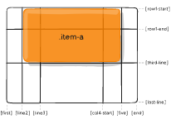
CSS Grid Item
A grid container contains grid items.
By default, a container has one grid item for each column, in each row, but you can style the grid items so that they will span multiple columns and/or rows.
.item {
grid-column-start: <number> | <name> | span <number> | span <name> | auto;
grid-column-end: <number> | <name> | span <number> | span <name> | auto;
grid-row-start: <number> | <name> | span <number> | span <name> | auto;
grid-row-end: <number> | <name> | span <number> | span <name> | auto;
}
.item-a {
grid-column-start: 2;
grid-column-end: five;
grid-row-start: row1-start;
grid-row-end: 3;
}

Slide 80
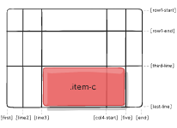
CSS Grid Item
grid-column / grid-row
Shorthand for grid-column-start + grid-column-end, and grid-row-start + grid-row-end, respectively.
.item {
grid-column: <start-line> / <end-line> | <start-line> / span <value>;
grid-row: <start-line> / <end-line> | <start-line> / span <value>;
}
.item-c {
grid-column: 3 / span 2;
grid-row: third-line / 4;
}

Slide 81
CSS Grid Item
grid-area
The grid-area property can be used as a shorthand property for the grid-row-start, grid-column-start, grid-row-end and the grid-column-end properties.
.item {
grid-column: <start-line> / <end-line> | <start-line> / span <value>;
grid-row: <start-line> / <end-line> | <start-line> / span <value>;
}
.item-c {
grid-column: 3 / span 2;
grid-row: third-line / 4;
}

Slide 82
SASS
Sass (which stands for Syntactically Awesome Style Sheets) is an extension to CSS.
SASS (Syntactically awesome style sheets) is an extension of the CSS which adds syntactic power to the basic CSS language making it easier for developers to write CSS. In simple words, it is just a CSS pre-processor, so that you can write CSS in an easy and convenient way.

Slide 83
THANK YOU !!!

