Slide 1



VISVESVARAYA TECHNOLOGICAL UNIVERSITY, BELAGAVI
B.L.D.E.A’s V.P.DR.P.G.HALAKATTI COLLEGE OF ENGINEERING AND TECHNOLOGY,VIJAYAPUR-586103
DEPARTMENT OF COMPUTER SCIENCE AND ENGINEERING
PROJECT PHASE-I
Smart Phishing URL Detection System
Student Name | USN
Ahmadaraja C | 2BL24CS401
Amol S | 2BL24CS402
Irfan K | 2BL24CS406
Guide
Mrs. Anupama Inamdar
Co-ordinator
S.R.Patil
Dakshayani. I

Slide 2

INDEX
1. Overview
2. Literature Survey (URL Phishing Detection)
3. Problem Statements
4. Objectives
5. Drawbacks of Existing Research
6. Proposed solution
7. Workflow / System Flow/methodology
8. Conclusion

Slide 3
Overview
Smart Phishing URL Detection System :- is a machine learning–based solution designed to identify and block malicious URLs in real-time. It analyz URL patterns, domain features, and suspicious behaviors to protect users from phishing attacks and data breaches.
Applications
Browser Security – Real-time protection while browsing
Email Filtering – Detects phishing links in emails
Banking Security – Secures financial transactions
E-Commerce Platforms – Prevents fraudulent activities
Enterprise Systems – Protects organizational networks
Key Technologies
Machine Learning (ML) – Classifies URLs as safe or malicious
Artificial Intelligence (AI) – Improves detection over time
URL Feature Extraction – Analyzes structure & patterns
Cybersecurity Techniques – Ensures safe user interaction
Web Technologies – Enables browser & system integration

Slide 4
Literature Survey (URL Phishing Detection)
S.No | Author(s) | Year | Paper Title | Journal / Conference | Method / Model Used | Reported Accuracy | Key Limitation / Drawback
1 | Sultan Asiri, Yang Xiao et al. | 2023 | A Survey of Intelligent Detection Designs of HTML URL Phishing Attacks | IEEE Access | Deep Learning, Feature Extraction, Hybrid Models | High accuracy across DL models (~95%+) | Complex models, high computation cost (ResearchGate)
2 | Ali Aljofey et al. | 2024 | Detection Approach for Phishing Websites using URL & HTML Features | Scientific Reports (Nature) | URL + HTML feature-based ML model | ~97% detection accuracy | Requires large dataset, feature dependency (Nature)
3 | S. Carolin Jeeva et al. | 2024 | Intelligent Phishing URL Detection using Association Rule Mining | Springer | Association Rule Mining | High detection efficiency | Less effective for new/unseen attacks (Springer Nature Link)
4 | Ananya Bhat et al. | 2024 | A Survey on Phishing URL Detection | IJNTI | ML (RF, SVM, CNN, LSTM) | High accuracy (90–98%) | Blacklist limitations, feature engineering dependency (RJPN Research Journal)
5 | Lizhen Tang & Qusay Mahmoud | 2024 | ML-Based Solutions for Phishing Website Detection | MDPI Journal | Machine Learning (SVM, RF, NN) | Accurate classification models | Cannot detect zero-day phishing URLs (MDPI)
6 | Rasha Zieni et al. | 2025 | Phishing or Not Phishing? Detection Survey | IEEE Access | Heuristic + ML + DL techniques | Improved detection rates | Lack of unified evaluation methods (DOAJ)
7 | Diya Saxena et al. | 2025 | Phishing URL Detection Using Machine Learning | IJSRST | ML-based classification | High accuracy (~95%) | Overfitting and dataset bias issues (IJSSRT)
8 | Sambare et al. | 2025 | Phishing URL Detection: ML Approaches Survey | LNNS (Springer) | URL, Domain, HTML feature analysis | High detection performance | Feature extraction complexity (EurekaMag)
9 | Y. Le et al. | 2025 | Smart Phishing Detection using AI & Feature Selection | Elsevier | AI + Feature Selection + ML | High accuracy & reduced features | Dataset dependency
10 | R. Verma, N. Das | 2022 | Phishing Detection using NLP Techniques | ACM Conference | NLP + Classification | Better text-based detection | Limited URL-only performance

Slide 5
Literature Survey (URL Phishing Detection)
S.No | Author(s) | Year | Paper Title | Journal / Conference | Method / Model Used | Reported Results | Key Limitation / Drawback
11 | Md. Redwan Ahmed et al. | 2024 | Phishing URL Detection using Feature Extraction & ML | IEEE Conference | Decision Tree, Feature Extraction | 92% accuracy | High computation & feature dependency
12 | Mouad Zouina, B. Outtaj | 2017 | Lightweight URL Phishing Detection using SVM | Springer Journal | SVM + Similarity Index | 93.8% accuracy | Limited for new phishing patterns
13 | Ali Aljofey et al. | 2022 | Detection using URL and HTML Features | Scientific Reports (Nature) | ML + URL + HTML features | 90% accuracy | Requires large dataset & feature engineering
14 | Mehmet Korkmaz et al. | 2020 | ML-Based URL Phishing Detection | ICCCNT Conference | Machine Learning Models | Effective classification | Cannot handle zero-day attacks well
15 | Sultan Asiri et al. | 2023 | Survey of Intelligent Phishing Detection | IEEE Access | ML, DL, Hybrid Models | 90–94% accuracy | High model complexity
16 | Diya Saxena et al. | 2026 | Phishing URL Detection using ML | IJSRST Journal | ML Classification Models | ~93% accuracy | Dataset bias & overfitting
17 | Wei Wei et al. | 2020 | CNN-Based URL Phishing Detection | Sensors / Elsevier | Deep Learning (CNN) | Improved detection | High training time
18 | Sneha Baskota | 2025 | Phishing URL Detection using Bi-LSTM | Research Paper | Deep Learning (Bi-LSTM) | 91% accuracy | Needs large dataset & resources
19 | Zahra Ahmad et al. | 2021 | Phishing Detection using Random Forest | IEEE Conference | Random Forest Classifier | 96% accuracy | Needs feature selection, weak for zero-day
20 | Sahingoz O. K. et al. | 2019 | ML Based Phishing Detection using URLs | Elsevier Journal | NLP + ML (NB, SVM) | 94% accuracy | Depends on dataset quality

Slide 6
Problem Statements
Existing phishing detection systems face significant challenges that limit their effectiveness:
Blacklist Dependency
Reliance on pre-existing lists limits detection of new, unknown threats
No Real-Time Detection
Delayed response times allow malicious links to compromise systems before detection
Low Accuracy
High false positive and false negative rates reduce user trust
No Adaptive Learning
Static systems cannot learn from new phishing techniques
Poor User Awareness
Limited feedback fails to educate users about potential threats

Slide 7
Objectives
Detect phishing URLs with high accuracy
Provide real-time analysis
Reduce false positives/negatives
Improve user awareness
Handle new unknown threats

Slide 8
Drawbacks of Existing Research
Limited Scope
High Computational Cost
Most systems focus only on URL analysis without considering contextual factors
Resource-intensive methods slow down browsing experience
Static Models
False Positives
Fixed algorithms cannot adapt to evolving phishing techniques
Legitimate sites incorrectly flagged as malicious frustrate users
Scalability Issues
Systems struggle to handle large volumes of URLs efficiently

Slide 9
Proposed Solutions
Core Functional Components
Intelligent Feature Extraction: Automatically analyzes URL structures, domain information, and suspicious patterns to identify red flags.
ML-Based Classification: Uses trained algorithms to differentiate between legitimate and fraudulent websites based on extracted features.
Real-Time Detection Engine: Provides immediate feedback to the user, blocking malicious links before they can compromise sensitive data.
Key Technical Advantages
High Accuracy: Engineered to reduce both false positives (legitimate sites incorrectly flagged) and false negatives (undetected threats) through intelligent analysis.
Adaptive Security: Unlike static systems, the AI-driven model improves its detection capabilities over time as it encounters new phishing techniques.
Scalable Architecture: Designed to handle large volumes of URLs efficiently without significant computational costs or browsing delays.
Proposed Workflow
Input: User enters or encounters a URL.
Analysis: The system performs real-time feature extraction and processes it through the ML model.
Output: Provides a security prediction and takes defensive action if a threat is detected.

Slide 10

  Methodology
🔹 1. Data Collection
Collect dataset of phishing and legitimate URLs from online sources (e.g., Kaggle, PhishTank).
🔹 2. Data Preprocessing
Remove duplicates and missing values
Normalize URLs
Label data (Phishing = 1, Legitimate = 0)
🔹 3. Feature Extraction
Extract important URL features such as:
URL length
Presence of “@”, “-”, “//”
Domain age, IP usage
Number of subdomains
🔹 4. Model Training
Train machine learning models like:
Random Forest
Support Vector Machine (SVM)
Logistic Regression
🔹 5. Model Evaluation
Evaluate performance using:
Accuracy
Precision
Recall
F1-score
🔹 6. Prediction System
Deploy model to classify URLs as:
👉 Phishing or Legitimate in real-time

Slide 11
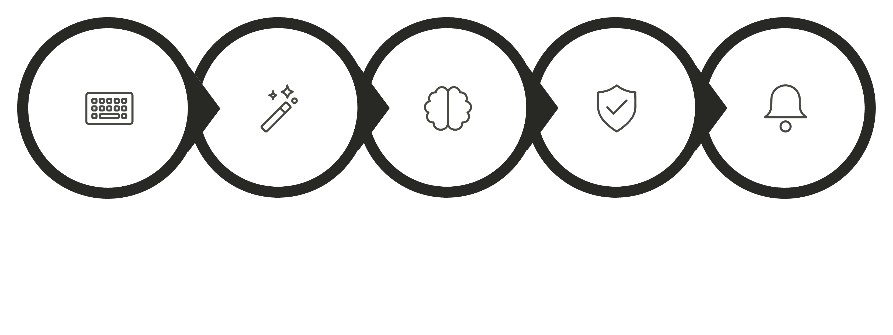
Workflow / System Flow
Feature Extraction
User Input
ML Model
Prediction
Output

Slide 12
Conclusion
Improved Detection
Higher Accuracy
Enhanced Security
ML-based approach identifies both known and emerging phishing threats
Reduced false positives and negatives through intelligent analysis
Real-time protection empowers users to browse safely
URLShield represents a significant advancement in phishing detection technology, combining machine learning with real-time analysis to provide robust protection against evolving cyber threats.

