Slide 1



VISVESVARAYA TECHNOLOGICAL UNIVERSITY, BELAGAVI
B.L.D.E.A’s V.P.DR.P.G.HALAKATTI COLLEGE OF ENGINEERING AND TECHNOLOGY,VIJAYAPUR-586103
DEPARTMENT OF COMPUTER SCIENCE AND ENGINEERING
PROJECT PHASE-II
Smart Phishing URL Detection System
Student Name | USN
Ahmadaraja C | 2BL24CS401
Amol S | 2BL24CS402
Irfan K | 2BL24CS406
Guide
Mrs. Anupama Inamdar
Co-ordinator
S.R.Patil
Dakshayani. I

Slide 2

Phishing URL Detection System
Hybrid Deep Learning & Machine Learning Approach
A web-based application combining CNN-BiLSTM neural networks with ensemble methods for automated phishing detection

Slide 3
Project Overview
Objective
Problem
Detect phishing URLs using hybrid ML/DL architecture with real-time prediction capabilities
Growing threat of phishing attacks requires automated, scalable detection systems
Solution
Stack
Web application with dual models: CNN-BiLSTM for pattern recognition and RF/DT for fast inference
Flask backend, TensorFlow/Keras, Scikit-learn, HTML/CSS/JS frontend

Slide 4
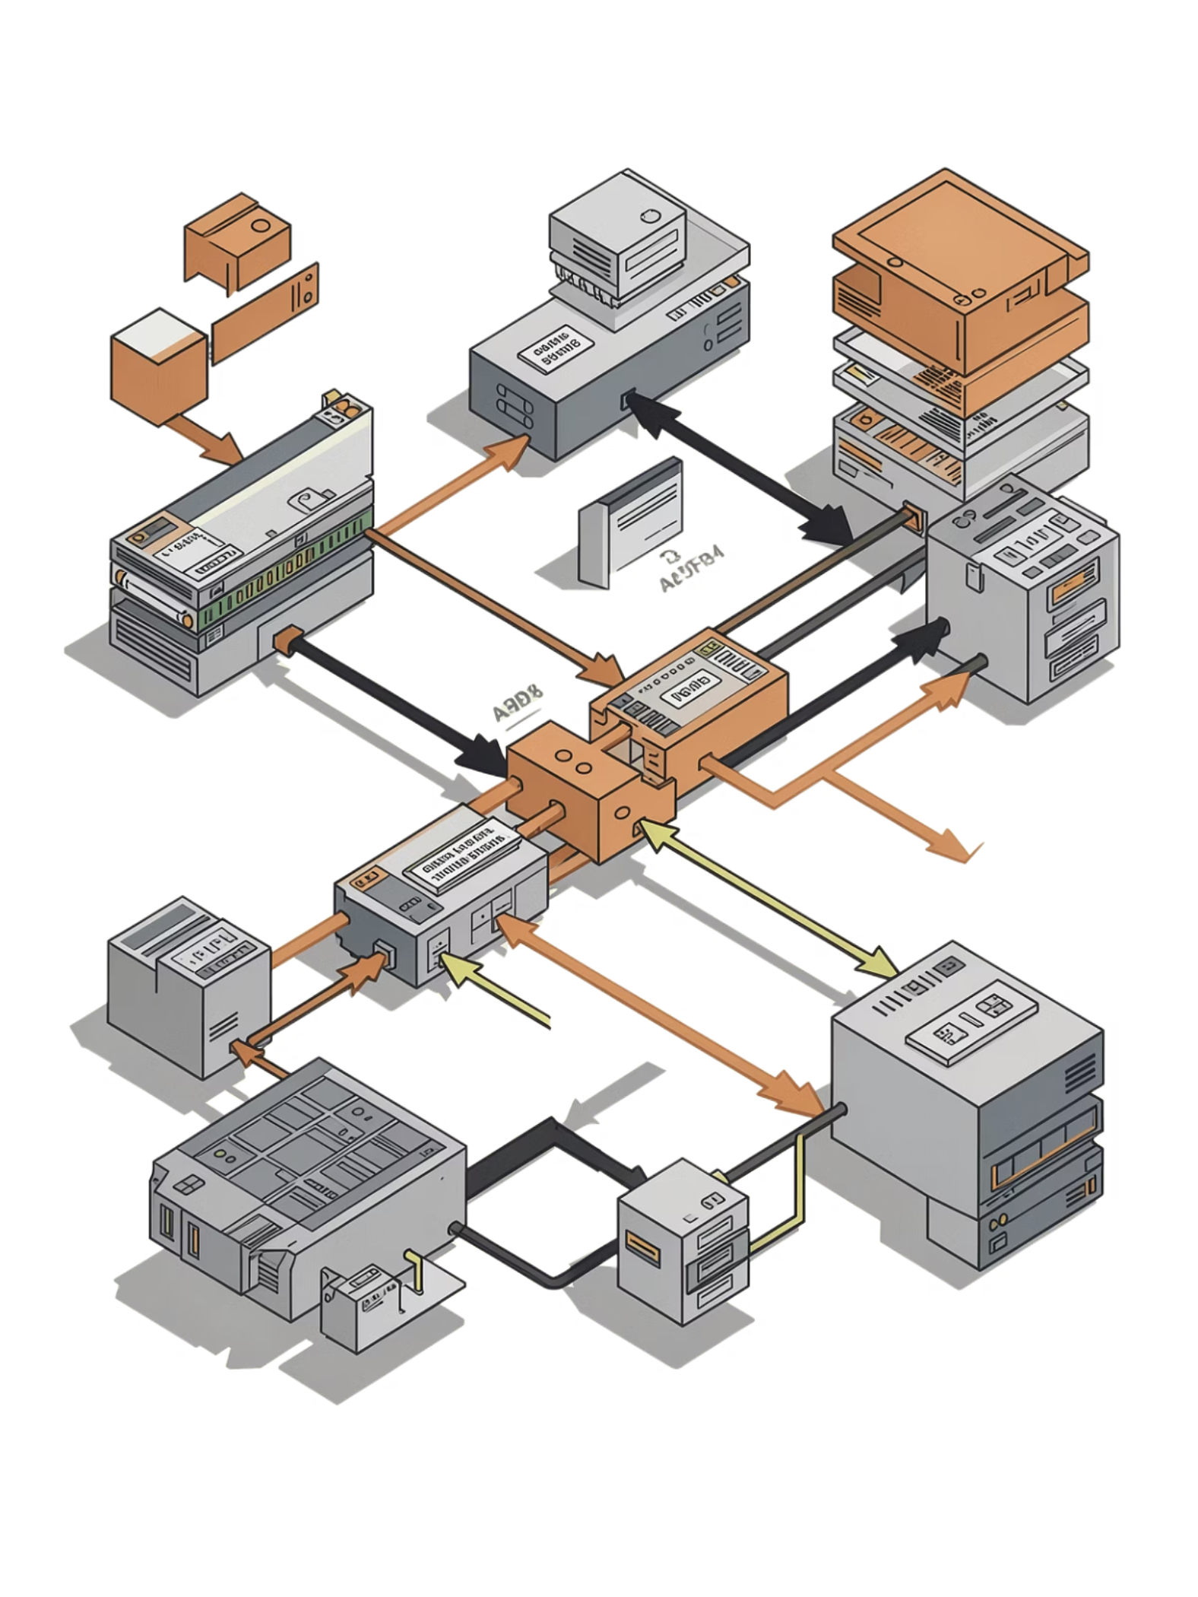
Dataset & Preprocessing
Data Sources
Feature Engineering
OpenPhish feed (2500+ real phishing URLs)
Synthetic legitimate domains (2500 URLs)
Stratified train/validation/test split
Character embeddings (VOCAB_SIZE: 256)
Statistical features (max length: 2048 chars)
URL structure analysis
Preprocessing
Cleaning Pipeline
Vectorization and scaling
StandardScaler for DT/RF models
URL normalization and deduplication
Format validation
Character-level tokenization

Slide 5
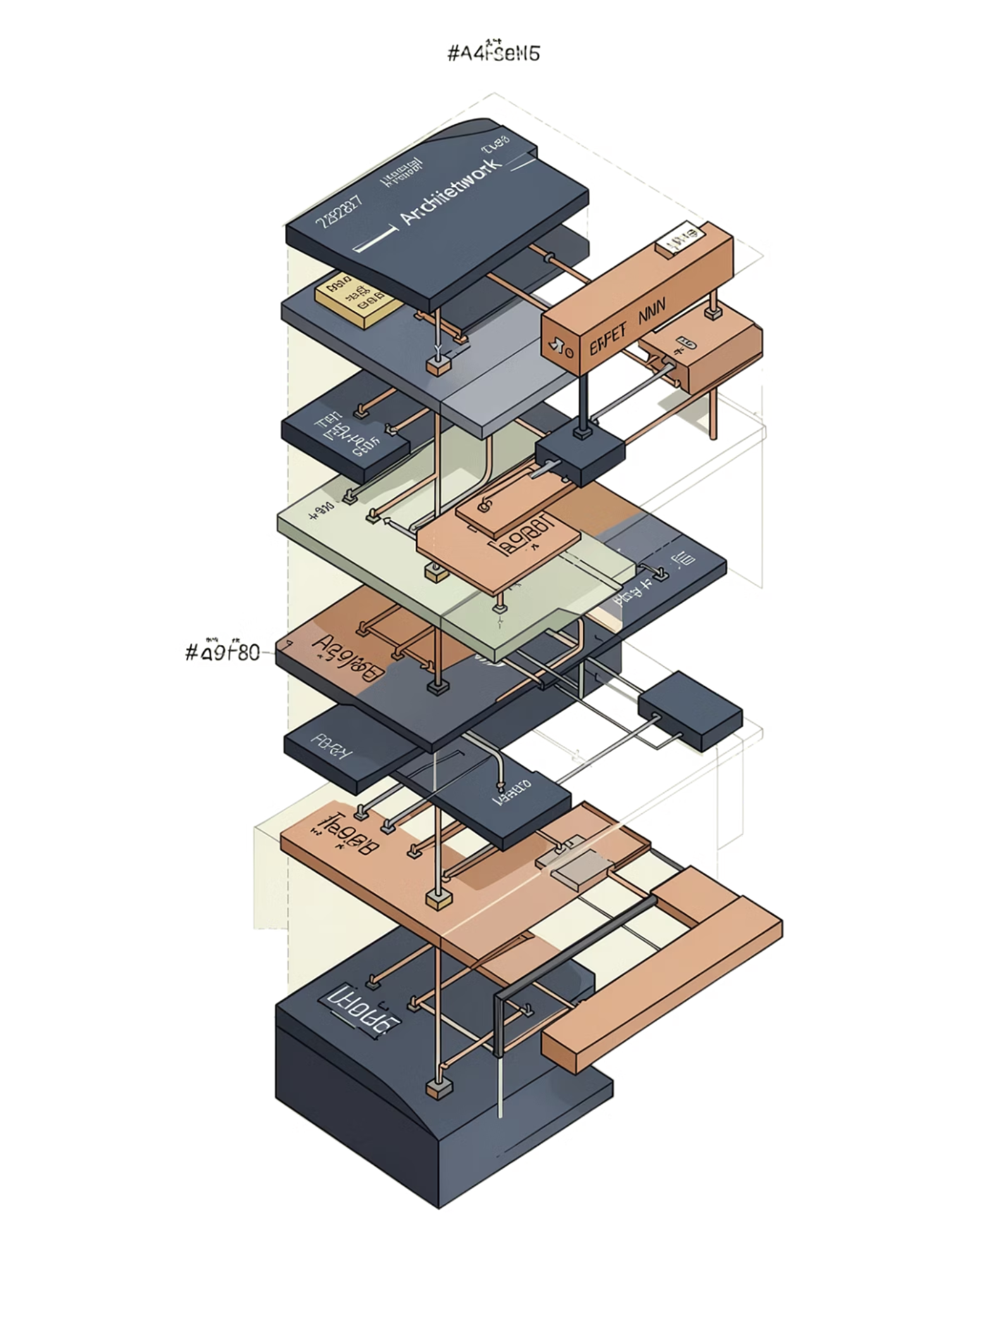
Model Architecture
CNN-BiLSTM
Character embedding → Conv1D (128 filters) → BiLSTM (64 units) → Dense layers
1
Adam optimizer with learning rate scheduling
Dropout (0.4) and L2 regularization (1e-4)
Batch normalization
Random Forest & Decision Tree
Statistical feature-based classification with hyperparameter tuning via grid search
2
Fast inference for production
Interpretable decision paths
Ensemble benefits

Slide 6
Implementation Progress
40%
60%
Completed
In Progress
Feature extraction, model architecture, Flask server, UI, prediction module, training pipelines, evaluation
Hyperparameter tuning, real-time API deployment, inference optimization
Completed Components
model/feature_extractor.py
model/architecture.py
app.py (Flask server)
templates/index.html
static/css/style.css
static/js/app.js
fetch_urls.py
model/predict.py
model/train.py
model/train_rf.py
model/evaluate.py

Slide 7



Performance Metrics
85%
88%
Accuracy
Precision
Overall correct classifications
Proportion of true positives
83%
85%
Recall
F1-Score
Phishing URL detection rate
Harmonic mean balance
Comparison Results
CNN-BiLSTM: Higher accuracy, slower inference
Random Forest: Faster predictions, interpretable
Ensemble: Optimal balance for production

Slide 8

Web Application Features
Real-Time Interface
Web-based UI for instant URL prediction with input validation and error handling
REST API
CORS-enabled /api/predict endpoint for integration with external systems
Batch Prediction
Process multiple URLs simultaneously for bulk analysis workflows

Slide 9

Model Persistence
Saved Components
scaler_dt.json: Decision Tree preprocessor
scaler_rf.json: Random Forest scaler
Model weights with architecture definitions
Training configurations for reproducibility
Deployment Strategy
Serialized models enable rapid deployment across environments while maintaining consistent preprocessing pipelines

Slide 10



Conclusion & Future Work
Key Achievements
Next Steps
Deployment Ready
Hybrid architecture implemented with 85%+ accuracy and real-time prediction capabilities
Ensemble methods, transfer learning from larger datasets, automated retraining pipeline
Production-grade API with validation, error handling, and batch processing support

Slide 11

Thank You
Questions and Discussion Welcome

