Slide 1

Java + Unit = JUnit

Slide 2
Agenda
- Unit Testing
- What is JUnit
- How to write JUnit test case
- Mocking Framework
- JUnit Benefits
- JUnit Best Practices

Slide 3
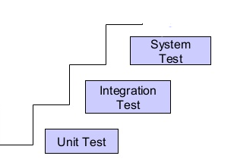
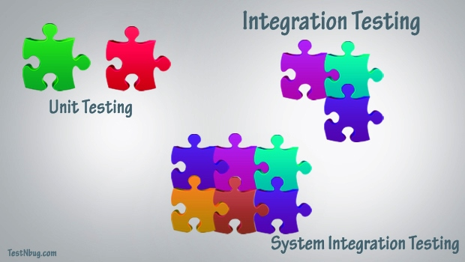
Software Testing?
Testing is the process of checking the functionality of the application whether it is working as per requirements.
Unit Testing: Testing small pieces of code, typically individual functions, alone and isolated.
Integration Testing: individual units are combined and tested as a group
System Testing: complete, integrated system is tested
Automated Test - No human involvement, test cases are executed by automated tools and programs, It’s fast and less costly compared to manual testing.

Slide 4
What is JUnit?
is unit testing framework for the purpose of writing & running repeatable tests for java programs.
A unit can be a function, a class
Unit testing refers to the practice of testing such small units (function & class) of your code, so as to ensure that they work as expected
Designed by Kent Beck, Erich Gamma in mid 90’s
- Open source framework maintained by Junit.org community http://junit.org.
- Its written in Java
- The framework resides under package org.junit for Junt 4 and later
- Junit is linked as JAR (junit.jar) at compile-time.
- Its really simple to integrate Junit in Maven project
<dependency>
<groupId>junit</groupId>
<artifactId>junit</artifactId>
<version>4.10</version>
</dependency>

Slide 5
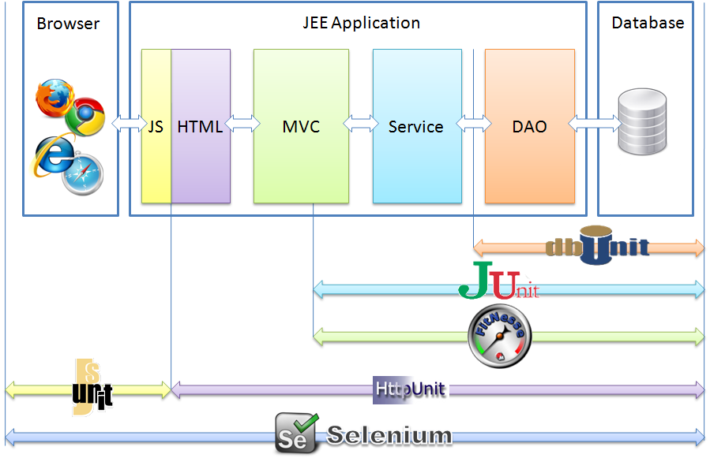
Automation Frameworks

Slide 6
Writing JUnit Test Case
Junit 4.x
Any class can be a test case. The test class does not need to extend any particular class.
All test methods should have @Test annotation.
Test methods to make Assert calls to validate the outcome
JUnit tests can be run automatically and they check their own results and provide immediate feedback
- JUnit tests can be organized into test suites containing test cases and even other test suites.
- JUnit shows test progress in a bar that is green if test is going fine and it turns red when a test fails.

Slide 7
Annotations
@Test – This is the test method to run
@BeforeClass – Run once before any of the test methods in the class, only once in execution
@AfterClass – Run once after all the tests in the class have been run
@Before – Run before each test
@After – Run after each test
@Ignore – To ignore Test

Slide 8
Junit Assert
- Junit provides assertion methods for to determine pass fail status of test case
- Types of assertions like Boolean, Null, Identical etc
Parameter order is “expected value” followed by “actual value”
Assert
class org.junit.Assert methods
assertFalse(condition) / assertTrue(condition)
assertNull(object) / assertNotNull(object)
assertEquals(expected, actual)
assertSame(expected, actual) / assertNotSame(expected, actual)
e.g. assertEquals(“failuer – string not equal, “expected text”, “actual text” )
Exceptions
- @Test, optional ‘expected’ attribute
- Try-catch and always fail()
- @Rule ExpectedException

Slide 9




Stub / Mocking
- Real world software has dependencies and The idea of unit testing is that we want to test our code without testing the dependencies
- Some “real” objects required in Unit test are really complex to instantiate and/or configure
Sometimes only interfaces exits implementation are not even coded
Frameworks allows creation of test double object / mock object / fake object
Mocking Frameworks

Slide 10
Mockito
is mocking framework, facilitates creating mock objects seamlessly.
It uses Java Reflection in order to create mock objects for a given interface.
- Its really simple to integrate Junit in Maven project
<dependency>
<groupId>org.mockito</groupId>
<artifactId>mockito-all</artifactId>
<version>1.9.5</version>
</dependency>

Slide 11
Mockito
- @Mock will create a mock implementation
- @InjectMocks will inject the mocks marked with @Mock to this instance when it is created.
- MockitoAnnotations.initMocks(this); create instance in setup()
- when then pattern - mock object using the methods when()
thenReturn(returnValue)
thenThrow(exception)
thenCallRealMethod()
thenAnswer()
e.g. when(stockServiceMock.getPrice(googleStock)).thenReturn(5);
- verify ensure whether a mock method is being called with required arguments or not
atLeast (int min) − expects min calls.
atLeastOnce () − expects at least one call.
atMost (int max) − expects max calls.
e.g. verify(stockServiceMock, times(1)).getPrice(googleStock);
- Inorder ensure calling order of method
InOrder inOrder = inOrder(stockServiceMock);
inOrder.verify(stockServiceMock).getPrice(googleStock);

Slide 12
JUnit Coverage
Determining which lines of code your tests have exercised and which they have not
Allows you to detect if your unit tests (or system tests) are adequately covering all possibilities or not
Goal 70% coverage

Slide 13
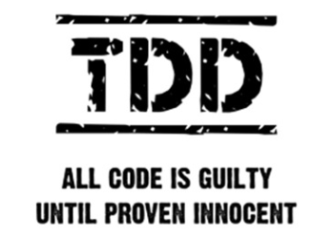
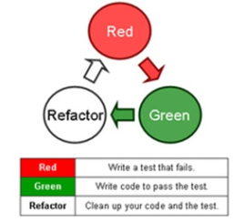
TDD – Test Driven Development
- is an evolutionary approach to development which combines test-first development where you write a test before you write just enough production code to full fill that test and refactoring.

Slide 14
Benefits
Elegantly simple, Can be run automatically, Check their own results and provide immediate feedback
Junit s ensure that code works as intended
Saves defect cost
Unit tests are also great for preventing regressions
Unit testing increases confidence. Unit testing is particularly important when software requirements change frequently.
Development is faster
In short, to Produce Better Code

Slide 15
Best Practices
- Separate production and test code. But typically in same package
Each unit test must run independently of all other unit tests.
Errors must be detected and reported test by test
- Use test data that is close to that of production.
- Test for both success and failure. Negative tests, exceptions and errors
- Test for boundary conditions
- Do not create test cases for everything. Instead, focus on the tests that impact the behavior of the system.
Before fixing a defect, write a test that exposes the defect.
Doesn’t do unnecessary things
Neither too simple nor too complex
What shouldn’t I test. Don’t test set/get methods
Run all your unit tests as often as possible, ideally every time the code is changed

Slide 16
