Slide 1

ID Card Management System
A Comprehensive Solution for Employees and Students By: 1. Amol Shirole 2. Rakesh Thakre
Dr.B.V.Hiray College of Management and Research Centre. Malegaon Date: 16/11/2024

Slide 2

Project Overview
1. A Django-based application to manage employee/student data.
2. Create and print ID cards with unique QR codes.
3. Efficient search functionality with QR code scanning.
4. Generate high-quality PDF versions of ID cards.
5. Supports multiple organizations with custom templates.

Slide 3
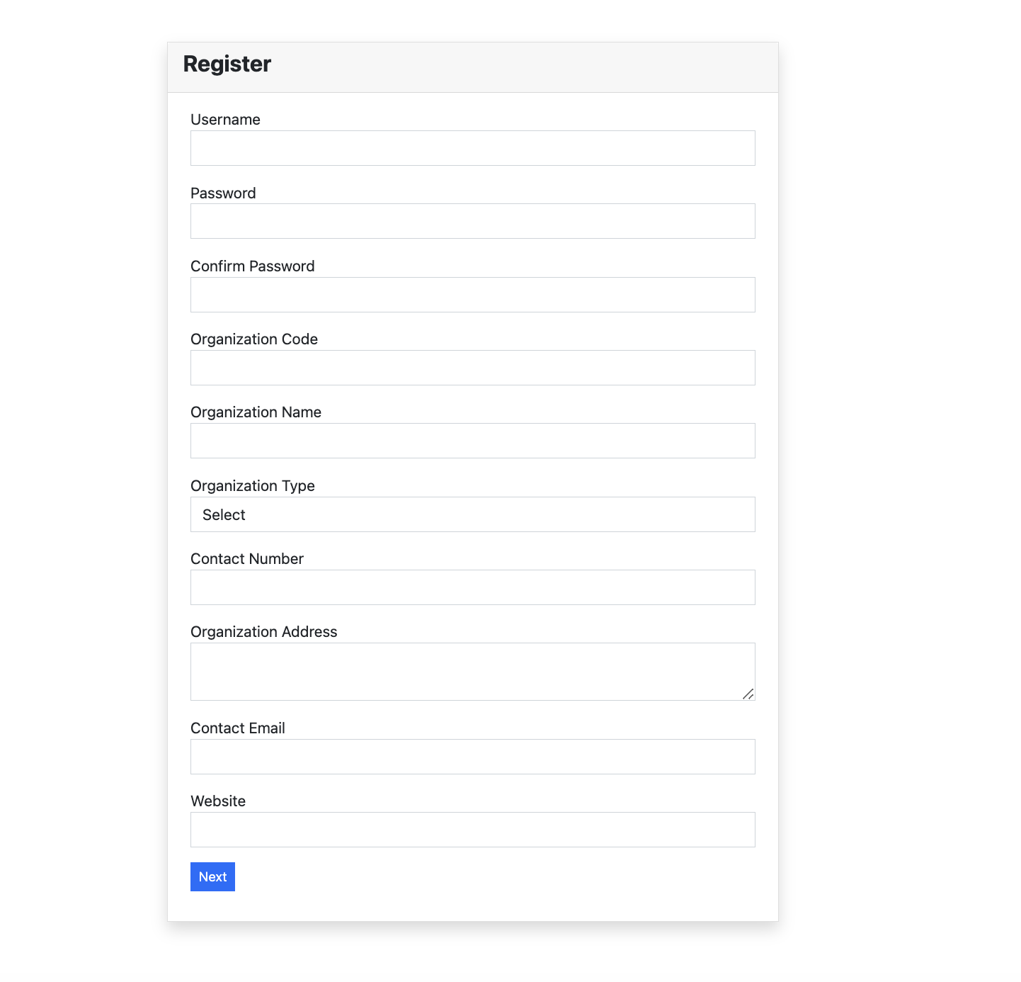
Key Features
User Registration & Profile Management: - Create or update user profiles. - Assign unique organization-specific codes. ID Card Templates: - Multiple templates for ID card customization. Employee/Student Management: - Add, edit, delete, and view employee/student details.

Slide 4
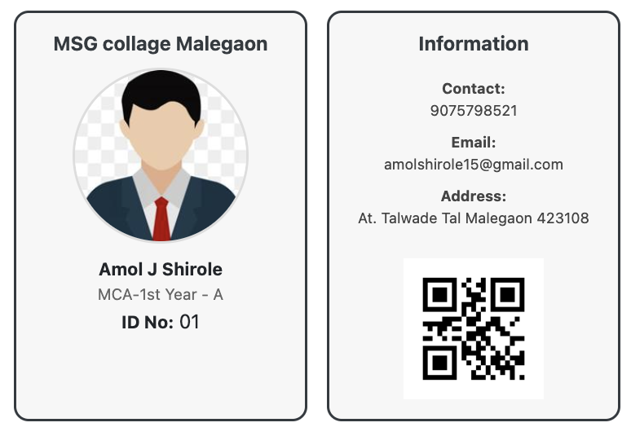
ID Card Functionality
ID Card Generation: - Automatically generates cards with custom templates. - Includes employee/student details and unique QR codes. Preview and Print: - Preview ID cards before printing. - High-quality downloadable PDFs.

Slide 5
Search & QR Code Scanning
Search Functionality: - Search employees/students using names, codes, or departments.
QR Code Scanning: - Instant retrieval of employee/student details by scanning QR codes.
- Enhances efficiency in large organizations.

Slide 6
Technical Implementation
Backend: Python Django 4.0 with a modular structure.
Database: SQLite for robust data storage.
Libraries: - Pillow: Image manipulation. - django-qr-code: QR code generation.
Frontend: HTML, CSS, Bootstrap for user-friendly design.

Slide 7
System Workflow
Admin Panel: - Manage users, templates, and profiles.
Employee/Student Module: - Add, update, or delete records. - Assign unique employee codes linked to profiles.
ID Card Module: - Generate, preview, and print ID cards.

Slide 8
Screenshots of the Project
Screenshot Placeholder

Slide 9
Benefits of the System
- Streamlined management of employee/student data.
- Time-saving with QR code scanning and search functionality.
- Easy customization of ID cards for various organizations.
- Secure and efficient data handling.

Slide 10
Thank You
Give Us Feedback! Contact Information: Email: amolshirole@gmail.com Phone: 9075798521 Presentation By: Amol Shirole & Rakesh Thakre

