Slide 1





PRADHAN MANTRI UJJWALA YOJANA
AMOL SINGH
231120003

Slide 2
CONTENTS OF THE PRESENTATION
INTRODUCTION TO PMUY
OBJECTIVE OF PMUY
WHY PMUY ?
EXPECTED IMPACTS INVESTIGATED BY POLICYMAKERS
STAKEHOLDERS OF
PMUY
ROLL OUT PROCESS OF PMUY
QUANTATIVE ANALYSIS
LINEAR REGRESSION MODEL
MULTIPLE REGRESSION MODEL - A STUDY
CHALLENGES OF PMUY
IMPROVING THE IMPACT OF PMUY

Slide 3
INTRODUCTION TO PRADHAN MANTRI UJJWALA YOJANA
Pradhan Mantri Ujjwala Yojana (PMUY) is a flagship policy initiated by the government of India to provide women below poverty line (BPL) access to clean energy fuel, Liquefied Petroleum Gas (LPG).
The scheme aimed to provide 5 crore (later extended to 8 crore) deposit free LPG connections to women who were devoid of LPG access and belonged to Below Poverty Line (BPL) which were to be identified from Socio Economic & Caste Census (SECC) -2011 list.
The scheme also provided an optional loan facility to cover the cost of stove and first refill, recovery of which was to be made from the subsidy accruing to the consumer on LPG refills under Direct Benefit Transfer for LPG (DBTL).
This mega social inclusion plan for covering each BPL household was launched by our honorable Prime Minister on 1st May 2016 at Balia, UP.

Slide 4
OBJECTIVE
The purpose of the scheme is to bring affordability to the poor especially women for use of cleaner fuel, reduction in air pollution and improving health and sanitation.
The accessibility to cleaner fuel and affordability are the key issues to the rural poor.
A large section of Society especially the poor and rural landless peasant workers have lagged behind in the economic and social development.
They also have not benefited from the government policies and programs and remained socially excluded from socio economic development.
Pradhan Mantri Ujjwala Yojana (PMUY)‟ is major steps towards Social inclusion by providing Free LPG connection to every BPL household.

Slide 5
WHY PRADHAN MANTRI UJJWALA YOJNA ?
The vulnerability to health risks increases due to the pollution produced from inefficient burning of biomass and use of traditional biomass cook stoves and unclean coals.
Nearly 121 million households are still using the inefficient challahs as per the Census of India 2011. Smoke inhaled by women at the time of cooking from unclean fuel is equivalent to burning 400 cigarettes in an hour.
Around 5 lakh death occurs annually in India while a large number of people suffers from respiratory disorders due to use of unclean cooking fuels.
India has around 24 crores household out of which 41% households i.e about 10 crores households are still dependent on fossil fuel for cooking even after 68 years of independence.

Slide 6
EXPECTED IMPACTS ENVISAGED BY POLICYMAKERS:
Health Improvement: One of the primary goals of PMUY is to improve the health outcomes of women and their families by providing access to clean cooking fuel.
Women's Empowerment: PMUY seeks to empower women by providing them with LPG connections in their names.
Environmental Sustainability: By promoting the use of LPG, which is a cleaner and more efficient cooking fuel compared to solid biomass fuels, PMUY contributes to environmental sustainability by reducing deforestation, carbon emissions, and indoor air pollution.
Economic Benefits: The scheme aims to alleviate the economic burden on BPL households by providing them with subsidized LPG connections.
Social Inclusion: PMUY is designed to promote social inclusion by ensuring that vulnerable sections of society, particularly women from BPL households, have access to clean cooking fuel, which is essential for their health, safety, and overall well-being.
These expected impacts demonstrate the multifaceted nature of PMUY's objectives, encompassing health, gender empowerment, environmental sustainability, economic development, and social inclusion.

Slide 7
STAKE HOLDERS OF THE PRADHAN MANTRI UJJWALA YOJNA
Government Agencies:
The Ministry of Petroleum and Natural Gas oversees the implementation of PMUY at the national level.
State-level nodal agencies, such as state governments and their respective departments, play a crucial role in the execution of the scheme in their jurisdictions.
Oil Marketing Companies (OMCs):
OMCs like Indian Oil Corporation, Bharat Petroleum Corporation Limited, and Hindustan Petroleum Corporation Limited are the primary implementing agencies responsible for distributing LPG connections under PMUY.
Beneficiaries:
Women from below-poverty-line (BPL) households are the primary beneficiaries of PMUY. Their role involves applying for the scheme, fulfilling eligibility criteria, and actively participating in LPG usage and safety awareness programs.

Slide 8
ROLL OUT PROCESS OF PRADHAN MANTRI UJJWALA YOJNA
Framework/Structure of Policy/Scheme:
Identification of Beneficiaries: Government agencies, in collaboration with local authorities, conduct surveys and identify eligible beneficiaries based on predefined criteria, such as socio-economic indicators and household income levels.
Application Process: Eligible women apply for PMUY through designated channels, submitting required documents such as Aadhaar cards, ration cards, and BPL certificates.
Verification and Enrollment: OMCs verify the eligibility of applicants and enroll them in the scheme. Upon verification, beneficiaries are issued LPG connections along with initial refill cylinders and stoves.
Distribution of LPG Kits: OMCs facilitate the distribution of LPG kits to beneficiaries through their network of distributors, ensuring last-mile delivery to remote and rural areas.
Subsidy Management: Subsidies are provided to beneficiaries directly into their bank accounts under the Direct Benefit Transfer (DBT) mechanism, ensuring transparency and minimizing leakages.
Monitoring and Evaluation: Government agencies and OMCs monitor the implementation progress, track utilization patterns, and evaluate the impact of PMUY on targeted beneficiaries and communities.

Slide 9
QUANTITATIVE ANALYSIS
ZONE | 2014-2015 | 2019-2020
North Zone | 40.88 | 61.51
NorthEast Zone | 32.18 | 44.75
Central Zone | 30.43 | 69.91
East Zone | 17.77 | 58.97
West Zone | 46.74 | 33.32
South Zone | 56.23 | 63.04
Table 1: Proportion of Households having access to LPG by Zone
Source: Asharaf, N., & Tol, R. S. J. (2024, March 25). The Impact of Pradhan Mantri Ujjwala Yojana on Indian Households. arXiv.org. https://arxiv.org/abs/2403.17112

Slide 10
QUANTITATIVE ANALYSIS
Category | 2014-2015 | 2019-2020
BPL Household | 22.07 | 45.13
Non-BPL Household | 44.32 | 61.88
Table 2: Proportion of Households having access to LPG
Source: Asharaf, N., & Tol, R. S. J. (2024, March 25). The Impact of Pradhan Mantri Ujjwala Yojana on Indian Households. arXiv.org. https://arxiv.org/abs/2403.17112

Slide 11
QUANTITATIVE ANALYSIS
Year | LPG Coverage
2016-2017 | 72.80 %
2017-2018 | 80.90%
2018-2019 | 94.30 %
Table 3: LPG Connection Status
CAG report, 2019
Raj, D. Y. D. K. S. D. (2020, June 2). Women Empowerment through Pradhan Mantri Ujjwala Yojana (PMUY) Scheme in Rajasthan: A Study on Rural Households in Selected Region. http://sersc.org/journals/index.php/IJAST/article/view/20156

Slide 12
QUANTITATIVE ANALYSIS
Year | Total Households (in lacs) | Domestic LPG Active Customers (in lacs)
2013-2014 | 2599.3 | 1451.76
2014-2015 | 2642.6 | 1485.58
2015-2016 | 2685.6 | 1662.55
2016-2017 | 2717.9 | 1916.4
Table 4: Active LPG Customers Per Year
Source: Kumar, S. (2018, January 1). Decision support system for Pradhan Mantri Ujjwala Yojana.

Slide 13
QUANTITATIVE ANALYSIS
Year | Avg. Annual Refill (Non- PMUY) | Avg. Annual Refill (PMUY)
2016-2017 | 7.5 | 3.9
2017-2018 | 7.3 | 3.4
2018-2019 | 6.7 | 3
Table 5 : Avg. Annual Refill of Cylinders per person
CAG report, 2019
Yadav, Y. (2020). Women Empowerment through Pradhan Mantri Ujjwala Yojana (PMUY) Scheme in Rajasthan: A Study on Rural Households in Selected Region. Social Science Research Network. https://doi.org/10.2139/ssrn.3618802

Slide 14
QUANTITATIVE ANALYSIS
Dimensions | Percentage
Affordability | 28%
Awareness of LPG refill | 11%
Lack of home delivery | 9%
Easy access to biomass | 28%
Fear of using LPG | 18%
Delayed delivery of LPG | 6%
CAG report, 2019
Table 6: Barriers to LPG Refills (After PMUY)
Yadav, Y. (2020). Women Empowerment through Pradhan Mantri Ujjwala Yojana (PMUY) Scheme in Rajasthan: A Study on Rural Households in Selected Region. Social Science Research Network. https://doi.org/10.2139/ssrn.3618802

Slide 15
Linear Regression Model
FORMING A HYPOTHESIS
SETTING THE NULL HYPOTHESIS-
Ho: Ujjwala yojana does not increase the LPG connection across 6 different zones of India namely NORTH ZONE, NORTHEAST ZONE, CENTRAL ZONE, EAST ZONE, WEST ZONE, SOUTH ZONE.
THE ALTERNATE HYPOTHESIS-
H1: Ujjwala yojana does increase the LPG connection across 6 different zones of India namely NORTH ZONE, NORTHEAST ZONE, CENTRAL ZONE, EAST ZONE, WEST ZONE, SOUTH ZONE.
REGRESSION MODEL - FORMATION
A regression analysis was applied to identify the impact of PMUY scheme as predictor (independent) variable and its effect on increase in number of LPG connection as a dependent variable using statistical analysis are presented.
ZONE | LPG CONNECTION | INDICATOR
NORTH ZONE | 40.88 | 0
NORTHEAST ZONE | 32.18 | 0
CENTRAL ZONE | 30.43 | 0
EAST ZONE | 17.77 | 0
WEST ZONE | 46.74 | 0
SOUTH ZONE | 56.23 | 0
Table 7: Proportion of Households having access to LPG by Zone (Before PMUY)
ZONE | LPG CONNECTION | INDICATOR
NORTH ZONE | 61.51 | 1
NORTHEAST ZONE | 44.75 | 1
CENTRAL ZONE | 69.91 | 1
EAST ZONE | 58.97 | 1
WEST ZONE | 33.32 | 1
SOUTH ZONE | 63.04 | 1
Table 8: Proportion of Households having access to LPG by Zone (After PMUY)
Source: Asharaf, N., & Tol, R. S. J. (2024, March 25). The Impact of Pradhan Mantri Ujjwala Yojana on Indian Households. arXiv.org. https://arxiv.org/abs/2403.17112

Slide 16
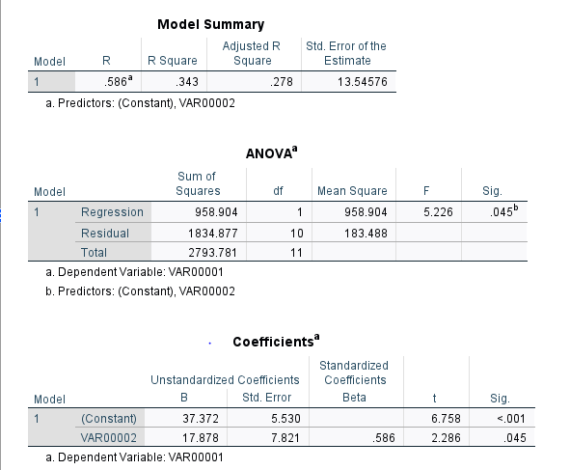
Linear Regression Model
RESULTS & OBSERVATIONS-
The equation of the line is- Ŷ = 37.372 + 17.878X .
R-Squared (R²) equals 0.343. This means that 34.3% of the variability of Y is explained by X.
Correlation (R) equals 0.586. This means that there is a moderate direct relationship between X and Y.
Overall regression: right-tailed, p-value = 0.04532. Since p-value < α (0.05), we reject H₀ and accept the alternate hypothesis H₁. Thus, our finding is statistically significant.
The data does not contain any big outliers as such.
Analysis of Data by : Statistical Package for Social Sciences (SPSS)

Slide 17
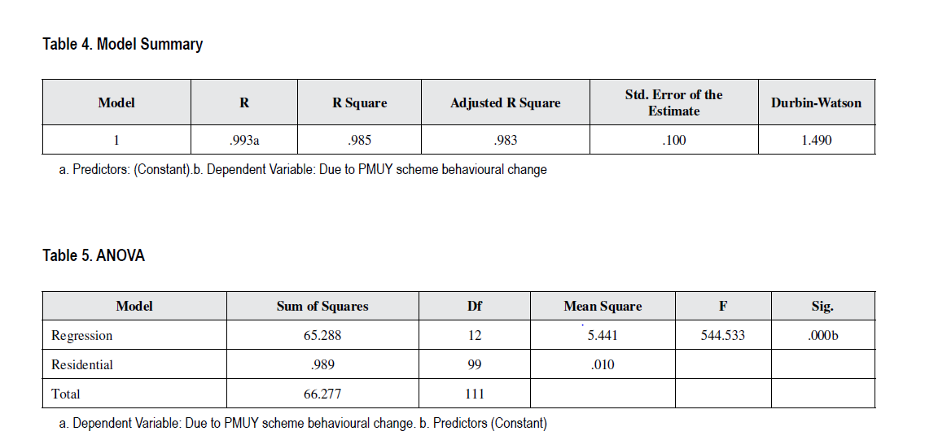
Multiple Regression Model: A Study
OBJECTIVES OF THE STUDY -
This study aims to achieve the following objectives:
To find out the impact of PMUY scheme and its effect on behavioral changes among rural women in three select districts.
TESTING HYPOTHESIS -
Ho: Respondent’s Ujjwala yojana scheme with twelve variables has no positive impact on behavioral changes among rural women.
Ho: Twelve variables related to Ujjwala scheme has no positive impact on behavioural changes among rural women.
The impact of Pradhan Mantri Ujjwala Yojana on Indian households. https://arxiv.org/html/2403.17112v1#:~:text=Using%20Propensity%20Score%20Matching%20and,parallel%20decrease%20in%20firewood%20consumption.

Slide 18
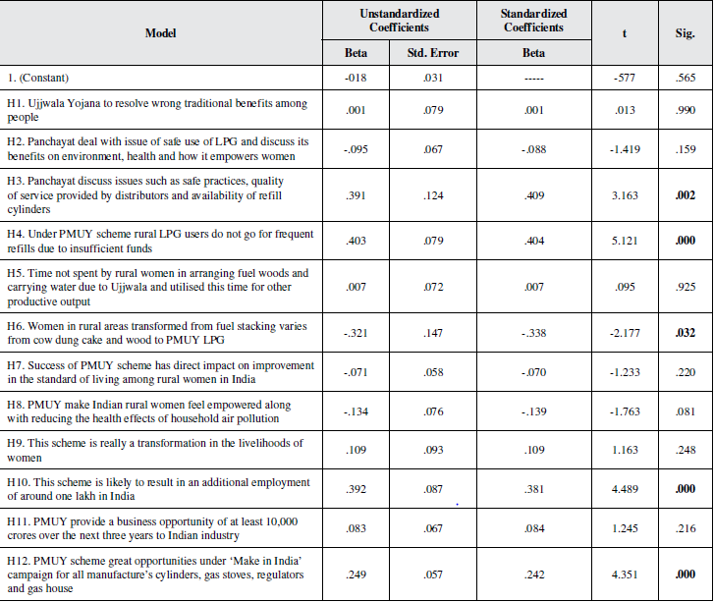
Multiple Regression Model: A Study
RESULTS & OBSERVATIONS-
Correlation (R) equals 0.985. This means that there is a strong direct relationship between Ujjwala scheme and behavioral changes among women.
The sample size reported is to be 112 and is taken from 3 districts of Tamil Nadu namely Vellore, Ranipet and Thirupattur.
The 5 variables have positive impact on Ujjwala yojana scheme with the effect on behavioral changes among rural women thereby not accepting the null hypothesis(H3, H4, H6, H10 and H12).
The other 7 variables do not have positive impact on Ujjwala yojana scheme with the effect on behavioral changes among rural women thereby accepting the null hypothesis(H1, H2, H5, H7, H8, H9 and H11) AT 5%
.
The impact of Pradhan Mantri Ujjwala Yojana on Indian households. https://arxiv.org/html/2403.17112v1#:~:text=Using%20Propensity%20Score%20Matching%20and,parallel%20decrease%20in%20firewood%20consumption.

Slide 19
QUALITATIVE ANALYSIS
The effectiveness of the Pradhan Mantri Ujjwala Yojana (PMUY) can be evaluated through various qualitative measures:
The issue of such as safe practices, quality of service provided by distributors and availability of refill cylinders is understood to be qualitatively solved using PMUY.
Under PMUY scheme rural LPG users do not go for frequent refill due to insufficient fund and other factors as well.
Women in rural areas started transformed from fuel stacking varies from cow dung cake and wood to PMUY LPG.
This scheme is likely to result in an additional employment of around one lakh people in India.
PMUY scheme great opportunities under ‘Make in India’ campaign for all manufacture’s cylinders, gas stoves, regulators and gas houses.

Slide 20
Challenges of PM UJJWALA YOJANA includes-
People in rural villages have wrong traditional benefits among themselves. These need to be changed so that people could accept the PMUY.
The local bodies such as panchayats are not doing their jobs properly as they should deal with the issue of safe use of LPG and discuss its benefits on environment, health and how it empowers women so that there should be awareness.
Ensuring that the benefits of PMUY reach the intended beneficiaries remains a challenge.
One of the biggest challenges of PMUY is the refilling of the gas cylinders in a timely manner, this can be due to many reasons as mentioned earlier.
Ensuring consistent supply of LPG cylinders, especially in remote or underserved areas, can be challenging due to logistical constraints, transportation issues, and fluctuations in demand.
Effective monitoring and evaluation mechanisms are essential to assess the impact of PMUY and identify areas for improvement. Strengthening data collection, analysis, and feedback mechanisms can enhance the program's effectiveness and accountability.
CHALLENGES OF PMUY

Slide 21
IMPROVING THE IMPACT OF PMUY
Improving the impact of PMUY
It is found that even in rural areas women use wooden logs to cook tasty veg and non-veg items just as they believe that it is tastier than food cooked with the help of LPG.
There is a need to change such type of attitude by way of campaigns as well as through village panchayat measures like banning of solid fuel in rural areas.
Through the PMUY scheme, rural women have got one cylinder, and it is found to be very difficult to get another refilled cylinder immediately within one or two days.
Hence, they may be given one more cylinder at a subsidized price or free of cost to use the LPG gas stove without disturbance of many days or weeks if the scheme truly deliberates thehealth problems of women.
Appropriate input controls, data validations and mandatory fields should be deployed in distributors’ software to restrict issuance of LPG connections to ineligible beneficiaries.

Slide 22
REFERENCES
Ahmad, N., Sharma, S., Singh, & Scholar. (2018). Pradhan Mantri Ujjwala Yojana (PMUY) Step towards Social Inclusion in India. ResearchGate.
Selvam, V., Ashok, D., Rajamanoharan, I. D., Rajalakshmi, V., & Vidhya, K. (2022). Impact of Ujjwala Yojana Scheme and its effect on behavioural changes among rural women. International Journal of Asian Business and Information Management, 13(1), 1–14. https://doi.org/10.4018/ijabim.315752
Aggarwal, S., Kumar, S., & Tiwari, M. K. (2018). Decision support system for Pradhan Mantri Ujjwala Yojana. Energy Policy, 118, 455–461. https://doi.org/10.1016/j.enpol.2018.04.011
Yadav, Y. (2020). Women Empowerment through Pradhan Mantri Ujjwala Yojana (PMUY) Scheme in Rajasthan: A Study on Rural Households in Selected Region. Social Science Research Network. https://doi.org/10.2139/ssrn.3618802
The impact of Pradhan Mantri Ujjwala Yojana on Indian households. (n.d.).https://arxiv.org/html/2403.17112v1#:~:text=Using%20Propensity%20Score%20Matching%20and,parallel%20decrease%20in%20firewood%20consumption.
Audit Reports | Comptroller and Auditor General of India. (n.d.). https://cag.gov.in/en/audit-report/details/55961

Slide 23
THANKYOU

