Slide 1

INFO 498 B: Android Development
Joel Ross
Spring 2016

Slide 2
Plan for the Day
Introductions and syllabus
Android History
break!
Getting Started: "Hello World"

Slide 3
Introductions

Slide 4
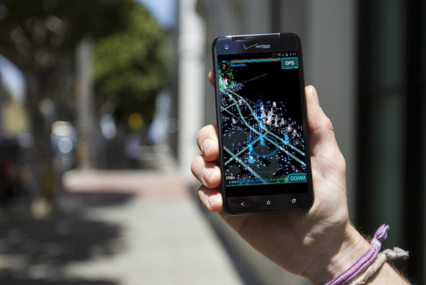


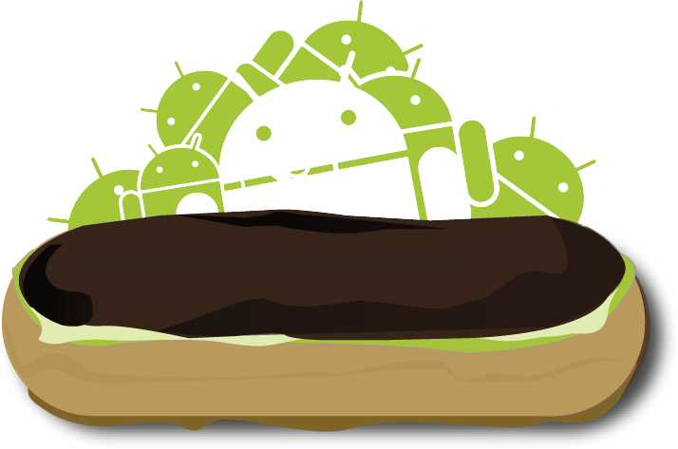
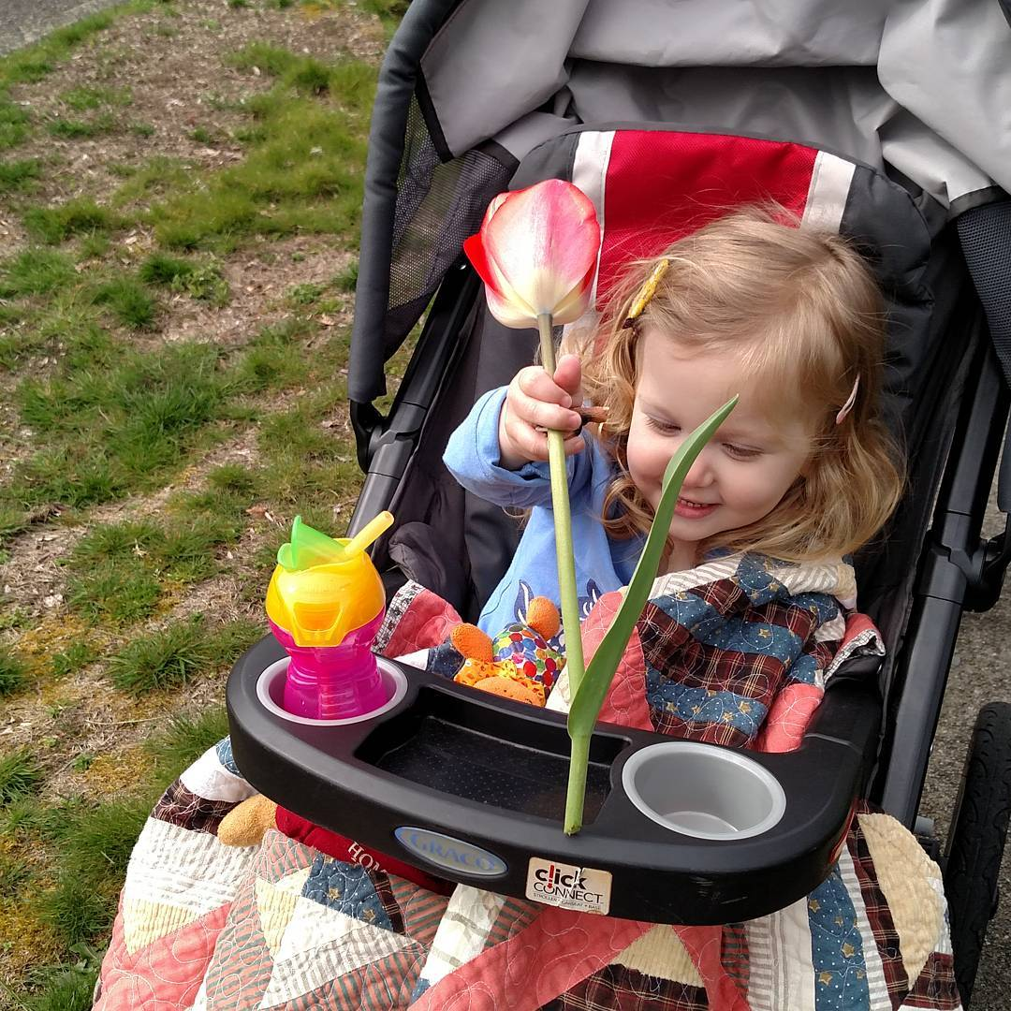

Who is Joel?

Slide 5
Who are you?
Ask the person across from you
Who are you?
Where are you from?
What are you most excited about for this class?

Slide 6
Course Materials
On Canvas
https://canvas.uw.edu/courses/1023396
On GitHub
https://github.com/info498d-w16/
Let your TA know your username!

Slide 7

What is Android?
Phone Brand
Operating System
Ecosystem
Platform

Slide 8








Some Android History
2003 | Founded by Android Inc.
2005 | Acquired by Google
2007 | Launch of Open Handset Alliance

Slide 9
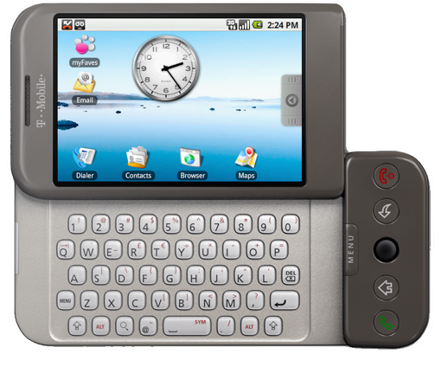
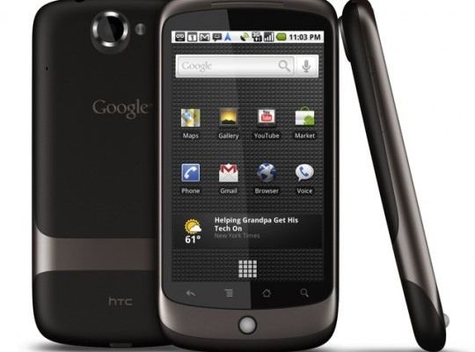
Some Android History
2008 | First Android Device (HTC Dream / G1) 528Mhz ARM 256mb RAM 3.2" screen at 320x480px
2010 | First Nexus Device (Nexus One) 1Ghz Scorpion 512mb RAM 3.7" screen at 480x800px

Slide 10

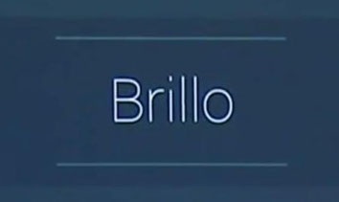
Some Android History
2014 | Android One
2015 | Project Brillo

Slide 11
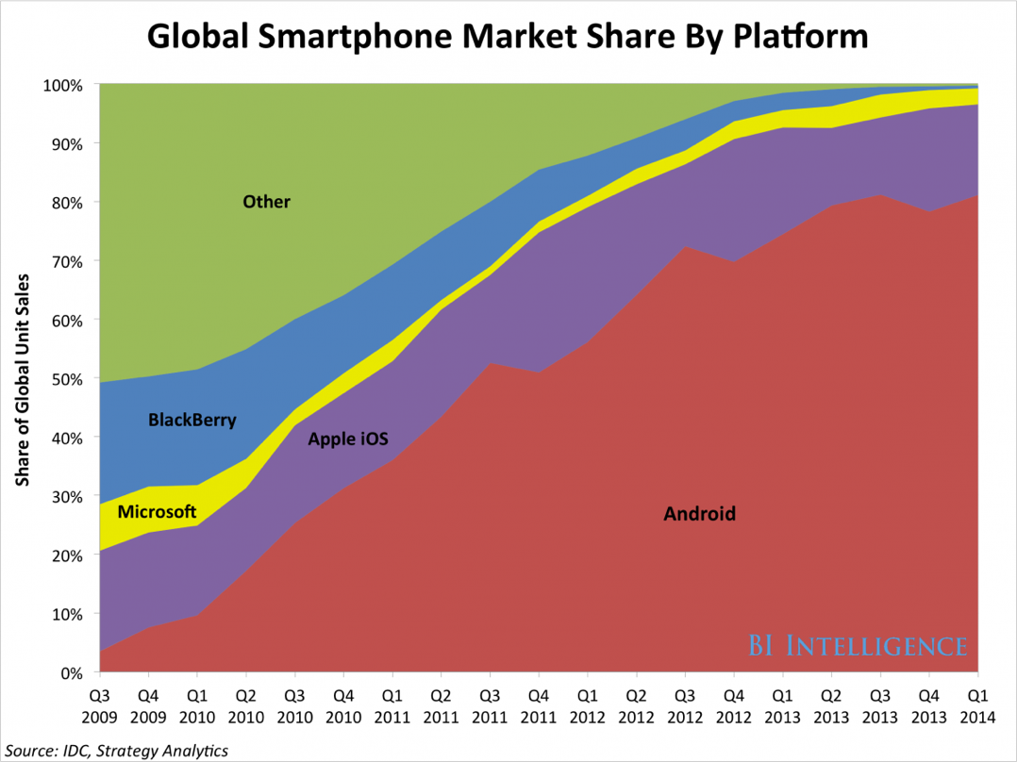
Popularity

Slide 12
Android Versions
Date | Version | Nickname | API Level
Sep 2008 | 1.0 | Android | 1
Apr 2009 | 1.5 | Cupcake | 3
Sep 2009 | 1.6 | Donut | 4
Oct 2009 | 2.0 | Eclair | 5
May 2010 | 2.2 | Froyo | 8
Dec 2010 | 2.3 | Gingerbread | 9
Feb 2011 | 3.0 | Honeycomb | 11
Oct 2011 | 4.0 | Ice Cream Sandwich | 14
July 2012 | 4.1 | Jelly Bean | 16
Oct 2013 | 4.4 | KitKat | 19
Nov 2014 | 5.0 | Lollipop | 21
Oct 2015 | 6.0 | Marshmallow | 23
Mar 2016 | N preview | Android N Developer Preview

Slide 13
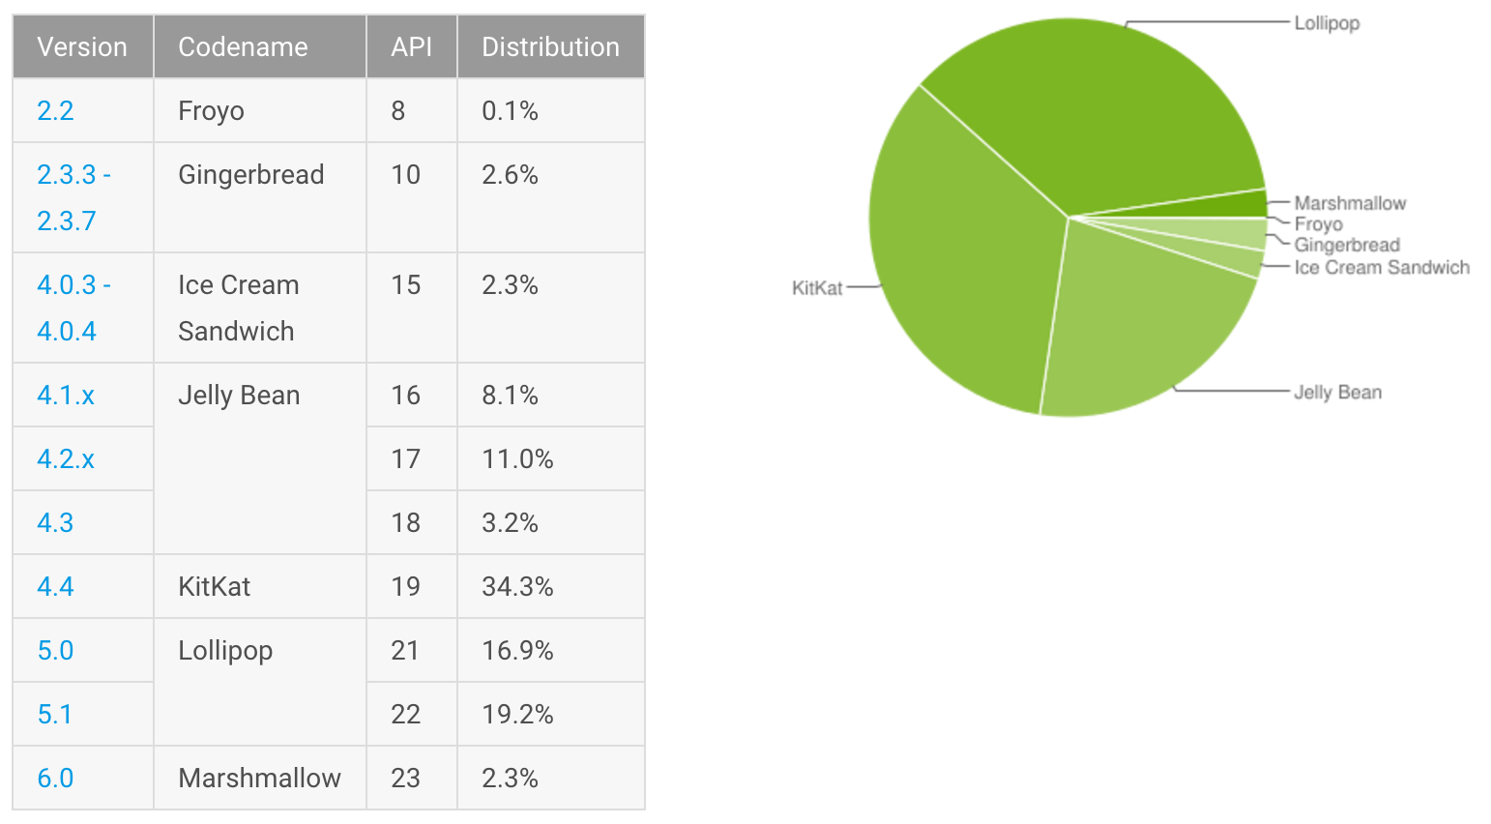
Android Versions
http://developer.android.com/about/dashboards/

Slide 14
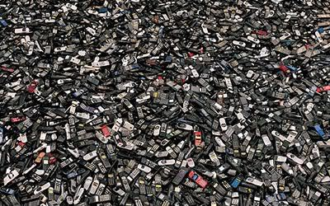
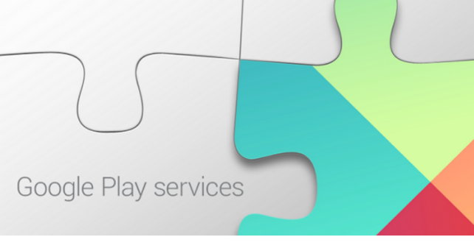
Upgrading Versions
Updates through purchasing new devices
Reliant on carriers… but some work to change that

Slide 15

https://source.android.com/

Slide 16

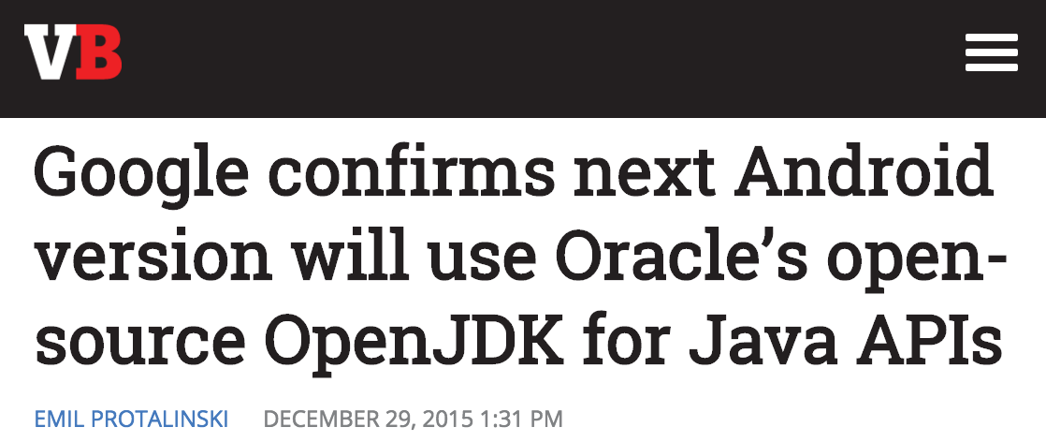
Legal Battles
vs.
Claim: Java API is copyrighted, so Google violated that by using it in Android (see EFF)

Slide 17

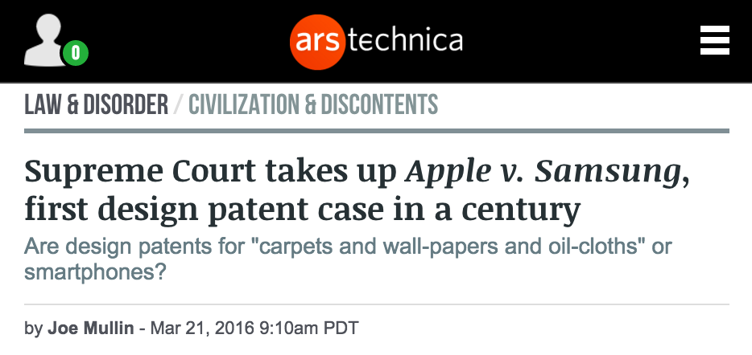
Legal Battles
vs.
Claim: Samsung infringed on Apple patents by copying elements of their UI design

Slide 18
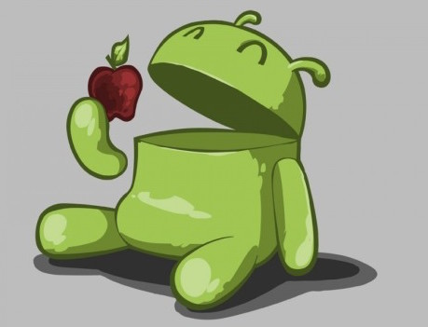

Slide 19
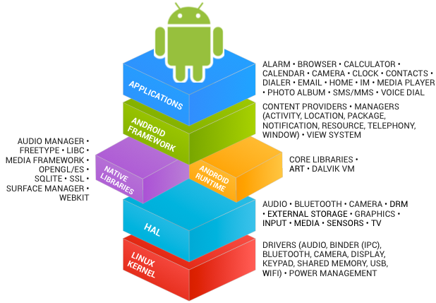
Android Architecture

Slide 20

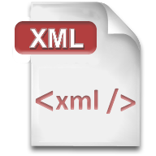
Programming Languages
Req: Journeyman Experience
Req: Any Experience

Slide 21
Building Apps: Dalvik
Dalvik Pre-Lollipop (5.0)
Register-based architecture
bytecode stored in DEX or ODEX files
Just-In-Time compilation to native code
Java Code
compile
DVM bytecode
JVM bytecode
"dexing"

Slide 22
Building Apps: ART
Android RunTime (ART) Post-Lollipop
Compile into native code on installation ("Ahead Of Time")
Accepts DEX bytecode (for backwards compatibility)
https://source.android.com/devices/tech/dalvik/

Slide 23

Packaging Apps: APKs
Basically .zip files
"side-load" or cryptographically sign for upload to Play Store

Slide 24
Building Process
Generate Java source files (e.g. from XML)
Compile Java source into JVM bytecode
"dex" JVM bytecode into Dalvik bytecode
Pack with graphics and assets into .apk
Cryptographically sign .apk
…
Profit!

Slide 25
Development Hardware
Windows, Mac, or Linux (because Java!)
Physical Android Device
turn on developer options!
Emulator (Virtual Device) available
emulator not great on Windows
use the Intel HAXM for acceleration!

Slide 26
Development Software
Java SDK
Gradle or Apache ANT
Android Studio IDE
Android SDK (command-line tools)
android manage SDK/AVDs
emulator run the emulator
adb "android debugging bridge" connect to devices (physical or virtual)

Slide 27


https://github.com/info498b-s16/lectures

