Slide 1
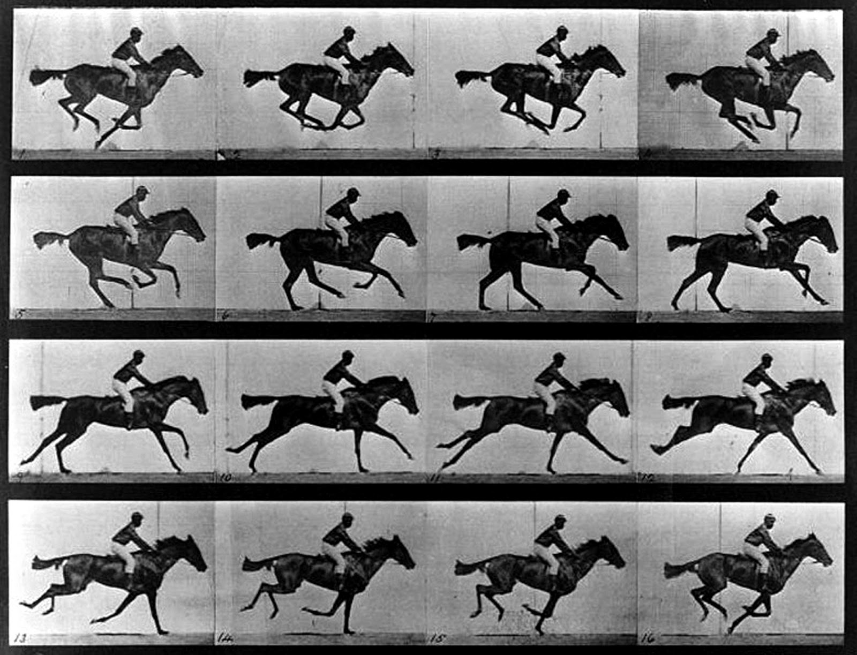

Slide 2
Interpolation
a
b

Slide 3
Interpolation
50% across
a
b
.5a + .5b

Slide 4
Interpolation
25% across
a
b
.75a + .25b

Slide 5
Interpolation
80% across
a
b
.2a + .8b

Slide 6
Interpolation
t across
a
b
(1-t)a + (t)b

