Slide 1
Google Cloud Messaging(GCM)
GCM is a push notification service.
It is completely free service.
This service helps developers to send messages between servers and client apps.
This include downstream messages from server to client app, and upstream messages from client apps to server.

Slide 2
GCM Overview
A lightweight downstream message inform a client app that there is new data to be fetched from server, for example 'new email' notification.
GCM message can transfer upto 4kb of payload to the client app.
GCM handles all aspects of queueing of messages and delivery to and from the target app.

Slide 3
Configuration
We need to configure GCM before used.
To configure GCM we need an google account.
Using an google account need to create a project on developers console.
Then enable GCM service for android i.e 'Google cloud messaging for android'.
Create an API key which is used on server side authentication.

Slide 4
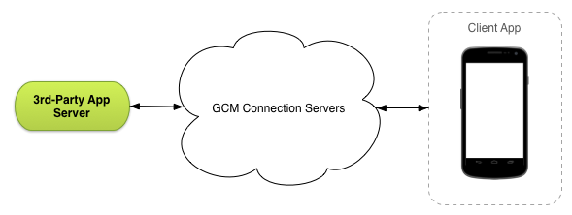
GCM Architecture

Slide 5
GCM implementation includes google connection server, an application server and client application.
Application server interact with GCM connection server.
GCM Connection Servers takes messages from application server and send them to the client app.
In our application server, we can implement either an HTTP or XMPP protocol to communicate with GCM connection server.

Slide 6
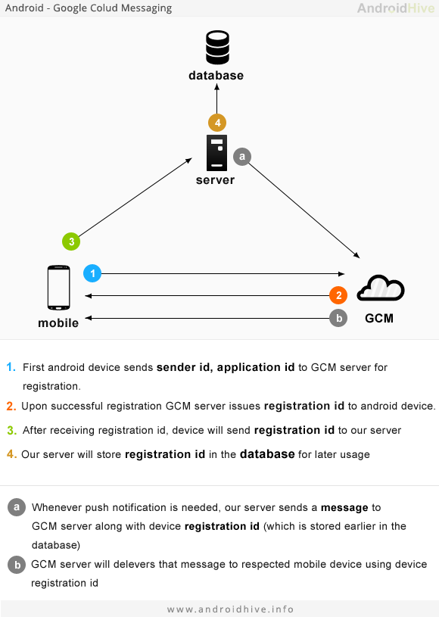
How GCM Works?

