Slide 1

Metal Backend for Hardware Acceleration
in Needle Framework
Yichen Mo, Mingming Zhang
amomorning@gmail.com, ssstare0@gmail.com
Notes:
Hello everyone, this is Yichen from online deep learning system course. Our project is metal backend for hardware acceleration in needle framework.

Slide 2
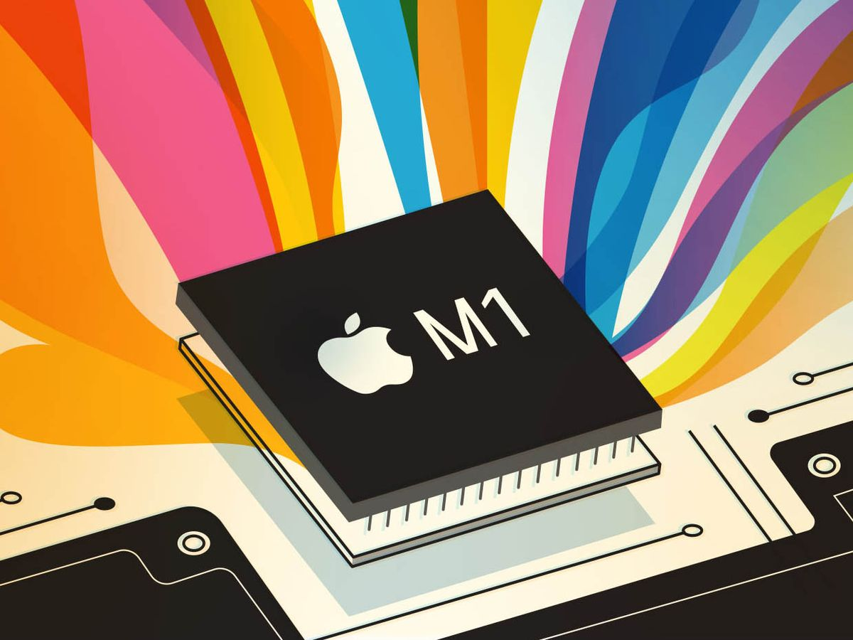
Outline
Overview
Operators
Results
Image credit: https://spectrum.ieee.org/the-mac-is-selling-like-never-before-thanks-to-the-m1-chip#toggle-gdpr
Notes:
Metal provides rich shading language and tight integration between graphics and compute.
Speaking of Apple Silicon, this newly designed M1 chip is still not perfectly supported in GPU accelerated framework, like PyTorch and Taichi.
The Needle framework has only cuda for GPU training acceleration. As our group members are all using M1 Mac, We are happy to implement this metal backend at beginning of the course, and I’d like to sharing you with our implementation as the final project.

Slide 3
Overview
Backend Selection
Backend NDArray
cuda
ndarray_backend_cuda.cu
ndarray_backend_metal.cc
metal
ops.conv
NDArray
kernels.metal
cpu
ndarray_backend_cpu.cc
cpu_numpy
Notes:
The needle framework supports a number of acceleration backend to improve the performance of its operation, such as matrix multiplication and convolutions.
Metal backend uses a queue of command buffers to organize the order of execution of computing, and all computation is defined in metal shading language, we put it into a single file named kernels.metal.

Slide 4
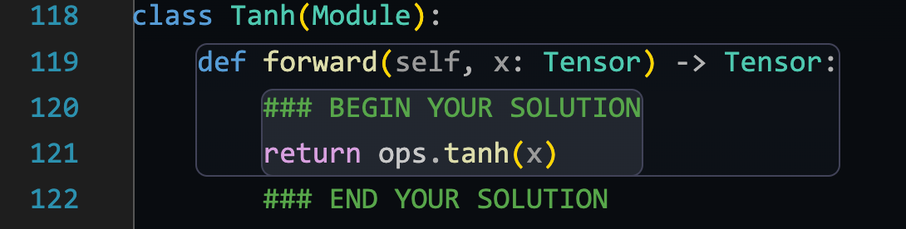
Operators
nn.py
Notes:
Take tanh activation function for example, in this pipeline we have actually implement 4 levels of abstraction.
First one is activation layer as nn module,

Slide 5
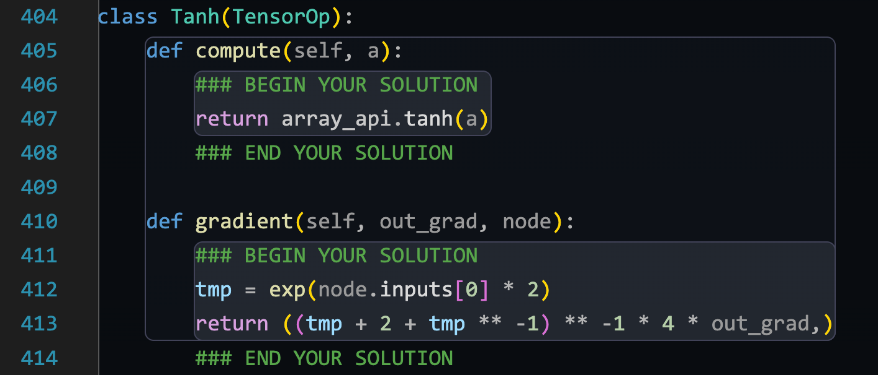
Operators
ops.py
Notes:
Second is an operator which calls backend array api ,

Slide 6
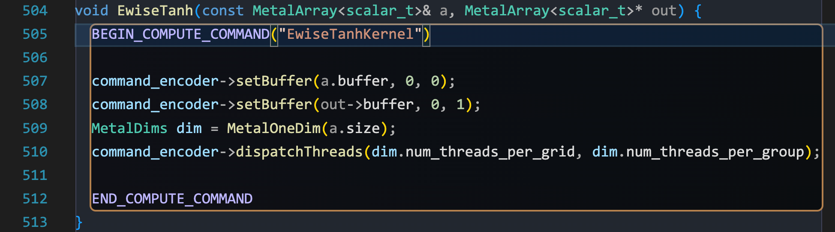
Operators
ndarray_backend_metal.cc
Notes:
Third one is in metal cplusplus interface, in which we define the command queue of computation.

Slide 7
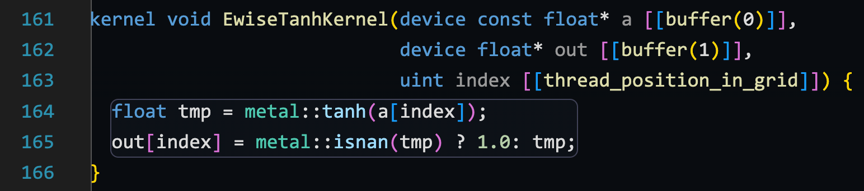
Operators
kernels.metal
Notes:
the forth is an element wise tanh kernel function, it finally calls the metal tanh api.

Slide 8
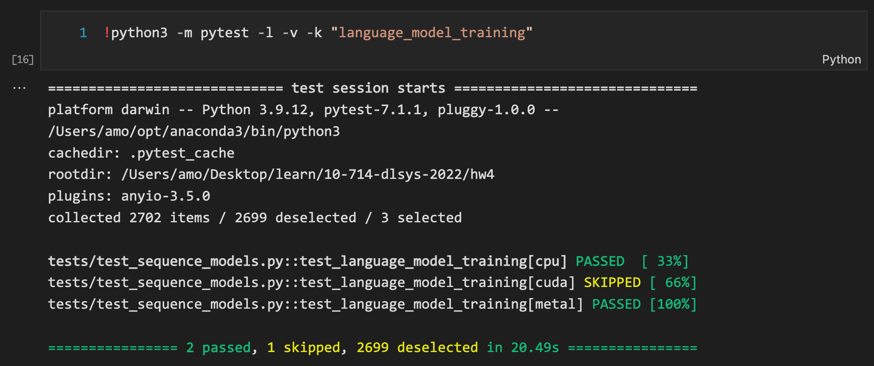
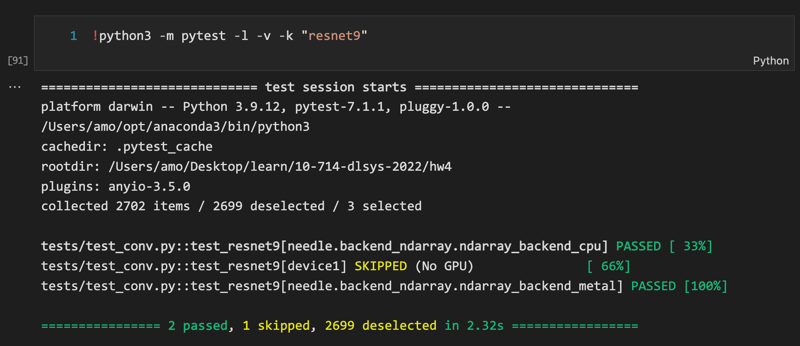
Results
Notes:
Our metal implementation works pretty well with all assignments and passed all test cases on mugrade grading system.
And we’d like to implement more fancy model and experiments in final report. Thank you for attention.

