Slide 1
EGCI 474 Lab 2:
Internetworking Technologies
Computer Engineering Department
Faculty of Engineering, Mahidol University

Slide 2
Basic Router
Commands and Configurations

Slide 3
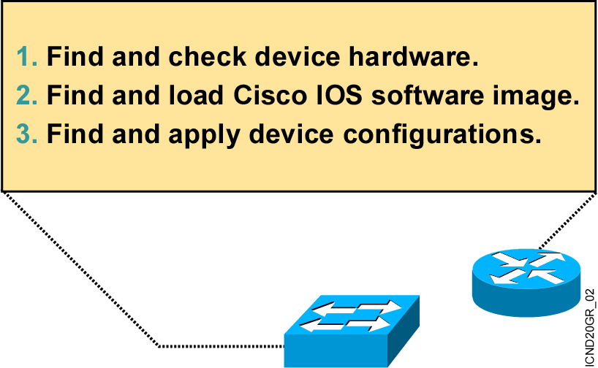
An Overview of Network Device Startup
Notes:
Purpose: This slide introduces the startup process on Cisco routers and switches.
Emphasize: Paraphrase or restate the three points and make sure your students follow the description. This description is necessary to keep a common perspective of what is occurring on the switch and the router; these three steps should be an anchor to return to as needed.
Transition: Where are the sources for configuration software?

Slide 4
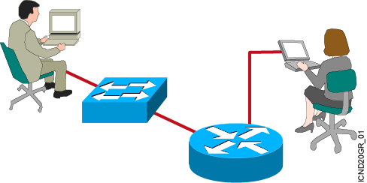
Configuring Network Devices
  Configuration sets up the device with the following:
    Network policy of the functions required
    Protocol addressing and parameter settings
    Options for administration and management
  Catalyst switch memory has initial configuration with default settings
  Cisco router will prompt for initial configuration if there is no configuration in memory
Notes:
Purpose: This slide discuss the initial configurations on the routers and switches.
Note: There is no setup mode on the Catalyst 1900 switch.

Slide 5
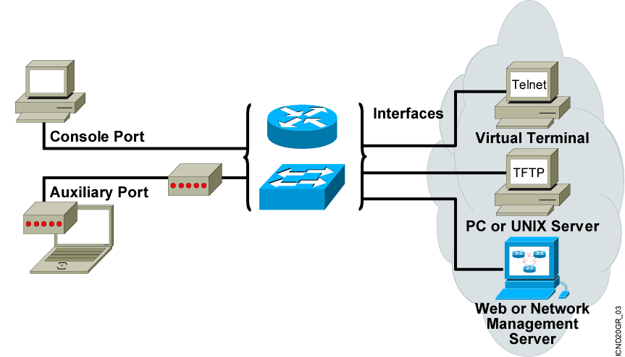
External Configuration Sources
Configurations can come from many sources.
Configurations will act in device memory.
Notes:
Purpose: This slide describes the different ways students can access the Catalyst switch or Cisco router to create a new configuration file or alter an existing one.
Emphasize: The network device can be configured from several locations. After you create the initial configuration, you can configure the ports or interfaces to enable configuration over virtual terminal ports (vty).
Both the router and switch support Telnet access as a virtual terminal.
The router by default supports virtual terminals 0 through 4. The router can be accessed for configuration purposes from the console port, the auxiliary port, and five VTY lines at the same time—up to seven people can configure the router at once.
You should caution students about the above point and inform them that security should be strictly observed through password protection to avoid unauthorized access of the configuration files.
Another component important to configuration in the network is a TFTP server.
The TFTP server can be a UNIX or PC workstation that acts as a central depository for files.
You can keep configuration files on the TFTP server and then download them to the device.
You can also configure them from a network management station running network management software such as CWSI, CiscoWorks, or HP OpenView. Before you can access or change the configuration from a virtual terminal, TFTP server, or network management station, you must have the device configured to support IP traffic.

Slide 6
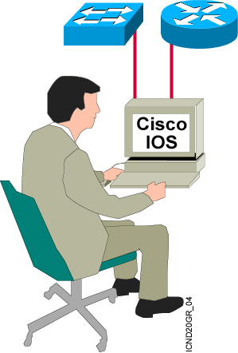
Cisco IOS User Interface Functions
  A CLI is used to enter commands.
  Operations vary on different internetworking devices.
  Users type or paste entries in the console command modes.
  Enter key instructs device to parse and execute the command.
  Two primary EXEC modes are user mode and privileged mode.
  Command modes have distinctive prompts.
Notes:
Purpose: This slide introduces the two Cisco IOS EXEC modes on the Catalyst 1900 switch and routers.
Emphasize: As you present this, describe the bullet points that can prepare your students to work with the Cisco IOS user interface.

Slide 7
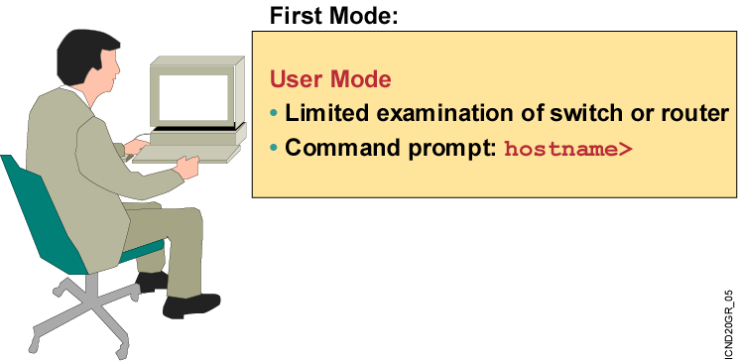
Cisco IOS Software EXEC Mode
There are two main EXEC modes for entering commands.
Notes:
Slide 1 of 2
Purpose: This slide describes the user EXEC mode.
Emphasize: Present the operational aspects of user EXEC mode.
Tell your students that this command level allows them to access only a limited amount of basic monitoring commands.
Emphasize that they need to look carefully at the command prompter to make sure that they are in the appropriate mode for the command that they want to enter into the network device. If your class can remember this, this will eliminate (or at least reduce) the number of times that you have to point out that a lab step is failing because the student is in user mode rather than in enabled mode.
Transition: An introduction of privileged (or enabled) mode.

Slide 8
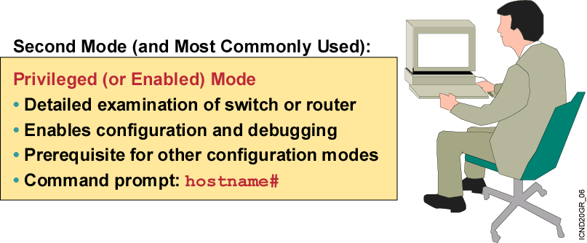
Cisco IOS Software EXEC Mode (Cont.)
Notes:
Slide 2 of 2
Purpose: This slide describes the privileged EXEC mode.
Emphasize: As you present the introductory material on privileged (also called “enabled”) mode, emphasize that this mode is the entry mode for all other configuration modes. Tell your students that they will need this mode for ICND labs and most of the network administration that they do back on the job.
Use the analogy of “the price of admission.” You must enter enable followed by the correct enable password; otherwise, you will not get into the network device; and will have to stay outside in user mode where you can only see a few basic things about the network device.
Note: This slide ends the introductory material that is common to the network devices covered in ICND.
Transition: Material specific to the initial startup of the Catalyst switch.

Slide 9
Summary
  The Cisco IOS software platform is implemented on all Cisco hardware platforms.
  You will use Cisco IOS software to communicate the configuration details that implement the learning objectives of this course.
  You can configure a switch or router from sources that are external to the device.
  Cisco IOS software uses a CLI as its traditional console environment. While Cisco IOS software is a core technology, Cisco IOS software operation details vary on different internetworking devices.
  The Cisco IOS software supports two EXEC command modes: user and privileged.
Notes:
Purpose: This slide discuss the initial configurations on the routers and switches.
Note: There is no setup mode on the Catalyst 1900 switch.

Slide 10
Router
Operate at Layer 3
Route packet between subnet
Usually, the function of router is to connect to WAN
Router will provide LAN Interface to connect to LAN Switch

Slide 11
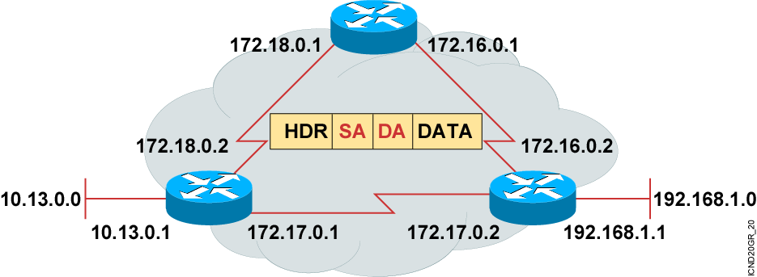
IP Addresses on Router and Host
  Unique addressing allows communication between end stations.
  Path choice is based on destination address.
  Location is represented by an address
Notes:
Purpose: This is an introduction slide to the IP addressing section.
Emphasize: Stations with internetwork access must have unique addresses.

Slide 12

Internal Configuration Components
RAM
NVRAM
Flash
ROM
console
Interface
Auxiliary

Slide 13
Router’s Memory
RAM → Working Area and Active Configuration
Flash → IOS software
ROM → Bootstrap ROM Monitor
NVRAM → Startup Configuration File

Slide 14
Connecting Console Interfaces
Connect a rollover cable to the router console port (RJ-45 connector).
Connect the other end of the rollover cable to the RJ-45 to DB-9 adapter
Attach the female DB-9 adapter to a PC.
Configure terminal emulation software on the PC for the following
  The appropriate com port
  9600 baud
  8 data bits
  1 stop bit
  No parity
  No flow control

Slide 15
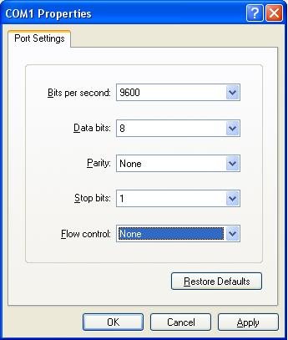
Connecting Console Interface

Slide 16
Cisco IOS
And Overview of Router Modes

Slide 17
Show version Command
wg_ro_a#show version
Cisco Internetwork Operating System Software
IOS (tm) 2500 Software (C2500-JS-L), Version 12.0(3), RELEASE SOFTWARE (fc1)
Copyright (c) 1986-1999 by cisco Systems, Inc.
Compiled Mon 08-Feb-99 18:18 by phanguye
Image text-base: 0x03050C84, data-base: 0x00001000
ROM: System Bootstrap, Version 11.0(10c), SOFTWARE
BOOTFLASH: 3000 Bootstrap Software (IGS-BOOT-R), Version 11.0(10c), RELEASE SOFTWARE (fc1)
wg_ro_a uptime is 20 minutes
System restarted by reload
System image file is "flash:c2500-js-l_120-3.bin"
--More--
Configuration register is 0x2102
Configuration register value in show version
Notes:
Emphasize: Use the show version command to display the value of the config register setting. When you change the config register, you will see the change from the show version output:
Configuration register is 0x2102 (will be 0x2142 at next reload).
The new config register value will be used at the next reload.

Slide 18
show flash Command
wg_ro_a#show flash
System flash directory:
File Length Name/status
1 10084696 c2500-js-l_120-3.bin
[10084760 bytes used, 6692456 available, 16777216 total]
16384K bytes of processor board System flash (Read ONLY)
Notes:
Note: The current state of the Flash memory is in read-only mode. It is running Cisco IOS from Flash.
This router has a total of 16 MB of Flash memory. The Flash contains one Cisco IOS image and there is 6.69 MB of available space left in Flash.

Slide 19
Purpose of Cisco IOS Software
Function as operating system for Cisco Router
Basic routing functions
Reliable and secure access to networked resources
Network scalability
Other services and features such as QoS, Multicast etc

Slide 20
Cisco IOS Naming Conventions
ตัวอย่างเช่น c2600-jk9o3s-mz.122-27.bin
  C2600 → เป็น IOS ที่ทำงานอยู่ในเราท์เตอร์ตระกูล 2600
  Jk9o3s → บ่งบอกถึงฟีเจอร์เซตของ IOS
  M → m หมายถึง IOS รุ่นนี้ทำงานใน RAM
  Z → z หมายถึง IOS รุ่นนี้ได้รับการบีบอัดแบบ zip compressed
  122.27 → เป็นหมายเลขเวอร์ชันของ IOS (major release 12.2 และ maintenance release 27)

Slide 21
Router Startup Sequence
Perform power-on self test (POST) to discover and verify hardware
Load and run bootstrap code from ROM
Find the Cisco IOS software and Load It.
Find the startup configuration and Load it into running configuration

Slide 22
Router Startup Sequence
ROM
Bootstrap
Load Bootstrap
Flash
Cisco
Internetwork
Operating
System
Locate and load
Operating system
TFTP Server
ROM
NVRAM
Configuration
File
Locate and load
Configuration file
Or
Enter setup - mode
TFTP Server
Console

Slide 23
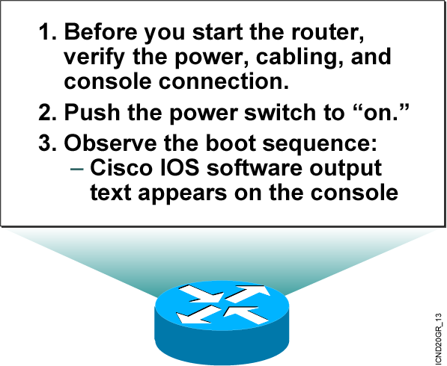
Initial Startup of the Cisco Router
  System startup routines initiate router software
  Router falls back to startup alternatives if needed
Notes:
Purpose: This slide describes a high-level overview of the startup sequences on the router.
Emphasize: A detailed flowchart covers this in much more detail in Chapter 6, “Catalyst Switch Operations.” Config register is also covered in Chapter 6.
The startup routines for Cisco IOS software have the goal of starting router operations. The router must deliver reliable performance connecting the user networks it was configured to serve. To do this, the startup routines must:
Make sure that the router comes up with tested hardware.
Find and load the Cisco IOS software that the router uses for its operating system.
Find and apply the configuration statements about router-specific attributes, protocol functions, and interface addresses.
The router will make sure that it comes up with tested hardware. When a Cisco router powers up, it performs a POST. These diagnostics verify the basic operation of the CPU, memory, and interface circuitry. After verifying the hardware functions, the router proceeds with software initialization. Some startup routines act as fallback operations that are able to perform the router startup should other routines be unable to do so. This flexibility allows Cisco IOS software to start up in a variety of initial situations.

Slide 24
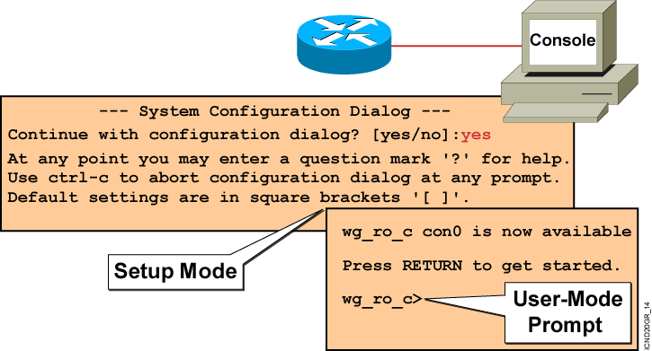
Bootup Output from the Router
  Unconfigured Versus Configured Router
Notes:
Purpose: This slide describes the difference between the console output of an unconfigured router and a configured router.
Emphasize: The router has setup mode to prompt the user for an initial configuration. The Catalyst 1900 switch has no setup mode, it comes with a factory default configuration.
Transition: The next series of slides shows the setup mode prompting.
Note: The setup mode prompting on Cisco IOS Release 12.0 is different than pre-release 12.0.

Slide 25
Setup: The Initial Configuration Dialog
Router#setup
--- System Configuration Dialog ---
Continue with configuration dialog? [yes/no]: yes
At any point you may enter a question mark '?' for help.
Use ctrl-c to abort configuration dialog at any prompt.
Default settings are in square brackets '[]'.
Basic management setup configures only enough connectivity
for management of the system, extended setup will ask you
to configure each interface on the system
Would you like to enter basic management setup? [yes/no]: no
Notes:
Purpose: This slide describes the setup mode on the router.
Emphasize: One routine for initial configuration is the setup mode. The primary purpose of the setup mode is to rapidly bring up a minimal-feature configuration for any router that cannot find its configuration from some other source.
For many of the prompts in the system configuration dialog of the setup command facility, default answers appear in square brackets ([ ]) following the question. Pressing the Return key allows you to use the defaults. If the system was previously configured, the defaults that appear are the currently configured values. If you are configuring the system for the first time, the factory defaults are provided. If there is no factory default, as in the case of passwords, nothing is displayed after the question mark (?).
At this point, you can choose not to continue with the system configuration dialog and exit by entering No at the prompt. To begin the initial configuration process, enter Yes. You can press Ctrl-C to terminate the process and start over at any time. When you are using the command form of setup (Router#setup), Ctrl-C returns you to the privileged EXEC prompt (Router#).
If a “-- More --” prompt appears, press the space bar to continue.
Note: When the student performs the router setup mode lab later, make sure they select “no” at the “Would you like to enter basic management setup?” prompt.

Slide 26
Setup Initial Global Parameters
Configuring global parameters:
Enter host name [Router]:wg_ro_c
The enable secret is a password used to protect access to
privileged EXEC and configuration modes. This password, after
entered, becomes encrypted in the configuration.
Enter enable secret: cisco
The enable password is used when you do not specify an
enable secret password, with some older software versions, and
some boot images.
Enter enable password: sanfran
The virtual terminal password is used to protect
access to the router over a network interface.
Enter virtual terminal password: sanjose
Configure SNMP Network Management? [no]:
Notes:
Slide 1 of 2
Purpose: This slide describes the setup mode on the router.
Emphasize: You are prompted for global parameters at the console. You use the configuration values you have determined for your router to enter the global parameters at the prompts.
The first global parameter allows you to set the router host name. This host name will precede the Cisco IOS prompts for all configuration modes. At the factory the router name default is shown between the square brackets as [Router].
Use the next global parameters shown to set the various passwords used on the router.
You must enter an enable secret password. When you enter a string of password characters for the prompt to “Enter enable secret,” the characters are processed by Cisco-proprietary encryption, which can enhance the security of the password string. Whenever anyone lists the contents of the router configuration file, this enable password appears as a meaningless string of characters. Setup recommends, but does not require, that the enable password be different from the enable secret password.

Slide 27
Setup Initial Protocol Configurations
Configure LAT? [yes]: no
Configure AppleTalk? [no]:
Configure DECnet? [no]:
Configure IP? [yes]:
Configure IGRP routing? [yes]: no
Configure RIP routing? [no]:
Configure CLNS? [no]:
Configure IPX? [no]:
Configure Vines? [no]:
Configure XNS? [no]:
Configure Apollo? [no]:
Notes:
Slide 2 of 2
Purpose: This slide describes the setup mode on the router.
Emphasize: When the students perform the lab later, make sure the students select “yes” to “Configure IP?” and “no” to all other protocols.

Slide 28
Setup Interface Parameters
BRI interface needs isdn switch-type to be configured
Valid switch types are :
[0] none..........Only if you don't want to configure BRI.
[1] basic-1tr6....1TR6 switch type for Germany
[2] basic-5ess....AT&T 5ESS switch type for the US/Canada
[3] basic-dms100..Northern DMS-100 switch type for US/Canada
[4] basic-net3....NET3 switch type for UK and Europe
[5] basic-ni......National ISDN switch type
[6] basic-ts013...TS013 switch type for Australia
[7] ntt...........NTT switch type for Japan
[8] vn3...........VN3 and VN4 switch types for France
Choose ISDN BRI Switch Type [2]:
Configuring interface parameters:
Do you want to configure BRI0 (BRI d-channel) interface? [no]:
Do you want to configure Ethernet0 interface? [no]: yes
Configure IP on this interface? [no]: yes
IP address for this interface: 10.1.1.33
Subnet mask for this interface [255.0.0.0] : 255.255.255.0
Class A network is 10.0.0.0, 24 subnet bits; mask is /24
Do you want to configure Serial0 interface? [no]:
Notes:
Purpose: This slide describes the setup mode on the router.
Emphasize: You are prompted for parameters for each installed interface. You use the configuration values you have determined for your interface to enter the interface parameters at the prompts. Later on in the lab, the students will only be configuring an IP address on E0 only.
Note: With 12.0, the subnet mask is actually entered in dotted decimal format.

Slide 29
Setup Interface Summary
First, would you like to see the current interface summary? [yes]:
Interface IP-Address OK? Method Status Protocol
BRI0 unassigned YES unset administratively down down
BRI0:1 unassigned YES unset administratively down down
BRI0:2 unassigned YES unset administratively down down
Ethernet0 unassigned YES unset administratively down down
Serial0 unassigned YES unset administratively down down
  Interfaces Found During Startup
Notes:
Purpose: This slide describes the setup mode on the router.

Slide 30
Setup Script Review and Use
The following configuration command script was created:
hostname Router
enable secret 5 $1$/CCk$4r7zDwDNeqkxFO.kJxC3G0
enable password sanfran
line vty 0 4
password sanjose
no snmp-server
!
no appletalk routing
no decnet routing
ip routing
no clns routing
no ipx routing
no vines routing
no xns routing
no apollo routing
isdn switch-type basic-5ess
interface BRI0
shutdown
no ip address
!
interface Ethernet0
no shutdown
ip address 10.1.1.31 255.255.255.0
no mop enabled
!
interface Serial0
shutdown
no ip address
<text omitted>
end
[0] Go to the IOS command prompt without saving this config.
[1] Return back to the setup without saving this config.
[2] Save this configuration to nvram and exit.
Enter your selection [2]:
Notes:
Purpose: This slide describes the options available when exiting out of the setup mode on the router.
Emphasize: When you complete the configuration process, select [2] to save the configurations to NVRAM and make the configuration active in RAM.
If you select [0], the configuration is not saved to NVRAM or RAM.
Note: With 12.0, these are new options to select when exiting setup mode.

Slide 31
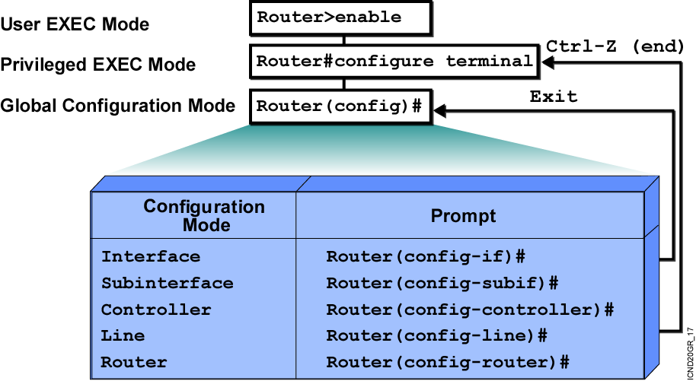
Overview of Router Modes
Notes:
Emphasize: Here is a list of some of the configuration modes available.
For a complete list of the router configuration modes, refer to the Cisco Documentation CD-ROM.

Slide 32
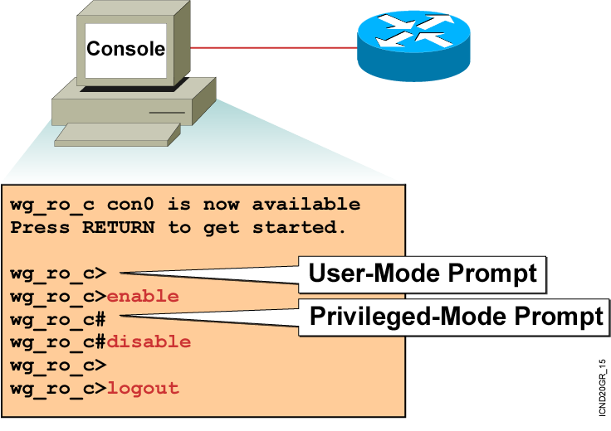
Logging In to the Router
Notes:
Purpose: This slide discusses the two EXEC modes.
Emphasize: Teach your students to look for and identify the prompt that indicates if they are in the correct mode for a given command.

Slide 33
Router User-Mode Command List
wg_ro_c>?
Exec commands:
access-enable Create a temporary Access-List entry
atmsig Execute Atm Signalling Commands
cd Change current device
clear Reset functions
connect Open a terminal connection
dir List files on given device
disable Turn off privileged commands
disconnect Disconnect an existing network connection
enable Turn on privileged commands
exit Exit from the EXEC
help Description of the interactive help system
lat Open a lat connection
lock Lock the terminal
login Log in as a particular user
logout Exit from the EXEC
-- More --
  You can abbreviate a command to the fewest characters that make a unique character string.
Notes:
Emphasize: Notice that there are more commands available on the router than the Catalyst 1900 switch.

Slide 34
Router Privileged-Mode Command List
wg_ro_c#?
Exec commands:
access-enable Create a temporary Access-List entry
access-profile Apply user-profile to interface
access-template Create a temporary Access-List entry
bfe For manual emergency modes setting
cd Change current directory
clear Reset functions
clock Manage the system clock
configure Enter configuration mode
connect Open a terminal connection
copy Copy from one file to another
debug Debugging functions (see also 'undebug')
delete Delete a file
dir List files on a filesystem
disable Turn off privileged commands
disconnect Disconnect an existing network connection
enable Turn on privileged commands
erase Erase a filesystem
exit Exit from the EXEC
help Description of the interactive help system
-- More --
  You can complete a command string by entering the unique character string, then pressing the Tab key.
Notes:
Emphasize: Notice that there are more commands available on the router than the Catalyst 1900 switch.

Slide 35
Router Command-Line Help Facilities
Context-Sensitive Help
Console Error Messages
Provides a list of commands and the arguments associated
with a specific command
Identifies problems with router commands that are incorrectly entered so you can alter or correct them
Command History Buffer
Allows recall of long or complex commands or entries for reentry, review, or correction
Notes:
Note: The Catalyst 1900 has a fixed history size of 10 which can’t be changed.

Slide 36
Router Context-Sensitive Help
Router#
clok
Translating "CLOK"
% Unknown command or computer name, or unable to find computer address
Router#
cl?
clear clock
Symbolic Translation
Command Prompting
Last Command Recall
Router#
clock
% Incomplete command.
Router#
clock ?
set Set the time and date
Router#
clock set
% Incomplete command.
Router#
<Ctrl-P>clock set ?
hh:mm:ss Current Time
Notes:
Slide 1 of 2
Emphasize: Suppose you want to set the router clock. If you do not know the command, use context-sensitive help to check the syntax for setting the clock. The help output shows that the set keyword is required. Next, check the syntax for entering the time.
Now enter the current time using hours, minutes, and seconds, as shown.
The system indicates that you need to provide additional arguments to complete the command. Press Ctrl-P (or Up arrow) to repeat the previous command entry automatically. Then add a space and a question mark (?) to reveal the additional arguments.
Now you can complete the command entry.
The caret symbol (^) and help response indicate an error. To list the correct syntax, reenter the command up to the point where the error occurred, and then enter a question mark (?).
Enter the year using the correct syntax and press Return to execute the command.
Note that the user interface provides syntax checking in the form of an error location indicator (^). The caret symbol character appears at the point in the command string where you entered an incorrect command, keyword, or argument. The error location indicator and interactive help system allow you to find and correct syntax errors easily.

Slide 37
Router Context-Sensitive Help (cont.)
Router# clok
Translating "CLOK"
% Unknown command or computer name, or unable to find computer address
Router#
clock set 19:56:00
% Incomplete command.
Router#
Command Prompting
Syntax Checking
Command Prompting
clear clock
Router#
clock set 19:56:00 ?
<1-31> Day of the month
Router#
MONTH Month of the year
% Incomplete command.
Router#
clock set 19:56:00 04 8
Router#
^
set Set the time and date
% Invalid input detected at the '^' marker
Router#
Router#
clock set 19:56:00 04 August
% Incomplete command.
% Incomplete command.
Router#
Router#
clock set 19:56:00 04 August ?
<1993-2035> Year
hh:mm:ss Current Time
Notes:
Slide 2 of 2

Slide 38
Enhanced Editing Commands
Router>Shape the future of internetworking by creating unpreced
  Shape the future of internetworking by creating unprecedented value for customers, employees, and partners.
Notes:
Layer 1 of 9
Purpose: This slide explains how to use the editing capabilities of Cisco IOS software.
Emphasize: Layer 1—Some commands can be longer than the number of characters available on the screen after the prompt. The user interface now supports automatic scrolling of long lines. Notice that we have run out of room on this line. The line will scroll over ten spaces at a time in order to allow longer lines.

Slide 39
Enhanced Editing Commands (cont.)
Router>$ value for customers, employees, and partners.
(Automatic scrolling of long lines.)
Ctrl-A
Move to the beginning of the command line.
Ctrl-E
Move to the end of the command line.
Esc-B
Move back one word.
Esc-F
Move forward one word.
Ctrl-B
Move back one character.
Ctrl-F
Move forward one character.
Ctrl-D
Delete a single character.
Notes:
Layer 9 of 9
Emphasize: Layer 9 — Ctrl-D deletes a single character.

Slide 40
Router Command History
Ctrl-P or Up Arrow
Recalls last (previous) commands
Ctrl-N or Down Arrow
Recalls more recent commands
show history
Shows command buffer contents
history size line
Sets the buffer size permanently
terminal history size lines
Sets session command buffer size
Notes:
Emphasize: The user interface provides a history or record of commands you have entered. This feature is particularly useful for recalling long or complex commands or entries. With the command history feature, you can complete the following tasks:
Set the command history buffer size
Recall commands
Disable the command history feature
By default, command history is enabled and the system records ten command lines in its history buffer. To change the number of command lines the system will record during the current terminal session, use the terminal history size or history size command. The maximum number of commands is 256.
To recall commands in the history buffer beginning with the most recent command, press Ctrl-P or the Up arrow key. Repeat the key sequence to recall successively older commands.To return to more recent commands in the history buffer after recalling commands with Ctrl-P or the Up arrow, press Ctrl-N or the Down arrow. Repeat the key sequence to recall successively more recent commands.
Once you enter the unique characters for a command, press the Tab key and the interface will finish the entry for you.
On most laptop computers you may also have additional select and copy facilities available. Copy a previous command string, then paste or insert it as your current string.
Note: The Catalyst 1900 has a fixed history size of ten which can’t be changed.

Slide 41
Examining the show Commands
There are many show commands that you can use to examine the contents of files in the route and for troubleshooting.
In both privileged EXEX and user EXEC modes, the command show ? Provides a list of available show commands

Slide 42
show version Command
wg_ro_a# show version
Cisco Internetwork Operating System Software
IOS (tm) 2500 Software (C2500-JS-L), Version 12.0(3), RELEASE SOFTWARE (fc1)
Copyright (c) 1986-1999 by cisco Systems, Inc.
Compiled Mon 08-Feb-99 18:18 by phanguye
Image text-base: 0x03050C84, data-base: 0x00001000
ROM: System Bootstrap, Version 11.0(10c), SOFTWARE
BOOTFLASH: 3000 Bootstrap Software (IGS-BOOT-R), Version 11.0(10c), RELEASE SOFTWARE(fc1)
wg_ro_a uptime is 20 minutes
System restarted by reload
System image file is "flash:c2500-js-l_120-3.bin"
(output omitted)
--More--
Configuration register is 0x2102
Notes:
Purpose: This slide presents the show version command.
Emphasize: Point out that this command is useful when troubleshooting problems because it gives the versions of the various software components and files. It also displays how long the router has been in operation and where it obtained the image file.
Config register is discussed in Chapter 6, “Catalyst Switch Operations.”

Slide 43
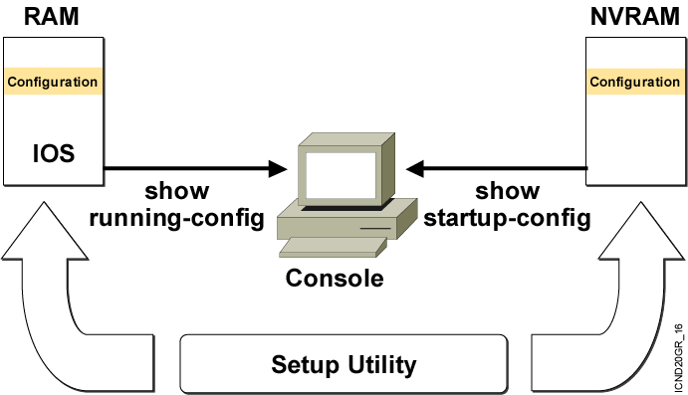
Viewing the Configuration
Notes:
Emphasize: When you exit the setup mode, the configuration can be saved to RAM and NVRAM at the same time.
Note: The Catalyst 1900 has no show start command. It automatically saves the running configuration to NVRAM.

Slide 44
show running-config and show startup-config Commands
In RAM
In NVRAM
wg_ro_c#show running-config
Building configuration...
Current configuration:
!
version 12.0
!
-- More --
wg_ro_c#show startup-config
Using 1359 out of 32762 bytes
!
version 12.0
!
-- More --
  Displays the current and saved configuration
Notes:
Purpose: This slide shows the format and output of the show running-config and show startup-config commands, which display the active and backup configuration files, respectively.
Emphasize: We put these two commands on the same page because it is easy to confuse the two. The show running-config command displays the configuration information in memory, while the show startup-config command displays the backup file.
Often in class someone will enter commands and then say that the router did not accept them. This scenario might indicate that the person entered the commands to modify the configuration information in memory, and then entered a show startup-config (show config) to look at the backup file that has not yet been updated to reflect the changes. You must use another command to update the backup file.
Default parameters do not display in the running configuration.
In Cisco IOS Release 10.2 and earlier, the write terminal command shows the running configuration, and the show config command shows the startup configuration.

Slide 45
Saving Configurations
wg_ro_c#
wg_ro_c#copy running-config startup-config
Destination filename [startup-config]?
Building configuration…
wg_ro_c#
  Copies the current configuration to NVRAM
  Another command is “wr”
  Be aware that we need to use “copy run start” in lab simulation part
Notes:
Emphasize: Copying to NVRAM overwrites the contents in NVRAM.

Slide 46
Summary
  The startup of a Cisco router requires that you verify the physical installation, power up the router, and view the Cisco IOS software output on the console.
  The router startup sequence is similar to the startup sequence of the Catalyst switch. The router first performs POST, then it finds and loads the IOS image. Finally, it finds and loads the device configuration file.
  Use the enable command to access the privileged EXEC mode from the user EXEC mode.

Slide 47
Summary (Cont.)
  The Cisco router uses Cisco IOS software with extensive command-line input help facilities, including context-sensitive help.
  The Cisco IOS CLI includes an enhanced editing mode that provides a set of editing key functions.
  The Cisco router CLI provides a history or record of commands you have entered. This feature, called the command history, is particularly useful to help you recall long or complex commands or entries.
  After logging in to a Cisco router, you can verify the router initial startup status using the router status commands: show version, show running-configuration, and show startup-configuration.

Slide 48
Basic Router Configurations

Slide 49
Configuring a Router Name
Router(config)#hostname Einstein
Einstein(config)#

Slide 50
Other Console-Line Commands
Router(config)#line console 0
Router(config-line)#exec-timeout 0 0
  Prevents console session timeout
Router(config)#line console 0
Router(config-line)#logging synchronous
  Redisplays interrupted console input
Notes:
Emphasize: If the student enters no exec by mistake, the console port EXEC mode will be disabled once the student is logged out of the current session. If this happens, you have to break into the router using ROM monitor to recover (set the config reg to 0x2142 so it will ignore NVRAM).

Slide 51
Configuring an Interface
Router(config)#interface type number
Router(config-if)#
  type includes serial, ethernet, token ring, fddi, hssi, loopback, dialer,
  null, async, atm, bri, tunnel, and so on
  number is used to identify individual interfaces
Router(config)#interface type slot/port
Router(config-if)#
  For modular routers, selects an interface
Router(config-if)#exit
Quits from current interface configuration mode
Notes:
Purpose: This slide shows the interface configuration mode.
Emphasize: The top line is the format of the command used in fixed-port routers. The type field shows the interface type, which can be Ethernet, Token Ring, or another interface. The number field is the number of the interface. For example, if the router has two Ethernet interfaces, and one is known as Ethernet0, the other will be called Ethernet1.
The second command is used on the Cisco 7000 and 7200 series routers, which can accept multiple interface cards with multiple ports on each card. In this case, the first number is the number of the card, or slot number. The second number is the port on the card. For example, on the second interface card, the first Ethernet interface is specified as Ethernet 2/0.
If you have Cisco 7000 and 7500 series routers with VIP cards, you define an interface by slot, port adapters, and port numbers. Port adapters are assigned either a 0 or 1 number.
Use the exit command to leave the current configuration mode.

Slide 52
Configuring a Serial Interface
Enter Global
Configuration Mode
Router#configure terminal
Router(config)#
Router(config)#interface serial 0
Router(config-if)#
Specify Interface
Set Clock Rate
(on DCE interfaces only)
Router(config-if)#clock rate 64000
Router(config-if)#
Router(config-if)#bandwidth 64
Router(config-if)#exit
Router(config)#exit
Router#
Set Bandwidth
(recommended)
Notes:
Layer 2 of 2
Purpose: This slide shows two configuration parameters for the serial interface.
Emphasize: Layer 2— Issue the clock rate command with the desired speed. On serial links, one side of the link acts as the DCE and the other side of the link acts as the DTE. By default, Cisco routers are DTE devices, but can be configured as DCE devices. In a “back-to-back” cable configuration where a modem is not used, one end must provide the clocking signal. You must specify a clock rate for the DCE interface end in this type of environment. Desired clock rate is in bits per second. Be sure to enter the complete clock speed. For example, a clock rate of 56000 cannot be abbreviated to 56. If you are using an EIA/TIA-232 cable, using a high clock rate may cause errors on the line. Use the show controller serial 0 command to verify if the router has a DCE or DTE cable connected to it. Note, the router only reads the DCE/DTE cable information at startup.
The bandwidth command overrides the default bandwidth (1.544M). The bandwidth parameter (in kbps) is used to calculate statistics like load and it is used by routing protocols such as IGRP. We will learn more about routing protocols in Chapter 9, “Determining IP Routes.”
To return to privileged EXEC mode, enter exit until the privileged EXEC prompt appears.
Note: In the lab, the core router has the DCE cables and the workgroup router has the DTE cable.

Slide 53
Disabling or Enabling an Interface
Router#configure terminal
Router(config)#interface serial 0
Router(config-if)#shutdown
%LINK-5-CHANGED: Interface Serial0, changed state to administratively down
%LINEPROTO-5-UPDOWN: Line protocol on Interface Serial0, changed state to down
Administratively turns off an interface
Router#configure terminal
Router(config)#interface serial 0
Router(config-if)#no shutdown
%LINK-3-UPDOWN: Interface Seria0, changed state to up
%LINEPROTO-5-UPDOWN: Line Protocol on Interface Serial0, changed state to up
Enables an interface that is administratively shut down
Notes:
Emphasize: The Catalyst 1900 switch also uses the shut and no shut command.

Slide 54

Interface descriptions
An interface description should be used to identify important information such as a distant router, a circuit number, or a specific network segment.

Slide 55
Configuring the Router IP Address
wg_ro_c#configure terminal
wg_ro_c(config)#interface ethernet 0
wg_ro_c(config-if)#ip address 192.168.1.1 255.255.255.0
wg_ro_c(config-if)#no shutdown
wg_ro_c(config-if)#exit

Slide 56
Router show interfaces Command
Router#show interfaces
Ethernet0 is up, line protocol is up
Hardware is Lance, address is 00e0.1e5d.ae2f (bia 00e0.1e5d.ae2f)
Internet address is 10.1.1.11/24
MTU 1500 bytes, BW 10000 Kbit, DLY 1000 usec, rely 255/255, load 1/255
Encapsulation ARPA, loopback not set, keepalive set (10 sec)
ARP type: ARPA, ARP Timeout 04:00:00
Last input 00:00:07, output 00:00:08, output hang never
Last clearing of "show interface" counters never
Queueing strategy: fifo
Output queue 0/40, 0 drops; input queue 0/75, 0 drops
5 minute input rate 0 bits/sec, 0 packets/sec
5 minute output rate 0 bits/sec, 0 packets/sec
81833 packets input, 27556491 bytes, 0 no buffer
Received 42308 broadcasts, 0 runts, 0 giants, 0 throttles
1 input errors, 0 CRC, 0 frame, 0 overrun, 1 ignored, 0 abort
0 input packets with dribble condition detected
55794 packets output, 3929696 bytes, 0 underruns
0 output errors, 0 collisions, 1 interface resets
0 babbles, 0 late collision, 4 deferred
0 lost carrier, 0 no carrier
0 output buffer failures, 0 output buffers swapped out
Notes:
Purpose: This slide presents the show interfaces command, which indicates whether the network is operating at the physical and data link layers. The command output is interpreted later in this chapter.
Emphasize: The top line of the output tells us that the line is up. A few lines down, the output provides the IP address, and below that some characteristics like BW for bandwidth, and DLY for delay. On the next line down, we find an encapsulation type of ARPA. ARPA means Ethernet II, which is the default IP encapsulation type for Ethernet interfaces on Cisco routers.
A runt is an Ethernet frame that is too small to be legal (less than 64 bytes), and a giant is an Ethernet frame that is too big (greater than 1518 bytes).

Slide 57
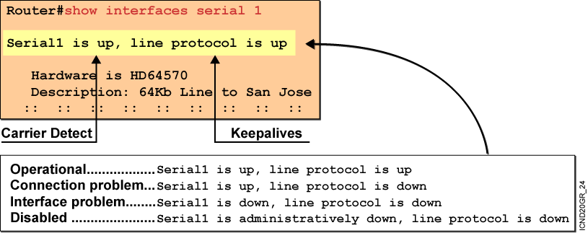
Interpreting the Interface Status
Notes:
Purpose: This slide explains how to interpret the show interfaces serial command output.
Emphasize: The show interfaces serial command output indicates that the serial interface is up and the line protocol is up. The first parameter refers to the hardware layer and essentially reflects whether the interface is receiving the Carrier Detect signal from the other end. The second parameter refers to the data link layer. This parameter reflects whether the data link layer protocol keepalives are being received.
If both the interface and the line protocol are up, the connection is operational.
If the hardware is up and the line protocol is down, a connection problem exist such as no clocking, wrong encapsulation type, or no keepalives.
If both the line protocol and the interface are down, a cable might never have been attached to the router. On the serial cable, you can plug in the cable upside-down, causing the pins on the serial cable to break.
There is one more possibility. If the information says “administratively down,” you have manually disabled (shut) the interface.
Cisco offers a hardware class (IMCR) that discusses the router hardware in more detail.

Slide 58
Verifying a Serial Interface Configuration
Router#show interface serial 0
Serial0 is up, line protocol is up
Hardware is HD64570
Internet address is 10.140.4.2/24
MTU 1500 bytes, BW 64 Kbit, DLY 20000 usec, rely 255/255, load 1/255
Encapsulation HDLC, loopback not set, keepalive set (10 sec)
Last input 00:00:09, output 00:00:04, output hang never
Last clearing of "show interface" counters never
Input queue: 0/75/0 (size/max/drops); Total output drops: 0
Queueing strategy: weighted fair
Output queue: 0/1000/64/0 (size/max total/threshold/drops)
Conversations 0/1/256 (active/max active/max total)
Reserved Conversations 0/0 (allocated/max allocated)
5 minute input rate 0 bits/sec, 0 packets/sec
5 minute output rate 0 bits/sec, 0 packets/sec
(output omitted)
BW 64 Kbit,
Notes:
Purpose: This slide shows how to verify the changes you make to an interface.
Emphasize: Notice the bandwidth has been changed to 64K from the default of 1.544M.

Slide 59
Serial Interface show controller Command
Router#show controller serial 0
HD unit 0, idb = 0x121C04, driver structure at 0x127078
buffer size 1524 HD unit 0, V.35 DTE cable
.
.
.
V.35 DTE Cable
Shows the cable type of serial cables
Notes:
Emphasize: This command requires a space between the word serial and the interface number. The router only checks for the cable type at powerup.

Slide 60
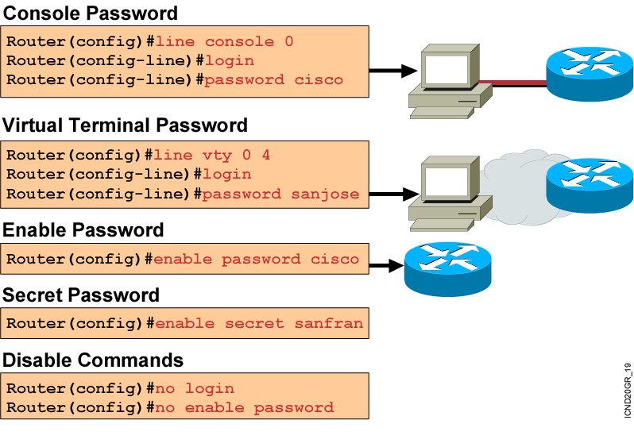
Configuring a Router Password
Notes:
Layer 2 of 2
Emphasize: The router has one enable password. Remember that this is your only protection. Whoever owns this password can do anything with the router, so be careful about communicating this password to others. To provide an additional layer of security, particularly for passwords that cross the network or are stored on a TFTP server, you can use either the enable password or enable secret commands. Both commands accomplish the same thing; that is, they allow you to establish an encrypted password that users must enter to access enable mode (the default), or any privilege level you specify. Cisco recommends that you use the enable secret command because it uses an improved encryption algorithm. Use the enable password command only if you boot an older image of the Cisco IOS software, or if you boot older boot ROMs that do not recognize the enable secret command. If you configure the enable secret password, it is used instead of the enable password, not in addition to it.
Cisco supports password encryption. Turn on password encryption using the service password-encryption command. Then enter the desired passwords for encryption. Immediately, on the next line, enter the no service password-encryption command. Only those passwords that are set between the two commands will be encrypted. If you enter service password-encryption and then press Ctrl-Z to exit, all passwords will be encrypted.
Note: Password recovery is not covered in the course materials. Refer the students to the IMCR class.

Slide 61
การทำให้สามารถเทลเน็ตมายังเร้าเตอร์ได้
มีขั้นตอนดังต่อไปนี้
1. Enter global configuration mode
2. เซ็ต Line VTY password และกำหนดให้มีการ Login
3. เซ็ต Enable secret
ตัวอย่าง
Router(config)#line vty 0 4
Router(config-line)#password linepwd
Router(config-line)#login
Router(config-line)#exit
Router(config)#enable secret secpwd

Slide 62
!!Error Message!! เกี่ยวกับการเซตให้เทลเน็ตได้
Password required, but none set
- แสดงว่าไม่ได้เซ็ตรหัสผ่านบน Line VTY ไว้
%No password set
- ไม่ได้เซ็ตรหัสผ่านของ Enable secret ไว้

Slide 63
End of Lab.

