Slide 1
EGCI 474 Lab 3:
Internetworking Technologies
Computer Engineering Department
Faculty of Engineering, Mahidol University

Slide 2
Register Configuration

Slide 3
Register Configuration
2
1
0
2
15
0
14
0
13
1
12
0
11
0
10
0
9
0
8
1
7
0
6
0
5
0
4
0
3
0
2
0
1
1
0
0
BOOT FIELD
0 = load statrup-config from NV RAM
1 = ignore startup-config

Slide 4
สรุปค่าของ config-register ส่วนที่เกี่ยวกับ boot field
0x2100 → boot to ROM monitor mode (ROMMON)
0x2101 → boot to mini IOS (RXBoot)
0x2102 – 0x210F → boot from command “boot system” in startup config
By default, if there is no “boot system”, router will try to load IOS from
1. Flash 2.TFTP Server 3.RXBoot 4.Boot to ROMMON

Slide 5
Config-register Value to ignore configuration in NVRAM
By default, 6th Bit of config-register is off(0) This means router will try to load startup config file from NVRAM. The config-register in this case is 0x2102.
In case we want to recover password, we need to turn on 6th Bit of config-register to ignore startup config file in NVRAM.This can be done by changing config-register to 0x2142

Slide 6
Determining the Current Configuration Register Value
wg_ro_a#show version
Cisco Internetwork Operating System Software
IOS (tm) 2500 Software (C2500-JS-L), Version 12.0(3), RELEASE SOFTWARE (fc1)
Copyright (c) 1986-1999 by cisco Systems, Inc.
Compiled Mon 08-Feb-99 18:18 by phanguye
Image text-base: 0x03050C84, data-base: 0x00001000
ROM: System Bootstrap, Version 11.0(10c), SOFTWARE
BOOTFLASH: 3000 Bootstrap Software (IGS-BOOT-R), Version 11.0(10c), RELEASE SOFTWARE (fc1)
wg_ro_a uptime is 20 minutes
System restarted by reload
System image file is "flash:c2500-js-l_120-3.bin"
--More--
Configuration register is 0x2102
Configuration register value in show version
Notes:
Emphasize: Use the show version command to display the value of the config register setting. When you change the config register, you will see the change from the show version output:
Configuration register is 0x2102 (will be 0x2142 at next reload).
The new config register value will be used at the next reload.

Slide 7
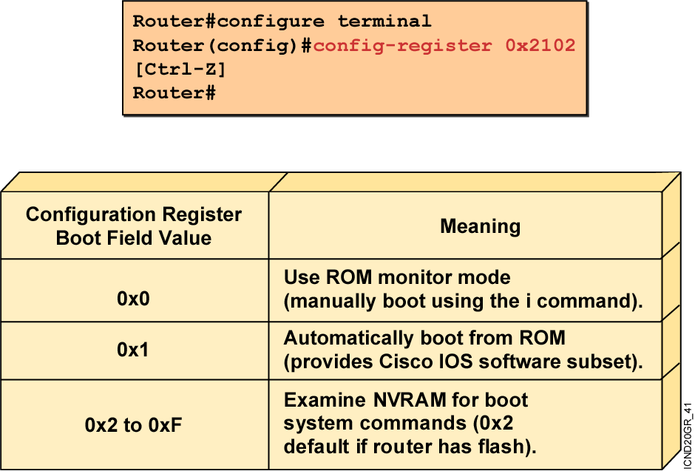
Configuration Register Values
  Configuration register bits 3, 2, 1, and 0 set boot option.
  Check the configuration register value with show version.
Notes:
Layer 4 of 4
Emphasize: Layer 4—Finishes with the third case, a boot field setting in the range of 0x2 to 0xF. The entry of a configuration register value in the 0x2 to 0xF range is significant. When the router attempts to boot from the net (Netboot), the bootstrap program generates a Cisco IOS filename based on the value of the boot field. For example, with the setting 0x2, the default Cisco IOS filename generated will be cisco2-xxxx, where xxxx refers to a processor name (for example, 2500). Again, refer students to the IMCR course for details.
You use the config-register command to change the value.
Notice that the bottom lines of the show version output indicates what value the config register will be on the next reload.

Slide 8
Manage IOS and Configuration File

Slide 9
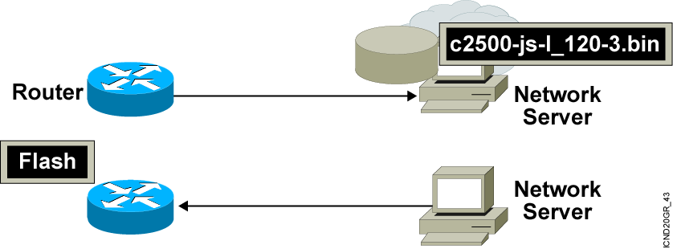
Managing Cisco IOS Images
Notes:
Emphasize: This section introduces topics on managing your configuration file and Cisco IOS image.

Slide 10
Verifying Memory and Deciphering Image Filenames
wg_ro_a#show flash
System flash directory:
File Length Name/status
1 10084696 c2500-js-l_120-3.bin
[10084760 bytes used, 6692456 available, 16777216 total]
16384K bytes of processor board System flash (Read ONLY)
  Verify that flash memory has room for the Cisco IOS image.
  Can use command “show version” to verify flash size as well
Notes:
Emphasize: The show flash command is an important tool to use to gather information about your router memory and image file. Caution students that they must know that they are loading the correct and appropriate image. The name for the Cisco IOS image file contains multiple parts, each with a specific meaning:
The first part of the image name contains the platform on which the image runs. In this example, the platform is C2500.
The second part of the name identifies the special capabilities of the image file. A letter or series of letters identifies the feature sets supported in that image. In this example, the “j” indicates this is an enterprise image, and the “s” indicates it contains extended capabilities.
The third part of the name specifies where the image runs and if the file is compressed. In this example, “l” indicates the file is relocatable and not compressed. Relocatable means the Cisco IOS can be run from Flash or from RAM. You should be careful in reading the Cisco IOS image filename. Some fonts display the lowercase letter “l” and the number 1 as the same character. How you enter the characters will impact the ability of the router to load the files correctly.
The fourth part of the name indicates the version number. In this example, the version number is 12.0 (3).
The final part of the name is the file extension. The .bin extension indicates this file is a binary executable file.
The Cisco IOS software naming conventions, name part field meaning, image content, and other details are subject to change. Refer to Cisco Connection Online (CCO) for updated details.

Slide 11
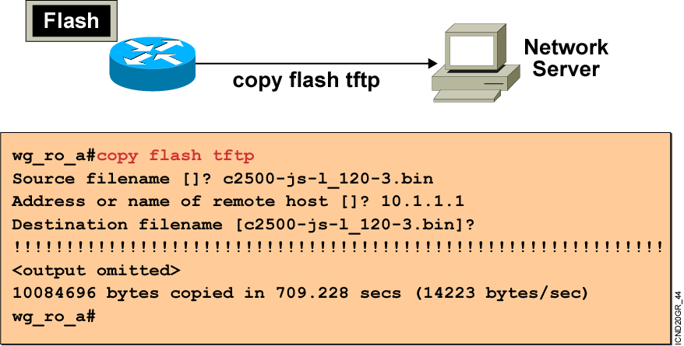
Creating a Software Image Backup
Back up current files prior to updating flash memory.
Notes:
Purpose: This slide discusses how to create a backup version of a Cisco IOS software image to a TFTP server.
Emphasize: Routers by default come with Flash memory that has a preloaded copy of the Cisco IOS software. Although Flash is extremely reliable—good for 65 years and 100,000 rewrites—it is a good idea to make a backup copy of the Cisco IOS software if you have a TFTP server available. If you have to replace Flash memory for some reason, you will have a backup copy at the revision level currently running on your network.
The copy command screen output varies depending on the Cisco IOS software level.
Determine the platform type of your TFTP server prior to beginning the backup procedure. The TFTP server may be running Windows, UNIX, Mac, or other OS. Filename and directory access procedures may vary depending on the TFTP server platform and platform version.

Slide 12
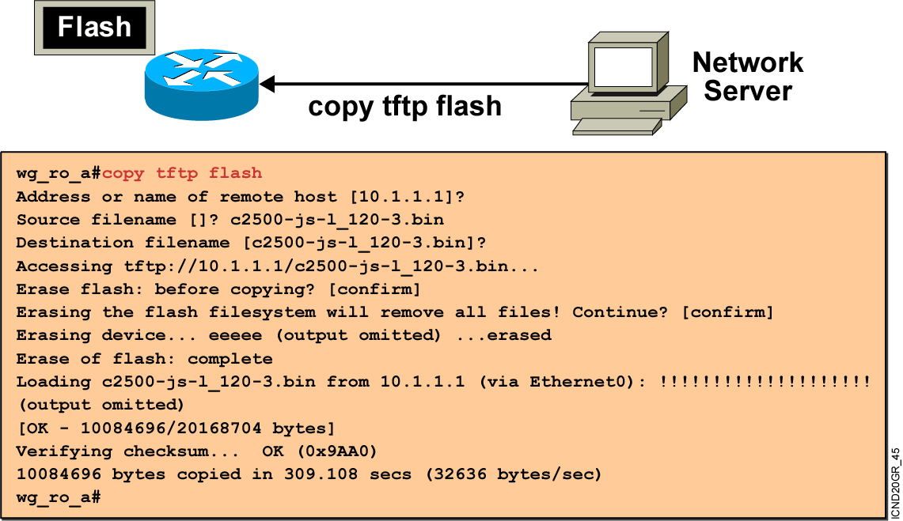
Upgrading the Image from the Network
Notes:
Purpose: This slide describes how to load a backup version of a Cisco IOS software image from a TFTP server to the router.
Emphasize: If you need more Flash space to load a copy of the Cisco IOS software, you must first erase the Flash memory. You cannot erase a single image—you must erase all copies of Cisco IOS software from Flash. However, if Flash memory on the router is partitioned, you can erase one or more of the parts.
After the TFTP transfer is completed, use the show flash command to view the file size to compare its size with that of the original on the server.
If the Cisco IOS is running from Flash, then the Flash is in the read-only state. To change the Flash to a writeable state, you can use the boot system TFTP command to boot a Cisco IOS from a TFTP server and the Cisco IOS will be run from RAM, or you can go to the Rxboot mode to perform the copy.

Slide 13
Issue on changing IOS Software
When upgrading IOS, 2 factor need to be concerned
- Flash Size
- DRAM Size
We can verify these 2 factors by using “show version”
We can verify flash size by using “show flash”

Slide 14
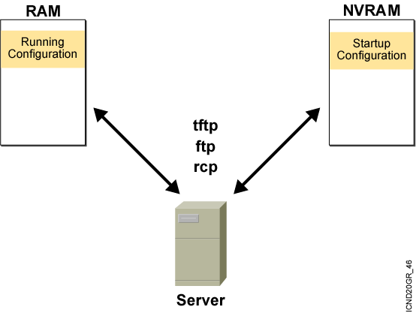
Device Configuration Files

Slide 15
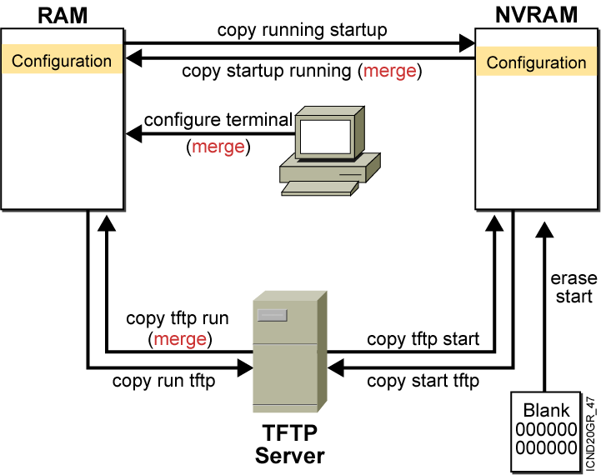
Cisco IOS copy Command
  NVRAM
  Terminal
  TFTP server
  Erase start
Notes:
Layer 4 of 4

Slide 16
Cisco IOS copy Command Example
running-config
TFTP Server saved.cfg
interface s0
ip address 10.1.1.1 255.255.255.0
interface e0
ip address 10.2.2.2 255.255.255.0
interface e1
no ip address
interface e0
ip address 172.16.1.1 255.255.255.0
interface e1
ip address 192.168.1.1 255.255.255.0
copy tftp run (merged)
interface s0
ip address 10.1.1.1 255.255.255.0
interface e0
ip address 172.16.1.1 255.255.255.0
interface e1
ip address 192.168.1.1 255.255.255.0
Resulting
running-config
Notes:
Note: Cisco IOS Release 12.0 supports a new syntax for the copy command.

Slide 17
copy run tftp and copy tftp run commands
wg_ro_a#copy running-config tftp
Address or name of remote host []? 10.1.1.1
Destination filename [running-config]? wgroa.cfg
.!!
1684 bytes copied in 13.300 secs (129 bytes/sec)
wg_ro_a#copy tftp running-config
Address or name of remote host []? 10.1.1.1
Source filename []? wgroa.cfg
Destination filename [running-config]?
Accessing tftp://10.1.1.1/wgroa.cfg...
Loading wgroa.cfg from 10.1.1.1 (via Ethernet0): !
[OK - 1684/3072 bytes]
1684 bytes copied in 17.692 secs (99 bytes/sec)
Notes:
Note: Cisco IOS Release 12.0 supports a new syntax for the copy command.

Slide 18
Cisco Discovery Protocol (CDP)

Slide 19
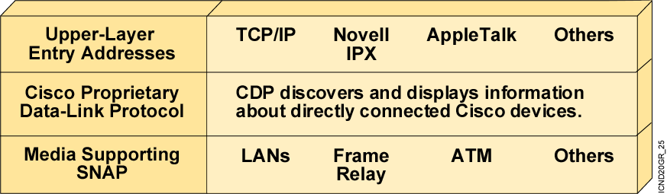
Cisco Discovery Protocol
CDP is a proprietary utility that gives you a summary of directly
connected switches, routers, and other Cisco devices.
CDP discovers neighboring devices regardless of which protocol suite
they are running.
Physical media must support the Subnetwork Access Protocol (SNAP)
encapsulation.
Notes:
Note: CDP is sent using multicast frames with the MAC address 0100.0ccc.cccc.

Slide 20
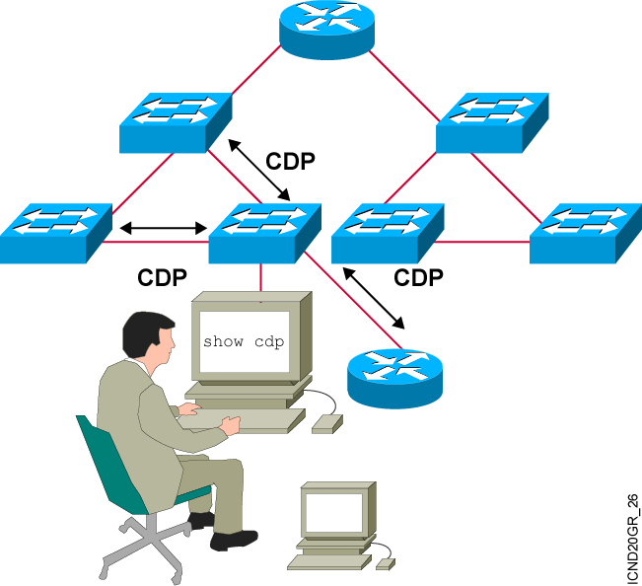
Discovering Neighbors with CDP
CDP runs on routers with Cisco IOS® software
Release 10.3 or later and on Cisco switches and hubs.
Summary information includes:
  Device identifiers
  Address list
  Port identifier
  Capabilities list
  Platform
Notes:
Emphasize: CDP is media- and protocol-independent and runs on all Cisco-manufactured equipment including routers, access servers, switches, and some managed hubs. With CDP, network management applications can retrieve the device type and SNMP agent address of neighboring devices. This capability enables applications to send SNMP queries to neighboring devices.
CDP allows network management applications to dynamically discover Cisco devices that are neighbors. CDP runs on all media that support the Subnetwork Access Protocol, including LAN and Frame Relay. CDP runs over the data link layer only, not the network layer. Therefore, two systems that support different network-layer protocols can learn about each other.
Cached CDP information is available to network management applications. Cisco devices never forward a CDP packet. When new information is received, old information is discarded. The holdtime determines how long to keep existing information from a neighbor.

Slide 21
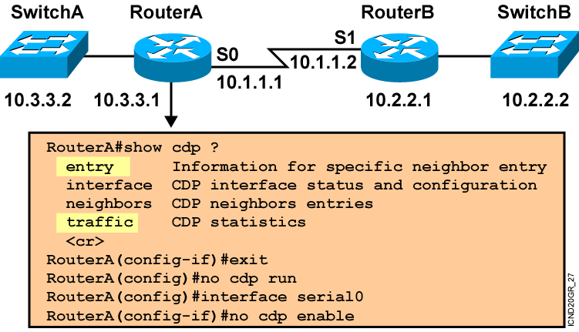
Using CDP
Notes:
Note: Some of the CDP commands are not available on the Catalyst 1900 switch, like cdp run, show cdp traffic, and show cdp entry.

Slide 22
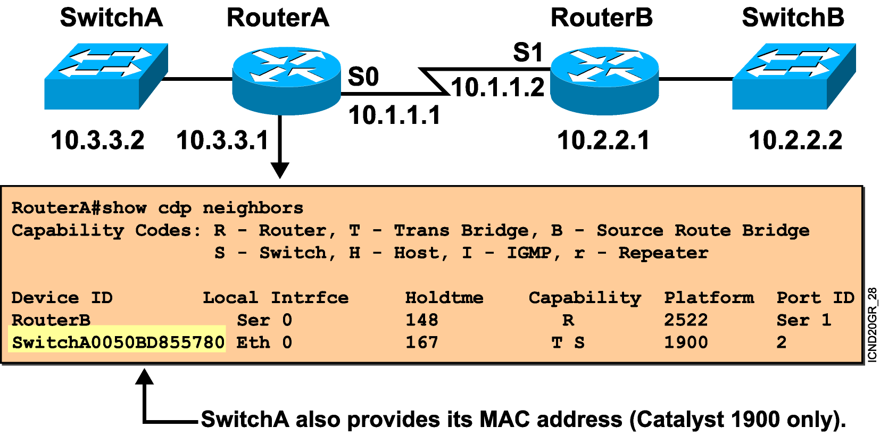
Using the show cdp neighbors Command
Notes:
Emphasize: This graphic shows the show cdp neighbors command initiated from a router, which displays a summary of the capabilities and access details for the CDP neighbors. The show cdp neighbors detail command shows detailed information about the same devices.
Note: If the neighbor is a Catalyst 1900 switch, the switch MAC address is also displayed. If the switch is a 2900xl, its MAC address is not displayed.

Slide 23
CDP Command
Show cdp neighbor
  To show and create simple network map
Show cdp neighbor detail
  To see detail of neighbor router such as IP Address
CDP is useful when troubleshooting problem about “directly connected” neighbor

Slide 24
End of Lab

