Slide 1
Stepper Motors
A stepper motor is electromechanical device which converts electrical pulses into discrete mechanical movements.
When electrical current is applied to it, the shaft of the motor rotates in steps and this type of movement give the motor its name.

Slide 2
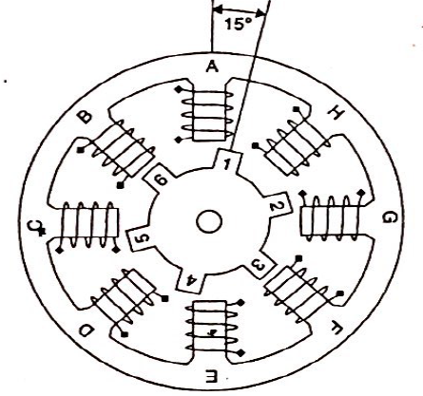
Principle of operation
Stepper motors have multiple toothed electromagnets arranged around a central gear shaped piece of iron.
The electromagnets are energized by an external control circuit which send pulses to the motor

Slide 3
Principle of operation
To turn the motor shaft, one of electromagnets is given power first, which makes the gear’s teeth magnetically attracted to electromagnet’s teeth.
When one tooth of gear is thus aligned to the energized electromagnet, others are slightly offset from corresponding electromagnets.
When next is turned ‘On’ and first is turned ‘off’, gear rotates slightly to align with next one and the process is repeated.
Each those slightly rotations are called step with integral no. of steps making a full rotation. In this way motor can be turned by a precise angle.

Slide 4
Principle of operation
The rotation of motor is related to sequence of input pulses:
The order in which a particular sequence is applied decides the direction of rotation(clockwise or anti-clockwise)
The speed of stepping depends on frequency of the pulses applied
Higher the frequency, faster the stepping motor

Slide 5
Uses
It is used where the movements need to be finely controlled. Because motor moves in steps and steps can be quite small in size.
E.g. If each step-2 degree
i. One complete rotation(360 degree)- 180 steps required.
ii. For 90 degrees rotation- 45 pulses
They are used in applications such as
Printers, plotters, hard disk drives, medical equipment fax machines and automotive and industrial applications Where precise and controlled rotation is required. Robotics is another area where it is used.

Slide 6
Driving a Stepper Motor
Full Step Drive: Both the phases are always ON. The motor will have full rated torque which is achieved by sequence of 1s and 0s.
For clockwise sequence to be applied :. 09,0CH,06,03
For anti –clockwise: 03,06,0CH,09
Step No. | A | B | A | B
1 | 1 | 0 | 0 | 1
2 | 1 | 1 | 0 | 0
3 | 0 | 1 | 1 | 0
4 | 0 | 0 | 1 | 1

Slide 7
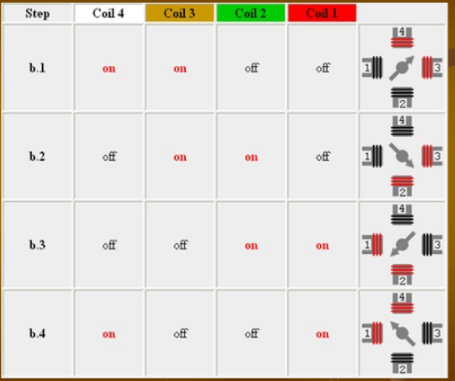
Full step Drive

Slide 8
Wave Drive
In this drive only a single phase is activated at a time . It has same no. of steps as full step drive but motor will have significantly less torque
For clockwise sequence is 8,4,2,1
For anti-clockwise: 1,2,4,8
Step No. | A | B | A | B
1 | 1 | 0 | 0 | 0
2 | 0 | 1 | 0 | 0
3 | 0 | 0 | 1 | 0
4 | 0 | 0 | 0 | 1

Slide 9
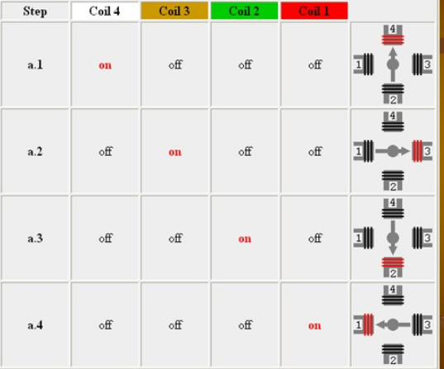
Wave Drive

Slide 10
Half stepping
When half stepping drive alternates between two phases ON and single phase ON.
Step No | A | B | A | B
1 | 1 | 0 | 0 | 1
2 | 1 | 0 | 0 | 0
3 | 1 | 1 | 0 | 0
4 | 0 | 1 | 0 | 0
5 | 0 | 1 | 1 | 0
6 | 0 | 0 | 1 | 0
7 | 0 | 0 | 1 | 1
8 | 0 | 0 | 0 | 1

Slide 11
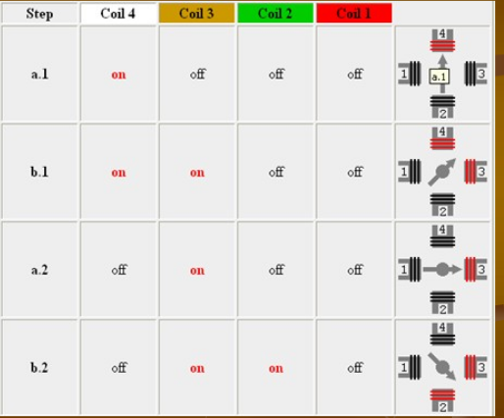
Half Stepping

Slide 12
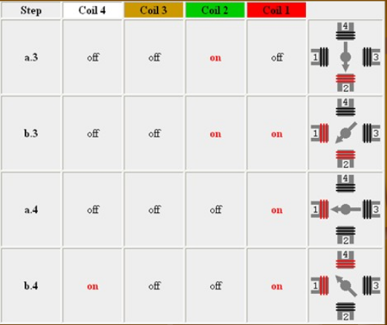
Half stepping

Slide 13
Using an 8051 to interface a Stepper Motor
We can run a motor using a sequence generated by MCU, say 8051.
The motor cannot driven directly from its pins because motor requires a current much more than can be applied by MCU.
Current drivers are needed between 8051 port lines and the leads of the motor.
Transistors with high current capability (e.g. Darlington pair or power transistors) can be used.

Slide 14
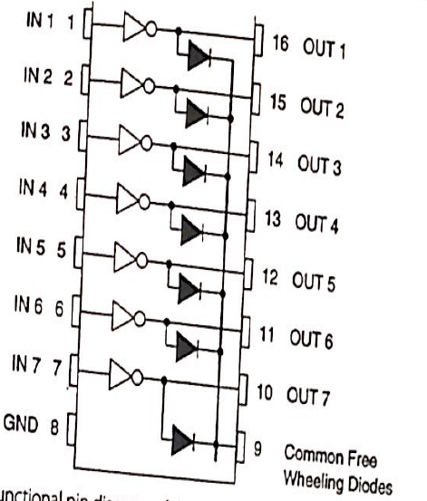
Using an 8051 to interface a Stepper Motor
There are special motor driving ICs available e.g. ULN 2003
IC contains an array of seven darlington pair transistors.
MCU generating a sequence for energizing a stepper motor, with IC ULN 2003 being used to raise the current level

Slide 15
Other issues regarding stepper motor
There is a chance of back emf produced during the de-energization of the coils. This can damage the circuits producing the sequence and hence diodes are connected which block these spikes. Such diodes are called flywheel, flyback, free wheeling or snubber diodes
Darlington pair transistor are used for producing high current required to drive motors , diodes are connected to block emf.
Such a diode is also in-built within the motor driving IC ULN 2003.

Slide 16
DC Motor

Slide 17
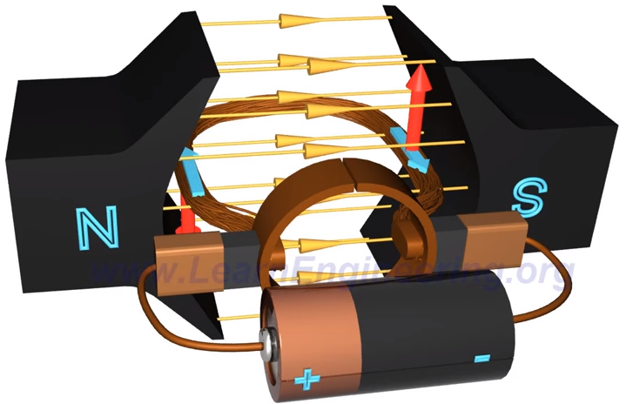
DC Motor

