Slide 1
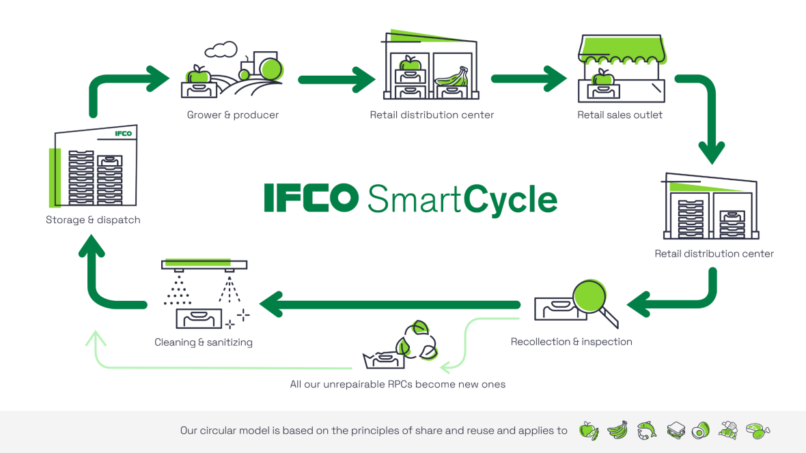
IFCO DS Technical Test
Alex Monràs Blasi
alexmonrasblasi@gmail.com

Slide 2
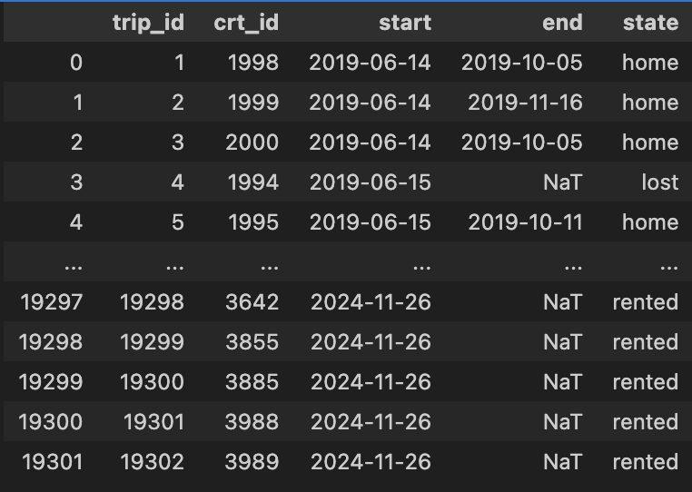
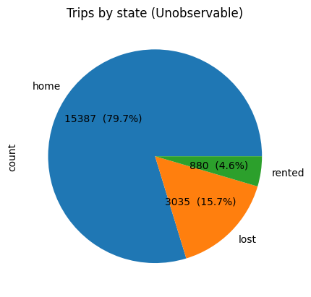
Estimating Shrinkage Rate
and Pool Size
Given a dataset of trips, propose a method to determine shrinkage rate and pool size

Slide 3
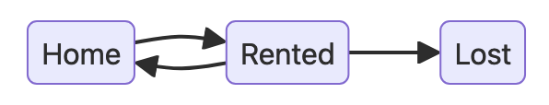






A state transition model
Each asset undergoes a series of state transitions
Nr of unfinished trips:
Rate of change:

Slide 4
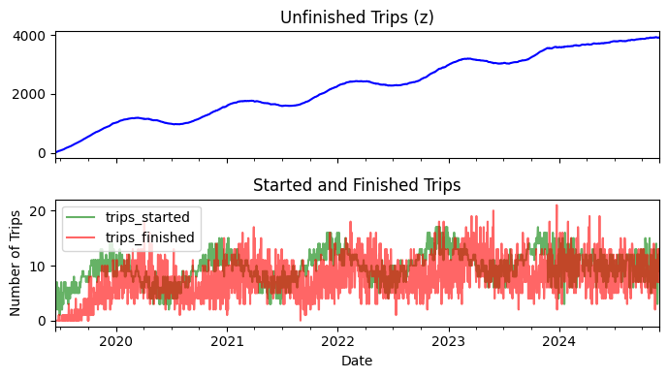

Slide 5


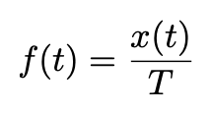
The Ergodic hypothesis
(No global synchronization mechanisms)
Averages over time equal ensemble averages:
For the distribution over states:
The trip finish rate is then given by

Slide 6

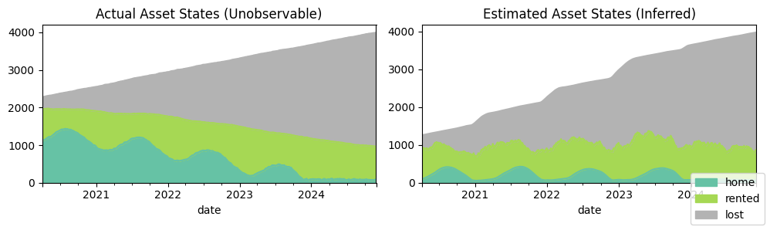
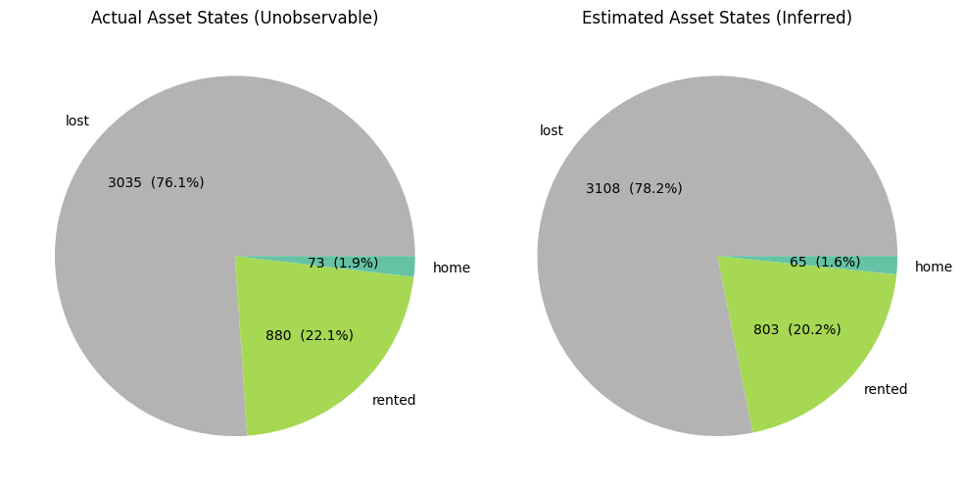
Estimating Pool Size

Slide 7


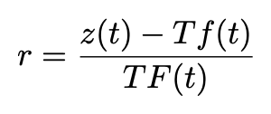

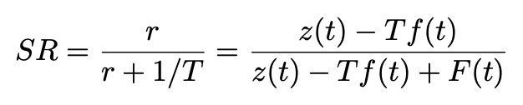
Shrinkage Rate vs Daily Loss rate
Daily loss rate (r): probability that a rented asset becomes lost any given day
Shrinkage Rate (SR): Probability that a trip ends up in a lost asset

Slide 8
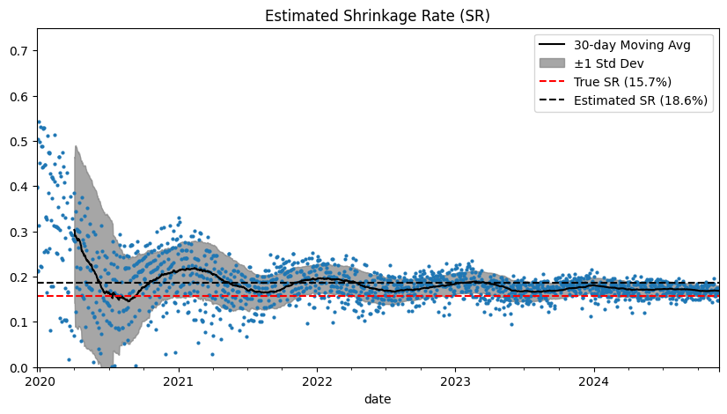
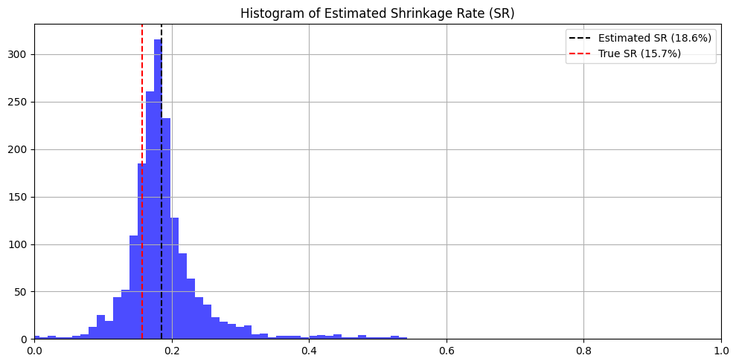

Slide 9
Scenario 2
Assume we can only measure the rental date on a percentage of trips
Can we still observe number of rented and returned assets every day?
Historical totals?
We only need the start date for estimating T

Slide 10
Outlook
Proposed a method to estimate SR and Pool size:
Method based on rate equations
Independent of
Underlying trip statistics
Demand seasonality
Minimal assumptions
Ergodicity
Extensions:
Analyze confidence intervals
Bayesian Smoothing & filtering
Risks
Ergodicity assumption: System out of equilibrium
Observability: Nr. of Started and Finished trips, average trip duration

Slide 11
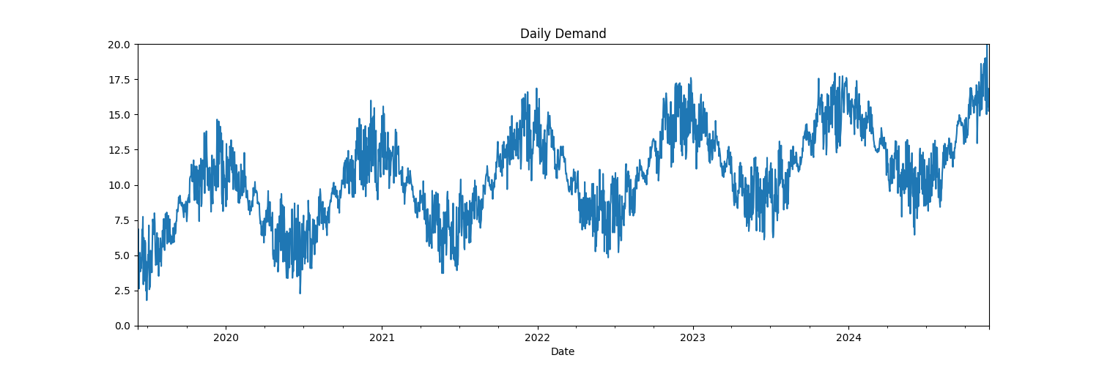
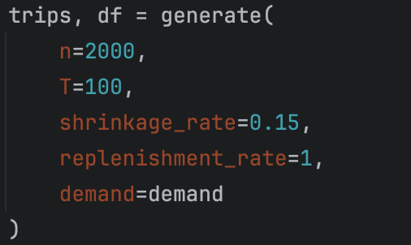
About the synthetic data
Starting pool of 2000 assets
Trip durations: LogNormal(100, 50)
Shrinkage Rage: 15%
Replenishment rate: 1 asset/day
Demand: trend + yearly & monthly seasonality

Slide 12
