Slide 1
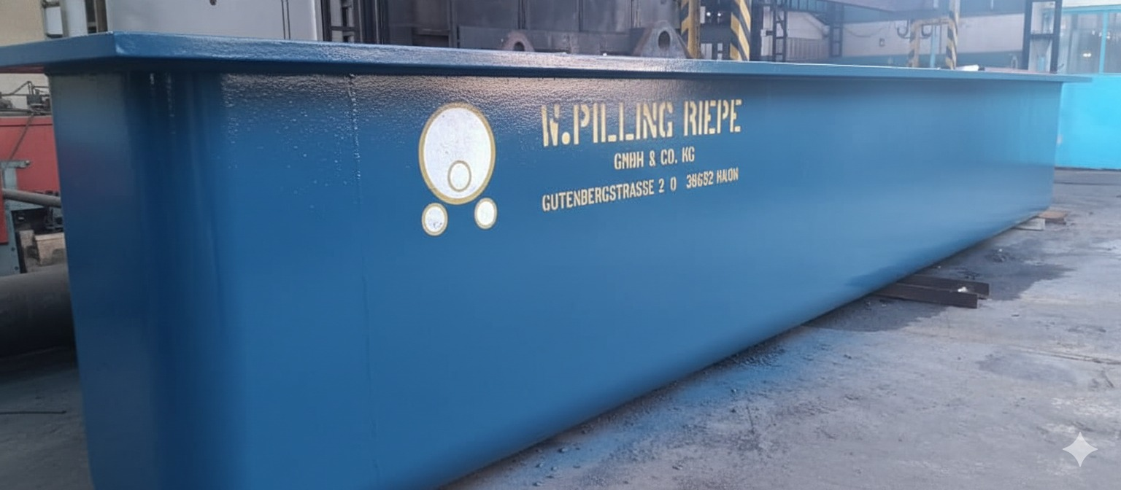
PYGLARA
Prensados y Galvanizados de Lara, S.A.
The largest galvanizing plant in central-western Venezuela
Investment Opportunity | April 2026
CONFIDENTIAL
Notes:
Good day. My name is Andres Montbrun, commercial representative of PYGLARA. I am going to present you with a unique opportunity in the Venezuelan industrial sector.

Slide 2
THE OPPORTUNITY
A 50-year industrial plant with world-class German equipment
$2.2M-$3.0M
300 TM/mes
Replacement cost
(build from scratch)
Proven production
(best historical month)
936 varillas/dia
3 meses
Copper line with no
domestic competitor
From investment to
revenue generation
Assets valued in the millions. Operational in one quarter.
2 / 30
Notes:
Building this plant from scratch today would cost between $2.2 and $3 million. It has German Pilling equipment, proven 300 tons per month, and a UNIQUE copper line in Venezuela.

Slide 3
WHY NOW
Venezuela reopens its oil sector — demand for galvanized steel explodes
$183 BN
$41 BN
Oil capex projected
through 2040 (Rystad Energy)
Fabrication & construction
#1 service segment
50 YEARS
ONLY 2
Without updating
PDVSA infrastructure
Commercial galvanizing service
providers in all of Venezuela
Fuente: Rystad Energy, Oil & Gas Capex Outlook
3 / 30
Notes:
Venezuela's oil sector needs galvanized steel for EVERYTHING surrounding the pipelines. There are only 2 commercial hot-dip galvanizing service providers in the entire country: ALF Galvanizados in Valencia (~9,000 TM/year) and PYGLARA. PDVSA's transmission pipelines use specialized coatings (FBE/3LPE), not galvanizing. However, ALL structural steel surrounding those pipelines — pipe racks, cable trays, platforms, handrails, grating, and stairs — is hot-dip galvanized per ASTM A123. That structural steel is our market.

Slide 4
THE DEMAND IS ALREADY HERE
Concrete investments announced since January 2026
Jan 3, 2026
Oil sector reopens to private investment
Jan 6, 2026
Rystad Energy: $183B oil capex 2026-2040
$41B in fabrication & construction alone
Jan 9-10, 2026
Repsol: triple production to 135,000 bpd
New Orinoco Belt blocks = new infrastructure
Jan 30, 2026
Chevron Q4: 240,000 bpd, +50% in 18 months
Expansion of existing facilities
Feb 4, 2025
Movistar/Telefonica: $500M investment
805 5G nodes + 500 base stations = galvanized towers
Mar 11, 2026
Reuters: Chevron & Shell close first major deals
Production contracts = immediate structural steel demand
Sep 2025
CONATEL: National Telecom Plan 2025-2031
1,500 4G + 500 5G stations + 36,000 km fiber optic
Mar 2026
Venezuela reaches 1.1M bpd production
Oil recovery underway — demand accelerates
These are not projections — these are signed contracts and public announcements with verified dates.
Notes:
These are not projections — these are signed deals and public announcements with dates. The companies investing billions will need galvanized structural steel for every platform, pipe rack, cable tray, handrail, and grating panel they build. Sources: Rystad Energy (Jan 6 2026), CNBC/Chevron Q4 earnings (Jan 30 2026), Reuters/Repsol (Jan 9-10 2026), Telefonica (Feb 4 2025), CONATEL (Sep 2025), OilPrice.com (Mar 25 2026), Bloomberg (Feb 12 2026), Reuters (Mar 11 2026).

Slide 5
WHAT THE OIL SECTOR ACTUALLY GALVANIZES
Not the pipelines — everything around them
Pipe racks
3m-12m pieces
→ 7m / 9m kettle
$41B
Cable trays
2.4m-6m sections
→ 3.5m / 7m kettle
Fabrication & construction (Rystad Energy, Jan 2026)
Platforms & walkways
Panels up to 6m
→ 7m kettle
$10B+
Handrails & stairs
3m-6m sections
→ 7m kettle
Grating (floor panels)
Standard panels
→ 7m kettle
Materials & metals
Bolts, nuts, hardware
Per ASTM A153
→ 65cm centrifuge
$10B+
Electrical & instrumentation
PYGLARA's kettles handle every product category on this slide. At 300 TM/month, we need to capture less than 3% of the oil sector's annual galvanizing demand to operate at 100% of proven capacity. Only 2 active galvanizers serve all of Venezuela.
Notes:
A common misconception is that galvanizing serves the pipeline itself. In reality, oil & gas pipelines use specialized coatings like FBE or 3LPE. But every refinery, pumping station, terminal, and drilling platform needs thousands of tons of galvanized structural steel for the infrastructure that supports those pipelines. Pipe racks, cable trays, grating, handrails, platforms — all hot-dip galvanized per ASTM A123. These are 3-12 meter pieces that fit perfectly in our 7m and 9m Pilling kettles. Rystad Energy projects $41B in fabrication & construction, $10B+ in materials & metals, and $10B+ in electrical & instrumentation.

Slide 6
TELECOMMUNICATIONS: 2,000+ NEW TOWERS
Stations
PYGLARA SERVES BOTH DEMAND STREAMS
5,000
5K
+2,000 new stations
Tower steel demand: ~10,000 tons (2025-2031)
4K
Ground rod demand: ~18,000 copper rods nationwide
3,000
3K
At 300 TM/month: all tower steel covered in 3 months
2K
At 936 rods/day: all ground rods produced in 20 days
1K
Only company in Venezuela providing both: galvanized structure + copper grounding
2024 Existing
2031 Plan
Every cell tower requires galvanized steel structure. Every base station needs copper grounding rods. PYGLARA serves BOTH needs — the only company in Venezuela that can.
Notes:
Telefonica announced $500 million for Venezuela on February 4, 2025. The CONATEL National Telecom Plan 2025-2031 calls for 1,500 new 4G stations, 500 5G stations, reinforcement of 3,000 existing stations, and 36,000 km of fiber optic. Each of those stations needs a galvanized tower and copper grounding. PYGLARA is the only company that can supply both products domestically.

Slide 7
WHY GALVANIZING
Hot-dip galvanizing outperforms paint in every aspect
FEATURE | GALVANIZED | PAINT
Service life | 50-100 years | 3-5 years (requires repainting)
Bond type | Metallurgical bond (zinc-iron) | Surface adhesion (peels off)
Self-healing | YES — zinc protects cuts and scratches | NO — any damage exposes the steel
Lifecycle cost | ~70% cheaper long-term | Repainting every 3-5 years adds up
Impact resistance | Excellent — no bubbles, flakes | Cracks, blisters and peels
Corner protection | Corners receive MORE zinc (galvanic) | Corners receive LESS paint
Maintenance | Zero for decades | Constant inspection and repainting
Galvanizing is not a coating — it is a permanent metallurgical bond between zinc and steel. The zinc sacrifices itself to protect the iron (cathodic protection).
7 / 30
Notes:
Hot-dip galvanizing creates a metallurgical bond between zinc and steel. Unlike paint, zinc self-heals: if scratched, surrounding zinc cathodically protects exposed steel. Service life is 50-100 years vs. 3-5 for paint, and lifecycle cost is ~70% lower.

Slide 8
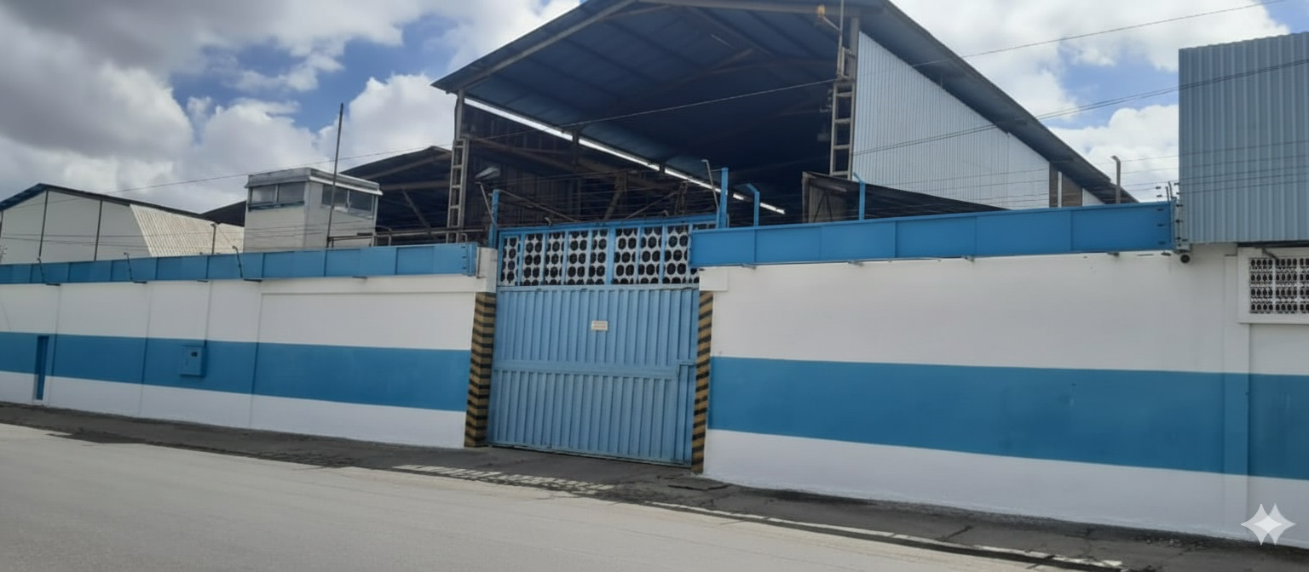





THE PLANT
50 years of industrial operations
Zona Industrial I, Barquisimeto, Estado Lara
3,640 m2 across 2 industrial warehouses
Property title: clean
PDVSA gas (active contract), 66 kVA, industrial water
RIF: J-07014488-0 | Active municipal license
8 / 30
Notes:
La planta esta en el corazon de la Zona Industrial I de Barquisimeto. Titulo limpio, contrato de gas con PDVSA activo, todo listo para operar.

Slide 9
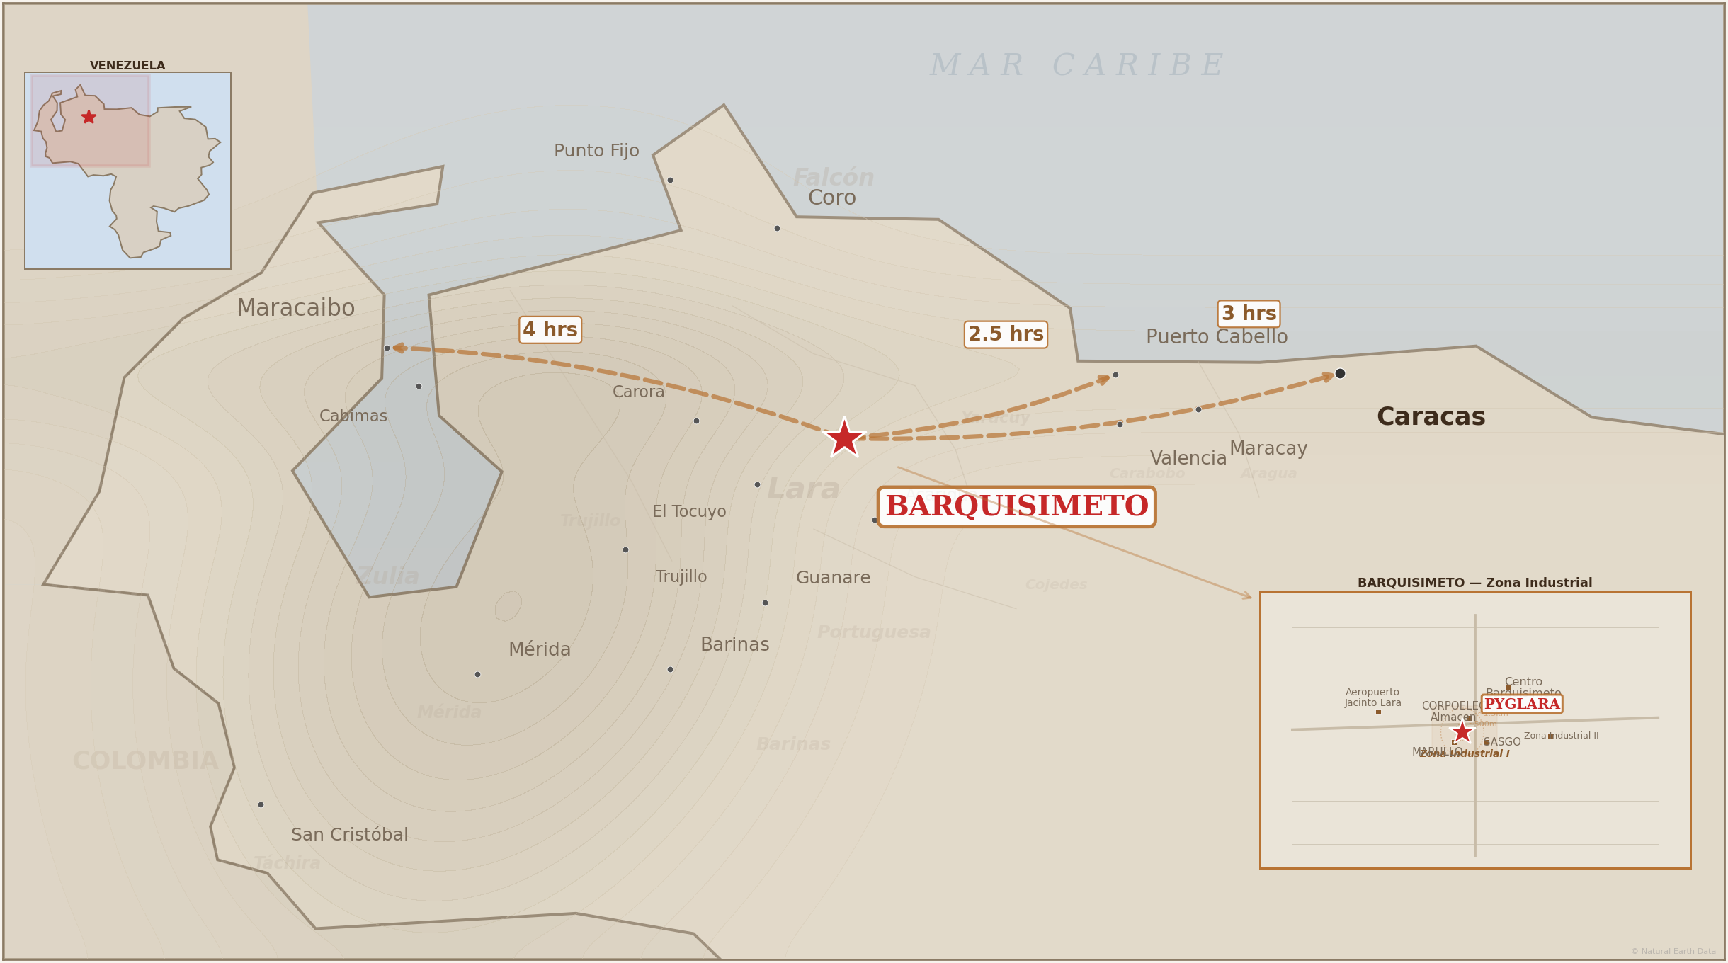
STRATEGIC LOCATION
Barquisimeto: logistics hub of central-western Venezuela
9 / 30
Notes:
Map of Venezuela showing Barquisimeto (PYGLARA), Puerto Cabello (2.5h), Caracas (3h) and Maracaibo (oil). Coverage of 8 western states.

Slide 10






GEOGRAPHIC ADVANTAGES
What our location means for the plant
Puerto Cabello — 2.5 hours
Caracas — 3 hours
Main zinc import port in the country. Reduces raw material delivery costs and lead times.
Direct highway connection to the capital. Access to construction and infrastructure clients.
Oil sector — Zulia 4 hours
Coverage of 8 states
Direct access to Lake Maracaibo oil region. PDVSA and contractors need galvanized steel.
Lara, Yaracuy, Portuguesa, Falcon, Trujillo, Barinas, Merida, and Zulia. No nearby competitor in the entire region.
Industrial Zone I — clients meters away
Industrial gas and energy pricing
CORPOELEC, SASGO, Marullo and INDUESCA are in the SAME industrial complex. Zero transport costs.
PDVSA Gas rate for industrial zone. Regulated electricity pricing — very competitive fixed costs.
10 / 30
Notes:
6 geographic advantages: Puerto Cabello 2.5h, Caracas 3h, Zulia oil 4h, 8-state coverage, clients in same complex, industrial gas/energy pricing.

Slide 11
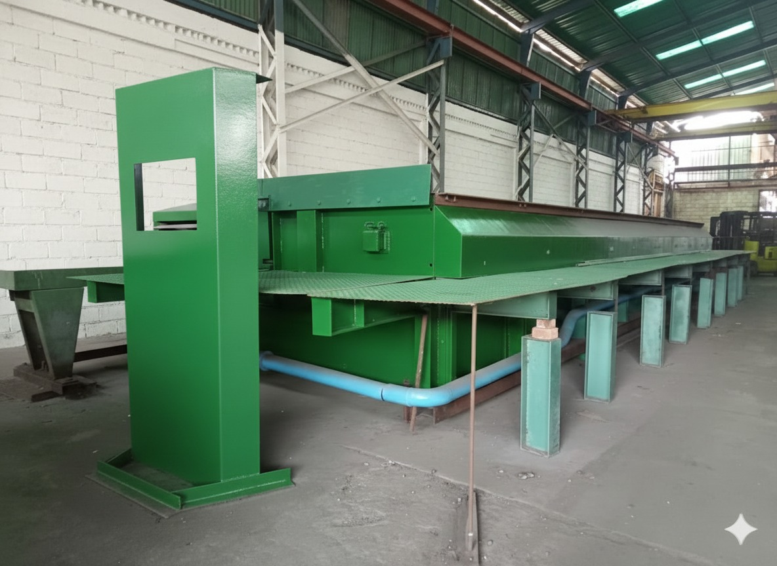
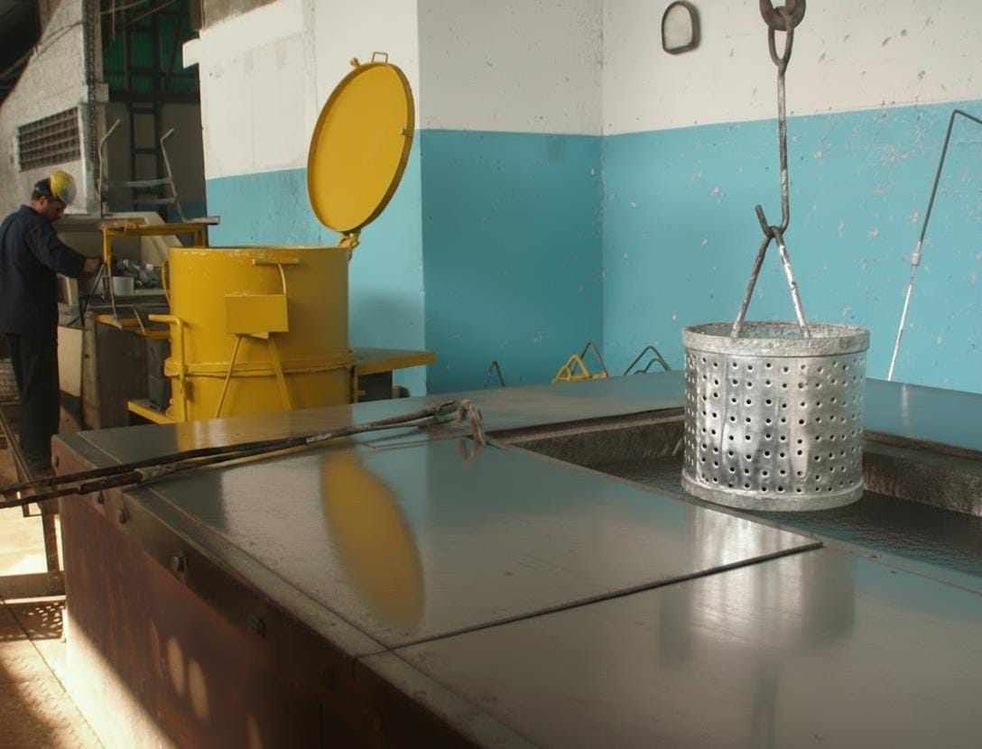
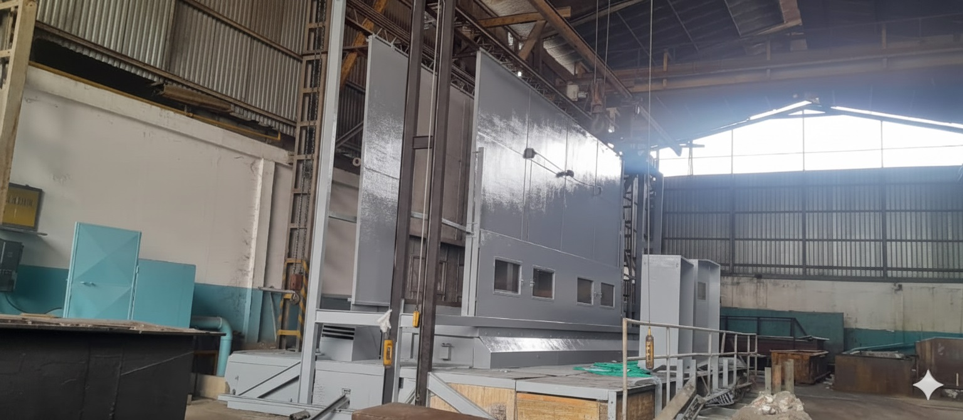
WORLD-CLASS EQUIPMENT
Pilling Kettles — W. Pilling Riepe GmbH & Co. KG, Germany (since 1873)
KETTLE | STATUS | APPLICATION
7 meters | Installed, burners OK, awaiting zinc | Towers, poles, structures
9 meters | Pending installation (valued $570K) | Oversized work pieces
3.5 meters | Inactive — needs repair | Cable trays, supports, barriers
Centrifuga 65cm | ACTIVE, good condition | Nails, hardware, bolts
Proven production (7m): 300 TM/mes
Mejor mes historico. La cuba de 9m (pendiente de instalar) y la de 3.5m (en reparacion) representan capacidad adicional futura.
11 / 30
Notes:
Pilling kettles from world-leading manufacturer since 1873. Proven production: 300 MT/mo with 7-meter kettle.

Slide 12



THE PILLING ADVANTAGE
“The Ferrari of galvanizing kettles”
W. Pilling Riepe GmbH & Co. KG
World's leading manufacturer of galvanizing kettles since 1873 — over 150 years of German engineering.
Electroslag welding
Patented process that creates defect-free joints. Wall thickness up to 80mm — indestructible.
Decades of service life
Pilling kettles last 20-30+ years with basic maintenance. PYGLARA's burners confirmed in good condition.
9m Pilling Kettle
Valued at $570,000
Replacement value: $1.1M+
The kettles alone (7m + 9m + 3.5m + centrifuge) cost between $1.14M and $1.34M at replacement price.
12 / 30
Notes:
W. Pilling Riepe GmbH is the world-leading manufacturer of galvanizing kettles since 1873. Its kettles use electroslag welding with walls up to 80mm. They last decades. PYGLARA kettles alone are worth over $1.1 million at replacement cost.

Slide 13



PRODUCTS & APPLICATIONS
Every type of steel that needs corrosion protection
ELECTRICAL
OIL & GAS
CONSTRUCTION
Poles, transmission towers,
cable trays, hardware
Demand: 2,000+ new 4G/5G towers + CORPOELEC on-site. Every pole needs galvanizing.
Pipe racks, cable trays,
platforms, grating, handrails
Demand: $41B Rystad fab & construction segment 2026-2040. Pipe racks alone fill a month.
Beams, columns, sheets,
roofing, stairs, crash barriers
Demand: VINCI/Freyssinet MSE walls in active projects + housing & highway boom.
RENEWABLE ENERGY
INFRASTRUCTURE
AGRO / INDUSTRIAL
Solar panel mounts,
wind towers, brackets
Demand: National solar expansion + grid modernization. Mounting systems all galvanized.
Mechanically stabilized earth walls,
signage, pedestrian bridges
Demand: 34 historical clients. Freyssinet and road/bridge projects in pipeline.
Fencing, mesh, barbed wire,
silos, tanks, gates
Demand: Marullo (same block) + PROALCA + regional agroindustrial restart.
MSE retaining walls (VINCI/Freyssinet, Zona Industrial I): galvanized steel strips embedded in fill — PYGLARA's 7m kettle is purpose-built for this. At 300 TM/month proven output, one kettle serves all six categories above. Filling PYGLARA to capacity requires less than 3% of Venezuela's oil sector galvanizing demand.
13 / 30
Notes:
PYGLARA can galvanize any steel piece. Main sectors are electrical, oil, construction, renewable energy, infrastructure and agriculture. Note: Oil & gas pipelines use specialized coatings (FBE/3LPE), not galvanizing. Our O&G market is the structural steel surrounding the pipelines — pipe racks, cable trays, platforms, grating, and handrails. Mechanically stabilized earth is a retaining wall system using galvanized steel strips — Freyssinet/Geoquest is a historical client.

Slide 14
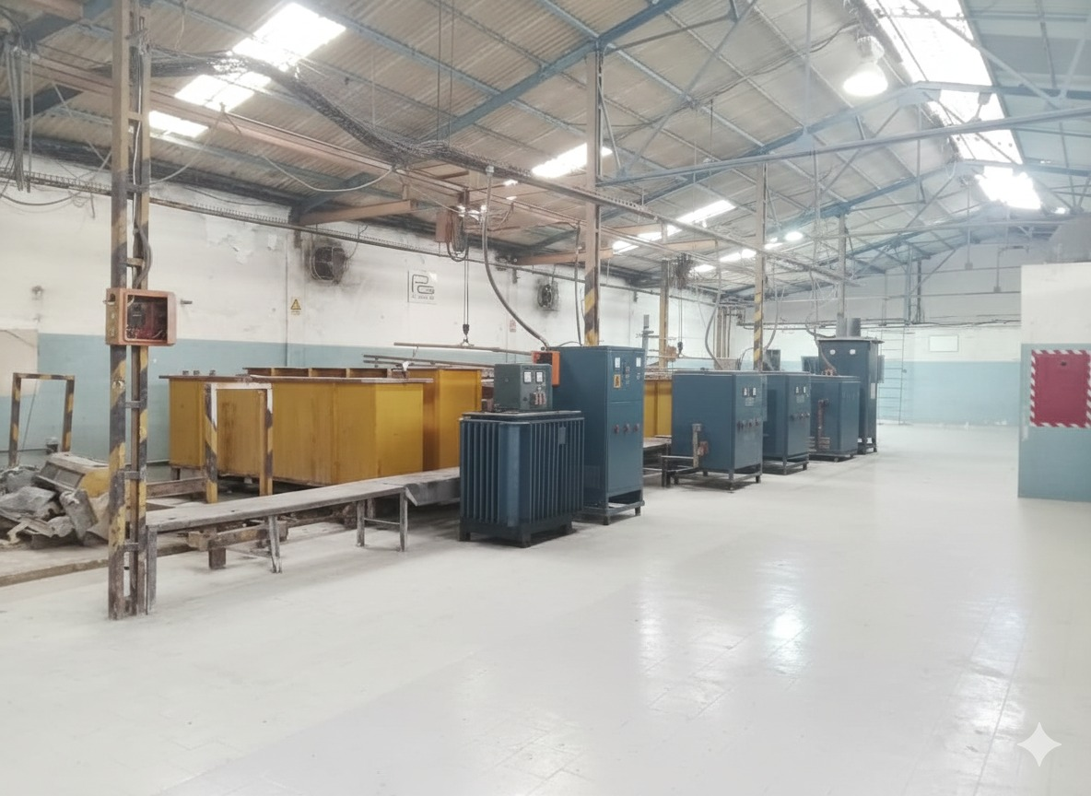
COPPER ELECTROPLATING
ZERO domestic competitors
Product
Copperweld-type grounding rods
Process
Copper electroplating (electrolytic bath)
Diameter
5/8" to 1"
Length
1.2m to 3.0m
Coating
300 um +/- 50 copper
Capacity
936 units/day (24h cycle)
Revenue
$561K - $1.05M/year at full capacity
ENELVEN (now CORPOELEC) purchased 20,000 rods in 2004-2005
14 / 30
Notes:
There is NO other manufacturer of copper grounding rods in Venezuela. Everything is imported. ENELVEN (now CORPOELEC) purchased 20,000 units in 2004-2005. The global copper ground rod market is valued at $2.5 billion (2025) and growing at 7% CAGR. Key growth drivers are exactly our sectors: telecommunications (5G towers), renewable energy (solar installations), and electrical infrastructure rehabilitation. Every 5G tower, solar installation, and electrical substation requires copper grounding. All copper ground rods currently used in Venezuela are imported.

Slide 15
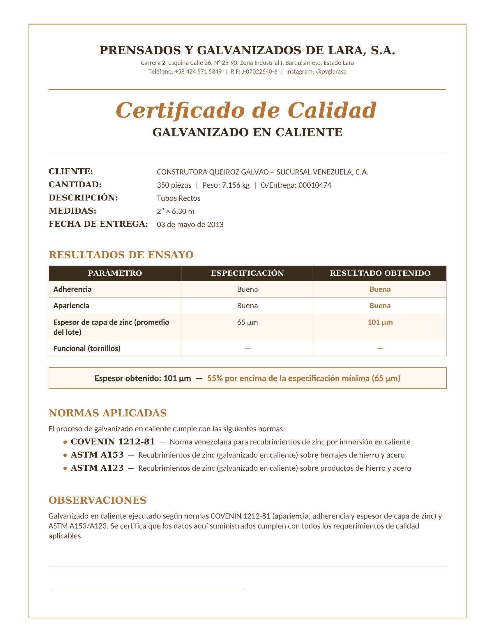

QUALITY & CERTIFICATIONS
International certifications + quality control on every batch
COVENIN 1212-81
Venezuelan galvanizing standard
ASTM A123
Zinc coatings on iron/steel
ASTM A153
Zinc coatings on hardware
"Certificamos cada lote — espesor obtenido: 101 um (55% sobre especificacion)"
15 / 30
Notes:
PYGLARA operates under COVENIN 1212-81, ASTM A123 and ASTM A153. In the certificate shown, thickness achieved was 101 um — 55% above the minimum specification of 65 um.

Slide 16
THE TEAM
50 years of accumulated experience in industrial galvanizing
Ing. Francisco Ballesteros Z.
Ing. Miriam Armas
FOTO
FOUNDER
FOTO
PLANT ENGINEER
Founded and led PYGLARA for over 50 years, keeping it operational through economic contractions exceeding 70%. Extensive industrial network across Venezuela and abroad. Undisputed authority in industrial galvanizing.
36+ years of technical experience. Responsible for quality, production and certifications. Knows every piece of the plant. Primary source for technical due diligence.
OPERATIONS TEAM
At full capacity: 15 workers (piece-rate). Currently: 3 workers. Direct supervision by Ing. Miriam. Hiring scales with production — no fixed payroll commitments until there is volume.
16 / 30
Notes:
Founder Ing. Francisco Ballesteros led PYGLARA 50+ years through 70%+ economic contractions. Ing. Miriam Armas: 36+ years of technical experience. Workers on piece-rate — payroll scales with production.

Slide 17
TRACK RECORD & CLIENTS
50 years of operation — financial data confirmed by SENIAT
TOP 3 YEARS (SENIAT)
CLIENTS & PARTNERS
$1.71M
$1.74M
$1.73M
CORPOELEC
SASGO
$288K
(16.8%)
$316K
(18.1%)
$203K
(11.8%)
20,000 copper ground rods
Electric poles & towers
MARULLO
FREYSSINET
Agroindustrial machinery
MSE retaining walls (VINCI Group)
INDUESCA
DISMACA
Cable trays & towers
EPC / Oil & Gas
2006
2009
2012
Sales
Profit
Data declared to SENIAT (verifiable). Exchange rates: CADIVI 2006/2009, post-devaluation 2012.
34 clientes historicos 6 interested in reactivating orders
17 / 30
Last year of continuous operation: 2015. 675 MT of flat bars that year alone. Stopped due to lack of zinc, NOT lack of demand.
Notes:
Financial data was declared to SENIAT and is verifiable. Top 3 years exceeded $1.7M in sales. CORPOELEC, SASGO, Marullo, Freyssinet, INDUESCA and DISMACA are historical clients. 34 documented clients, 6 interested in reactivating orders.

Slide 18
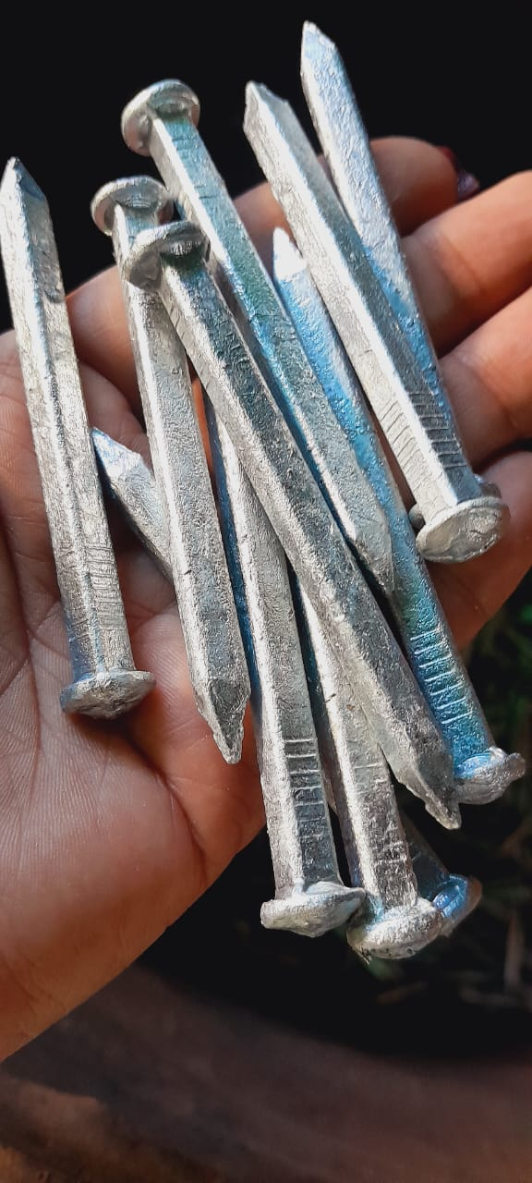
CURRENT PLANT INVENTORY
Materials, equipment and machinery available at the time of transaction
RAW MATERIALS ON SITE
Material | Quantity
Zinc SHG 99.99% | 2,041 kg
Hydrochloric acid (HCl) | 4,600 kg
Ammonium chloride (NH4Cl) | 500 kg
MACHINERY & EQUIPMENT
Equipment | Quantity
Clark Forklifts (2,500 kg) | 3 units
Overhead Cranes (2-5 MT) | 2 units
Industrial Scale | 1 unit
Three-phase Rectifiers (copper) | 6 units
Electrolytic Tanks (copper) | 10 units
65cm Centrifuge | ACTIVE
Galvanized nails — current production with 65cm centrifuge
The 65cm centrifuge is OPERATIONAL and producing galvanized nails TODAY — the plant is not completely idle.
18 / 30
Notes:
La planta tiene inventario de materia prima: 2 toneladas de zinc, 4.6 toneladas de HCl, 500 kg de NH4Cl. Tres montacargas, dos gruas, bascula. La centrifuga de 65cm esta activa produciendo clavos.

Slide 19




COMPETITIVE POSITION
Only 2 commercial galvanizing service providers in the entire country — all others galvanize only their own products
2
$2.2M
18-36
Commercial service providers
in all of Venezuela
Minimum investment for
a new entrant
Months of construction
to compete
Extremely high barrier to entry — building a galvanizing plant takes years and millions of dollars
Pilling equipment (Germany) is not available locally — impossible to replicate quickly
PYGLARA has clean title, active permits, and is ready to operate in 3 months
Coverage: Lara, Yaracuy, Portuguesa, Falcon, Barinas, Zulia (oil) — at 300 TM/month: est. 6-12% of Venezuela's active galvanizing demand
19 / 30
"Extremely high barrier to entry"
Notes:
We verified this through web research in April 2026. The only other commercial hot-dip galvanizing service provider is ALF Galvanizados in Valencia (~9,000 TM/year, Grupo SUGACA). SIGALCA/MAPLOCA galvanizes its own sheet products — not a third-party service. DISMACA has internal galvanizing for its own EPC projects but doesn't offer it commercially. No other commercial service provider was found in the entire country. Building a new plant costs over $2 million and takes 18-36 months.

Slide 20
GALVANIZING ECONOMICS
Variable and fixed cost structure per galvanized ton
Variable Costs (per ton) | $/TM | $/Kg | % Variable
Zinc SHG 99.99% (10% absorption x $4,220/TM) | $422 | $0.422 | 78%
Hydrochloric acid HCl (4.2% x $1,174/MT) | $49 | $0.049 | 9%
Ammonium chloride NH4Cl (3% x $2,300/MT) | $69 | $0.069 | 13%
TOTAL VARIABLE | $540 | $0.54 | 100%
SELLING PRICE (market range) | $1,200-$1,500 | $1.20-$1.50
CONTRIBUTION MARGIN (range) | $660-$960 | $0.66-$0.96 | 55%-64%
MONTHLY FIXED COSTS
NET PROFIT PER TON (range)
Gas PDVSA: $1,800 | Seguridad: $1,200
Salarios: $2,300 | Electricidad: $200 | Otros: $100
Revenue: $1,200-$1,500 - Variable: $540 - Fixed: ~$44-$131
$529 - $916 / MT net
Total: $5,600/mo (+$7,500 labor at full capacity)
= $13,100/mo at 300 MT → only $44/MT additional
Depends on volume, zinc price, and selling price
20 / 30
Sources: Ing. Miriam (verified), LME zinc March 2026. Prices and costs subject to market volatility.
Notes:
Variable costs: $540/MT. Fixed: $5,600-$13,100/mo. Net margin: $529-$916/MT depending on volume and pricing. Zinc and selling price are key variables.

Slide 21
FINANCIAL PROJECTIONS
Three scenarios — actual production depends on demand, zinc supply, and operational capacity
Scenario | MT/mo | Revenue/mo | Costs/mo | Profit/mo | Profit/yr
Conservative | 100 | $120K-$150K | $60K-$67K | $53K-$90K | $636K-$1.1M
Moderate | 200 | $240K-$300K | $114K-$121K | $119K-$186K | $1.4M-$2.2M
Best historical | 300 | $360K-$450K | $175K-$182K | $178K-$275K | $2.1M-$3.3M
KEY ASSUMPTIONS & VARIABLES
Selling price: $1,200-$1,500/MT (depends on market and part type)
Variable cost: ~$540/MT (zinc at current LME price — subject to volatility)
Fixed costs: $5,600-$13,100/mo (scale with labor based on volume)
Ranges reflect factors such as zinc availability, seasonal demand, and actual operational capacity.
+ Copper electroplating line at full capacity: $561K - $1.05M/year additional revenue
55%-64%
10-20 MT
<7%
Operating margin
range
Break-even
range/month
Break-even as
% of capacity
21 / 30
Notes:
Three scenarios by volume. Conservative: 100 MT/mo → $53K-$90K profit. Moderate: 200 MT → $119K-$186K. Best historical: 300 MT → $178K-$275K. Break-even: 10-20 MT/mo.

Slide 22


BREAK-EVEN POINT
Estimated break-even: 10-20 MT/mo — less than 7% of proven production
10-20 MT
Break-even
300 MT/mo — Proven production
Profitable from a very low volume — wide margin of safety
Best historical month was 300 MT. Break-even is less than 7% of that capacity.
Fixed costs: $5,600-$13,100/mo (depends on scale). Variable: ~$540/MT (subject to zinc price).
Range depends on selling price ($1,200-$1,500/MT), zinc cost, and labor level.
22 / 30
Notes:
Break-even: 10-20 MT/mo depending on pricing and costs. Less than 7% of proven production of 300 MT/mo.

Slide 23

CAPITAL DEPLOYMENT
Phased startup capital — each phase funds the next
Phase 1: 3.5m Kettle
$94,400
~$30K-$80K/mo
Repair + 20 MT zinc
Phase 2: 7m Kettle
$216,000
$90K-$275K/mo
50 MT zinc + cranes
Phase 3: Copper Line
$52,500
+$30K-$56K/mo
Rectifiers + tanks
Phase 4: 9m Kettle
TBD
Future capacity
Installation + zinc
Minimum investment (Phases 1-2): $336K → Potential: $90K-$275K/mo (depends on volume)
23 / 30
Notes:
With $336K startup. Potential: $90K-$275K/mo depending on volume. Each phase funds the next.

Slide 24
ASSET VALUATION
Replacement cost — what it would cost to build from scratch
Category | Value Range
Terreno + 2 galpones (3,640 m2) | $692K - $990K
Pilling kettles (7m + 9m + 3.5m + centrifuge) | $1,140K - $1,340K
Copper line (6 rectifiers, 10 tanks) | $100K - $200K
Cranes, forklifts, industrial scale | $90K - $180K
Chemical processing + infrastructure | $90K - $180K
Permits, installation, commissioning | $72K - $140K
TOTAL REPLACEMENT COST | $2.2M - $3.0M
Una nueva planta toma 18-36 meses de construccion. PYGLARA esta lista en 3 meses.
24 / 30
Notes:
Solo las cubas Pilling cuestan mas de un millon. El terreno con galpones vale entre $700K y un millon.

Slide 25



WHAT THE ACQUISITION INCLUDES
100% equity ownership (Sociedad Anonima)
PYGLARA brand + 50 years of reputation
2 industrial warehouses with clean title (3,640 m2)
34 documented historical clients
4 Pilling kettles (Germany) + furnaces and burners
Active permits: RIF, license, PDVSA Gas contract
Complete copper electroplating line
Personnel with 36+ years of technical experience
2 overhead cranes + 3 Clark forklifts + industrial scale
25 / 30
Notes:
El inversionista obtiene TODO: planta, equipos, marca, clientes, permisos, 50 anos de reputacion.

Slide 26
NEXT STEPS
01
Visit the plant
See the Pilling equipment firsthand
02
Review the full document
25-35 page investment document with all the details
03
Discuss terms
Due diligence process and negotiation
"This plant is ready. The clients are waiting. All it needs is zinc."
26 / 30
Notes:
Lo unico que falta es zinc en la cuba.

Slide 27




PYGLARA
Prensados y Galvanizados de Lara, S.A.
Andres Montbrun
Commercial Representative
+1 786 354 6586
andymontbrun@propozl.com
WhatsApp
Calle 26, entre Av. 1ra y 2da
Galpon 25-90, Zona Industrial I
Barquisimeto 3001, Venezuela
Scan to contact
CONFIDENTIAL

Slide 28


OFAC COMPLIANCE FRAMEWORK
General License 50A
Permits certain transactions related to Venezuela
Non-Sanctioned Activity
Industrial galvanizing services are NOT sanctioned
100% Private Capital
No government ownership whatsoever
No Sanctioned Entities
No involvement with PDVSA beyond standard gas utility
Legal Counsel
Consult Venezuela-experienced counsel for specific guidance
This presentation does not constitute legal advice.
28 / 30
Notes:
PYGLARA is a private Venezuelan company with zero government ownership. Industrial galvanizing is not a sanctioned sector.

Slide 29
USD REPATRIATION MECHANISM
Revenue
(USD-equivalent)
Casa de Cambio
or Mercantil Panama
International
Transfer
Clients pay based
on exchange rate
~1.5% fee normally
standard FX channel
USD repatriation
to investor
Revenue denominated in USD-equivalent pricing
Casa de cambio or Mercantil Panama — ~1.5% fee (standard)
Post-January 2026 government has normalized foreign exchange
Multiple private companies currently repatriating profits via same channels
Currency volatility exists but is mitigated by USD-equivalent pricing model.
29 / 30
Notes:
Revenue is priced in USD-equivalent terms. Conversion through casa de cambio at ~1.5% fee.

Slide 30
KEY RISKS AND MITIGATION
Risk | Impact | Mitigation
Zinc price volatility | Medium | Pass-through cost — client pays based on absorption rate
Regulatory margin cap (30%) | Low | Market achieves ~50% actual. 30% is legal floor.
Political/regulatory change | Medium | Infrastructure is bipartisan. Post-Jan 2026 govt is oil-friendly.
Client volume below forecast | Low | Break-even at 14 TM/month (4.5% of proven capacity).
Equipment failure | Low | $25-50K maint. budget. 36+ years of technical expertise on staff.
Currency/exchange risk | Medium | USD-equivalent pricing. Revenue follows exchange rate.
The core risk is macro. The core mitigation is that PYGLARA is an infrastructure play — whoever governs needs galvanized steel.
30 / 30
Notes:
Every investment has risks. PYGLARA is an infrastructure play. Break-even is only 4.5% of capacity.

