Slide 1
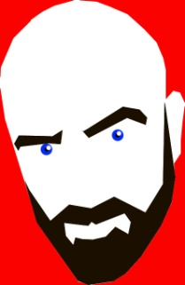
Allan Cavanagh
www.caricatures-ireland.com/blog
@allancavanagh on Twitter

Slide 2
My talk:
Tips I’ve picked up

Slide 3
My talk:
Tips I’ve picked up
How you can start to develop on online presence

Slide 4
My talk:
Tips I’ve picked up
How you can start to develop on online presence
It’s not a universal model, but the bones are flexible

Slide 5
My talk:
Tips I’ve picked up
How you can start to develop on online presence
It’s not a universal model, but the bones are flexible
By all means, call me a bullshitter.

Slide 6
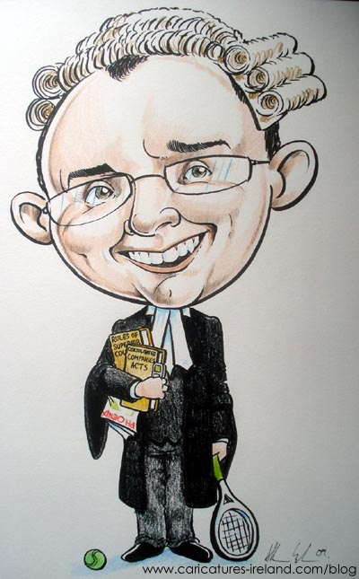
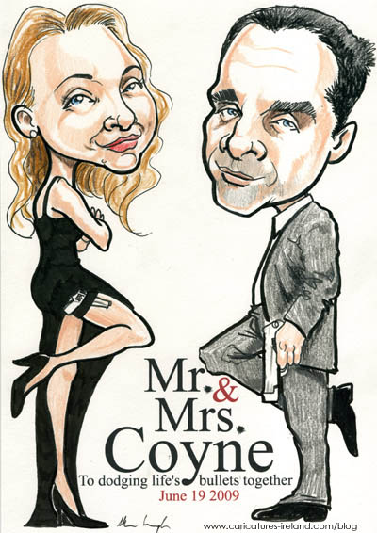
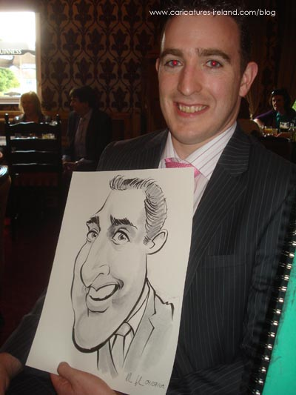
Allan Cavanagh
Cartoonist and Caricature Artist

Slide 7
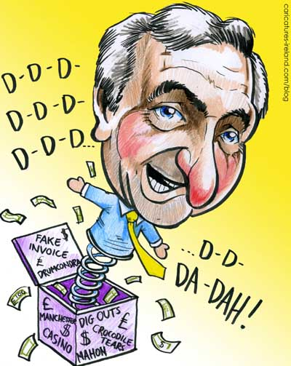
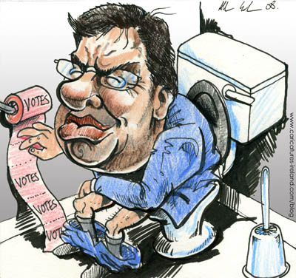
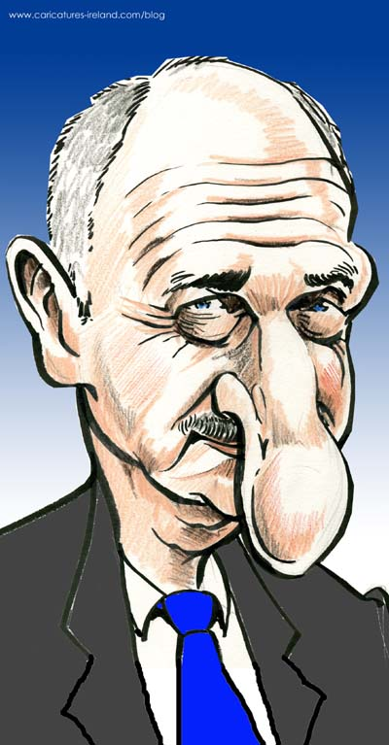
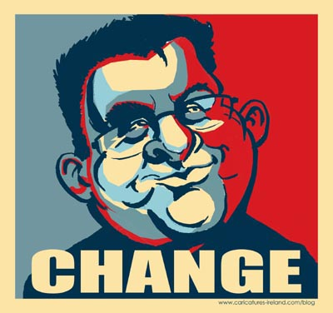
Double Vision by Charlie Adley

Slide 8
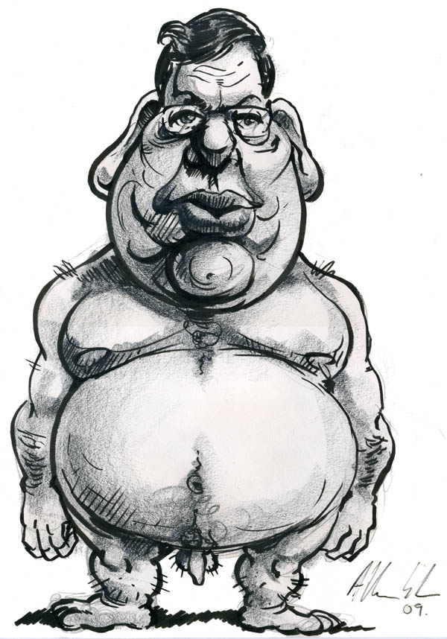

Slide 9
Allan Cavanagh
Business is a blank page.

Slide 10
Allan Cavanagh
Business is a blank page.
You have the potential to reach global audience.

Slide 11
Allan Cavanagh
Business is a blank page.
You have the potential to reach global audience.
The tools to do this are free(ish).

Slide 12
Tool 1: Domain Names
Buy 2 domain names:
www.yourname.ie
www.keywords.ie or .com
GOOGLE READS DOMAIN NAMES.
Make your name your brand

Slide 13
Tool 1: Domain Names
I recommend www.blacknight.com’s Medius plan to get started.

Slide 14
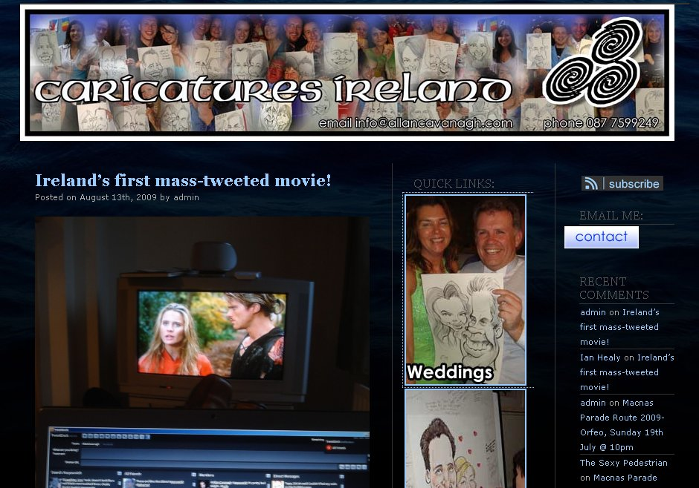
Tool 2: The Blog

Slide 15
Tool 2: The Blog
Shop window
Communicate with a global audience
Dynamic- it’s a living, breathing presence online

Slide 16
Tool 2: The Blog
First read blogs- Google Reader.
Use Wordpress.
Exchange links with your peers.
NEVER EVER SPAM.
Interact on other blogs.

Slide 17
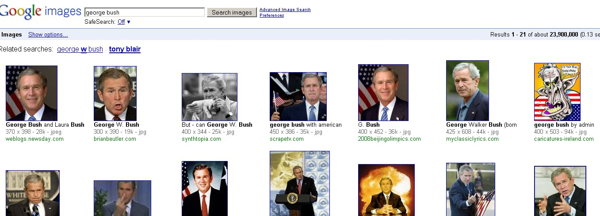
Tool 2: The Blog
Name your images

Slide 18
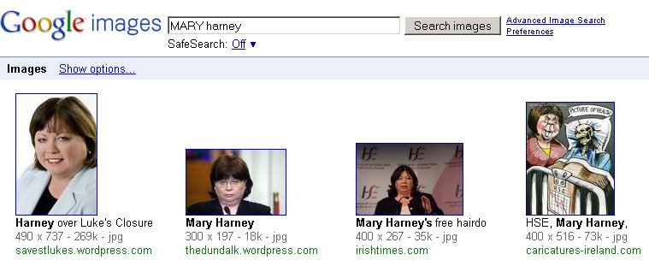
Tool 2: The Blog
Name your images

Slide 19
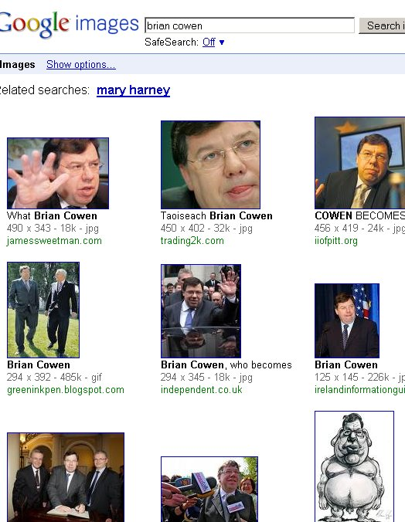
Tool 2: The Blog
Name your images

Slide 20
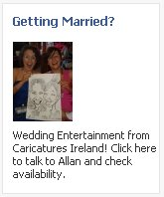
Tool 3: Facebook and Twitter
Facebook ads
Group pages
Terms of Use

Slide 21
Tool 3: Facebook and Twitter
Twitter is intensive microblogging
140 characters
Great craic
Casual, chatty, friendly (mostly)
#asyouwish

Slide 22
Tools 4- agizillion…
Find out what’s out there
Can you use it/ adapt it?
Don’t expect instant results

Slide 23
Freelance Arts Career
Low overheads
Potential “global” reach
Tax exemptions- http://www.revenue.ie/en/tax/it/reliefs/artists-exemption.html

Slide 24
Freelance Arts Career
Highly competitive
Long hours of the self employed
Feast or famine

