Slide 1
Meet the Team
Courtney Lewis, Alicia Morgan, and Amber Scotty

Slide 2
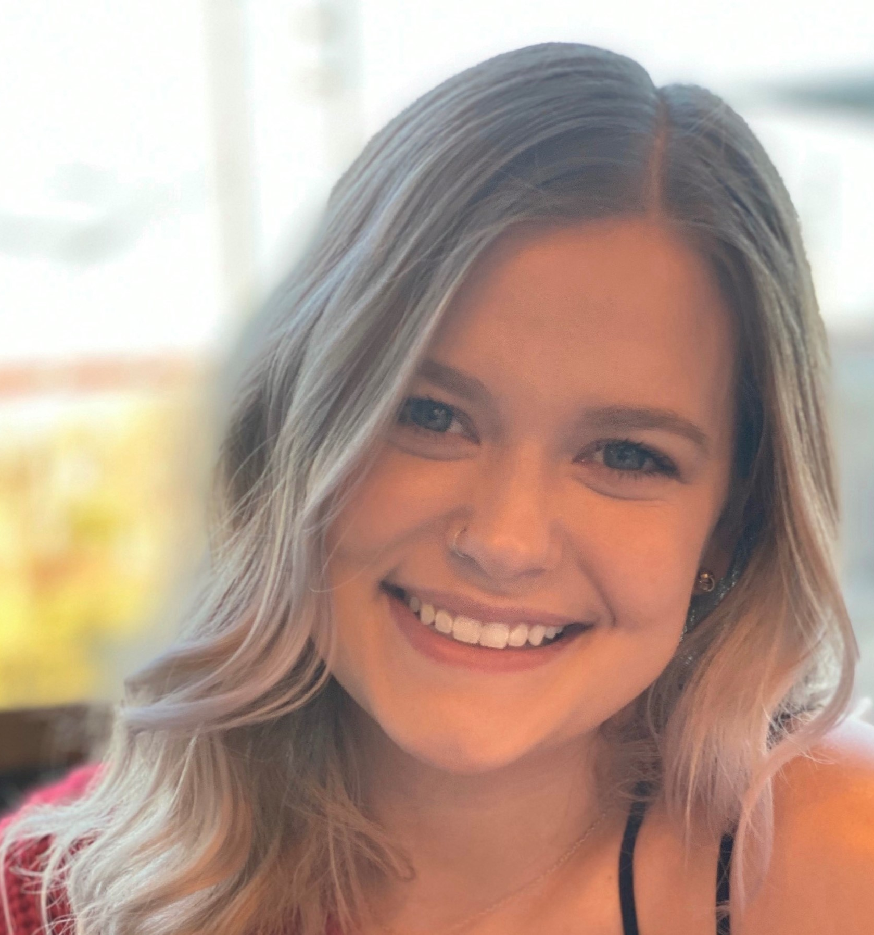
Alicia Morgan
As the daughter of an Engineer and an Accountant, my love for numbers began early! I graduated Glasgow High School in 2012 with honors and began my journey with Entity in 2021 after learning my love of coding and data at work.
For the past 5 years I have worked with Medicare, as a remote claims adjuster, which is what lead to my passion and skill of problem solving. Before claims, I worked in insurance verification and billing at my local hospital, and as a Personal Marketing Assistant where I planned events, created logos, and was responsible for all accounts payable/receivable.
I am a very determined and fast-learning individual who is looking to maintain a steady career involved in Data Science where I can continue to move up and grow with my company as my skills develop.

Slide 3
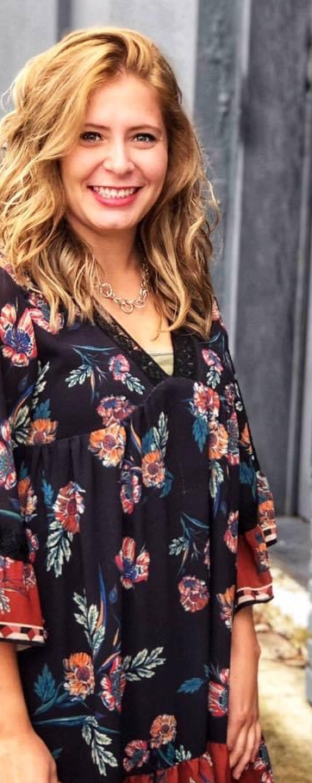
Amber Scotty
I graduated from The Ohio State University Agricultural Technical Institute (ATI) in the spring of 2012 with an Associate’s Degree in Horse Science. After graduating from ATI, I continued my academic career to The Ohio State University main campus majoring in Animal Science: Bioscience Specialization. I graduated from The Ohio State University in 2014.
Once I graduated from The Ohio State University, I landed a job working at WIL Research as a Research Biologist. This role gave me some insights of laboratory experience working with animals and how pharmaceutical medicines are created in stages during pre-clinical trials. I worked at this research facility for about a year until I was offered a job opportunity in Texas working as an Animal Control Officer.
I moved to Texas in the spring of 2015. This job was extremely rewarding yet difficult. This position allowed me to help educate the general public about proper animal welfare. I was then promoted to a Code Enforcement Officer, and I worked in this position for several years until I decided I wanted a change in life.
I decided to go back to school in June 2021. This is when I was first introduced to coding and the Data Science Course offered through Entity Academy. My journey through this course has allowed me to gain valuable critical thinking and problem-solving skills with a new love for Data Science and Coding!

Slide 4
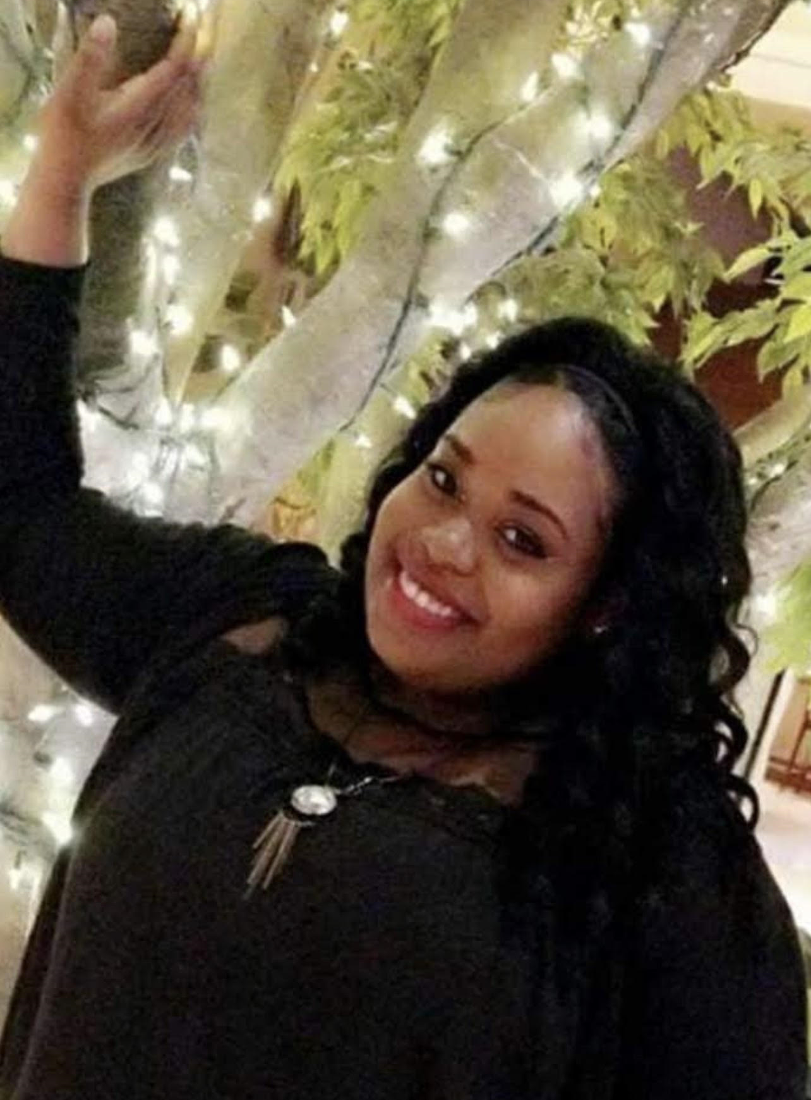
Courtney Lewis
Growing up I was always very curious and loved learning how things worked. I was an excellent student who had perfect attendance all four years of high school and graduated top 20 of my class on May 17, 2012. I always enjoyed math and analytical thinking and was always told I was very observant. Originally, I started in the field of dentistry but later changed my major to Process Technology.
I obtained my Associate degree in Applied Science and Technology at Louisiana Delta Community College on Dec 15, 2014. I had plans of becoming an engineer, but I was made an offer by Drax Biomass during my last semester at Delta. I started as a heavy equipment operator where I operated a 25-ton crane and Volvo loaders to unload logger trucks. I was later promoted to a Process Quality Lab Technician where my love for gathering data, running analysis tests and drawing conclusions emerged.
In January of 2020, I moved to Texas from Louisiana and started working at General Motors. While it was interesting to assemble vehicles like: Tahoes, Denalis, Escalades, and Suburbans, I wanted a change from the industrial field.
I decided to enroll in the Data Science program through SCI. While attending the course I’ve been working remotely as a Collection Specialist at Credit Management. Now I’m looking forward to pursuing a career in the exciting field of data science.

