Slide 1












Collection

Slide 2
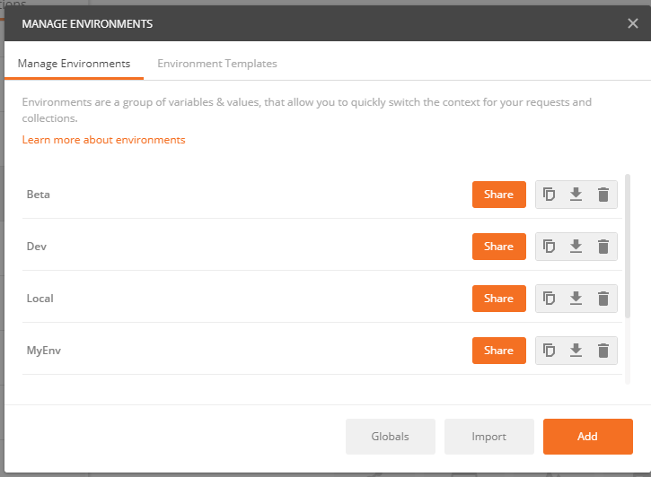
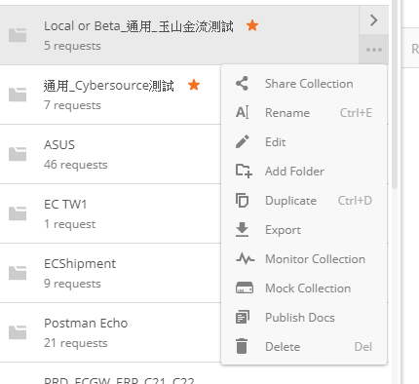

Slide 3
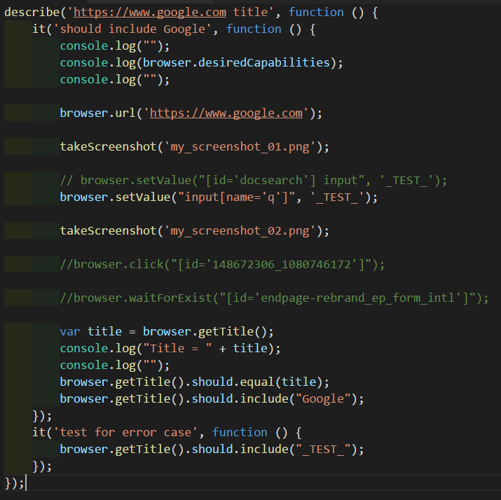

Slide 4




Xvfb – X Virtual Frame Buffer

Slide 5

Collection
Task
Task
ENV
TASK
TASK
DEV_TASK
DEV_TASK

Slide 6
Collection
Task
Task
Global.ENV
ENV
ENV
TASK
TASK
TASK
TASK

