Slide 1

The governed operating layer
for the AI-run company.
The business lives in AMOS. The AI is the operator.
Investor deck · July 2026
amoslabs.com
Notes:
AMOS is not another AI assistant. It is the durable governed operating layer that lets changing AI models safely operate a real company.
Open with the category: the models change; the company context, permissions, actions and learning history stay in AMOS.

Slide 2
THE PROBLEM
AI can reason.
Most companies still can't
let it act.
01
Fragmented context
Data, apps, documents and history live in separate silos.
02
No safe action layer
Chat produces insight; humans still translate it into work.
Company truth is scattered across disconnected applications. Every model session starts with partial context, while consequential actions still land on a human desk.
03
No durable learning
Intent, approval and outcome disappear into tickets and chats.
AMOS LABS · CONFIDENTIAL
02
Notes:
Lead with the practical blocker: intelligence is abundant, but context, authority and accountability are missing.
The opportunity is not a better chat window. It is the operating environment around the model.

Slide 3
THE THESIS
Models will keep changing.
CHANGE
Your company endures.
the
intelligence
KEEP
AMOS holds the durable company memory, connections, rules, permissions, actions and proof. Claude, GPT, Codex—or the next great model—operates through the same governed surface.
the
company
AMOS LABS · CONFIDENTIAL
03
Notes:
This is the category-defining line: change the intelligence without reconnecting the company.
Model choice becomes a feature; durable governed company context becomes the platform.

Slide 4
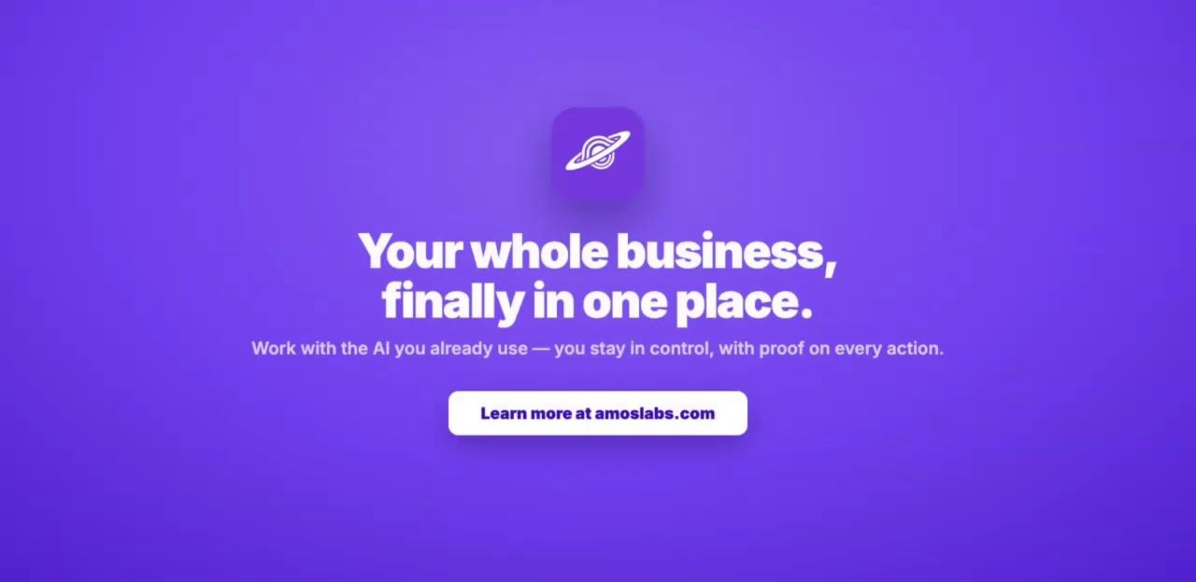

PRODUCT IN 71 SECONDS
See the complete loop
Connect → understand → act → approve → prove → learn
WATCH
AMOS Launch Video
youtube.com/watch?v=KfWwN2SHEf0
Open the 71-second video ↗
AMOS LABS · CONFIDENTIAL
Source: AMOS launch video on YouTube
04
Notes:
In a live pitch, play the video here. It runs 1 minute 11 seconds.
If the deck is forwarded, the thumbnail button and QR code open the exact YouTube URL.

Slide 5
PRODUCT ARCHITECTURE
AMOS Desktop is the cockpit. The brain stays portable.
THE INTERFACES
AMOS Desktop · Claude · GPT · Codex · open models · any MCP client
AMOS CONTROL PLANE
Company memory
Connections
Policies
Actions
Approvals
Receipts
THE COMPANY
CRM · finance · ERP · documents · marketing · databases · bespoke apps
AMOS LABS · CONFIDENTIAL
05
Notes:
AMOS separates intelligence from the business environment.
This architecture enables model choice, tenant-scoped access, sovereign deployment and durable organizational memory.
[Sources] - AMOS product architecture and Desktop positioning; founder-provided, 2026-08-01. [/Sources]

Slide 6
THE COMPOUNDING MOAT
Every action leaves proof. Every proof improves the next action.
A receipt binds intent, context, policy checks, approval, evidence and outcome. Over time, that becomes governed organizational learning—not a pile of chat history.
1
2
3
4
5
BUILD
MEASURE
APPROVE + PROVE
LEARN
IMPROVE
The receipt graph compounds across actions, workflows, people and outcomes.
AMOS LABS · CONFIDENTIAL
Source: amoslabs.com — governed organizational learning
06
Notes:
Most AI products lose the evidence trail at the end of the chat. AMOS keeps it attached to the company.
The compounding asset is the governed record of what was attempted, allowed, approved, executed and learned.

Slide 7
LOCAL INTELLIGENCE
The intelligence follows the company home.
THE MECHANISM
PROOF, NOT PROMISE
Route locally. Escalate selectively.
120B open intelligence on owned hardware
AMOS qualifies each workflow, handles routine work on owned hardware, and escalates only the hard tail. Every escalation is receipted—and becomes a governed improvement signal.
01 Full GPT-OSS 120B runs on a 64 GB M1 Max—where stock full-Metal cannot.
02 Local and AWS controls passed the same hidden coding tests: 3/3.
03 Bit-exact async prefetch lifted coding-prompt prefill 70%.
“The margin curve improves as the measured local share compounds.”
Target: 80–90% local by workflow · frontier escalation stays governed and receipted
AMOS LABS · CONFIDENTIAL
07
Notes:
The local-intelligence program turns AMOS’s receipt graph into a compounding runtime advantage: routine work can move onto owned hardware while hard cases remain governed and receipted.
The 80–90% figure is a measured target by workflow, not a claim of frontier parity.
[Sources]
- https://github.com/amos-labs/amos-agent/blob/main/docs/LOCAL_120B_LIVE_BASELINE.md
- https://github.com/amos-labs/amos-agent/blob/main/docs/EXPERT_CACHE_ZERO_COPY_RESULTS.md
- https://github.com/amos-labs/amos-agent/pull/43
[/Sources]

Slide 8
GOVERNED AUTONOMY
From “do this” to “pursue this goal.”
AMOS can observe the business, propose experiments, park consequential work for approval, act within policy, measure the result and continue the loop.
GOAL
OBSERVE
PROPOSE
APPROVE / ACT
MEASURE
CONTINUE
Humans set goals, budgets and boundaries.
Agency can tighten policy; it can never loosen it.
AMOS LABS · CONFIDENTIAL
08
Notes:
This is the step beyond repeated prompts: self-directed work toward a measurable goal.
Consequential work never self-approves. The loop parks for a human; reversible actions can run inside explicit budgets and policy.

Slide 9
MARKET ENTRY
Land with one urgent workflow. Expand into the operating stack.
Start with a bounded pilot. Prove the outcome, then expand across workflows and the network.
04
03
Own the layer
02
Automate
01
Act
Company memory, policies, proof and learning remain portable across models.
Understand
Run governed workflows across existing systems and bespoke apps.
Create campaigns, update systems and publish—with approval.
Ask across finance, customers, documents and operations.
SMB → MID-MARKET → ENTERPRISE
AMOS LABS · CONFIDENTIAL
09
Notes:
The customer can start with a single painful workflow and expand without rebuilding context or governance.
AMOS also supports a builder path: create a vertical app once and resell it to a network of downstream businesses.

Slide 10
MARKET OPPORTUNITY
Beyond SaaS: building the backbone of the AI economy.
1M companies × $10K = $10B ARR—before infrastructure and marketplace upside.
04
03
Marketplace
02
AMOS Protocol
01
Smart infrastructure
Builders sell connections, workflows, goal adapters and vertical apps.
Operating layer
Makes capabilities discoverable, governed and billable across agents.
Govern cloud through MCP today; own compute + data centers when scale justifies it.
70M+ U.S. + European SMBs; governed memory, actions and proof.
TAKE RATE + NETWORK
1.4% BASE PENETRATION
AMOS LABS · CONFIDENTIAL
Sources: U.S. SBA (2026); European Commission (2026). Illustrative case; not a forecast.
10
Notes:
The customer can start with a single painful workflow and expand without rebuilding context or governance.
AMOS also supports a builder path: create a vertical app once and resell it to a network of downstream businesses.

Slide 11
COMMERCIAL TRACTION
Revenue is new. The pipeline is already in the millions.
Real revenue. Real deals. Active partners.
REVENUE TODAY
ACTIVE DEAL PIPELINE
PUBLIC-SECTOR WEDGE
$2,200 MRR
$MM+
Nuvola Academy
All added in the last month across more than eight SMB companies.
Includes a large-enterprise pilot; UT and life-sciences conversations remain early-stage.
Multiple partners are advancing government contracts focused on law-enforcement training.
8+ SMBs
Large-enterprise pilot
UT + life sciences
Partners active in every division
AMOS LABS · CONFIDENTIAL
Source: founder-provided commercial status, August 2026
11
Notes:
Do not overstate traction. The strongest claim is that the product is real, live and already operating real businesses.
Replace this slide with quantified ARR, paid accounts, activation and pipeline as the launch data matures.
[Sources] - Current MRR, SMB company count, active pipeline scale, large-enterprise pilot, UT and life-sciences stage, Nuvola government-contracting focus, and active partner channels across divisions; founder-provided by Rick Barkley, 2026-08-01. [/Sources]

Slide 12
BUSINESS MODEL
Revenue expands as AMOS becomes more of the operating stack.
A recurring platform foundation, modular product expansion and metered infrastructure—all visible and attributable to the customer.
01
02
03
Platform subscription
Modular expansion
Metered + sovereign infrastructure
Company brain, governed actions, proof, finance and the MCP control plane.
Marketing + CRM, industry modules, bespoke apps and additional teams.
Managed models, sovereign local intelligence pods, SES and compute—billed with transparent usage.
LAND
EXPAND
SCALE
AMOS LABS · CONFIDENTIAL
12
Notes:
The economic model aligns with customer value: start with the control plane, then expand into workflows, software and infrastructure.
Customers can bring their own model keys or use managed infrastructure. Cloud resources are metered and billed back.

Slide 13
CAPITAL DEPLOYMENT
$15–20M converts early pull into category speed.
At $17.5M, we can deepen the platform, deliver enterprise deployments, and build repeatable distribution in parallel.
01
02
03
Build + trust
Deploy + operate
Distribute + reserve
Product + platform — $5.0M
Security + compliance — $2.0M
FDE + customer success — $3.4M
Enterprise onboarding — $1.0M
GTM + partnerships — $4.1M
Local intelligence + compute — $2.0M
40% · $7.0M
25% · $4.4M
35% · $6.1M
AMOS LABS · CONFIDENTIAL
13
Notes:
The economic model aligns with customer value: start with the control plane, then expand into workflows, software and infrastructure.
Customers can bring their own model keys or use managed infrastructure. Cloud resources are metered and billed back.

Slide 14
COMPETITIVE POSITION
Others provide pieces. AMOS owns the operating layer between AI and the company.
CATEGORY
CONTEXT
ACTION
GOVERNANCE
PORTABLE
LEARNS
SOVEREIGN
Chat assistants
●
○
○
●
○
○
Point automation
○
●
△
○
○
○
Enterprise data platforms
●
△
●
○
△
△
AMOS
●
●
●
●
●
●
● native · △ partial · ○ not the core product
AMOS LABS · CONFIDENTIAL
14
Notes:
The competitors are not wrong; they solve narrower layers.
AMOS is differentiated by combining durable context, governed action, portability and the receipt-driven learning loop in one operating surface.

Slide 15
WHY THIS TEAM, WHY THIS ROUTE
Enterprise credibility. AI-native execution. Capital-efficient scale.
RICK BARKLEY
GO-TO-MARKET
Founder & CEO
SMB wedge + enterprise pull
Built and sold enterprise software before. Now translating hands-on experience in AI infrastructure, governed workflows and autonomous research loops into a product real companies can adopt.
01 Problem-led campaigns → live playground → signup
02 Founder-led sales into regulated and operationally complex companies
03 Builder/reseller path turns one vertical solution into many downstream accounts
“The AI is the operator. AMOS is the governed layer it operates through.”
Engineering across SF · Austin · Lisbon | US HQ: Austin · European HQ + EU/sovereign expansion: Lisbon
AMOS LABS · CONFIDENTIAL
15
Notes:
The story is not labor arbitrage. Portugal provides exceptional engineering talent, capital-efficient building and a credible European/sovereign path.
The funnel is measurable end-to-end: campaign message, landing page, playground, signup and onboarding campaign.

Slide 16
The governed operating layer
every company needs.
Raising $15–20M to turn early pull into the category-defining governed operating layer.
PRODUCT
DISTRIBUTION
ROUND SIGNAL
Harden product + enterprise trust
Turn pilots into repeatable expansion
$15–20M · seeking lead · Active Capital follow-on interest
Rick Barkley · rick@amoslabs.com
amoslabs.com · app.amoslabs.com/playground
Notes:
Close by asking for a next meeting, not generic feedback.
Active Capital interest is non-binding and contingent on securing a lead. Do not describe it as committed capital.
Add the exact round size and milestone plan once finalized.

