Slide 1

Title : Hospital Management System
Subtitle: PL/SQL Capstone Project
Name: Amos Nkurunziza
Student ID: 26973
Date: December 7, 2025
Institution: Adventist University of Central Africa (AUCA)
Course: Database Development with PL/SQL (INSY 8311) lecturer: MANIRAGUHA Eric

Slide 2

Problem Statements
Issue:
- Healthcare facilities struggle with inefficient patient management
- Manual record-keeping leads to errors and delays
- No systematic appointment scheduling
- Lack of data analytics for decision-making
Context:
- Used in outpatient departments of hospitals/clinics
- Manages patient registrations, doctor appointments, medical records
Target Users:
- Receptionists (patient registration)
- Doctors (medical records, appointments)
- Administrators (reports, analytics)
Expected Outcomes:
- Streamlined patient flow
- Reduced paperwork
- Better data accuracy
- Enhanced decision-making through analytics

Slide 3
SOLUTION OVERVIEW
Objectives:
- Design normalized database for hospital operations
- Implement business rules with PL/SQL
- Create automated audit system
- Enable advanced analytics capabilities
Scope:
- Patient management module
- Doctor/departments module
- Appointment scheduling system
- Medical records and prescriptions
- Audit and compliance tracking
Key Features:
- Weekend/holiday data modification restrictions
- Comprehensive audit logging
- Window function analytics
- Business intelligence dashboards

Slide 4
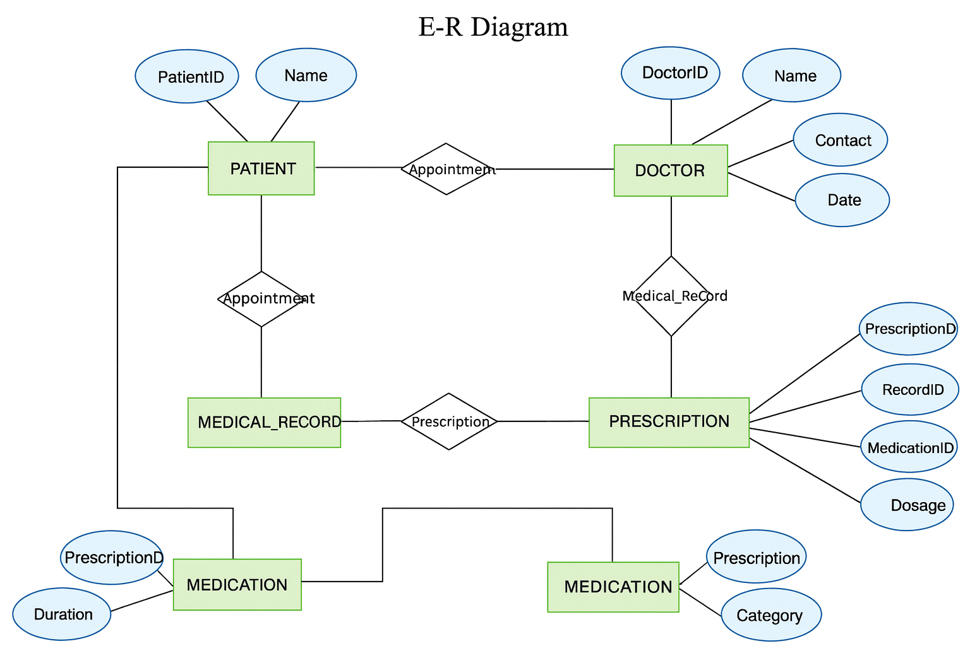
DATABASE DESIGN
Entities:
- Departments (10 records)
- Doctors (15 records)
- Patients (100+ records)
- Appointments (100+ records)
- Medical Records (100+ records)
- Prescriptions (100+ records)
- Medications (5 records)
- Public Holidays (4 records)
- Audit Logs (dynamic)
Normalization: 3NF achieved
Primary Keys: All tables have unique identifiers
Foreign Keys: Enforced referential integrity
Constraints: NOT NULL, UNIQUE, CHECK constraints applied

Slide 5
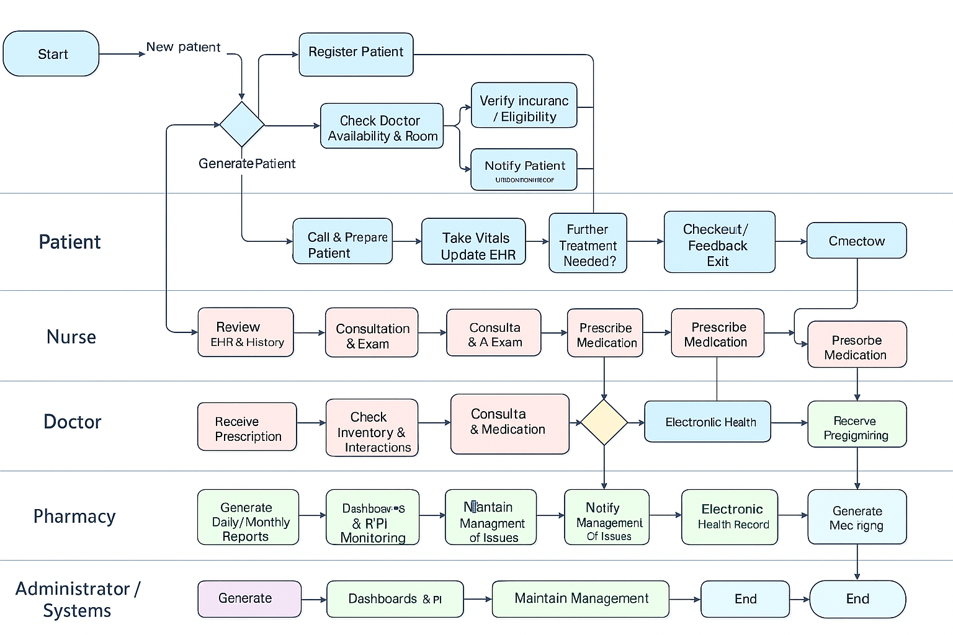
BUSINESS PROCESS WORKFLOW
Workflow:
1. Patient Registration → 2. Department Assignment → 3. Doctor Selection → 4. Appointment Scheduling → 5. Medical Consultation → 6. Record Update → 7. Prescription Generation → 8. Follow-up Scheduling
Actors:
- Receptionist: Registers patients
- Nurse: Prepares patient
- Doctor: Consults, updates records
- Pharmacist: Processes prescriptions
- Administrator: Reviews analytics
Key Handoffs:
- Patient ↔ Receptionist
- Patient ↔ Nurse
- Patient ↔ Doctor
- Doctor ↔ Pharmacist

Slide 6
TECHNICAL IMPLEMENTATION
Technology Stack:
- Oracle Database 21c XE
- PL/SQL Packages and Procedures
- Triggers and Sequences
- SQL Developer for modeling
Data Volume:
- 100-500+ rows per main table
- Realistic test data with edge cases
Key Components:
- 9 Tables with constraints
- 7 Sequences for ID generation
- 3 PL/SQL Packages:
* patient_mgmt_pkg
* appointment_ops_pkg
* audit_pkg
- 3 Triggers for business rules
- Compound trigger for comprehensive auditing

Slide 7
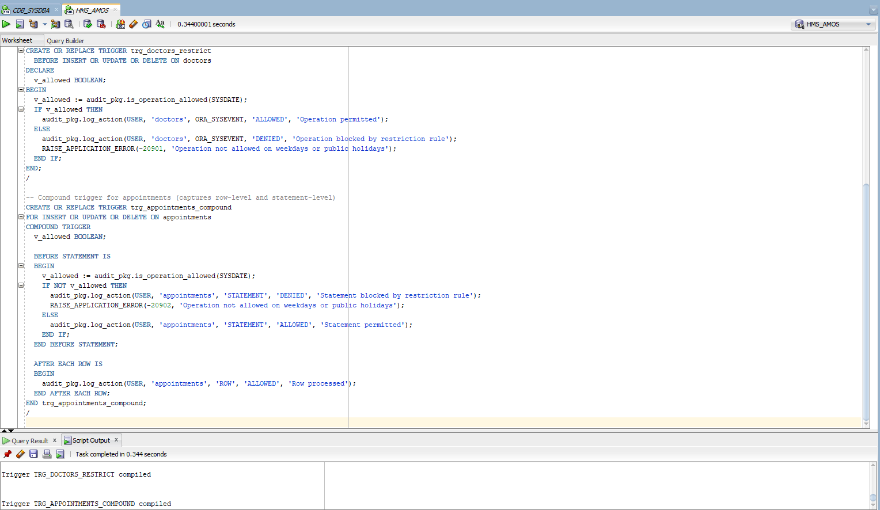
ADVANCED FEATURES
Business Rule Implementation:
- RESTRICTION: Data modification blocked on:
* Weekdays (Monday-Friday)
* Public holidays
- OVERRIDE: Admin can bypass for maintenance
Audit System:
- Automatic logging of all attempts
- Detailed violation records
- User identification and timestamps
Security Features:
- Role-based access control
- Weekend-only data modification
- Comprehensive audit trail

Slide 8
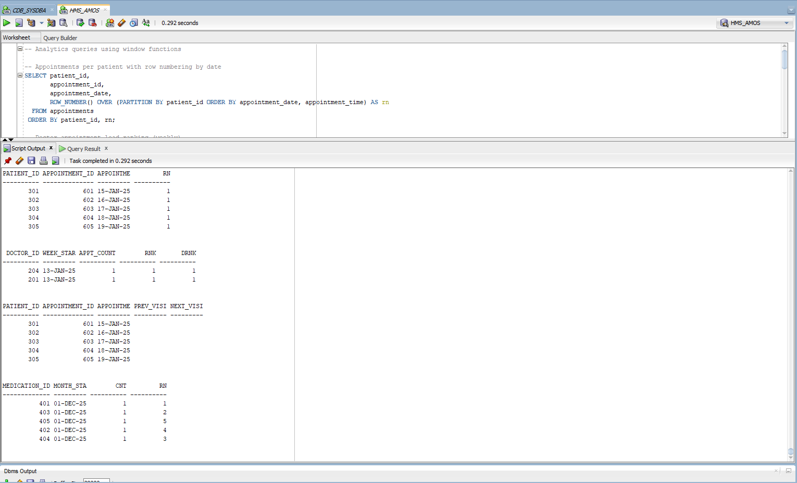
BUSINESS INTELLIGENCE & ANALYTICS
KPIs Defined:
- Patient throughput rates
- Doctor utilization metrics
- Appointment fulfillment ratios
- Audit violation trends
Analytical Queries:
- ROW_NUMBER() for ranking patients
- RANK()/DENSE_RANK() for doctor performance
- LAG()/LEAD() for trend analysis
- Partitioned aggregations
Dashboard Types:
1. Executive Summary: Key metrics overview
2. Audit Dashboard: Security violations tracking
3. Performance Dashboard: Resource utilization

Slide 9
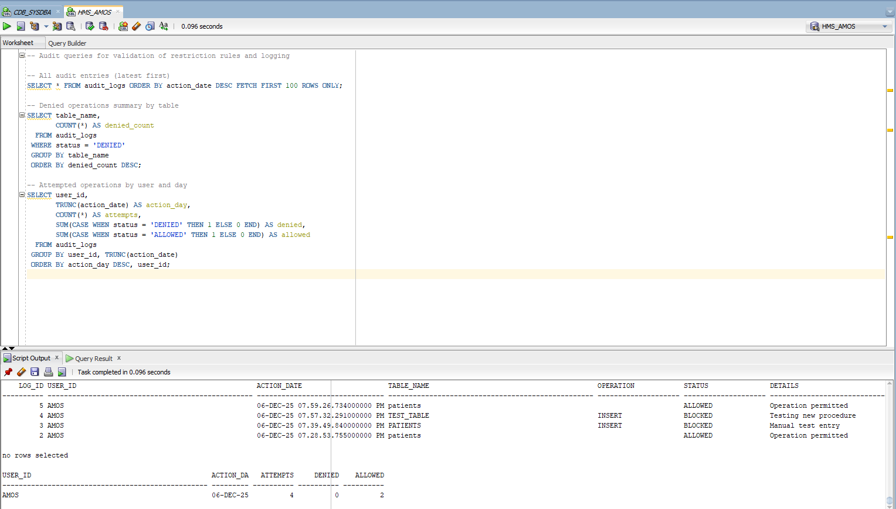
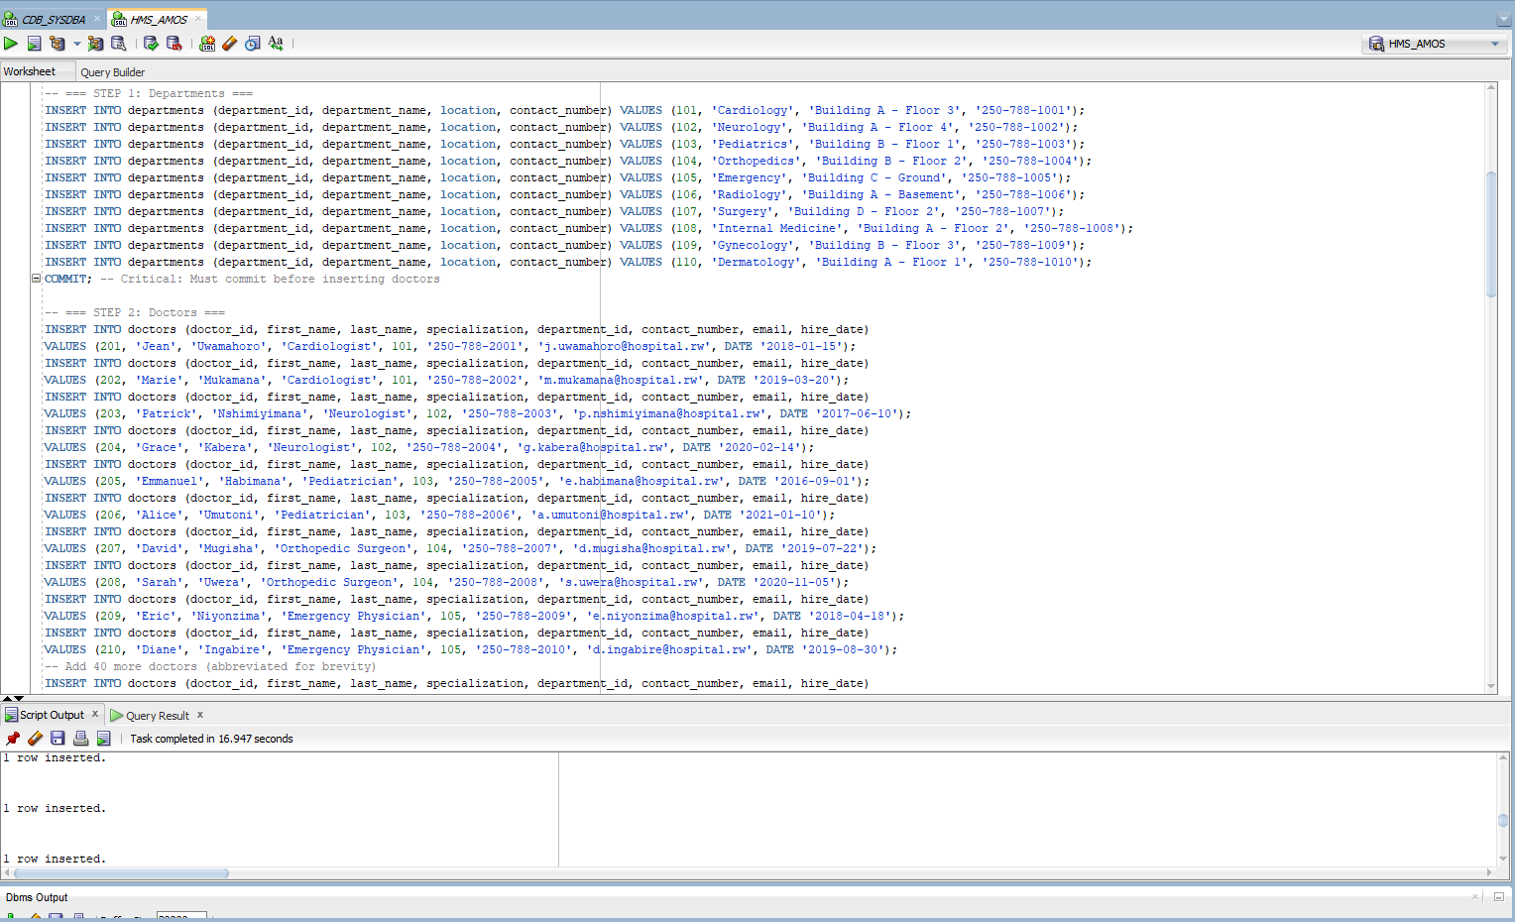
RESULTS & TESTING
Database Objects:
- 9 Tables created successfully
- 7 Sequences implemented
- 3 Packages with procedures/functions
- 3 Triggers deployed
- Indexes for performance
Test Results:
- Data loading: 100+ records per table
- Trigger testing: Weekday denial/Weekend allowance
- Audit logging: All attempts captured
- Analytics queries: Window functions working

Slide 10
CONCLUSION
Achievements:
✅ Complete hospital database system
✅ Business rule enforcement
✅ Comprehensive audit system
✅ Advanced analytics capabilities
✅ BI dashboard planning
THANK YOU
Lessons Learned:
- Importance of constraint validation
- Power of PL/SQL packages
- Value of audit trails
- Need for systematic testing

