Slide 1


Slide 2
Teaching the Touch Topics
Recursion and Iteration using Python

Slide 3
Outcomes
Be familiar with recursion and how to implement recursive functions
Be aware of the limits of recursion
Understand what is meant by iteration in the context of Python
Understand the use of the __iter__ and __next__ methods in Python iterators
Be able to use list comprehensions to create iterables
Be able to use Python Generator functions, appropriately

Slide 4
To understand recursion, one must first understand … recursion!

Slide 5
Functions, Stack Frames and the Stack
When a function is called, a stack frame is created
Stack frames are not Python specific
They contain various pieces of information to let Python handle functions
  The return address
  Arguments passed to the function
  Local variables
  Saved copies of any “registers” modified by the subprogram that will need to be restored

Slide 6
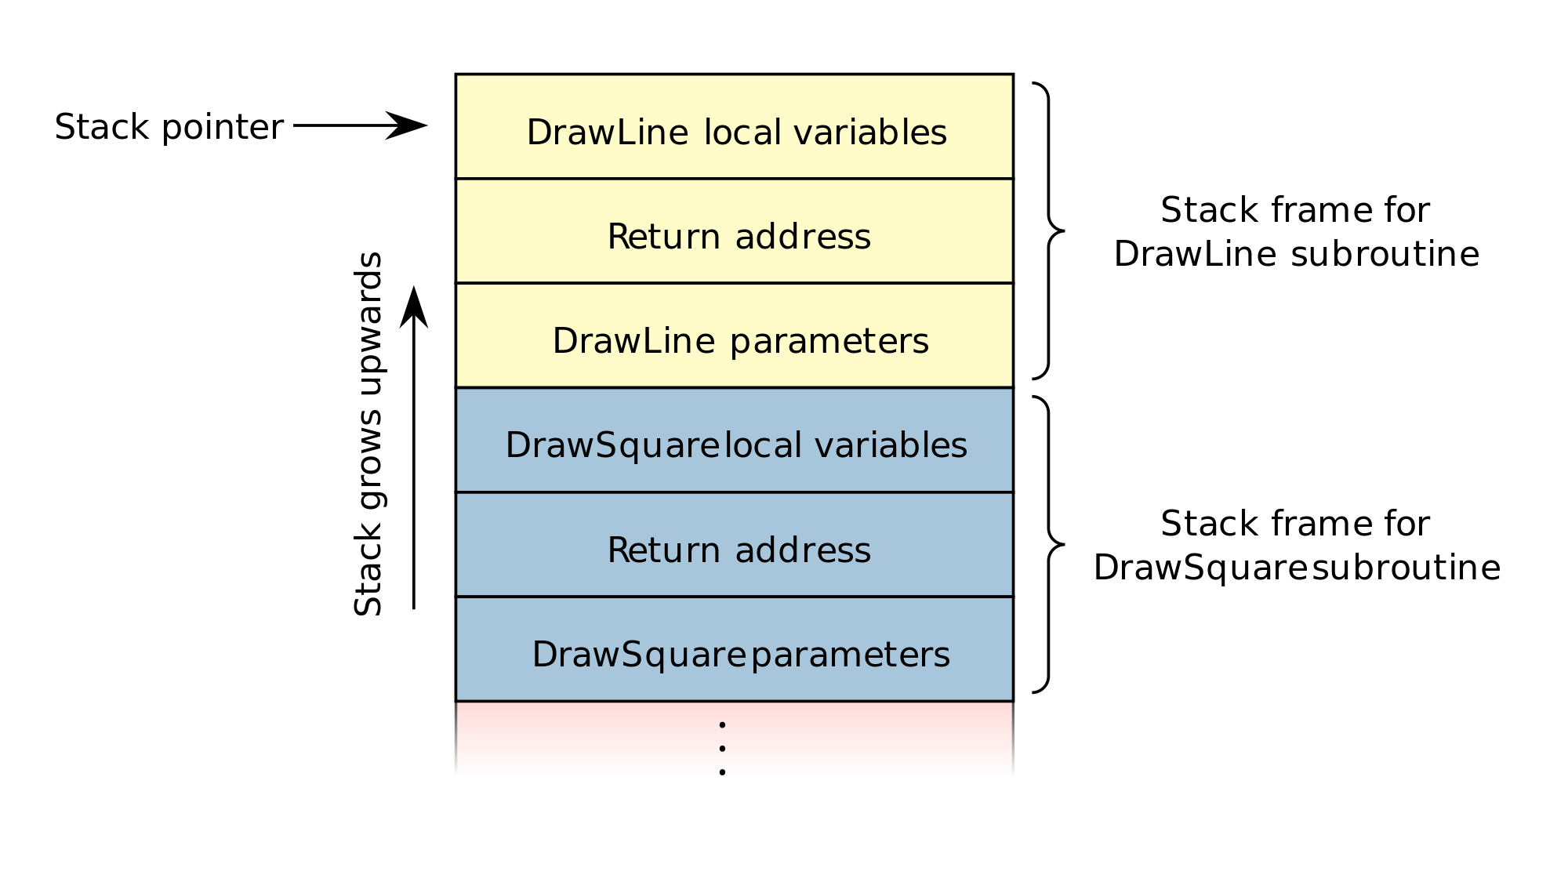
Stacks and Stack Frames
Each time a new function is called the current stack frame is pushed on to the call stack
When that function returns the last frame is popped from the stack and the previous state restored
Model stacks and stack frames

Slide 7
Stack Overflow
Not the website!
If we call too many functions without returning we risk causing a stack overflow error
In Python create a function that takes an argument, adds one to it, prints it out then calls itself passing in the new value
How many calls to itself does it manage before we get a crash?
To overcome this we need to introduce what is known as a Base Case

Slide 8
Functions that call themselves
The basis for recursion is we solve problems by creating functions that call themselves
This is typically more useful as a design for a programmer than as an efficient coding technique
The resulting code will probably be more elegant and compact, possibly simpler than it would have been if we had designed it iteratively.
The code might not be more efficient when it runs

Slide 9
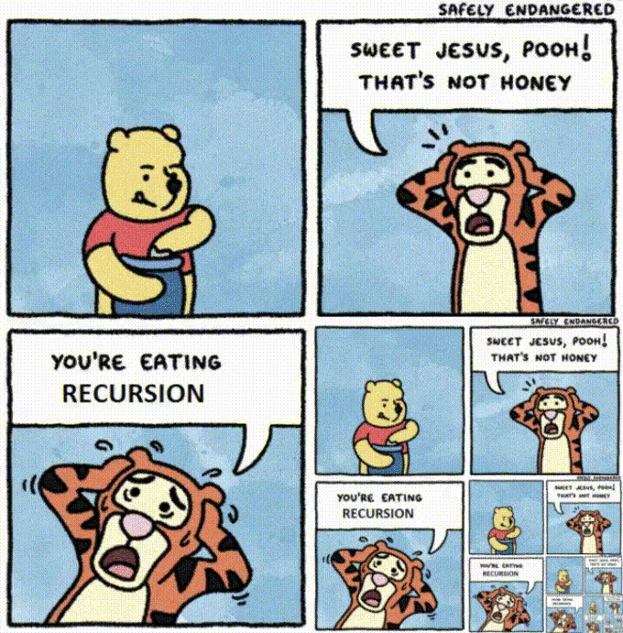
What happens if we forget the
Base Case?

Slide 10
Base Cases
To avoid just calling the same function forever, we create a base case.
The base case is the get out clause which lets us stop calling the function and start passing values back up the call stack
For instance to recursively count to 100 in the previous example we could modify the python code like this (see python file)
  Typically recursive functions return values rather than printing but it will serve to illustrate what I mean

Slide 11
Factorial
Lets implement the factorial function using recursion
Typically we start at an upper value (the one that is passed in) and then count down until we reach 0 (or 1)
  There is nothing to stop us from counting up if we wanted
This acts as the base case and we start returning at this point.
Extension – reimplement it with the values counting up from 1.

Slide 12
Problems
Write a function that returns the sum of the digits of an integer.
Write a recursive function (use no while loops or for loops) that prints all the elements of a list of integers,one per line. The parameters to the function should be a list of integers and the size of the list
Same problem as the last one, but print out the elements in reverse order.
Find the sum of the integers from 1 through n. Use recursion.
Count the number of zeros in a list of integers. Use recursion.
Find the minimum element in a list of integers. Use recursion.

Slide 13
Conclusions
Recursion is a useful tool to elegantly solve, certain problems
It may not create more efficient code
If you try to exceed the maximum allowable stack depth your program will crash
Certain problems may be easier to solve
Some comic relief

Slide 14
Iterators, List Comprehensions and Generators
Iterators are the mechanism by which we are able to traverse iterable objects
An iterable object is a collection such as a list or a string that we can go through pulling out one object at a time until we’ve done them all
Iterable objects have a built in method called __iter__ defined on it, which essentially describes how to get the next item from the iterable
We can manually create a copy of this and see what happens when call next() on the iterator over and over
See code

Slide 15
Designing your own Collection Classes
This is beyond the scope of what we are going to look at today, but essentially if you create your own custom classes that act as collections (ie they need to be iterable) then they will need to inherit from a class that is already iterable or you will need to supply the code necessary to make them iterable

Slide 16
List Comprehensions
This is a Pythonic way of creating a list object (or a tuple, set etc) using fewer lines of code.
  It is basically more readable than using a for loop
  Usually takes up less space
  May be more efficient in certain complex and advanced scenarios
We’re going to work through some python examples of common list comprehension types

Slide 17
Generators
Generators look almost like function definitions and function calls and use virtually the same syntax, we define them in the same way we do functions and also call them in the same way
The only difference is that for a function to be a generator it must contain the keyword yield
What this does is return a value just like a return would in a normal function but only when we iterate over the generator
If we have multiple yields in a generator, each time the generator is called it runs the code since the last yield up to the next one, but as we iterate over them
Lets have a look at this in Python

Slide 18
What are Generators for?
The manual generators we’ve been looking at don’t really give a good example of what they’re for
More typically we’d have some python code in the body of the generator, which updates a value each time it is run, and this would be the value which is then yielded each time
Normally these would be lists of values that are actually infinitely long (prime numbers, the next Fibonacci number, etc) which we want to iterate over, but which we can’t generate a list for due to the fact they are infinite sequences
Generators make use of lazy evaluation whereas when we build a list we are doing eager evaluation

Slide 19
Lazy vs Eager Evaluation
Eager evaluation describes what happens when we create a list (using a list comprehension or any other way)
  As we assign the contents, the data structure is created in full and stored somewhere in memory
  The whole structure is created
  We then iterate over it, or interact with it in other ways
Lazy evaluation describes a way of creating a recipe for a data structure where we always know how to get the next value
  We don’t create the whole thing (it may be impossible or inefficient to do so)
  Instead we yield the next value whenever we need it and iterate over it in this way

Slide 20
Building some Infinite Generators
Create a generator function that gives the next Fibonacci number each time you call it
Create a generator function that implements the factorial, returning the next value (if we put it in a loop could we create a factorial function that takes a value and gives us the factorial of it?)

Slide 21
Built in Generators
Python comes with various built in generators
These are contained within the Itertools module
Documentation for them exists here:
https://docs.python.org/3/library/itertools.html
Play with them, there are some very useful things in there, that I’ve previously implemented by hand because I wasn’t aware these existed
Create some simple programs to make use of them.

Slide 22
Conclusions
Iterables are collections of objects which can be iterated over
Iterators are the mechanism that allows this traversal
We can build lists and other similar objects using list comprehensions instead of simple for loops
Usually this is done for the sake of readability
Generators allow us to create iterable objects (that look like function calls) these may be infinitely long and make use of lazy evaluation to only get the next value each time

