Slide 1
Topic Filtering
CMDA Team

Slide 2
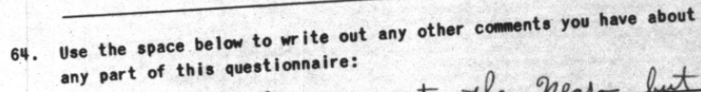
Goal
Given the responses to question 64, filter by those relating to race/race relations

Slide 3
Idea 1
Strategy
Create a list of keywords
Return responses that include these keywords
may choose to require a keyword be used at least some number of times
Limitations
Words with multiple meanings may lead to false positives
Fails to capture similar words/ideas/misspellings that may not be in the list
Forming a robust list of keywords requires a lot of foresight

Slide 4
Idea 2
Strategy
Create a “dictionary” of keywords
Provide example phrases using these words to give context
Use these phrases to get contextualized embeddings for the key tokens
Get embeddings for each token in a response
Return responses containing tokens with a high* cosine similarity to key tokens
* Finding this threshold requires some experimentation
Limitations
Not guaranteed to select a response even if it contains one of the keywords
This is sometimes beneficial depending on the context of the word.

Slide 5
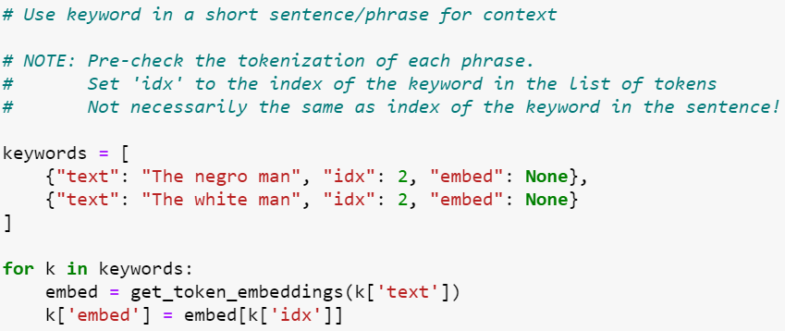
Idea 2 – Simple Dictionary
Build dictionary
Few keywords needed to get accurate results

Slide 6
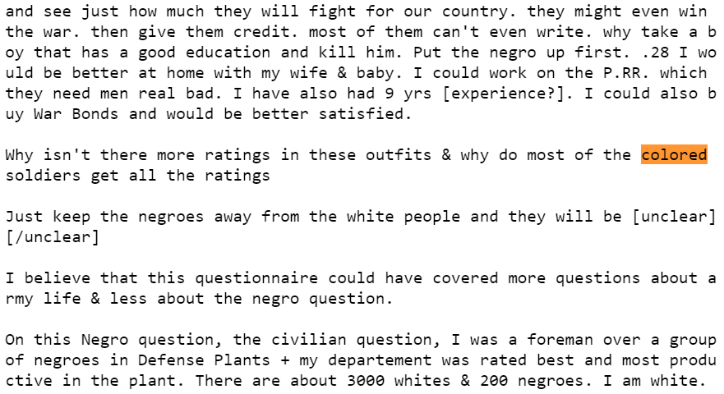
Idea 2 - Results
False positives: 9/1938
False negatives: 55/1938
~97% accuracy
Example of responses categorized as relating to race.
Notice that it picked up relevant responses that did not contain any of the designated keywords.

Slide 7
Extensions
Use the filtered responses for further research
Filter by other topics
would require a separate keyword dictionary
may need to adjust cosine similarity threshold
performance relative to the simple keyword list method may vary depending on list/dictionary size

