Slide 1
Lecture 3: Intro to Python & repl.it
CSC111: Introduction to CS through Programming
R. Jordan Crouser
Assistant Professor of Computer Science
Smith College

Slide 2
Announcements
Stuff to do ASAP if you haven’t already
Get on Discord
Sign up for repl.it (we’ll use it today!)
Get a copy of the e-book
About the book (warning messages, etc.)
TA hours and study groups start THIS week!

Slide 3
Overview of the week
Monday: Introduction to Python and repl.it
Lab: Getting Started with Python (due Wednesday before class)
Wednesday: User Input
Friday: Numbers

Slide 4

Recap
What do you remember
from Friday’s class?

Slide 5
Recap: the good news
“High level” programming languages like Python mean we don’t have to write in “low level” binary
Instead, we write statements like:
print(“hello”)
Notes:
However, it’s useful to understand that for all the things we ask of our machines at a high level, at this level (show hardware), everything we do is just operations on 0s and 1s.

Slide 7
What do you know?

Slide 8
multi-paradigm
interpreted language
with dynamic typing
and automatic memory management

Slide 9
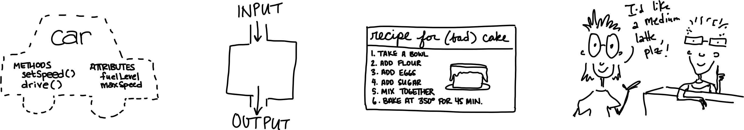
multi-paradigm
interpreted language
with dynamic typing
and automatic memory management
object-oriented
functional
imperative
declarative

Slide 10
multi-paradigm
interpreted language
with dynamic typing
and automatic memory management

Slide 11
Quick digression
 | COMPILER | INTERPRETER
What it takes in:
What it returns:
Relative speed:
Memory usage:
Work is done:
Reports errors:
Example language:

Slide 12
Quick digression
 | COMPILER | INTERPRETER
What it takes in: | an entire program | a single line of code (or a single instruction)
What it returns: | intermediate object code (e.g. classes) | <nothing>
Relative speed: | faster | slower
Memory usage: | uses more memory (↑ objects take space ↑) | uses less memory (no intermediate objects)
Work is done: | just once | every time the code is executed
Reports errors: | after checking the entire program | after each instruction is run

Slide 13
multi-paradigm
interpreted language
with dynamic typing
and automatic memory management
more about this
a bit later

Slide 14
Core concept 1: variables
In CS, a variable is a place to store a piece of data
In Python, variables are:
declared by giving them a name
assigned using the equals sign
Example:
x = 3
declaring
a variable x
assigning
the value 3 to x

Slide 15
Core concept 2: numeric values
Two kinds of numbers in CS:
integers (“whole numbers”)
floats (“decimals” or “floating point numbers”)
In Python, the kind of number is implied by whether or not the number contains a decimal point
Example:
x = 3
x = 3.0

Slide 16
Basic operations on numbers
Addition: +
Subtraction: -
Multiplication: *
Division: /
Exponentiation: ** (power)
Modular arithmetic: % (modulo)

Slide 17
Core concept 3: strings
In CS, a sequence of characters that isn’t a number is called a string
In Python, a string is declared using quotation marks
Strings can contain letters, numbers, spaces, and special characters
Example:
x = “Jordan”
x = “Stoddard G2”

Slide 18
Math on strings?!
Let’s say we have:
x = “Jordan”
If we ask Python for:
2*x
what will happen?

Slide 19
print(): a very useful function
A function is a procedure / routine that takes in some input and does something with it (just like in math)
In Python, the print() function takes in a value and outputs the value to the console
This seems silly now, but will come in handy in lab when you write/run your first program inside a file

Slide 20
Quick check in
a = 1
b = 2.7
c = “Smithies”

Slide 21
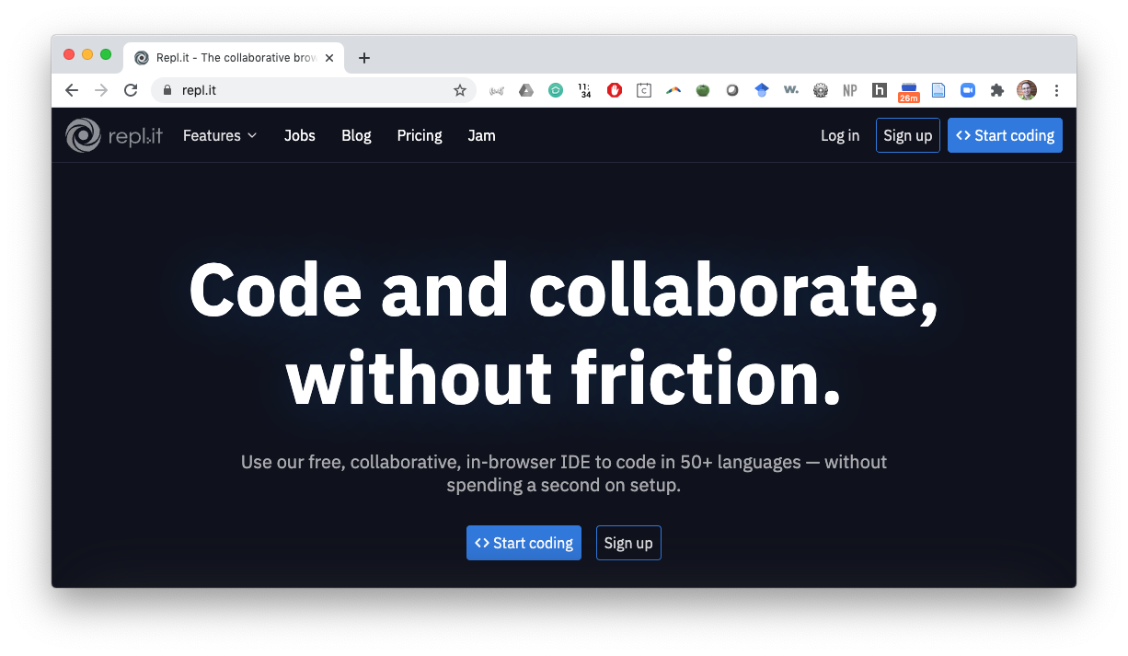
repl.it

Slide 22
Overview of the week
Monday: Introduction to Python and repl.it
Lab: Getting Started with Python
Wednesday: User Input
Friday: Numbers

Slide 23
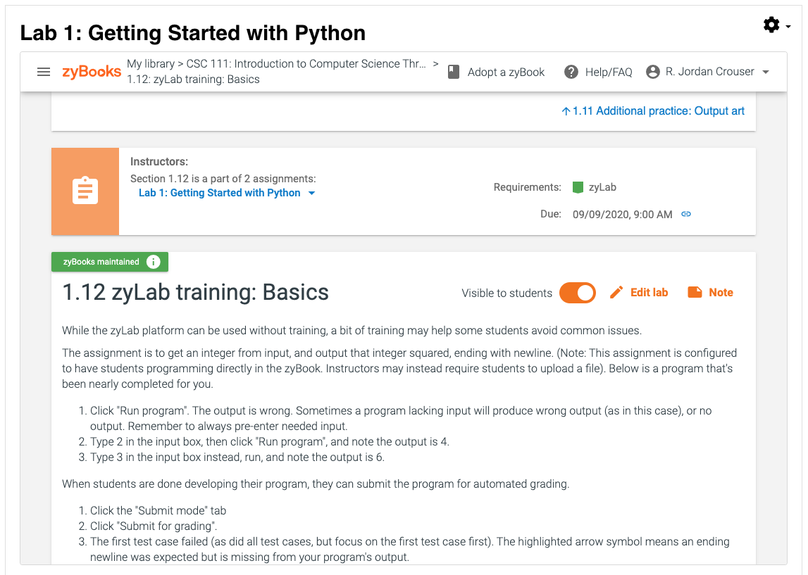
Your first taste of programming!

