Slide 1
Lecture 4: User input
CSC111: Introduction to CS through Programming
R. Jordan Crouser
Assistant Professor of Computer Science
Smith College

Slide 2
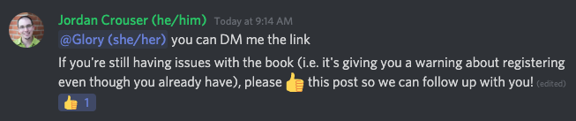
Announcements
Lab / reading “points”
Study group update

Slide 3
Overview of the week
Monday: Introduction to Python and repl.it
Lab: Getting Started with Python
Wednesday: User Input
Friday: Numbers

Slide 4

Lab 1: debrief
What did you encounter
in this week’s lab?
Notes:
Specifically: what was new?
Variables, data types, loops, lists…

Slide 5
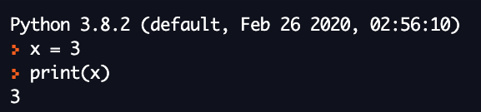
Recall: the print() function
print() outputs information to the console (”the shell”)
Works on lots of different data types (strings, integers, floats, and many more!)
When print() is called on (“passed”) a variable, it outputs the contents

Slide 6

The len() function
len() takes in a string and gives back the string’s length (number of characters, including spaces)
Can be called on string literals (“stuff in quotes”) or on variables whose contents are strings
Unlike print(), len() returns a value

Slide 7
Refresher exercise
Let’s write a short program that prints the following:
###########
# CSC 111 #
###########

Slide 8
Discussion
What if we wanted to be able to
print a banner around ANY word?
What would we need?
Notes:
Specifically: what was new?

Slide 9
Recall: variables
In CS, a variable is a place to store a piece of data
In Python, variables are:
declared by giving them a name
assigned using the equals sign
Example:
x = 3
declaring
a variable x
assigning
the value 3 to x

Slide 10


Back to the 4 basic tasks
processing
input
output
storage

Slide 11
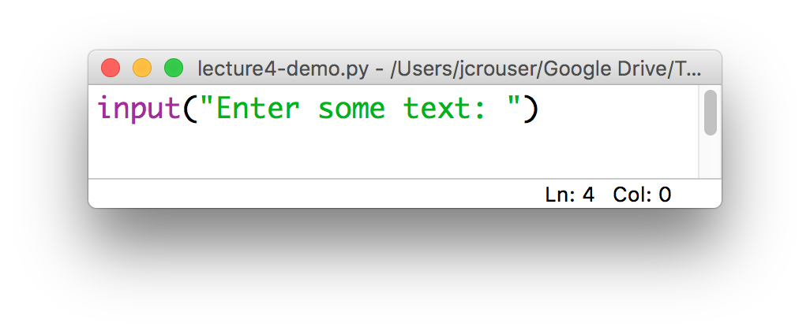
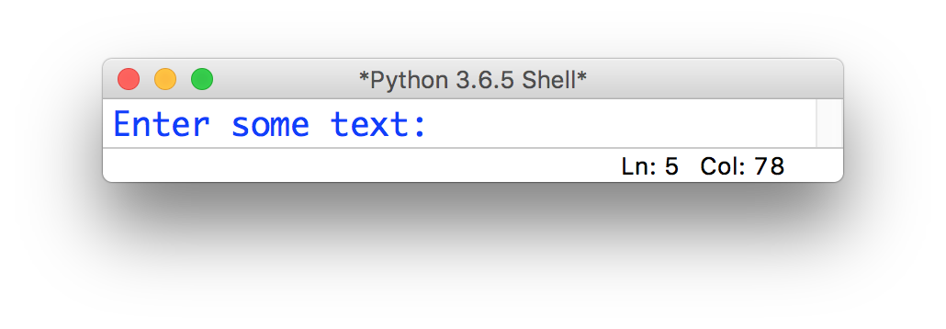
The input() function
Python has a built-in input() function that allows us to ask the user to type in information
The input() function takes in a value, which will be printed to the console as a prompt:

Slide 12
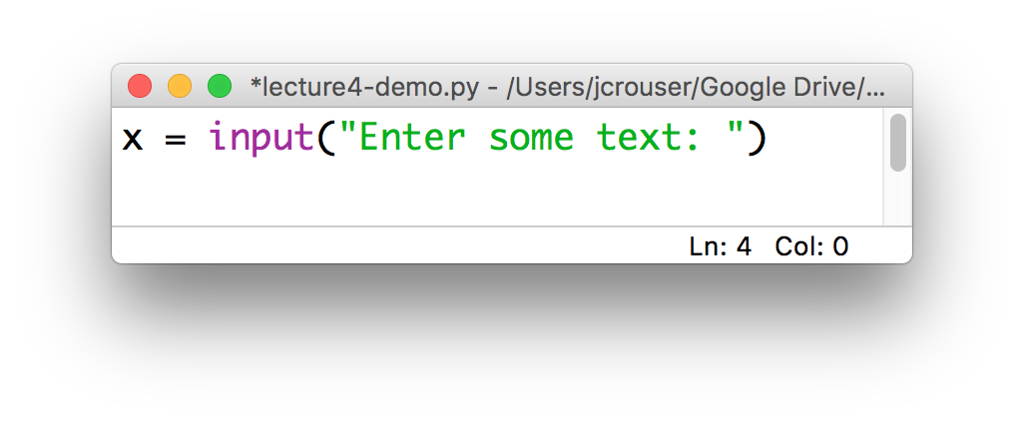
The input() function
In general, we will want to save what the user enters so we can do something with it
This means we need to assign the value returned by the input() function to some variable, e.g.

Slide 13
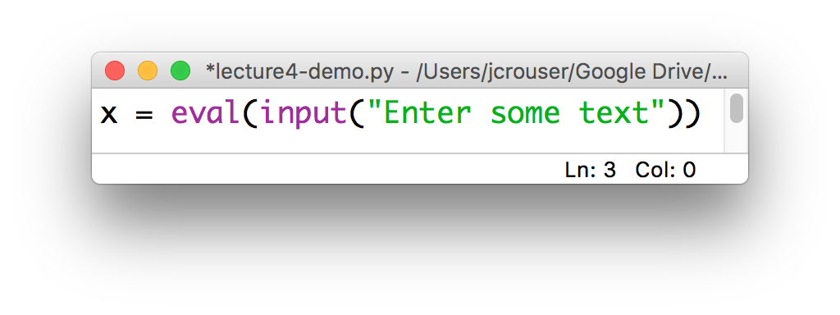
The eval() function
The user’s input is always returned as a string, even if they enter only numeric characters
If we want Python to interpret it as a number, we can use the eval() function
Then we can manipulate x using mathematical operations

Slide 14
Coding sprint: putting it all together
In your breakout room, write a program that asks the user to input() two strings:
a word
a number
Store the user input in appropriate variables (remember: eval() will return the numeric value of a string)
print() the word the user-specified number of times
Want a challenge? Also ask the user to input a character (a single letter or symbol), and use that to print a banner around the repeated word

Slide 15
Discussion
What did you come up with?
Notes:
Specifically: what was new?

Slide 16
Coming up next
A1: How Does it Do That? is due Friday 11:55pm
Friday 9/11: numbers (ints vs. floats)
Monday 9/14: mathematical operators
Wednesday 9/16: Life Skill #1: Pair Programming
Friday 9/18: Strings and string methods

