Slide 1
Lecture 5: Numbers (and a little more about variables)
CSC111: Introduction to CS through Programming
R. Jordan Crouser
Assistant Professor of Computer Science
Smith College

Slide 2
Announcements
We have a grader!
Pritish
MS student at UMass
(has interned at Cisco and IBM)

Slide 3
Debrief of Lab 1
85 / 94 people submitted
NBD this time, but please submit to the right place on Moodle!
Overall, very impressive!
Common hacks / mistakes:
Manually typing pipes (“ | “) inside the strings themselves
Confusion about syntax, esp.
for name in ["Aleah", "Belle", "Chen"]:
(not surprising! this language is totally new…
we’ll talk more about loops in 2 weeks)
Important note: whenever possible, turn in a program that doesn’t have syntax errors (i.e. that runs)

Slide 4
Overview of the week
More about variables
Numeric values and basic operations
Converting between floats and int
Lab: Cash Machine
Conditional (“if”) statements

Slide 5
(RECAP) Core concept 1: variables
In CS, a variable is a place to store a piece of data
In Python, variables are:
declared by giving them a name
assigned using the equals sign
Example:
x = 3
declaring
a variable x
assigning
the value 3 to x

Slide 6
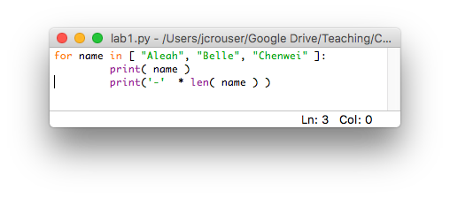
Keywords
Some words in Python* are reserved as keywords, and cannot be used as a variable name:
and as assert break class continue def del elif else except exec finally for from global if import in is lambda not or pass raise return try while with yield
We saw a few in lab last week:
* other languages have their own set of reserved words

Slide 7
More about naming variables
Rule 1: variable name must be at least 1 character long
Rule 2: 1st character must be alphabetic
(uppercase letter, lowercase letter, or underscore)
Rule 3: variable names can contain letters, numbers, and underscores (but not spaces or other punctuation)

Slide 8
Naming conventions
These aren’t rules (i.e. Python won’t throw an error), but they make life a lot easier if you follow them

Slide 9
Naming conventions
These aren’t rules (i.e. Python won’t throw an error), but they make life a lot easier
Convention 1: the name of the variable should tell you something about what the variable contains, e.g.
name = “Jordan”
is better than
blah = “Jordan”

Slide 10
Naming conventions
These aren’t rules (i.e. Python won’t throw an error), but they make life a lot easier
Convention 1: the name of the variable should tell you something about what the variable contains, e.g.
Convention 2: if you want to use multiple words as a variable name, separate them using _underscores_, e.g.
first_name = “Jordan”
last_name = “Crouser”

Slide 11
Naming conventions
These aren’t rules (i.e. Python won’t throw an error), but they make life a lot easier
Convention 1: the name of the variable should tell you something about what the variable contains, e.g.
Convention 2: if you want to use multiple words as a variable name, separate them using _underscores_, e.g.
Convention 3: if the value isn’t going to change (i.e. the variable is a constant), use ALL CAPS, e.g.
PI = 3.14159

Slide 12
Notes:
Let’s practice a little…
(show how changing the names of the variables doesn’t change how the program works… but it does change how it reads)

Slide 13
(RECAP) Core concept 2: numeric values
Two kinds of numbers in CS:
integers (“whole numbers”)
floats (“decimals” or “floating point numbers”)
In Python, the kind of number is implied by whether or not the number contains a decimal point
Example:
x = 3
x = 3.0

Slide 14

Discussion
Why do we care about
whether or not a number has a decimal point?

Slide 15
(RECAP) Math
Basic operators:
addition: +
subtraction: -
multiplication: *
division: /
exponentiation: ** (power)
modular arithmetic: % (modulo)
Negative values are allowed!
x = -3

Slide 16
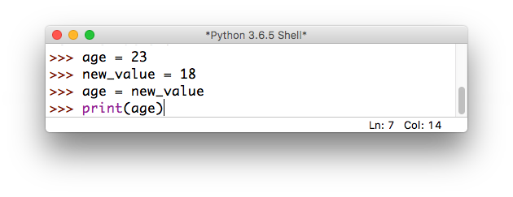
Overwriting variables
What happens if we do the following?

Slide 17
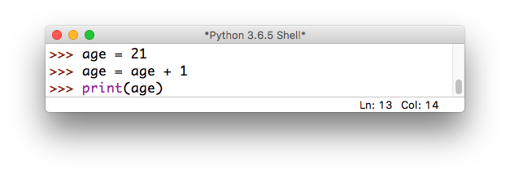
Incrementing variables
What about this?

Slide 18
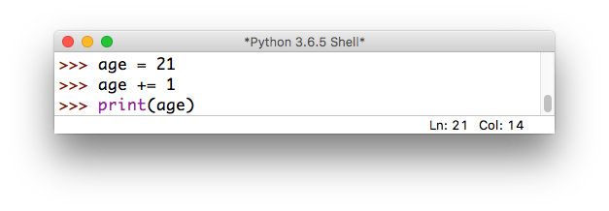
Incrementing variables
There’s a shorthand version for this:

Slide 19
Quick exercise
a = 10
b = 20
c = 30
a = b # a =
b = a # b =
c = c * 2 # c =
d = d – 10 # d =
# NameError:
# name 'd' is not defined
these are called
comments:
they are not executed
by the interpreter,
but are useful
for making
code readable

Slide 20
Some more useful shorthand
Simultaneous assignment:
a = 10
b = 20
c = 30
a = b
b = a
c = c * 2

Slide 21
Some more useful shorthand
Simultaneous assignment:
a, b, c = 10, 20, 30
a = b
b = a
c = c * 2

Slide 22
Some more useful shorthand
Simultaneous assignment:
a, b, c = 10, 20, 30
Swapping variables:
a = b
b = a
c = c * 2

Slide 23
Some more useful shorthand
Simultaneous assignment:
a, b, c = 10, 20, 30
Swapping variables:
a, b = b, a
c = c * 2

Slide 24
Quick exercise: unit conversion
Find a partner, and write a program that asks the user to input() a number representing a file size in Kb
Store the user input in an appropriate variable
Calculate the equivalent size in bits, bytes, Mb, and Gb:
1 byte = 8 bits
1 Kb = 1024 bytes
1 Mb = 1024 Kb
1 Gb = 1024 Mb
print() the converted sizes to the screen (ascending)
Want a challenge? See if you can print the units beside each of the values (try the str() method)

Slide 25
Discussion
What did you come up with?

Slide 26
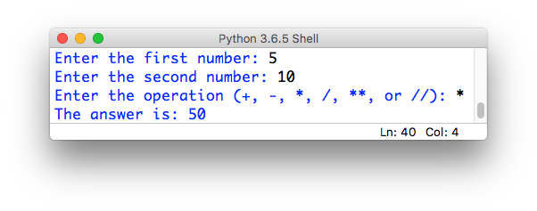
Assignment #2: clunky calculator
In this assignment, you will write a short python program that simulates basic calculator functionality.
The user interface of your calculator should ask the user to input two numbers, and then a string indicating which mathematical operation to perform. For example:

Slide 27
Assignment #2: clunky calculator
Your calculator should support add, subtract, multiply, divide and power (exponentiation) operations.
Optional: support integer division with a remainder.
Your calculator should be able to handle both integers and floats.
It’s important that your input goes in the prescribed order, and your output is formatted like the example
there are ~100 of you, and just me and Pritish to grade
Note: your ability to do this assignment will build as we learn things in lecture and lab this week. Remember: S⁴!
Submit your calculator.py on Moodle by 11:55pm on Sunday

