Slide 1
Lecture 6: Mathematical Operators and formatting
CSC111: Introduction to CS through Programming
R. Jordan Crouser
Assistant Professor of Computer Science
Smith College

Slide 2

Announcements 1/2
Information Session
Weds September 19th 5pm to 6pm
CC103/104

Slide 3

Announcements 2/2

Slide 4
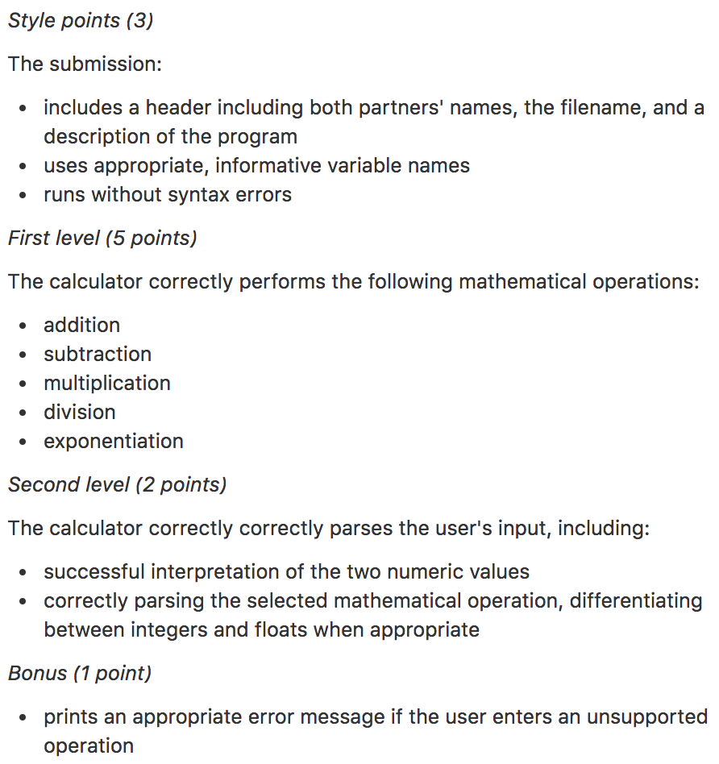
About the assignment rubric
Assignments are generally worth 10 points in this course
For assignment 2, these points fall into 3 categories:

Slide 5
About the assignment rubric
Assignments are generally worth 10 points in this course
For assignment 2, these points fall into 3 categories:

Slide 6
About the assignment rubric
Assignments are generally worth 10 points in this course
For assignment 2, these points fall into 3 categories:

Slide 7
About the assignment rubric
Assignments are generally worth 10 points in this course
For assignment 2, these points fall into 3 categories
Recommendation: go in order
Start with first level and style points
Then go on to second level points
And then attempt bonus points (if applicable)

Slide 8
Overview of the week
More about variables
Numeric values and basic operations
More mathematical operators
Revisiting ints and floats
The math module
Formatting
Lab: Cash Machine
Conditional (“if”) statements

Slide 9
(RECAP) Core concept 2: numeric values
Two kinds of numbers in CS:
integers (“whole numbers”)
floats (“decimals” or “floating point numbers”)
Basic operators:
addition: +
subtraction: -
multiplication: *
division: /
integer division: //
exponentiation: ** (power)
modular arithmetic: % (modulo)

Slide 10
(RECAP) Core concept 2: numeric values
Two kinds of numbers in CS:
integers (“whole numbers”)
floats (“decimals” or “floating point numbers”)
Basic operators:
addition: +
subtraction: -
multiplication: *
division: /
integer division: //
exponentiation: ** (power)
modular arithmetic: % (modulo)

Slide 11
Reviewing integer operators: // and %
What is the result of the following operations?
21 // 5
21 % 5
9 // 3
9 % 3
13 // 5
13 % 5
139 // 20
139 % 20
# 4
# 1
# 3
# 0
# 2
# 3
# 6
# 19

Slide 12
Built-in functions that work on numbers
abs(x) # return the absolute value of x
float(x) # return x parsed as a float
int(x) # return x parsed as an int
max(…) # return the largest of a list of numbers
min(…) # return the smallest of a list of numbers
round(x[, n]) # return x rounded to n digits after the # decimal point. If n is omitted, it # returns the nearest integer value
sum(…) # return the sum of a list of numbers

Slide 13
Aside: what does parsed mean?
abs(x) # return the absolute value of x
float(x) # return x parsed as a float
int(x) # return x parsed as an int
max(…) # return the largest of a list of numbers
min(…) # return the smallest of a list of numbers
round(x[, n]) # return x rounded to n digits after the # decimal point. If n is omitted, it # returns the nearest integer value
sum(…) # return the sum of a list of numbers

Slide 14
Aside: what does return mean?
abs(x) # return the absolute value of x
float(x) # return x parsed as a float
int(x) # return x parsed as an int
max(…) # return the largest of a list of numbers
min(…) # return the smallest of a list of numbers
round(x[, n]) # return x rounded to n digits after the # decimal point. If n is omitted, it # returns the nearest integer value
sum(…) # return the sum of a list of numbers

Slide 15
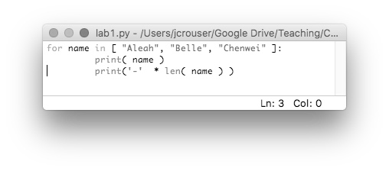
RECAP: Keywords
Some words in Python* are reserved as keywords, and cannot be used as a variable name:
and as assert break class continue def del elif else except exec finally for from global if import in is lambda not or pass raise return try while with yield
We saw a few in lab yesterday:
a reserved keyword
* other languages have their own set of reserved words

Slide 16
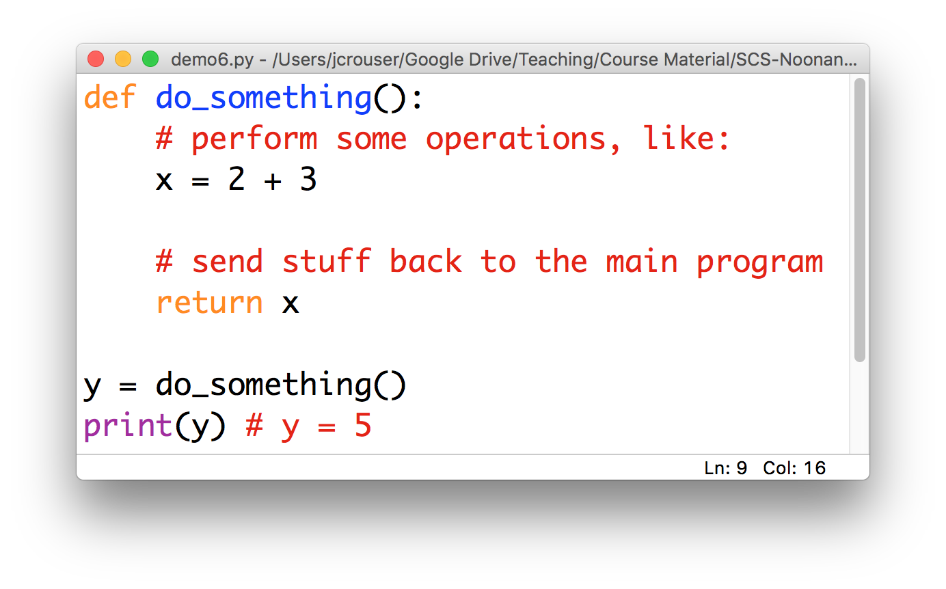
Foreshadowing: “functions”

Slide 17
The math module
Lots of other things we might want to do with numerical values are available as functions in the math module
import math
math.floor(f) # round float f down
math.ceil(f) # round float f up
math.sqrt(x) # take the square root of x
And more! Check out: https://docs.python.org/2/library/math.html
In Python, modules are just files containing Python definitions and statements (ex. name.py)
These can be imported using import name
To access name’s functions, type name.function()

Slide 18
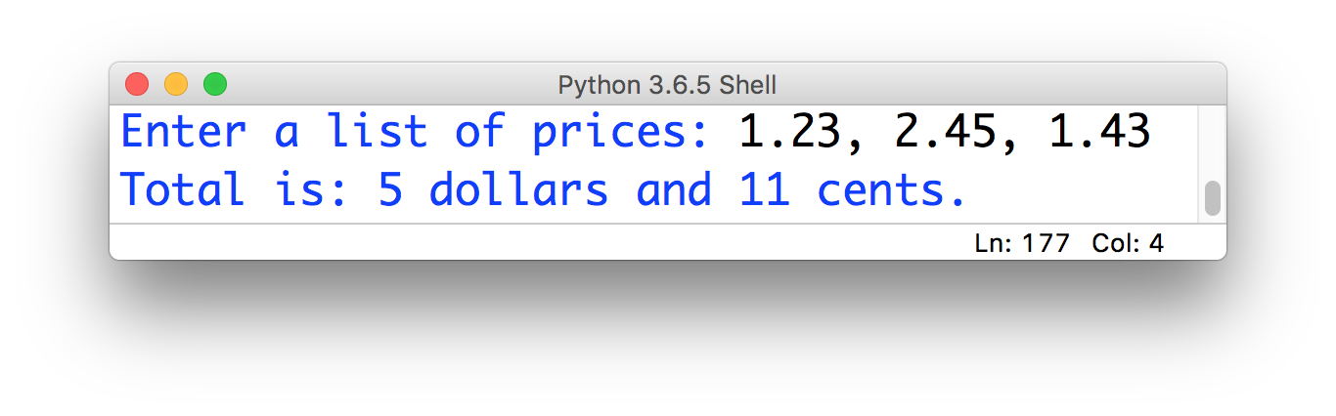
15-minute exercise: dollars and cents
Use built-in functions and functions from the math module to take a list of prices, calculate their sum, and output their total formatted like this:

Slide 19
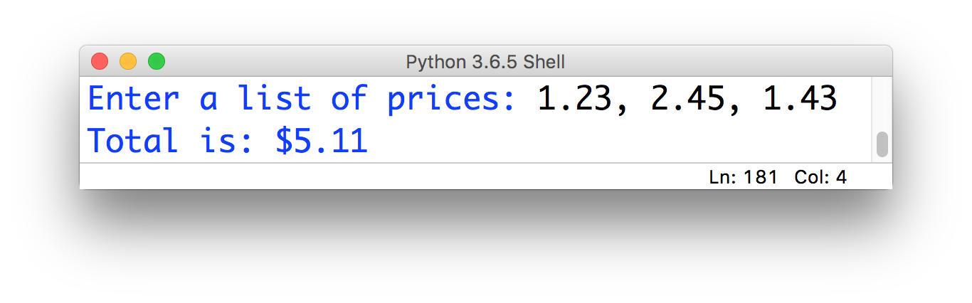
Finishing touches…
What we have now:
What we probably want:

Slide 20

Discussion
Ideas?
What tools do you have?

Slide 21
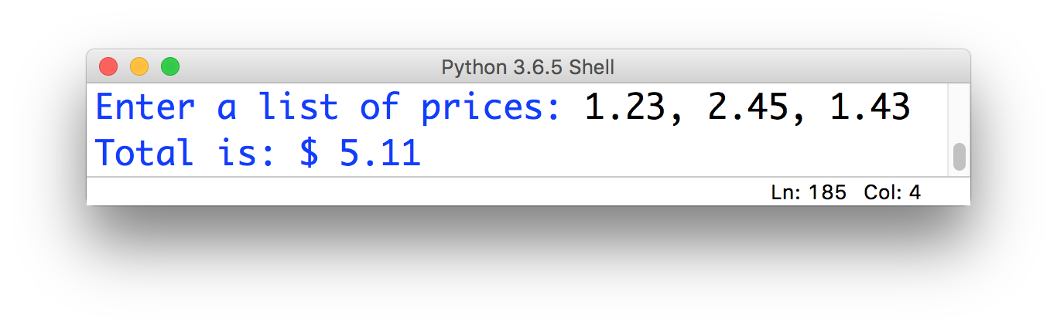
Close, but not quite:
Just using concatenation:
print(“Total is: $”, sum(x)))
annoying space

Slide 22

Closer, but unsatisfying (and fragile)
Using concatenation and casting to string:
print(“Total is: $”, str(sum(x))))
no annoying space

Slide 23
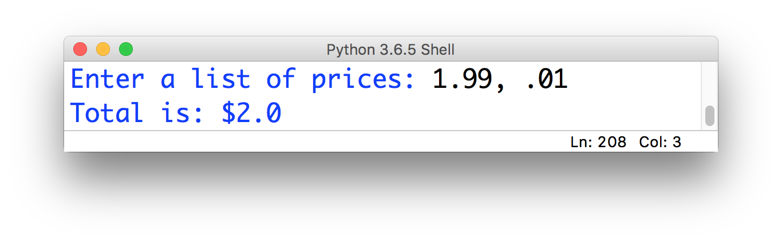
Closer, but unsatisfying (and fragile)
Using concatenation and casting to string:
print(“Total is: $”, str(sum(x))))
wrong number
of decimal places

Slide 24
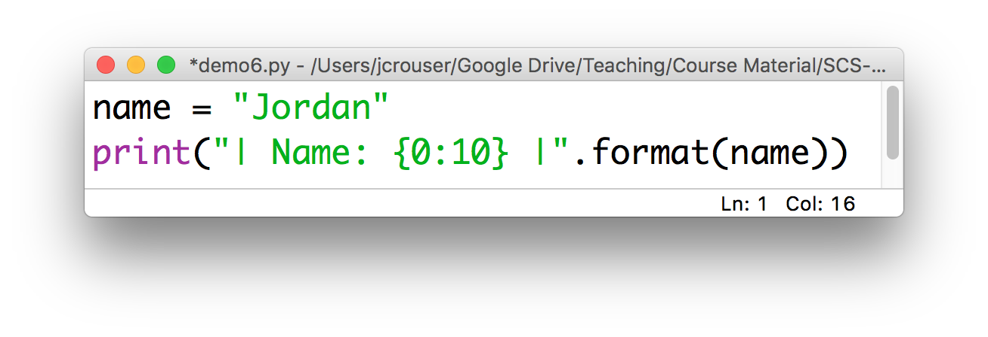
Solution: formatting with .format()
The .format() method (which gets called on a string) might be helpful here!
How it works:
Result: | Name: Jordan |
insert
print (at least)
10 characters

Slide 25
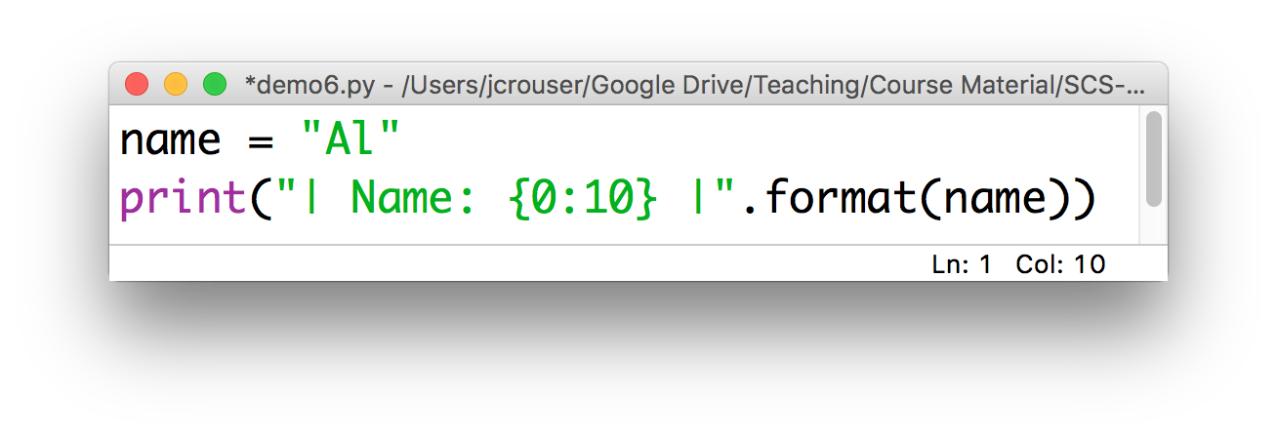
Solution: formatting with .format()
The .format() method (which gets called on a string) might be helpful here!
How it works:
Result: | Name: Al |

Slide 26
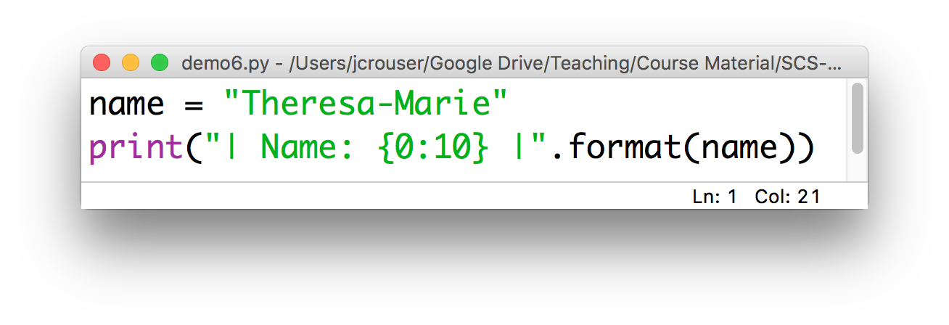
Solution: formatting with .format()
The .format() method (which gets called on a string) might be helpful here!
How it works:
Result: | Name: Theresa-Marie |
doesn’t truncate

Slide 27
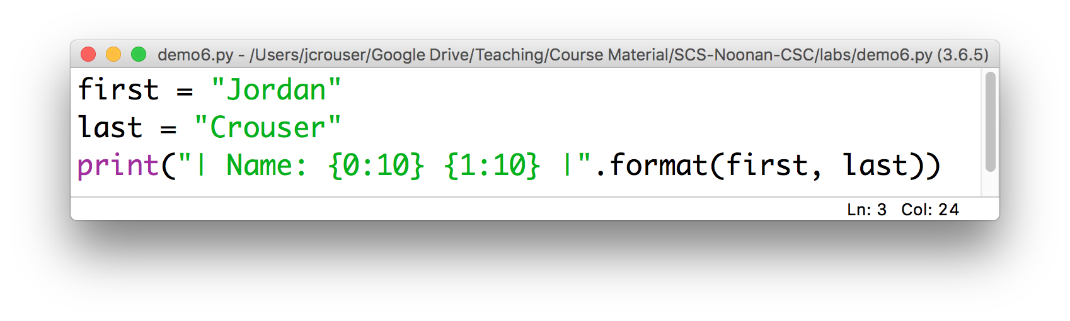
Calling .format() with multiple inputs
Can also handle multiple inputs, e.g.
Result: | Name: Jordan Crouser |
0th 1st
put the
1st thing here
put the
0th thing here

Slide 28
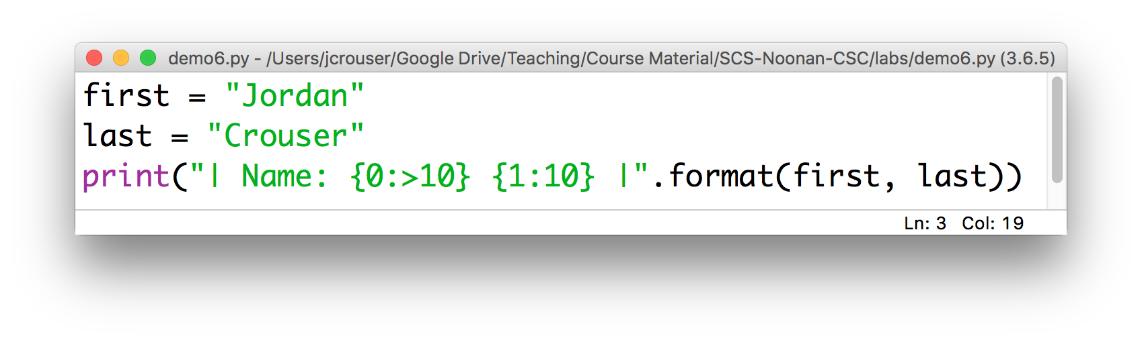
Right-justification with .format()
To align the format to the right instead of to the left, use >
Result: | Name: Jordan Crouser |

Slide 29
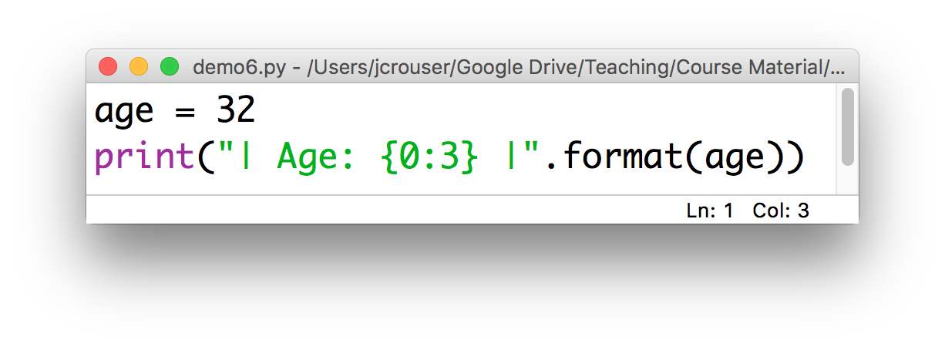
.format() on integers
Calling .format() on an integer works just like with strings, but they’re automatically right-aligned
Result: | Age: 32 |

Slide 30
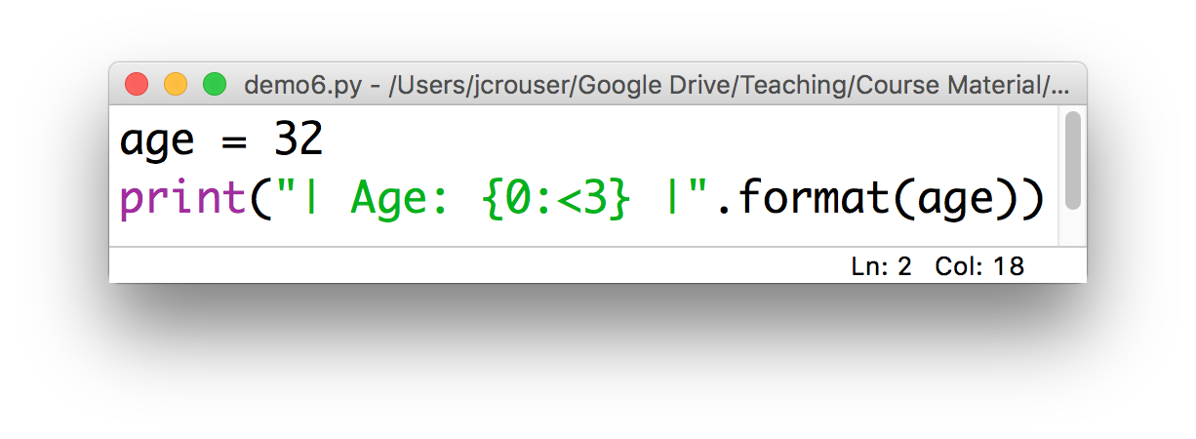
.format() on integers
Use < to left-align:
Result: | Age: 32 |

Slide 31
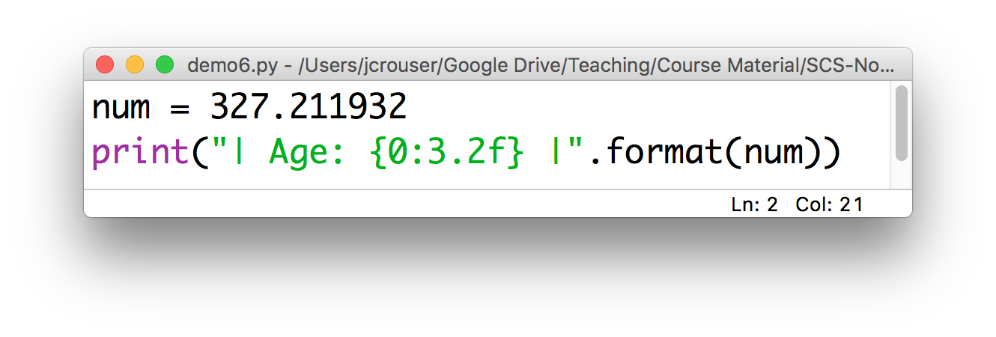
.format() on floats
We need to specify a number of digits before and after the decimal point:
Result: | Age: 327.21 |

Slide 32
Revisiting: dollars and cents
Modify your previous code to use the .format() method so that your output looks like this:

Slide 33
Overview of the week
More about variables
Numeric values and basic operations
More mathematical operators
Revisiting ints and floats
The math module
Formatting
Lab: Cash Machine
Conditional (“if”) statements

Slide 34
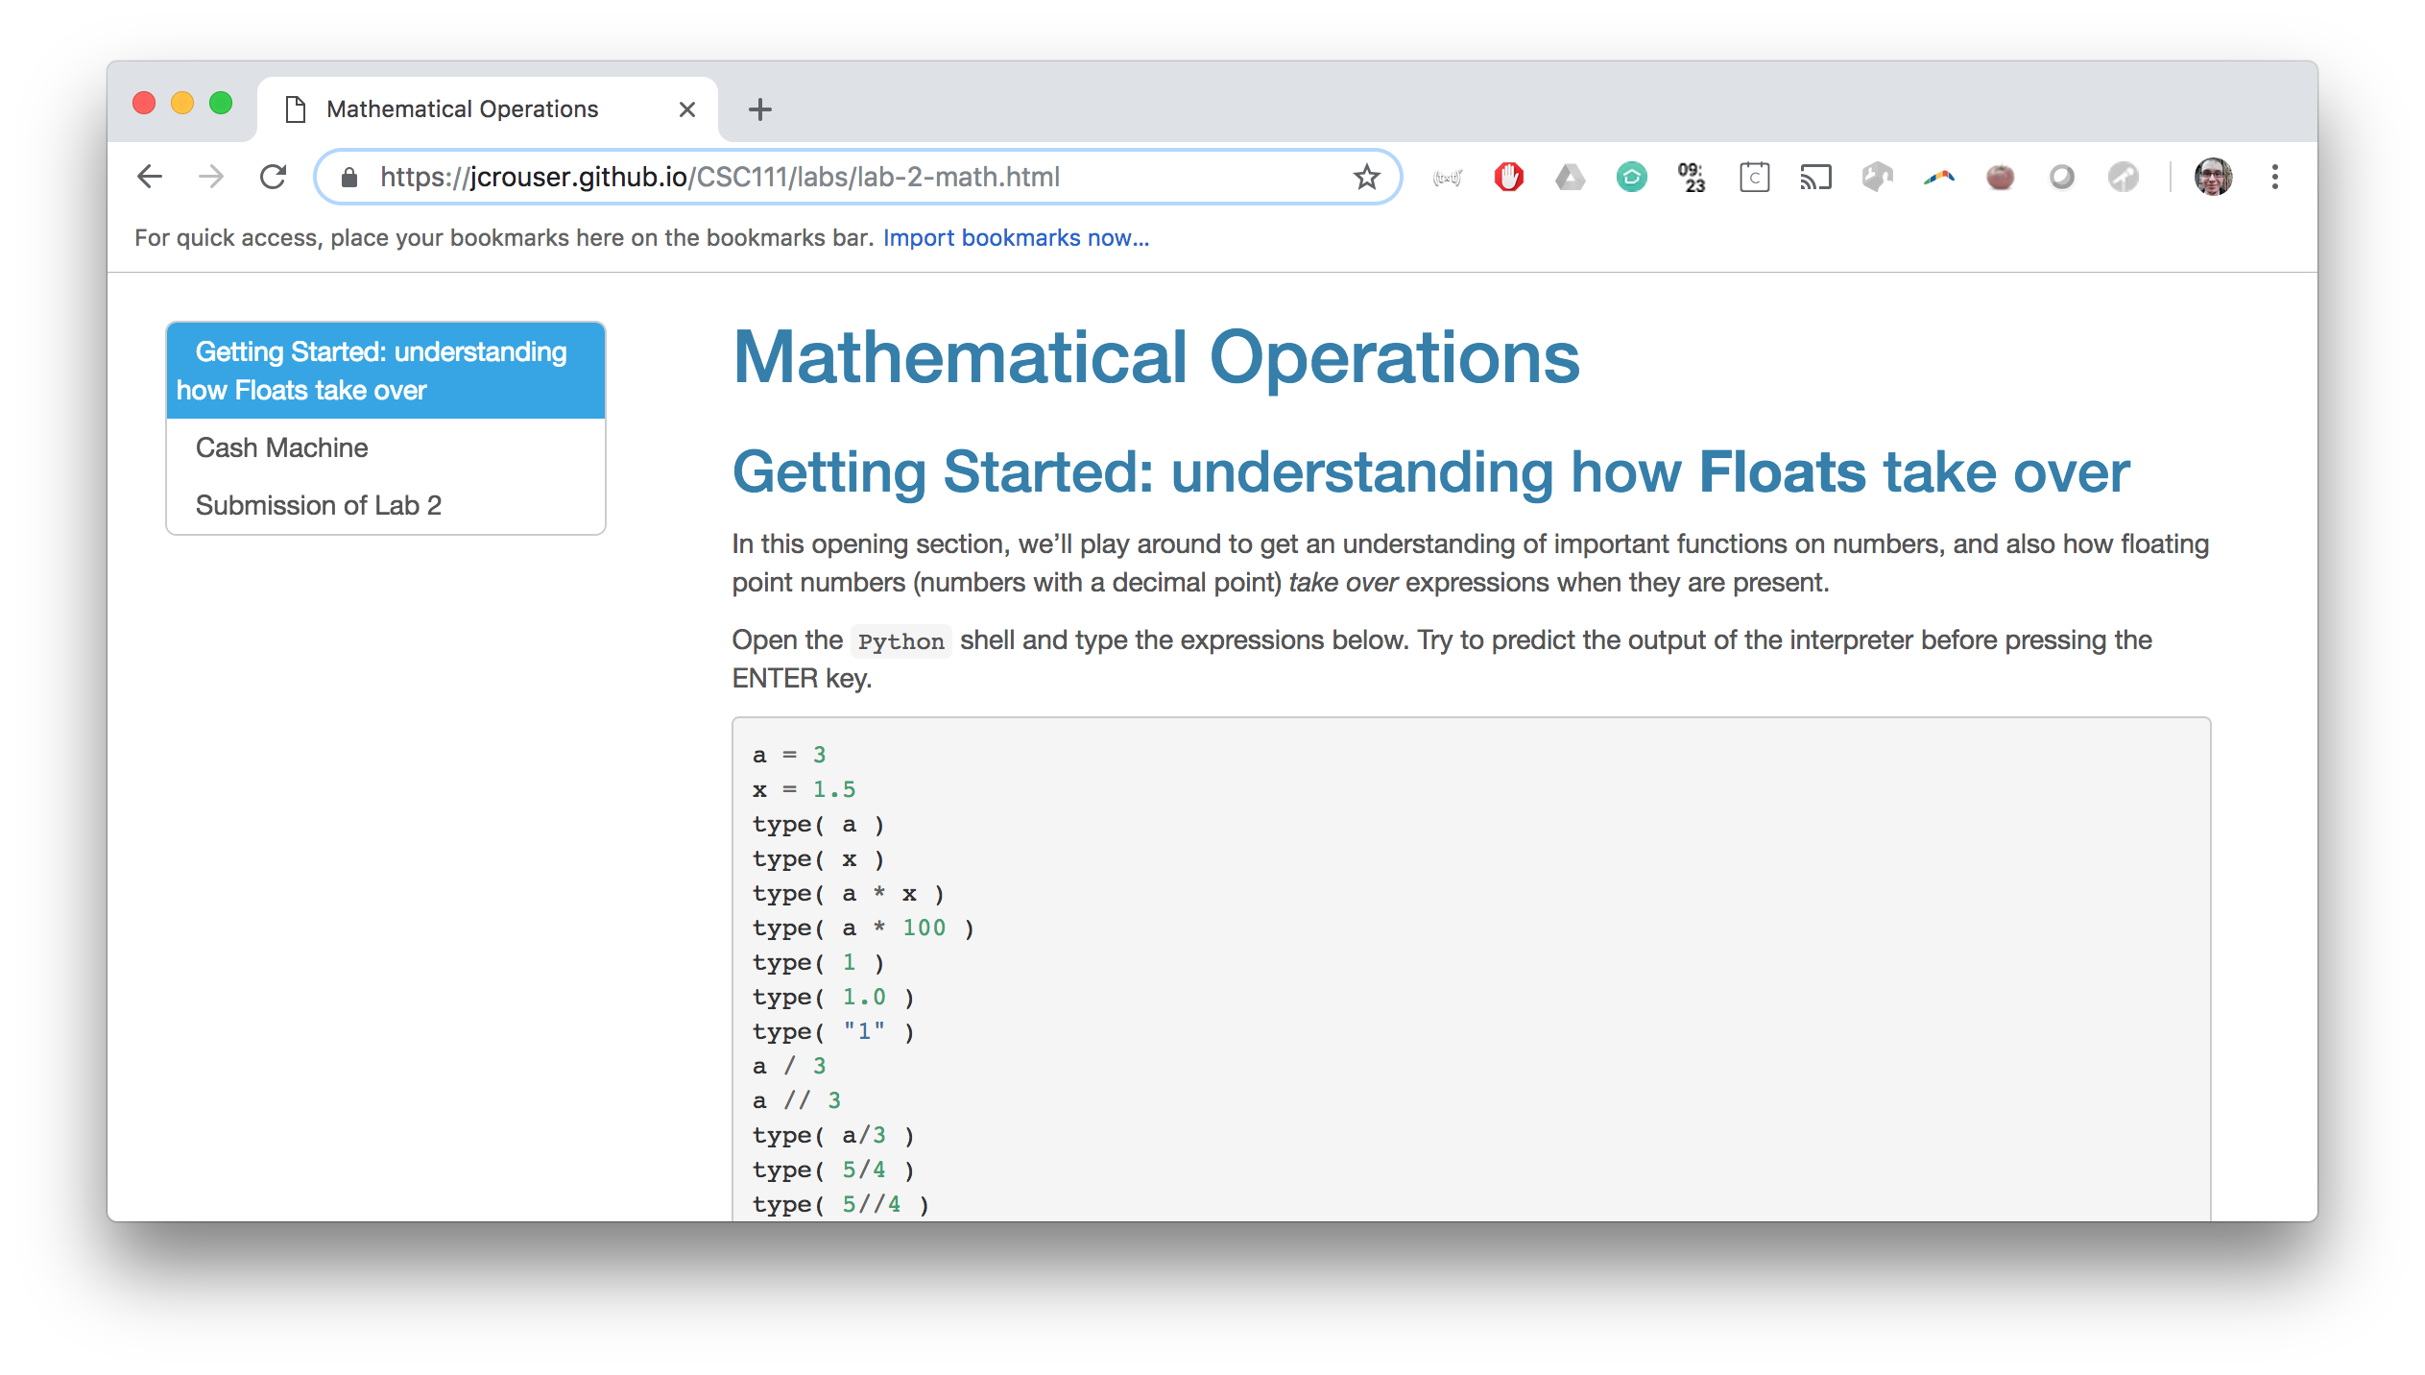
Lab 2: Cash Machine

