Slide 1
Lecture 8: Strings
CSC111: Introduction to CS through Programming
R. Jordan Crouser
Assistant Professor of Computer Science
Smith College

Slide 2
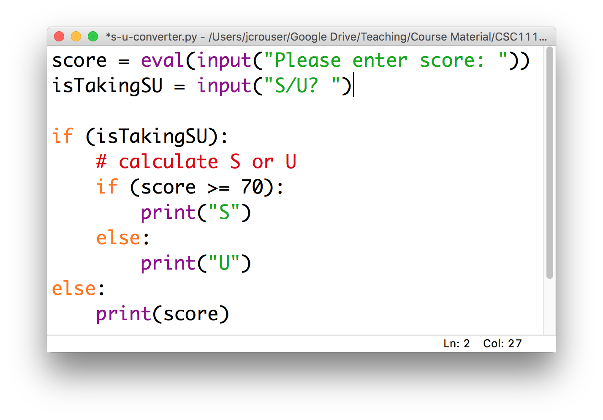
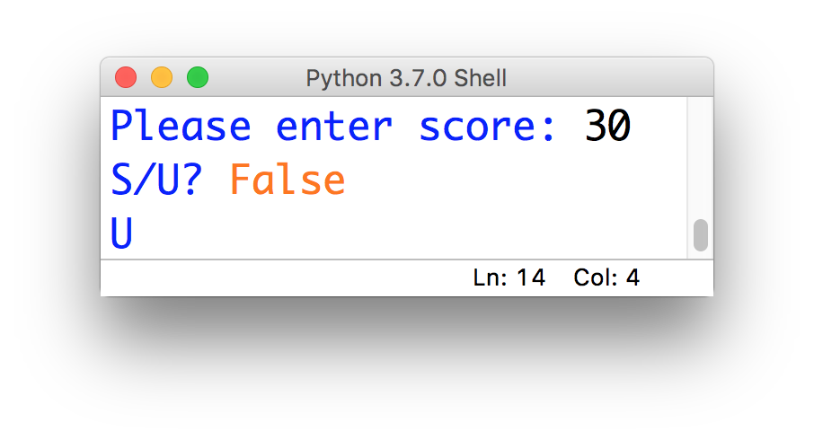
Discussion
what’s
going on?

Slide 3
Overview
Recap of data types
Strings
operations on strings
accessing individual letters
handy methods
The main() function
Lab: Pretty Printing
Life skill #2: debugging

Slide 4
(RECAP) Core concept 3: strings
In CS, a sequence of characters that isn’t a number is called a string
In Python, a string is declared using quotation marks
Strings can contain letters, numbers, spaces, and special characters
Example:
x = “Jordan”
x = “Stoddard G2”

Slide 5
Operations on strings
Concatenation: join two strings together with +, e.g.
“SCS” + “ “ + “Noonan”
Repetition (i.e. self-concatenation): use *, e.g.
3 * “hi”

Slide 6
Multi-line strings
Problem: a string that looks ugly when you try to type it all on one line, e.g.
desc = "This course is an introduction to co
mputer science and computer programming. The programming language Python (Version 3) is u
sed to introduce basic programming skills an
d techniques.”
We can use triple quotes to make a multi-line string, e.g.
desc = ”””This course is an introduction to
computer science and computer programming.
The programming language Python (Version 3)
is used to introduce basic programming
skills and techniques.”””

Slide 7
Escaping quotes
Problem: you have a statement that contains both an apostrophe and double quotes, e.g.
“I can’t!” he said
What’s the issue here?
If we try to wrap it in single quotes, Python thinks the apostophe in should end the string:
s = ‘“I can’t!” he said’
If we try to wrap it in double quotes, Python thinks the double quote at the beginning of the sentence should end the string
s = ““I can’t!” he said”

Slide 8
Escaping quotes
Problem: you have a statement that contains both an apostrophe and double quotes, e.g.
“I can’t!” he said
Solution: protect (“escape”) special characters using a backslash, e.g.
s = ‘“I can\’t!” he said’
or
s = “\“I can’t!\” he said”

Slide 9

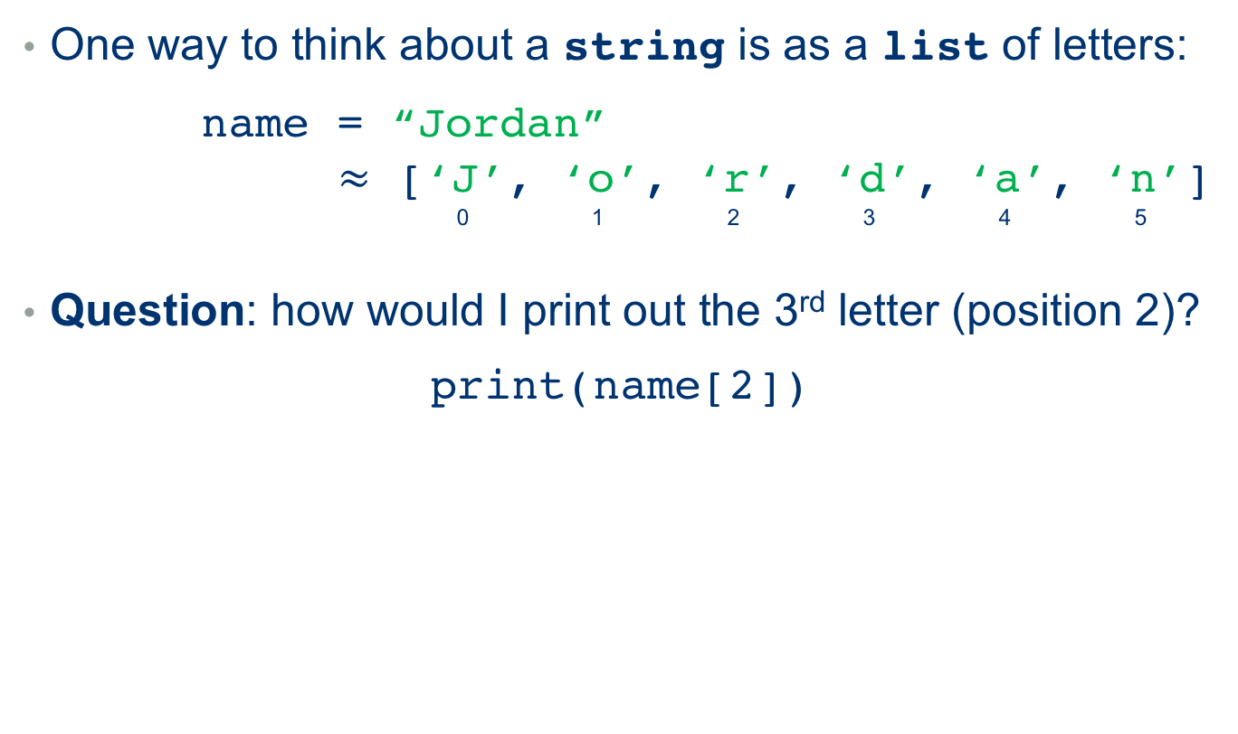
Accessing individual letters
One way to think about a string is as a list of letters:
name = “Jordan”
$≈$ [‘J’, ‘o’, ‘r’, ‘d’, ‘a’, ‘n’]
0 1 2 3 4 5
Question: how would I print out the 3rd letter (position 2)?
print(name[2])

Slide 10
“Slicing” (getting a substring)
What about the 2nd - 5th letters (positions 1-4)?
print(name[1:5])
What happens if we do this?
print(name[2:])
What about this?
print(name[-2:])
up to, but
not including
Notes:
Remove the first 2 characters
Remove everything but the last two characters

Slide 11
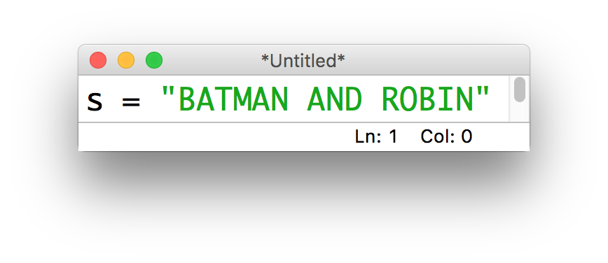
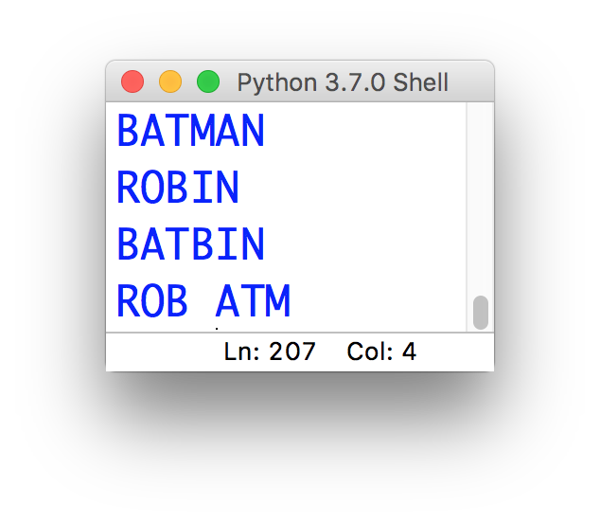
15-minute exercise
Given this string:
Write a short program that uses slicing to produce:

Slide 12
Discussion
What did you come up with?
Notes:
Remove the first 2 characters
Remove everything but the last two characters

Slide 13
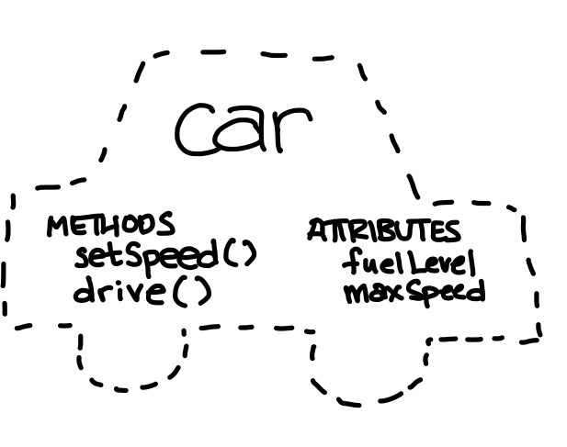
Strings as objects
“object-oriented”

Slide 14
Useful methods for working with strings
s.lower(): convert the string s to lowercase
s.upper(): convert the string s to UPPERCASE
s.strip(): remove whitespace from the start / end of s
s.replace('old', 'new'): replace all occurrences of 'old' in s by 'new'
s.split(c): slice s into pieces using c as a delimiter
s.join(list): opposite of split(), join the elements in the list together using s as the delimiter, e.g.
'-'.join(['a', 'b', 'c']) # a-b-c

Slide 15
Notes:
Let’s practice a little…
(show how changing the names of the variables doesn’t change how the program works… but it does change how it reads)

Slide 16
Fun fact
strings in python are immutable (along with ints, floats, bools, and a few other built-in types)
This means that when we call a method on them, the original isn’t modified

Slide 17
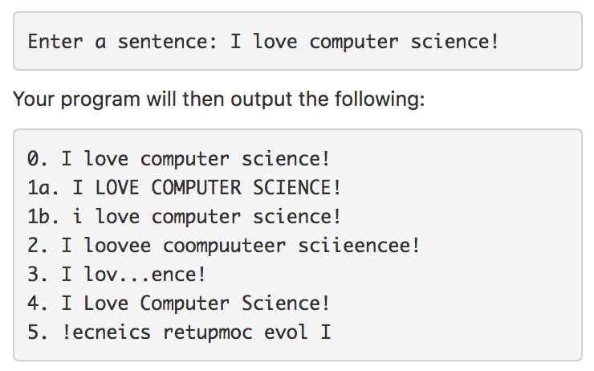
Assignment #3: copycat
In this assignment, you will write a python program that manipulates a user-entered string. For example:
You program will then output the following:
Submit your copycat.py on Moodle by 11:55pm on Sunday

Slide 18
Overview
Strings
operations on strings
accessing individual letters
handy methods
The main() function
Lab: Pretty Printing
Life skill #2: debugging

