Slide 1
Lecture 17: Dictionaries
CSC111: Introduction to CS through Programming
R. Jordan Crouser
Assistant Professor of Computer Science
Smith College

Slide 2
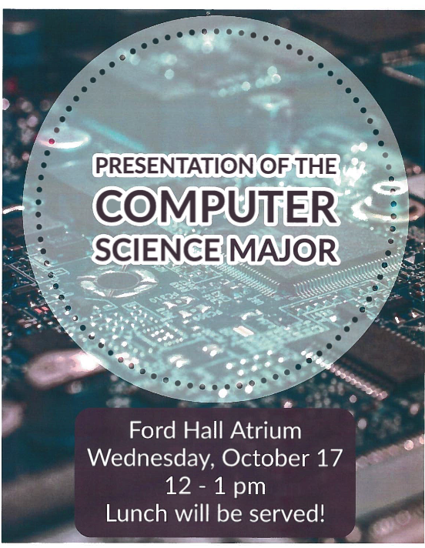
Announcements
(we will get out at
11:50 today,
those who wish
to attend can
walk over together!)

Slide 3
Revisiting Assignment 6: music library
In this assignment, you’ll use lists (and other collections) to create a music library interface
Using your interface, the user should be able to:
add a song (title, artist, album, link to youtube video, etc.)
delete an existing song
play a selected song’s youtube video
print the contents of the library to the screen
Hint: this week’s lab will be very helpful in getting started!

Slide 5
Outline
Recap: strings:
indexing
slicing
Lists
the basics
iterating
methods
A6 Demo
Dictionaries
motivation
defining a dictionary
converting multiple lists ←→ dictionaries

Slide 6

Recap: 15-minute exercise
Write a program that:
asks the user to input() names one at a time
adds each new name to a list called friends
and after each new name is added prints the list in alphabetical order
The program should loop until the user types “DONE”

Slide 7
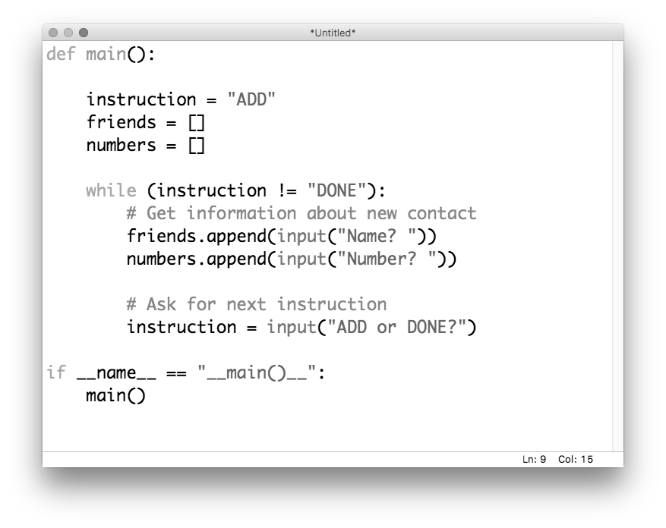
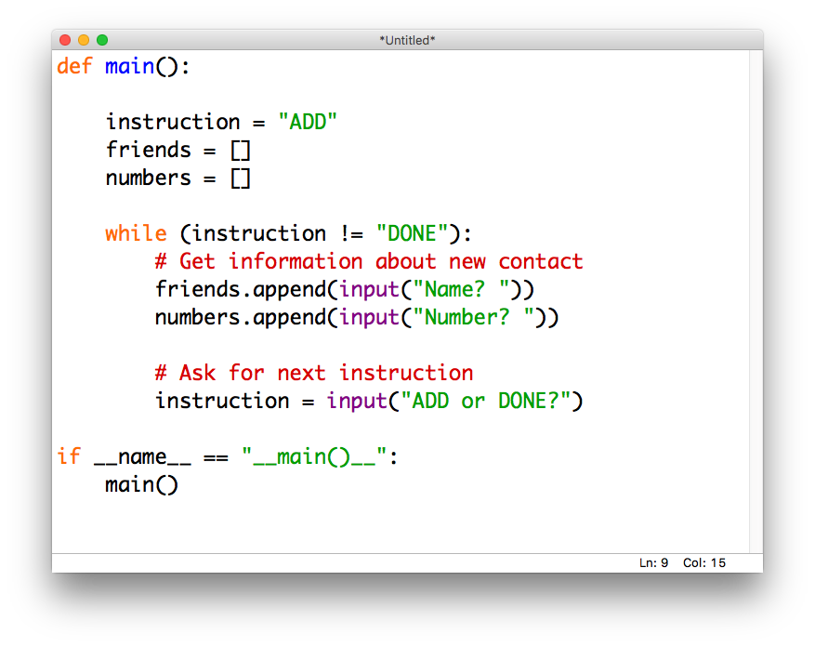
Motivation
Imagine we want to use the previous exercise to create a contact list. Could do it with multiple lists:

Slide 8
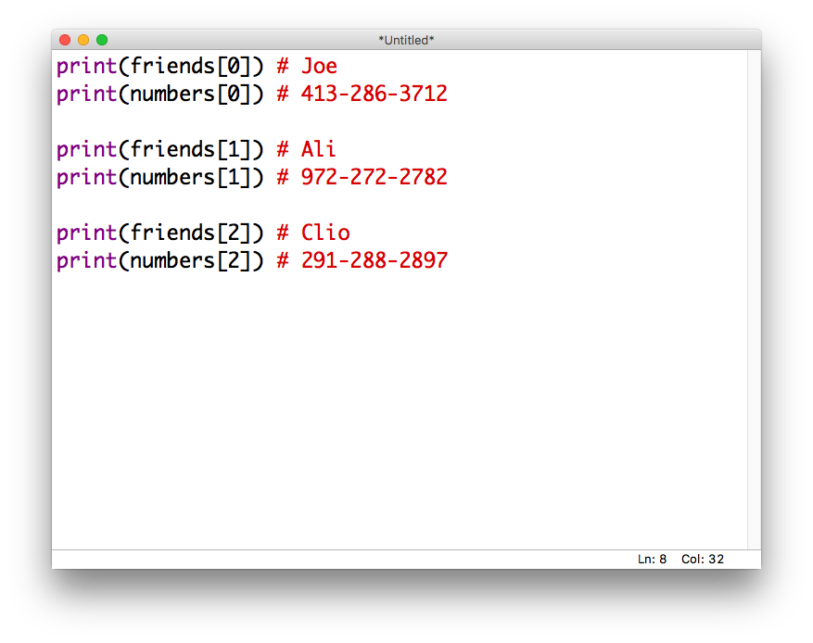
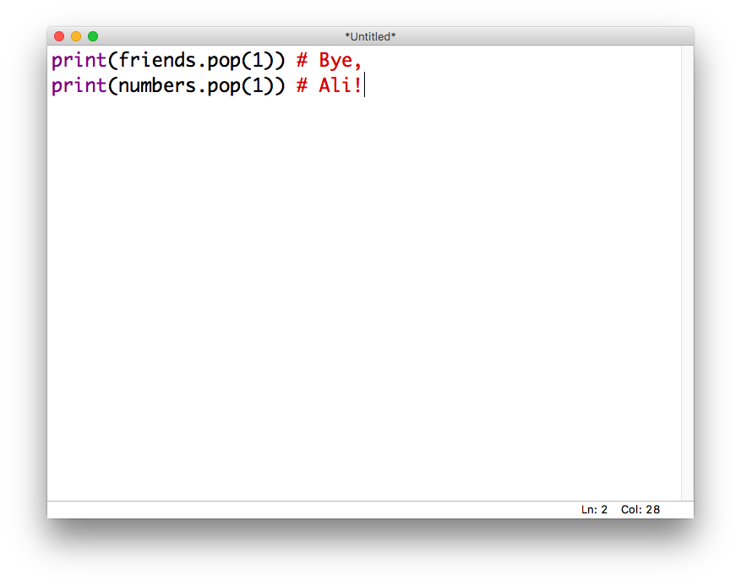
Motivation
If we want to access the data later:
Or worse, modify it…

Slide 9
What we really want
Each name should “map” to the corresponding number:
“Joe” → “413-286-3712”
“Ali” → “972-272-2782”
“Clio” → “291-288-2897”
That way, we could access the number using the name:
contacts[“Joe”] # “413-286-3712”

Slide 10
Introducing: dictionaries
lists were ordered sets of objects, and we accessed their contents via position (index)
dictionaries are unordered sets, and we can access their contents via keys
We declare them using {…} ← “curly braces” like this:
contacts = {}

Slide 11
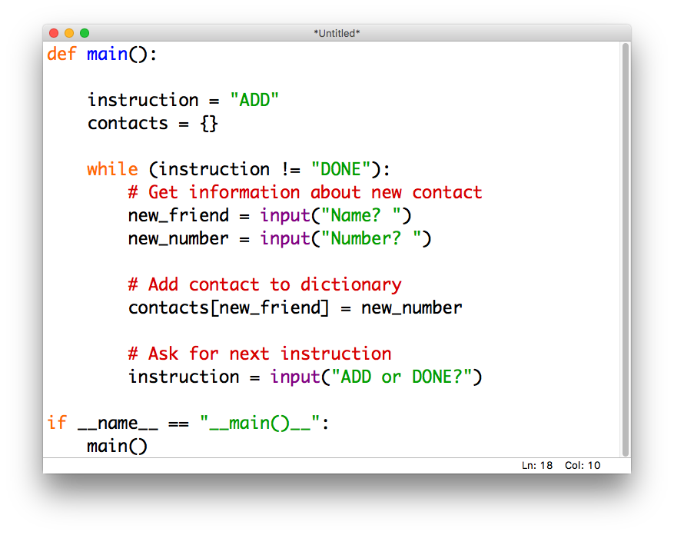
Contacts: take 2

Slide 12
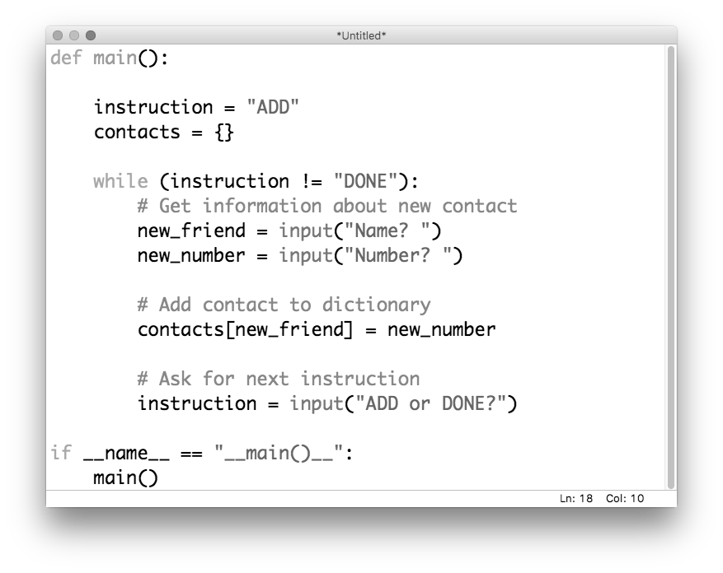
Contacts: take 2

Slide 13
Contacts: take 2

Slide 14
Contacts: take 2

Slide 15
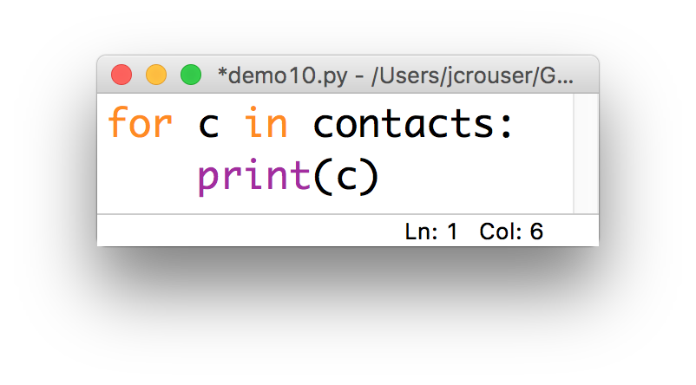
Interesting dilemma
What happens when we iterate over a dictionary?

Slide 16
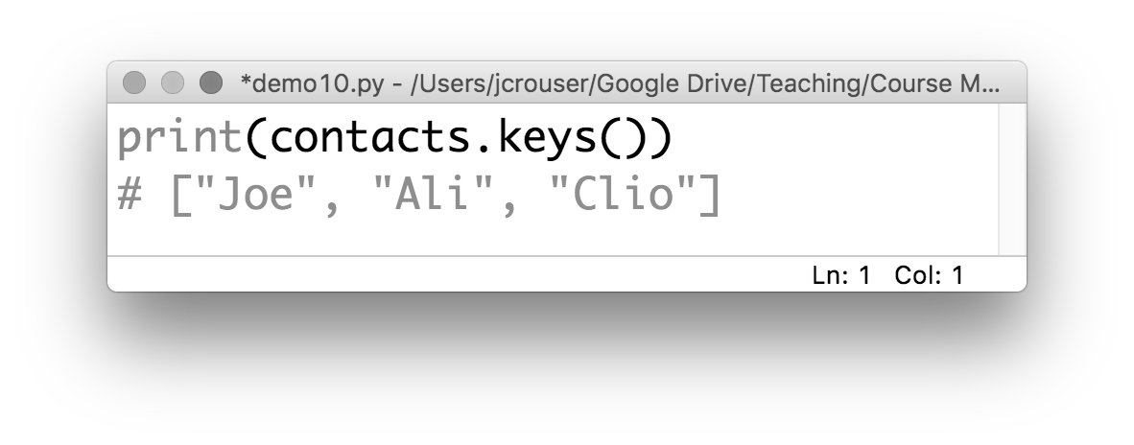
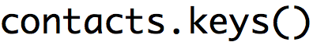
dictionary methods: .keys()
If you want to get a list of the keys in a dictionary

Slide 17
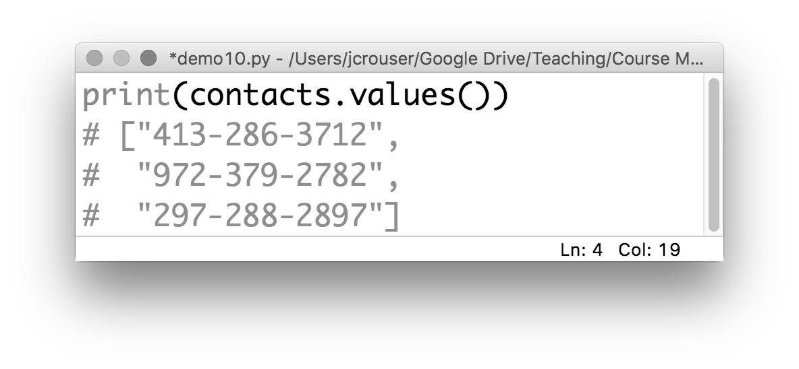
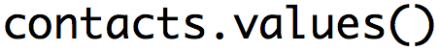
dictionary methods: .values()
If you want a list of the values in a dictionary

Slide 18
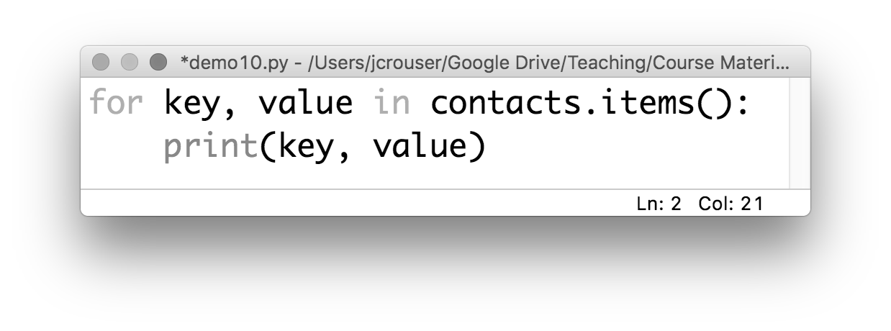
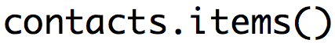
dictionary methods: .items()
If you want a list of the key,value pairs in a dictionary

Slide 19
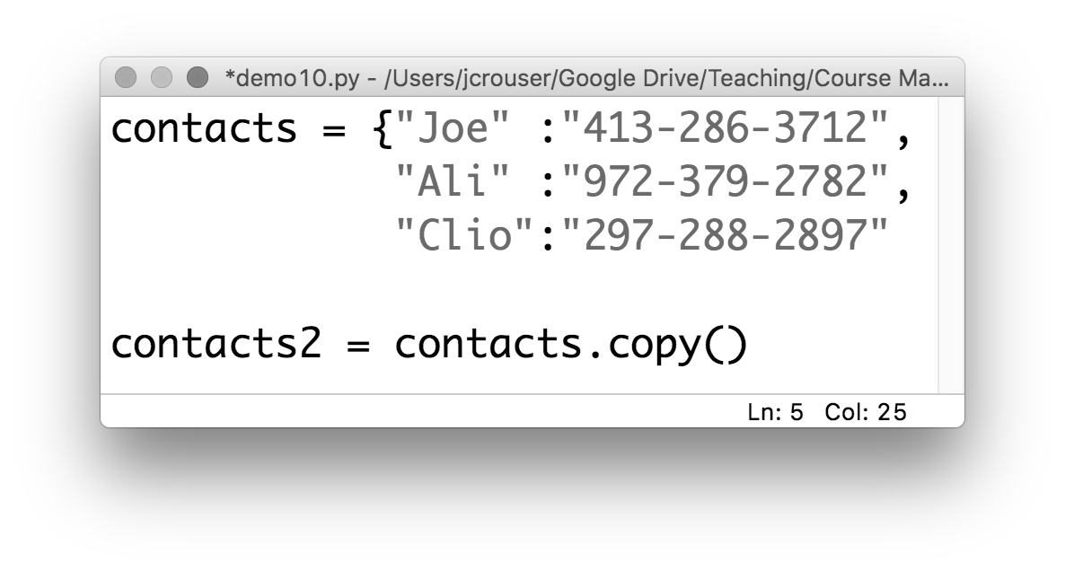
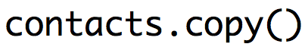
dictionary methods: .copy()
If you want to copy the dictionary :
just like with
a list

Slide 20
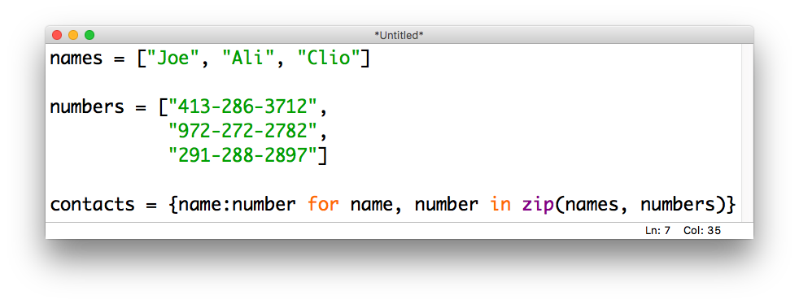
The zip(…) function
If you want to combine two lists into one dictionary, use a comprehension and the zip(…) function:

Slide 21
Recap
strings: immutable ordered collections of characters
lists: mutable ordered collections of objects
dictionaries: mutable unordered collections of objects

Slide 22
Passing “by reference”
What does this mean when we pass
a list / dictionary as input to a function?

Slide 23
Coming up
Recap: strings:
Lists
Dictionaries
Life Skill #4: Responsible Code Reuse

