Slide 1
Lecture 30: Interaction
CSC111: Introduction to CS through Programming
R. Jordan Crouser
Assistant Professor of Computer Science
Smith College

Slide 2
Announcements
Slight schedule change: no class on Weds. 25-Nov-2020
This week will be our last week of study groups
Starting next week, study group time slots will be used to workshop Final Projects and get help with debugging
Each team will be asked to choose a time slot that works best for (most of) the group members – survey coming to Discord shortly!

Slide 3
Debrief about FP1
41 amazing submissions (16 solo projects)
Ideas ranging from:
Videogames
Virtual gardens
Art galleries
Tools for college life (virtual tours, major requirement trackers, etc.)
…and many more!
Written feedback will be out this afternoon
Your team will then be registered as a group in Moodle
one submission for all group members
feedback automatically goes to all members

Slide 4
Outline for today
FP1 debrief
Interaction basics
mouse
keyboard
Starting Lab 10: Interactive Fish Tank

Slide 5

Draw stuff
“graphical primitives”
Lines
Points
Areas

Slide 6
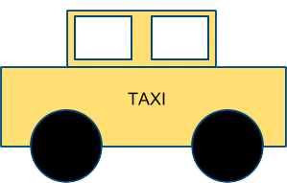
Draw stuff
using the graphics module

Slide 7
Make it move

Slide 8
3. Get input from the user and react

Slide 9
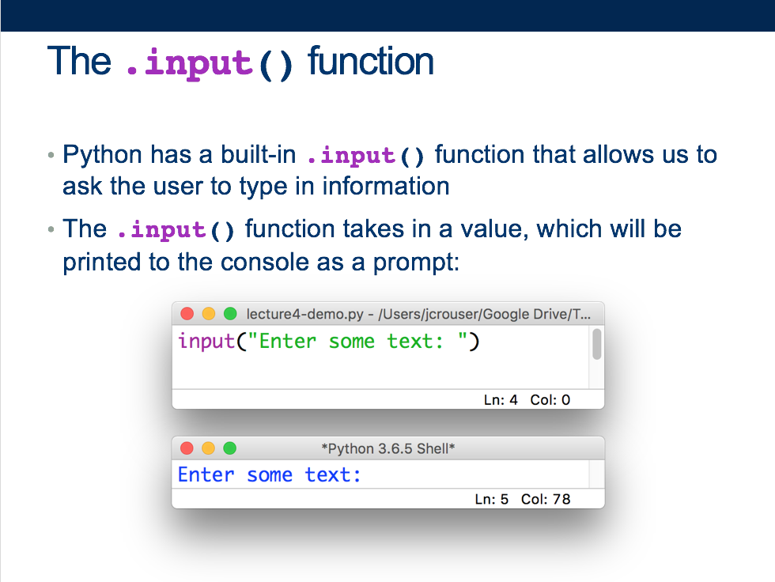
Lecture 4: first experience with user input

Slide 10
Interaction (def.)
Ways for the user to affect change in what’s happening in the program
Low level: between human and interface
the set of operations available
happens between the human and the physical computer
High level: between human and problem space
a cognitive act enabled by the interface
happens between the human and the digital objects

Slide 11

Example: Rubik’s Cube
What low-level interactions can you have?
What high-level interactions can you have?

Slide 12
Low-level vs. high-level interactions

Slide 13
Interaction with graphics objects
The GraphWin object has methods to detect interactions
Mouse:
.getMouse(): stop the program and wait for user to click
.checkMouse(): continuously check if the user has clicked
both return a Point object
Keyboard:
.getKey(): stop the program and wait for user to type
.checkKey(): continuously check if the user has typed
both return a string

Slide 14
Our first interactive graphics program

Slide 15
Notes about keyboard interaction
The strings returned by the .getKey() / .checkKey() methods ae called keycodes
Some keys don’t have an obvious letter attached to them, but their keycodes are still pretty intuitive, e.g.
See also: “space”, “Escape”, “minus”, “underscore”, “equal”, “plus”, “BackSpace”, “Return”, etc.
“Up”
“Left”
“Right”
“Down”

Slide 16
Outline
Animation debrief
Interaction basics
mouse
keyboard
In-Class Lab: Interactive Fish Tank

Slide 17


Challenge 1: press ’q’ to quit
Notes:
Our current aquarium probably still quits when the user clicks, but clicking is probably better used for more interesting interactions. Let’s change it so the program quits when the user presses the ‘q’ key.

Slide 18
Challenge 2: fish position
Notes:
Now instead of randomly adding fish all at the beginning, let’s add a fish every time the user clicks (at the position where their mouse was pointing).

Slide 19
Challenge 3: fish frenzy
Notes:
If we hit the spacebar, have the fish swim quickly toward nearest edge of the screen (flipping if necessary)

Slide 20
Coming up
Monday: Interaction
Lab 10: Interactive Fish Tank
Wednesday: Handling Exceptions
Friday: Special Topic – Ethical Issues in Tech
FP2: Persona, Paper Prototype, and Architecture Diagram

