Slide 1
Lecture 31: Handling Exceptions
CSC111: Introduction to CS through Programming
R. Jordan Crouser
Assistant Professor of Computer Science
Smith College

Slide 2
Outline
Monday: Interaction
Debrief of Lab 10: Interactive Fish Tank
Wednesday: Handling Exceptions
Friday: Special Topic – Ethical Issues in Tech
FP2: Persona, Paper Prototype, and Architecture Diagram

Slide 3

Discussion
What parts of Lab 10 were
the most challenging?

Slide 4
Takeaways from Lab 10
Algorithmic thinking is hard on multiple levels
Figuring out how to describe the process you want to happen
Translating that process into code
Recognizing when the code isn’t doing what you want
Evaluating efficiency
…and much more…
Yesterday was just a small taste (it’s okay if you didn’t finish)
Many more opportunities to master this skill, will be a recurring theme in future courses
CSC212
CSC250
CSC252

Slide 5
Coming up
Announcements
Final Project Proposal Recap
Working with files
what is a file?
reading data in
writing data out
Intro to Algorithms
Recap of Lab: Sorting
Handling Exceptions
Final Project Workshop

Slide 6
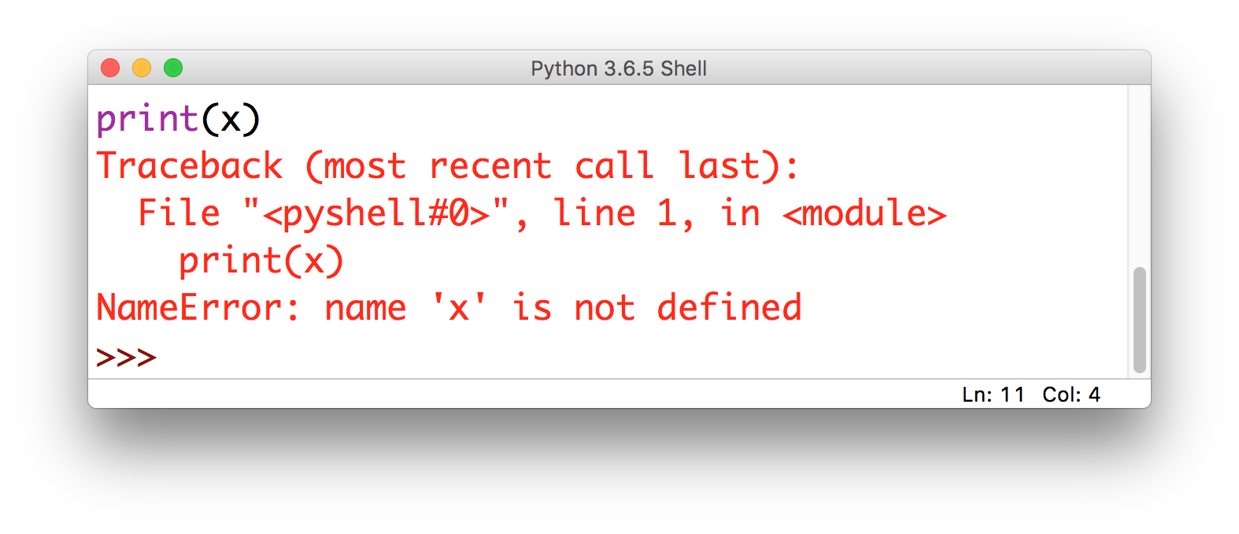
Lecture 10: some problems are obvious
this is called
an Exception

Slide 7
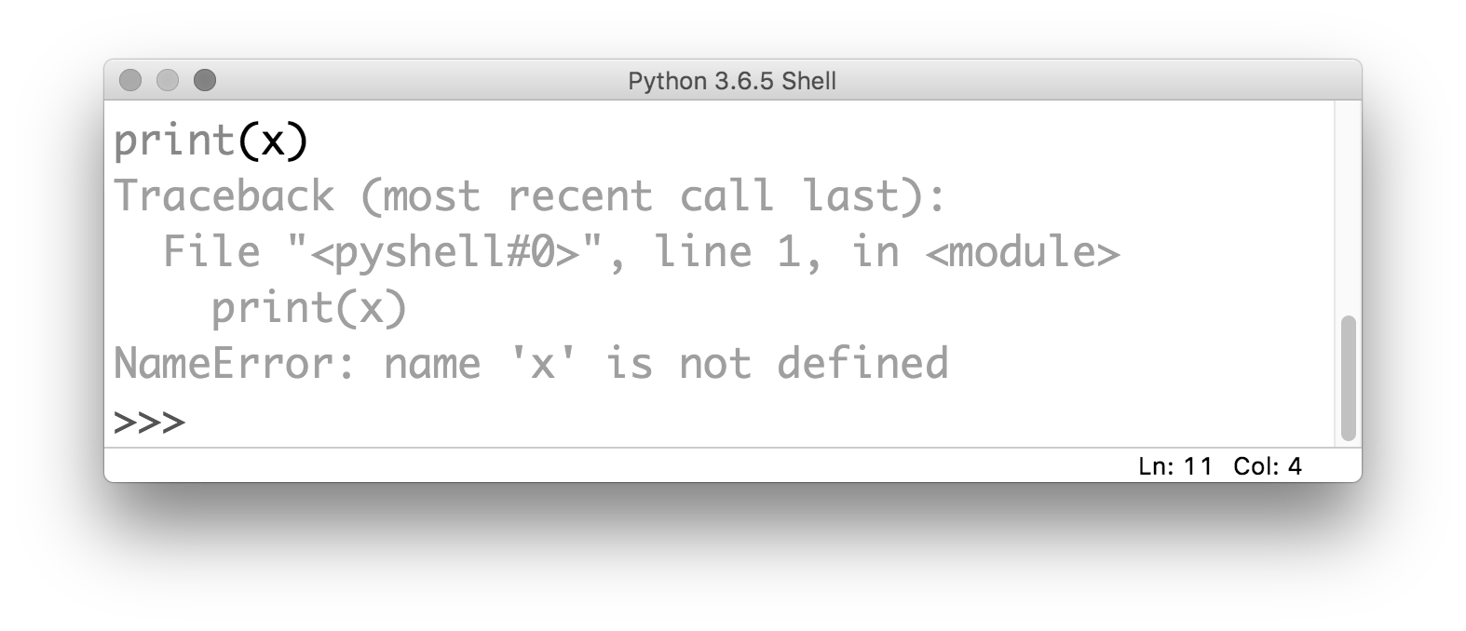
Lecture 10: some problems are obvious
the kind of error gives you
a clue about what the problem is

Slide 8
Lecture 10: some problems are obvious
it also tells you where the problem is
(but be careful!)

Slide 9
Discussion
But there’s a drawback to when your
program throws an Exception…
Notes:
It stops! As of right now, we don’t have any way to recover

Slide 10
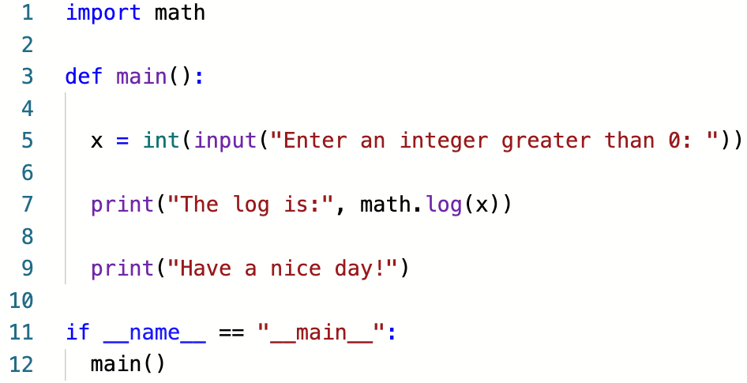
An example
What happens if the user enters
a negative number?

Slide 11
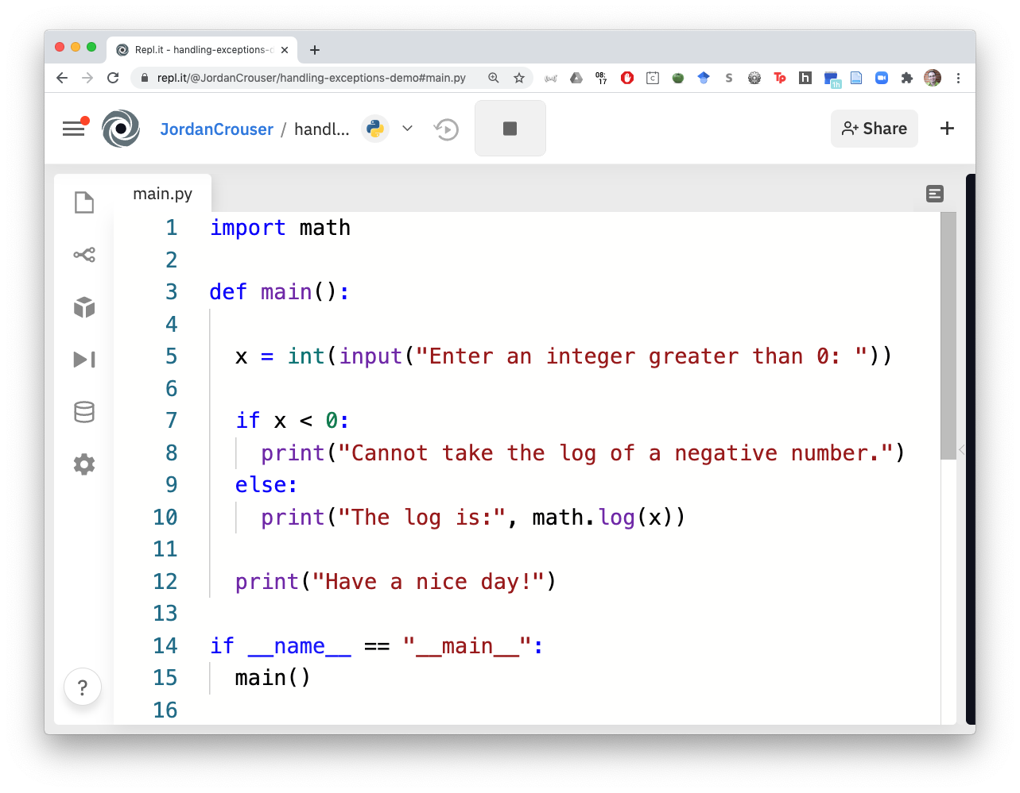
An example
What happens if the
user enters a string?

Slide 12
The try...except block
There are some cases where avoiding an Exception isn’t possible
In this case, we want tell Python:
what we want to happen (what to try)
how to handle it if things go wrong (except)

Slide 13
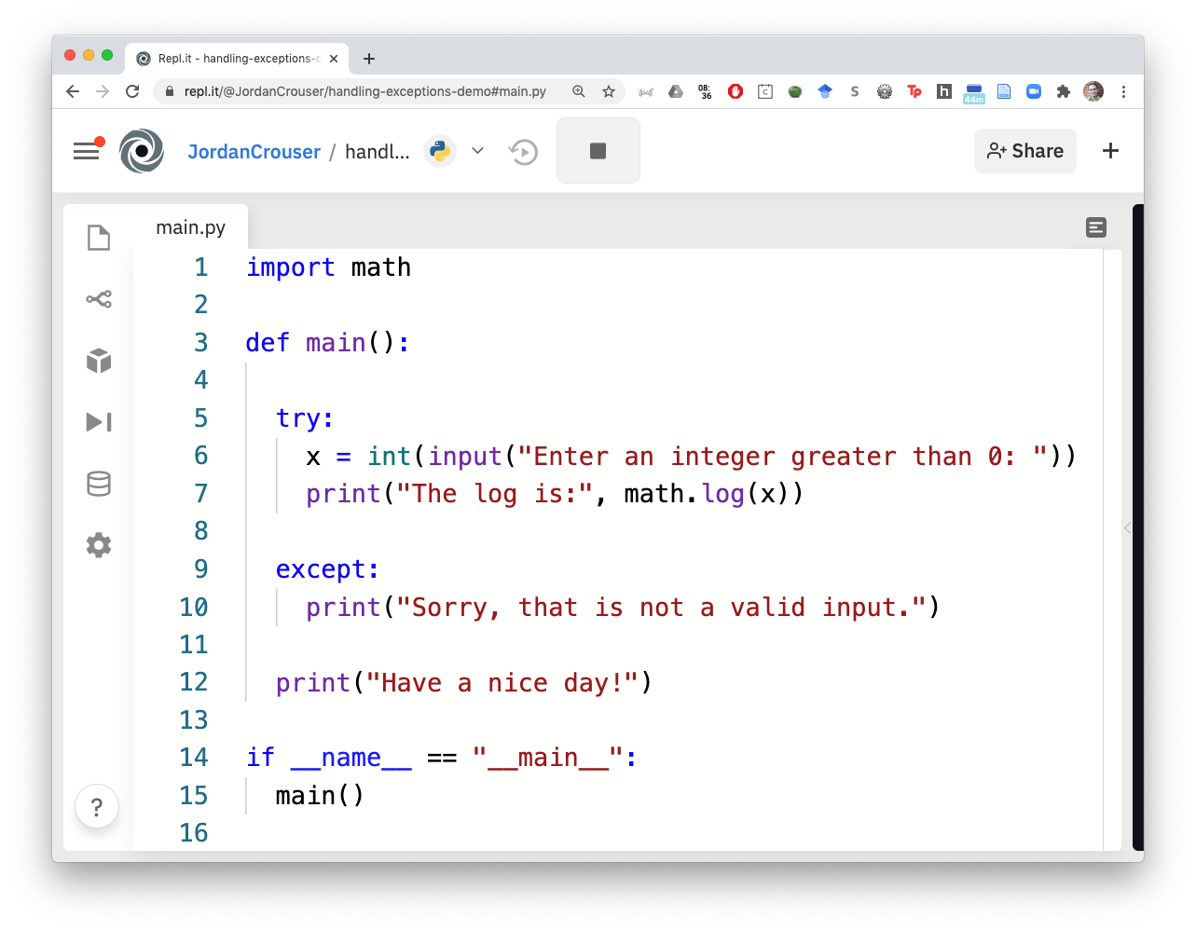
An example
Okay python:
try to do this

Slide 14
An example
except if you can’t;
then do this instead

Slide 15
Your turn!
Given: a (brittle) solution to A2: Clunky Calculator
Objective: find any places that might throw Exceptions, and handle them so the program doesn’t crash!
https://repl.it/@JordanCrouser/handling-exceptions-activity

Slide 16
Takeaways
Even if you can’t avoid all errors, you can design your program to fail gracefully
You can handle multiple different kinds of Exceptions, and you can handle them differently
Think about edge cases to provide specific feedback about what went wrong

Slide 17
Up next
Monday: Interaction
Debrief of Lab 10: Interactive Fish Tank
Wednesday: Handling Exceptions
Friday: Special Topic – Ethical Issues in Tech
FP2: Persona, Paper Prototype, and Architecture Diagram

