Slide 1
Lecture 31: INTRODUCTION TO ALGORITHMS
CSC111: Introduction to CS through Programming
R. Jordan Crouser
Assistant Professor of Computer Science
Smith College

Slide 2
Announcements
Additional office hours this week:
Wednesday (today) from 2 to 4
Friday from 1:30 to 3
(Friday session can be an exam post-mortem if you want, vote on Slack)
See Slack for additional tutorials and notes on:
DIY buttons using graphics.py
making your own timer using the time module
working with pygame

Slide 3
Outline
Algorithmic thinking activity
Sorting algorithms:
Insertion Sort
Selection Sort
Bubble Sort
Comparing algorithms
on specific examples
more generally
Lab

Slide 4

10 volunteers, please!

Slide 5
Outline
Algorithmic thinking activity
Sorting algorithms:
Insertion Sort
Selection Sort
Bubble Sort
Comparing algorithms
on specific examples
more generally
Lab

Slide 6

Debrief
What similarities / differences did you notice between the three approaches?

Slide 7
Discussion
How do you know which algorithm is better?

Slide 8
1. Consider a specific example
[3, 0, 1, 8, 7, 2, 5, 4, 9, 6]
How many steps will InsertionSort take?
How many steps will SelectionSort take?
How many steps will BubbleSort take?
Notes:
Let’s count…

Slide 9
InsertionSort: visually

Slide 10
SelectionSort: visually

Slide 11
BubbleSort:visually

Slide 12
2. Now consider a different example
[0, 1, 2, 3, 4, 5, 6, 7, 8, 9]
How many steps will InsertionSort take?
How many steps will SelectionSort take?
How many steps will BubbleSort take?
Notes:
Let’s count…

Slide 13
3. What about in general?
[ ??? ]
How many steps will InsertionSort take?
How many steps will SelectionSort take?
How many steps will BubbleSort take?
Notes:
This approach gets harder when we don’t know what’s going to be in the list.
And even when we do, if the list is really long, that’s going to be a lot of time spent counting operations.
We need a way to give a general bound without having to actually run the algorithm…

Slide 14
Algorithmic analysis
What we want: a way to get a rough bound (limit) on how many steps an algorithm could take, given input of a particular size
If the list has 5 items?
What about 10?
What about n?
Often care about: “what’s the worst that could happen?”
Mathematics to the rescue!

Slide 15
Asymptotic (“big-O”) notation
We can avoid details when they don’t matter, and they don’t matter when input size (n) is big enough
For polynomials: only the leading term matters
Ignore coefficients, talk about degree: linear, quadratic
y = 3x y = 6x-2 y = 15x + 44
y = x² y = x²-6x+9 y = 3x²+4x

Slide 16
3. What about in general?
[ ??? ]
How many steps will InsertionSort take?
How many steps will SelectionSort take?
How many steps will BubbleSort take?
Notes:
If we’re going to answer this question, we’ll need to write out the pseudocode for each algorithm

Slide 17
SelectionSort
Given some list of comparable items:
Find the smallest item.
Swap it with the item in position 0.
Repeat finding the next-smallest item, and swapping it
into the correct position until the list is sorted.
Notes:
How long could it take to find the smallest item?
And how many times do we do it?

Slide 18
BubbleSort
While the list is still unsorted:
For p in [0, ..., n-2]:
If item in position p is greater than item in position p+1:
Swap them
Notes:
How many items could we possibly need to move (while loop)?
How many times do we iterate (for loop)?

Slide 19
Takeaways
Big-O notation gives us a language to talk about and compare algorithms before we implement them (smart!)
InsertionSort, SelectionSort, and BubbleSort:
all the same in the worst case
different in the best case
what about the average case?
is there any algorithm that could do better in the worst case? (yes!)
As your programs get more complex, it’s helpful to think about the algorithm before you start coding

Slide 20
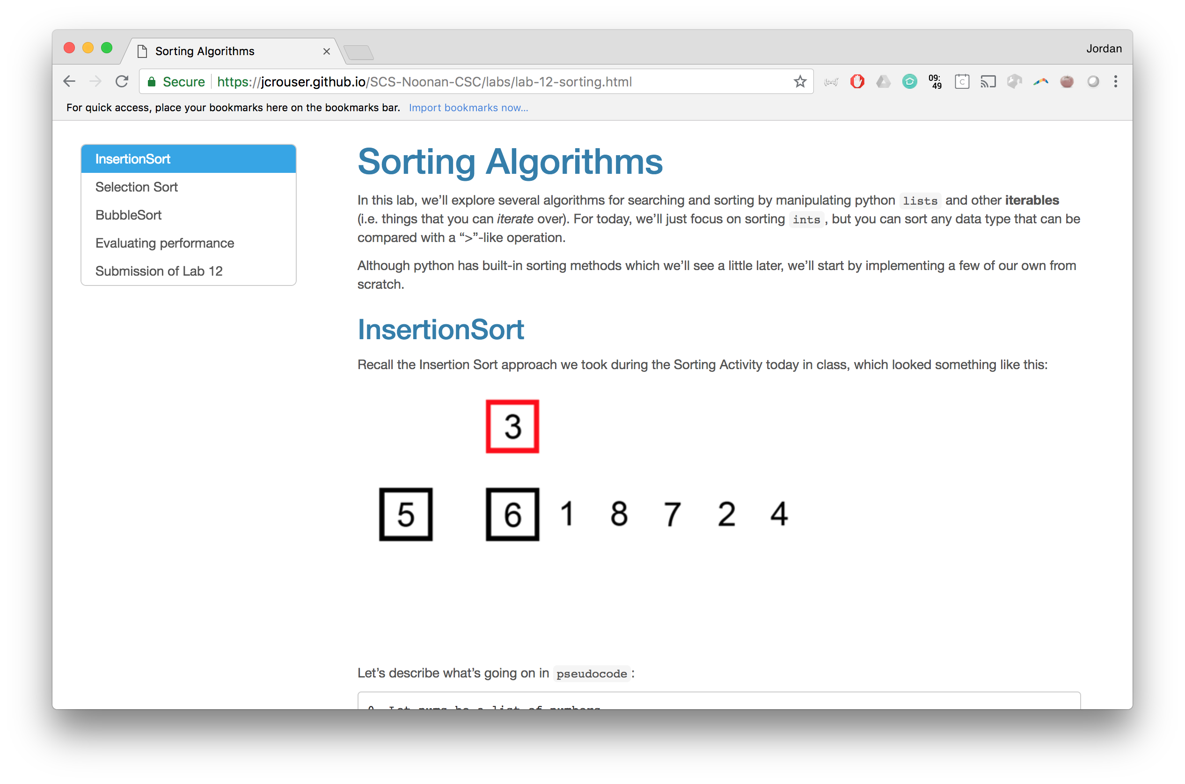
Lab: Sorting

Slide 21
Coming up
Announcements
Final Project Proposal Recap
Working with files
what is a file?
reading data in
writing data out
Intro to Algorithms
Lab: Sorting
Handling Exceptions

