Slide 1
Lecture 34: Final Project Workshop
CSC111: Introduction to CS through Programming
R. Jordan Crouser
Assistant Professor of Computer Science
Smith College

Slide 2
Final Project Deliverables
FP1: Proposal
FP2: Paper Prototype, Persona, Architecture Diagram
FP3: Working Prototype (i.e. code)
FP4: Presentation
FP5: Write Up and Final Version of Code

Slide 3
FP3: Working Prototype (i.e. code)
Due Sunday Dec. 9th at 11:55pm
Complete, organized, well-documented code:
in-line comments
appropriate variable / function names
docstrings explaining what each function / class does
includes all supplemental files (images, etc.)
Include a text file named README containing:
a description of the project
information on how to run your project
install links to any required modules
a list of known bugs
Runs without syntax errors

Slide 4
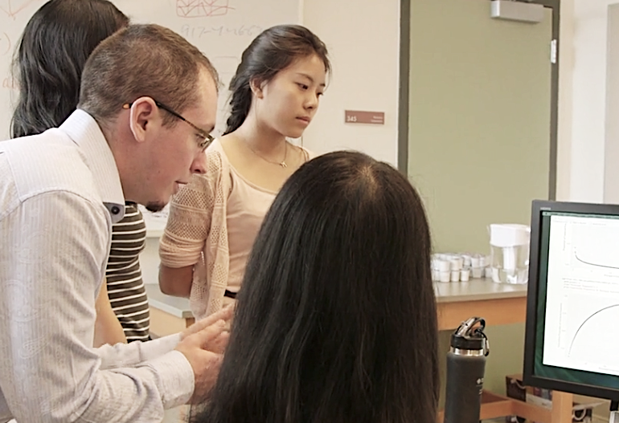
FP4: Presentation
Monday Dec. 10th from 11am-12:10pm in FORD ATRIUM
How it works:
bring a laptop with your project ready to go
there will be lots of tables in the atrium: pick a spot and set up!
external monitors available
demo your project to: me, each other, faculty, your friends, etc.
This is the fun part!
Grade: S/U

Slide 5
FP5: Write Up and Final Version
Due Wednesday December 19th at 11:55pm
For the code:
you may have learned something from other people’s demos that helps you fix a bug – do it!
same expectations as FP3 w.r.t. documentation, etc.
this is the version I will grade for “completeness”
For the writeup, 2-3 pages, including:
a description of the project, including the intended audience
a description of the architecture (how you designed the code)
a discussion of at least one major challenge, and how you overcame it
a description of your specific contributions to the project (this part to be completed independently)

Slide 6
FP Workshop: Part I (mini-demo)

Slide 7
FP Workshop: Part II
Get into your groups
Decide on a specific bug you want to fix or feature you want to implement
Get it done!

Slide 8
Coming up next
12/3: Advanced Topic: Human-Computer Interaction (HCI)
12/5: Final Project Workshop
12/7: Advanced Topic: Introduction to Java
12/10: Last Day of Class: Final Project Demonstrations
12/12: (class cancelled)

