Slide 1
Week 4 – Wednesday: Recursion pt. 1
R. Jordan Crouser
Assistant Professor of Computer Science
Smith College
SCS Noonan Scholars – Summer 2018

Slide 2
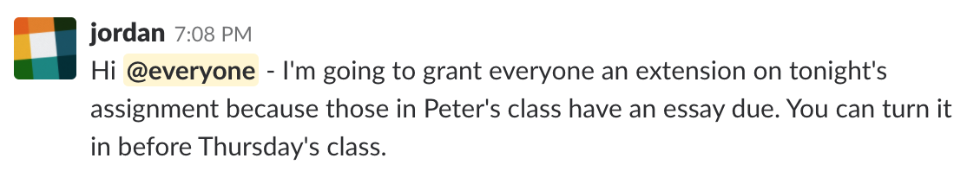
Announcements
Remember to pay attention to Slack notifications, they sometimes contain important information:
Lab 12 page was also down for awhile, now resolved
Proposal:
first half of class: finish Lab/HW 12
second half of class: introduce recursion
tomorrow: resume recursion

Slide 3
Outline
Motivating example: Towers of Hanoi
Tough problems, simple solutions
More Recursion & Recursive Functions
Finding the Largest in a List
Finding the Smallest in a List
Traversing a Maze
Fractal Trees
Lab

Slide 4
Towers of Hanoi

Slide 5
Rules of the game
You can only move one disk at a time
You can only move a disk to a pole where it will be the smallest (i.e. you can’t put a disk on top of a larger one)
You can only remove the smallest disk from a pole (i.e. you can’t lift up the stack to get a larger disk from below)

Slide 6

Discussion
Notice any patterns?

Slide 7
Recursive Towers
solve this
subproblem

Slide 8
Recursive Towers

Slide 9
Recursive Towers
move this
disk

Slide 10
Recursive Towers

Slide 11
Recursive Towers
solve this
subproblem

Slide 12
Recursive Towers

Slide 13
Recursive Towers
solve this
subproblem

Slide 14
Recursive Towers
solve this
subproblem

Slide 15
Recursive Towers

Slide 16
Recursive Towers
move this
disk

Slide 17
Recursive Towers

Slide 18
Recursive Towers
solve this
subproblem

Slide 19
Recursive Towers
…and so on!

Slide 20
The legend
Notes:
The puzzle was invented by the French mathematician Édouard Lucas in
1883.
There is a story about an Indian temple in Kashi Vishwanath which contains a
large room with three time-worn posts in it surrounded by 64 golden disks.
Brahmin priests, acting out the command of an ancient prophecy, have been
moving these disks, in accordance with the immutable rules of the Brahma,
since that time. The puzzle is therefore also known as the Tower of Brahma
puzzle. According to the legend, when the last move of the puzzle will be
completed, the world will end.

Slide 21
Discussion
How many moves does it take?

Slide 22

Algorithmic analysis
nDisks | nMoves
1 | 1
2 | 3
3 | 7
4 | 15
5 | 31
6 | 64
7 | 127
Notice any
patterns?
$$nMoves=2^{nDisks}−1$$

Slide 23
So… when will the world end?
Notes:
Roughly 584 BILLION years after they started

Slide 24
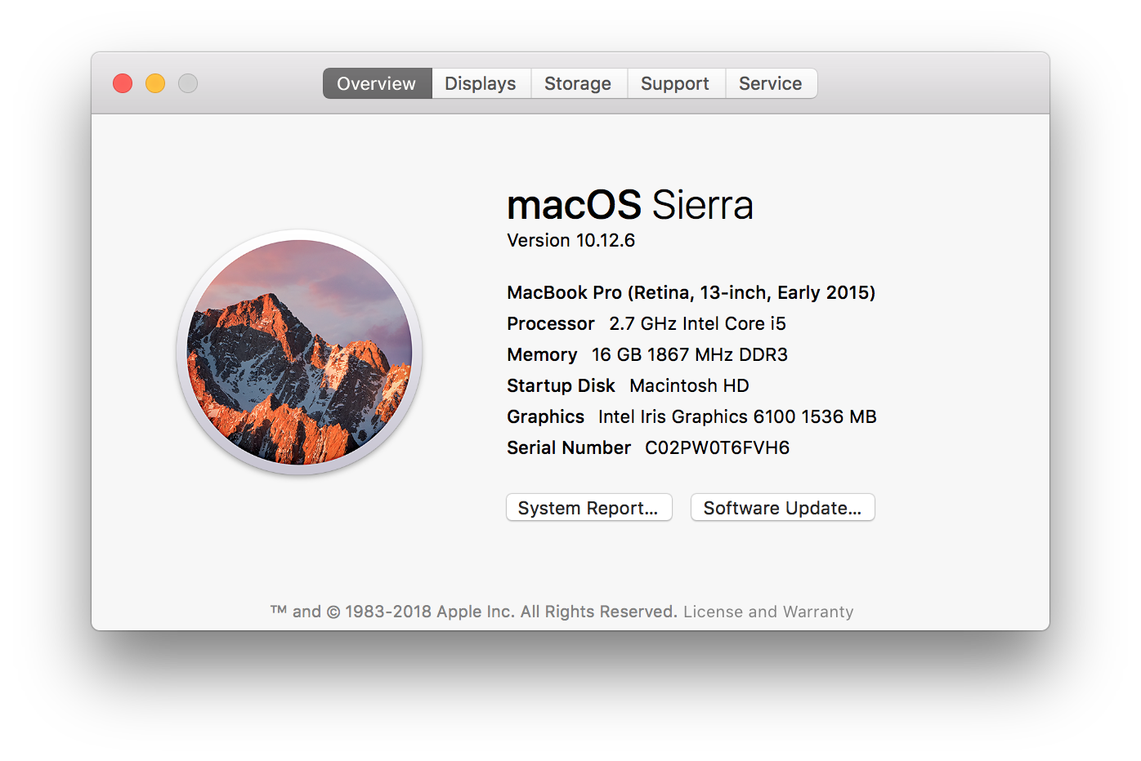
How about using a laptop?
Notes:
2.7 GHz processor means my laptop can perform roughly 2.7 billion operations per second
Let’s be generous and assume that we can move a disk in a single operation (we can’t)
2^64ops / 2.7 billion ops per second / 84000 seconds per day / 365 days per year = 46,154.4 years
So we’ve got some time ☺

Slide 25
Basic structure of a recursive algorithm
A base case: what to do in the simplest possible case (i.e. when you have a single disk)
A recursive step: break the original problem into one or more smaller problems, and solve that (saving the intermediate result)

Slide 26
Demo: Towers of Hanoi in Python

Slide 27
This week
Monday: Mock Midterm
Tuesday: Introduction to Algorithms
Wednesday: Recursion pt. 1
Thursday: Recursion pt. 2
Friday: Life Skill #4: Paper Prototyping

