Slide 1
Why Does My Computer Do That? Intro to Coding with Python– Numbers
Dr. Ab Mosca (they/them)
Slides based off slides courtesy of Jordan Crouser (https://jcrouser.github.io/)

Slide 2
Plan for Today
More variables
Numeric values and basic operations

Slide 3
(RECAP) Core concept 1: variables
In CS, a variable is a place to store a piece of data
In Python, variables are:
declared by giving them a name
assigned using the equals sign
Example:
x = 3
declaring
a variable x
assigning
the value 3 to x

Slide 4
Keywords
We want to use descriptive variable names
Some words in Python* are reserved as keywords, and cannot be used as a variable name:
and as assert break class continue def del elif else except exec finally for from global if import in is lambda not or pass raise return try while with yield
* other languages have their own set of reserved words

Slide 5
More about naming variables
Rule 1: variable name must be at least 1 character long
Rule 2: 1st character must be alphabetic
(uppercase letter, lowercase letter, or underscore)
Rule 3: variable names can contain letters, numbers, and underscores (but not spaces or other punctuation)

Slide 6
Naming conventions
These aren’t rules (i.e. Python won’t throw an error), but they make life a lot easier if you follow them

Slide 7
Naming conventions
These aren’t rules (i.e. Python won’t throw an error), but they make life a lot easier
Convention 1: the name of the variable should tell you something about what the variable contains, e.g.
name = “Jordan”
is better than
blah = “Jordan”

Slide 8
Naming conventions
These aren’t rules (i.e. Python won’t throw an error), but they make life a lot easier
Convention 1: the name of the variable should tell you something about what the variable contains, e.g.
Convention 2: if you want to use multiple words as a variable name, separate them using _underscores_, or camel case e.g.
first_name = “Ab”
lastName = “Mosca”
(but stick to one convention)

Slide 9
Naming conventions
These aren’t rules (i.e. Python won’t throw an error), but they make life a lot easier
Convention 1: the name of the variable should tell you something about what the variable contains, e.g.
Convention 2: if you want to use multiple words as a variable name, separate them using _underscores_, or camel case e.g.
Convention 3: if the value isn’t going to change (i.e. the variable is a constant), use ALL CAPS, e.g.
PI = 3.14159

Slide 10
Notes:
https://replit.com/team/CAIS117-F23
Let’s practice a little…
(show how changing the names of the variables doesn’t change how the program works… but it does change how it reads)
ex. name, favorite animal, least favorite animal

Slide 11
(RECAP) Core concept 2: numeric values
Two kinds of numbers in CS:
integers (“whole numbers”)
floats (“decimals” or “floating point numbers”)
In Python, the kind of number is implied by whether or not the number contains a decimal point
Example:
x = 3
x = 3.0

Slide 12
Discussion
Why do we care about
whether or not a number has a decimal point?

Slide 13
Math
Basic operators:
addition: +
subtraction: -
multiplication: *
division: /
exponentiation: ** (power)
modular arithmetic: % (modulo)
Negative values are allowed!
x = -3

Slide 14
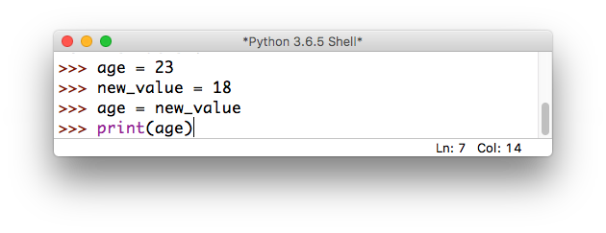
Overwriting variables
What happens if we do the following?

Slide 15
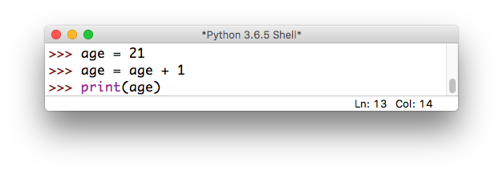
Incrementing variables
What about this?

Slide 16
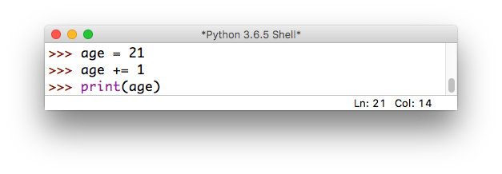
Incrementing variables
There’s a shorthand for this!

Slide 17
Quick exercise
a = 10
b = 20
c = 30
a = b # a =
b = a # b =
c = c * 2 # c =
d = d – 10 # d =
# NameError:
# name 'd' is not defined
these are called
comments:
they are not executed
by the interpreter,
but are useful
for making
code readable

Slide 18
Some more useful shorthand
Simultaneous assignment:
a = 10
b = 20
c = 30
a = b
b = a
c = c * 2

Slide 19
Some more useful shorthand
Simultaneous assignment:
a, b, c = 10, 20, 30
a = b
b = a
c = c * 2

Slide 20
Some more useful shorthand
Simultaneous assignment:
a, b, c = 10, 20, 30
Swapping variables:
a = b
b = a
c = c * 2

Slide 21
Some more useful shorthand
Simultaneous assignment:
a, b, c = 10, 20, 30
Swapping variables:
a, b = b, a
c = c * 2

Slide 22
Quick exercise: unit conversion
Find a partner, and write a program that asks the user to input() a number representing a file size in Kb
Store the user input in an appropriate variable
Calculate the equivalent size in bits, bytes, Mb, and Gb:
1 byte = 8 bits
1 Kb = 1024 bytes
1 Mb = 1024 Kb
1 Gb = 1024 Mb
print() the converted sizes to the screen (ascending)
Want a challenge? See if you can print the units beside each of the values (try the str() method)

Slide 23
Discussion
What did you come up with?

Slide 24
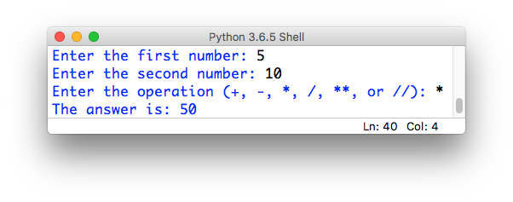
Assignment #2: clunky calculator
In this assignment, you will write a short python program that simulates basic calculator functionality.
The user interface of your calculator should ask the user to input two numbers, and then a string indicating which mathematical operation to perform. For example:

Slide 25
Assignment #2: clunky calculator
Your calculator should support add, subtract, multiply, divide and power (exponentiation) operations.
Optional: support integer division with a remainder.
Your calculator should be able to handle both integers and floats.
It’s important that your input goes in the prescribed order, and your output is formatted like the example

