Slide 1
Why Does My Computer Do That? Intro to Coding with Python– Mathematical Operators
Dr. Ab Mosca (they/them)
Slides based off slides courtesy of Jordan Crouser (https://jcrouser.github.io/)

Slide 2
Plan for Today
More mathematical operators
Formatting print statements

Slide 3
(RECAP) Core concept 2: numeric values
Two kinds of numbers in CS:
integers (“whole numbers”)
floats (“decimals” or “floating point numbers”)
Basic operators:
addition: +
subtraction: -
multiplication: *
division: /
integer division: //
exponentiation: ** (power)
modular arithmetic: % (modulo)

Slide 4
(RECAP) Core concept 2: numeric values
Two kinds of numbers in CS:
integers (“whole numbers”)
floats (“decimals” or “floating point numbers”)
Basic operators:
addition: +
subtraction: -
multiplication: *
division: /
integer division: //
exponentiation: ** (power)
modular arithmetic: % (modulo)

Slide 5
Reviewing integer operators: // and %
What is the result of the following operations?
21 // 5
21 % 5
9 // 3
9 % 3
13 // 5
13 % 5
139 // 20
139 % 20

Slide 6
Reviewing integer operators: // and %
What is the result of the following operations?
21 // 5
21 % 5
9 // 3
9 % 3
13 // 5
13 % 5
139 // 20
139 % 20
# 4
# 1
# 3
# 0
# 2
# 3
# 6
# 19

Slide 7
Built-in functions that work on numbers
abs(x) # return the absolute value of x
float(x) # return x parsed as a float
int(x) # return x parsed as an int
max(…) # return the largest of a list of numbers
min(…) # return the smallest of a list of numbers
round(x[, n]) # return x rounded to n digits after the # decimal point. If n is omitted, it # returns the nearest integer value
sum(…) # return the sum of a list of numbers

Slide 8
Aside: what does parsed mean?
abs(x) # return the absolute value of x
float(x) # return x parsed as a float
int(x) # return x parsed as an int
max(…) # return the largest of a list of numbers
min(…) # return the smallest of a list of numbers
round(x[, n]) # return x rounded to n digits after the # decimal point. If n is omitted, it # returns the nearest integer value
sum(…) # return the sum of a list of numbers

Slide 9
Aside: what does return mean?
abs(x) # return the absolute value of x
float(x) # return x parsed as a float
int(x) # return x parsed as an int
max(…) # return the largest of a list of numbers
min(…) # return the smallest of a list of numbers
round(x[, n]) # return x rounded to n digits after the # decimal point. If n is omitted, it # returns the nearest integer value
sum(…) # return the sum of a list of numbers

Slide 10
RECAP: Keywords
Some words in Python* are reserved as keywords, and cannot be used as a variable name:
and as assert break class continue def del elif else except exec finally for from global if import in is lambda not or pass raise return try while with yield
a reserved keyword
* other languages have their own set of reserved words

Slide 11
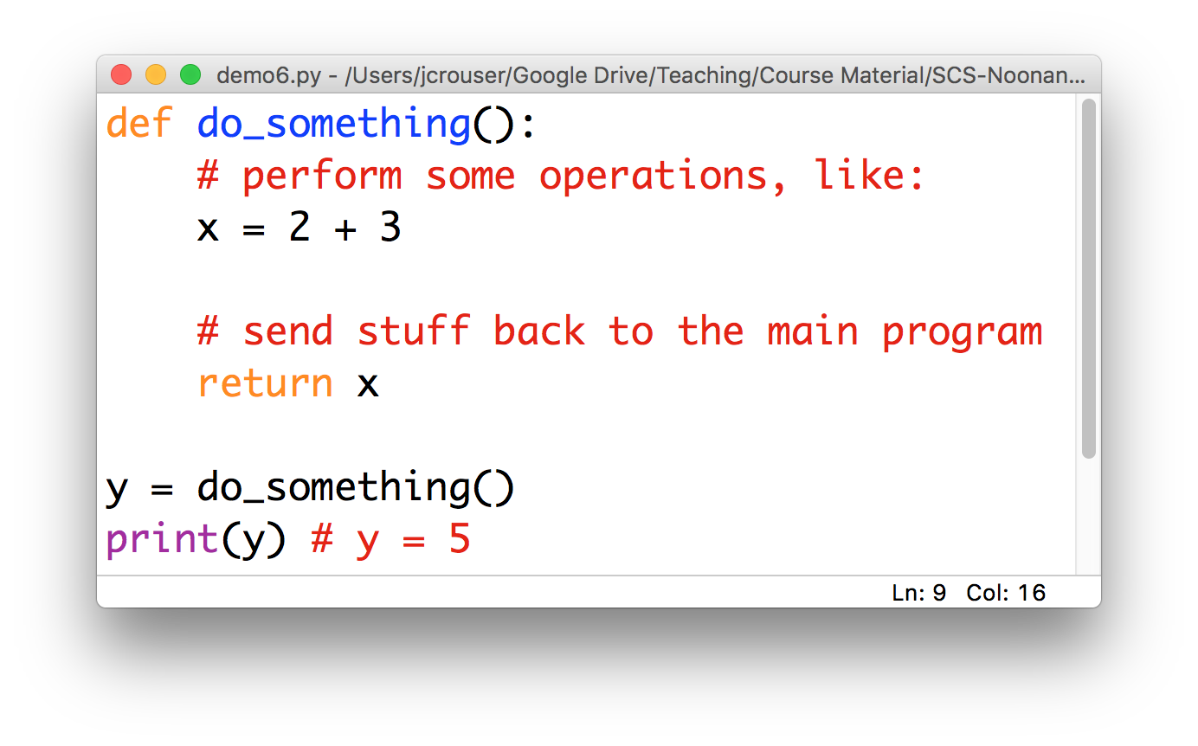
Peek ahead: “functions”

Slide 12
The math module
Lots of other things we might want to do with numerical values are available as functions in the math module
import math
math.floor(f) # round float f down
math.ceil(f) # round float f up
math.sqrt(x) # take the square root of x
And more! Check out: https://docs.python.org/2/library/math.html
In Python, modules are just files containing Python definitions and statements (ex. name.py)
These can be imported using import name
To access name’s functions, type name.function()

Slide 13
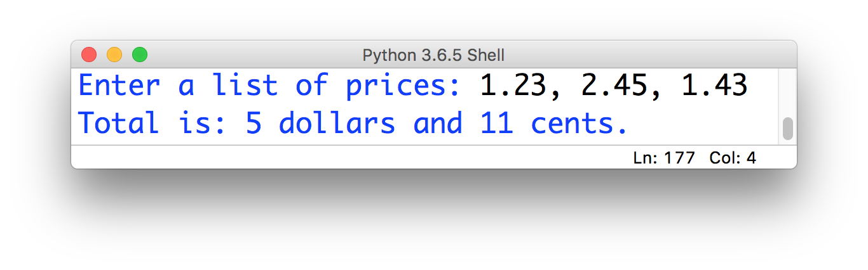
15-minute exercise: dollars and cents
Use built-in functions and functions from the math module to take a list of prices, calculate their sum, and output their total formatted like this:

Slide 14
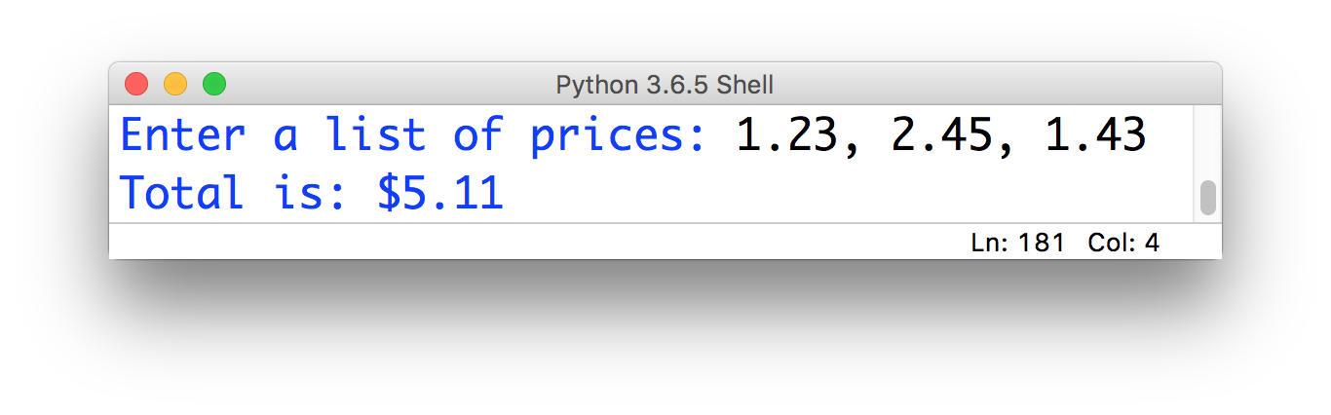
Finishing touches…
What we have now:
What we probably want:

Slide 15
Finishing touches…
What we have now:
What we probably want:
Ideas? What tools do you have to achieve this?

Slide 16
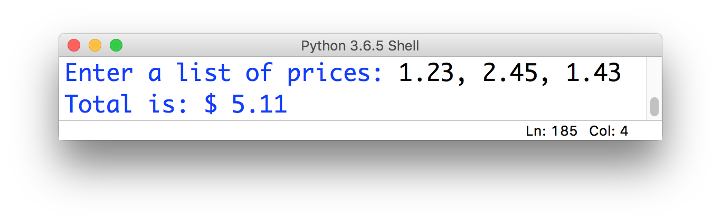
Close, but not quite:
Just using concatenation:
print(“Total is: $”, sum(x)))
annoying space

Slide 17

Closer, but unsatisfying (and fragile)
Using concatenation and casting to string:
print(“Total is: $”,str(sum(x))))
no annoying space

Slide 18
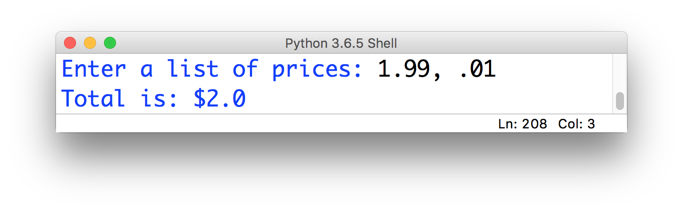
Closer, but unsatisfying (and fragile)
Using concatenation and casting to string:
print(“Total is: $”, str(sum(x))))
wrong number
of decimal places

Slide 19
Solution: formatting with .format()
The .format() method (which gets called on a string) might be helpful here!

Slide 20
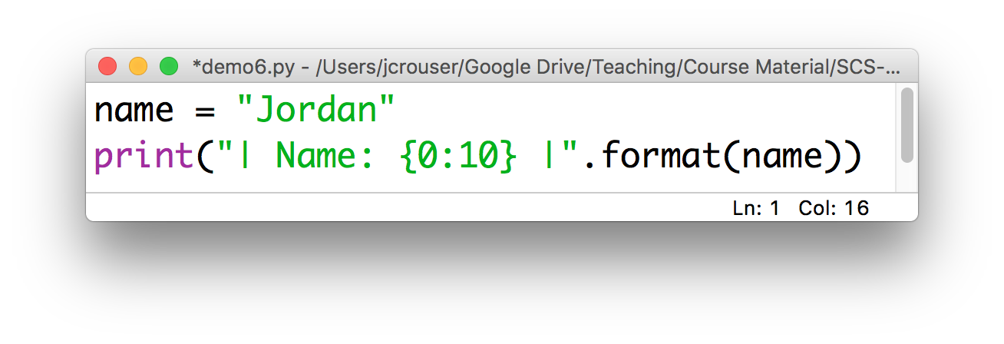
Solution: formatting with .format()
The .format() method (which gets called on a string) might be helpful here!
How it works:
Result: | Name: Jordan |
insert
print (at least)
10 characters

Slide 21
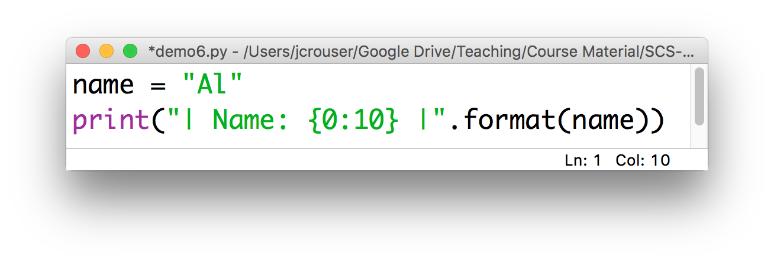
Solution: formatting with .format()
The .format() method (which gets called on a string) might be helpful here!
How it works:
Result: | Name: Al |

Slide 22
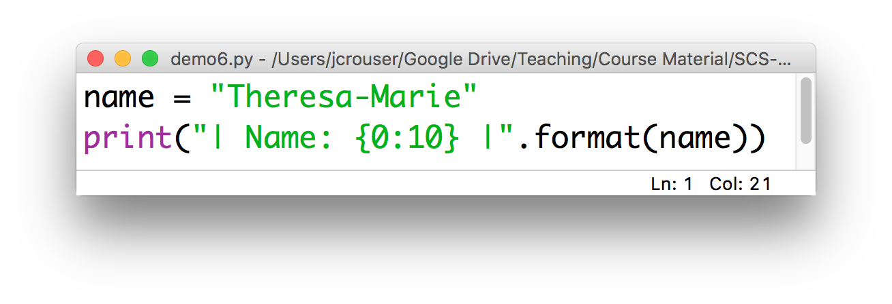
Solution: formatting with .format()
The .format() method (which gets called on a string) might be helpful here!
How it works:
Result: | Name: Theresa-Marie |
doesn’t truncate

Slide 23
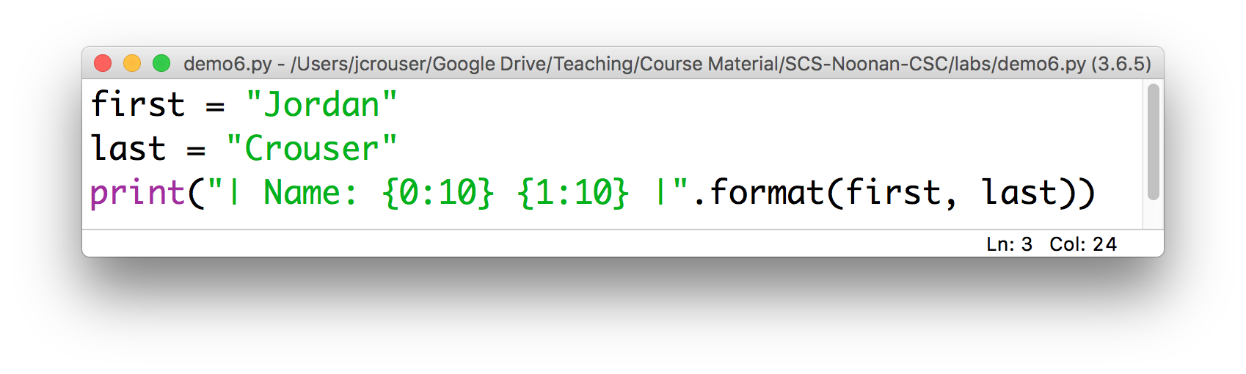
Calling .format() with multiple inputs
Can also handle multiple inputs, e.g.
Result: | Name: Jordan Crouser |
0th 1st
put the
1st thing here
put the
0th thing here

Slide 24
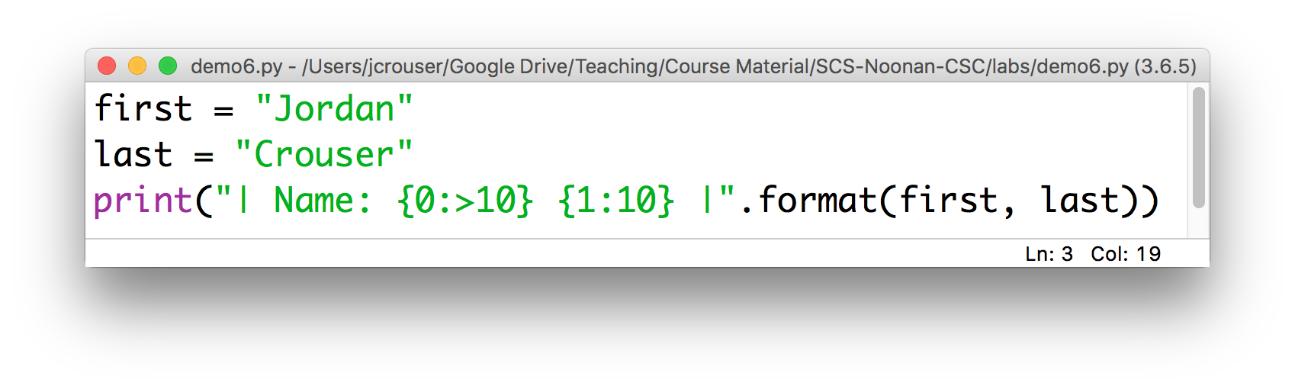
Right-justification with .format()
To align the format to the right instead of to the left, use >
Result: | Name: Jordan Crouser |

Slide 25
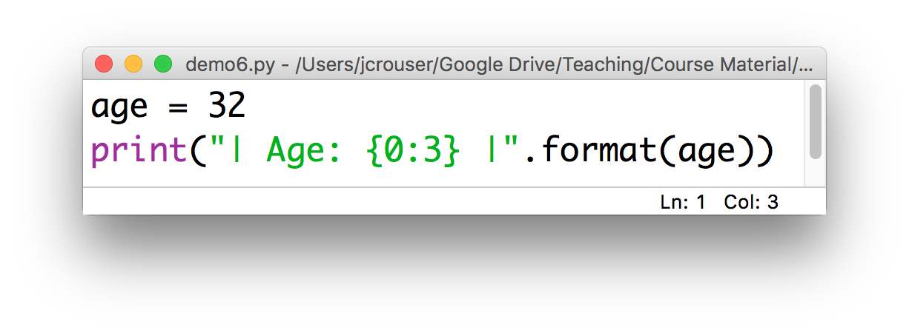
.format() on integers
Calling .format() on an integer works just like with strings, but they’re automatically right-aligned
Result: | Age: 32 |

Slide 26
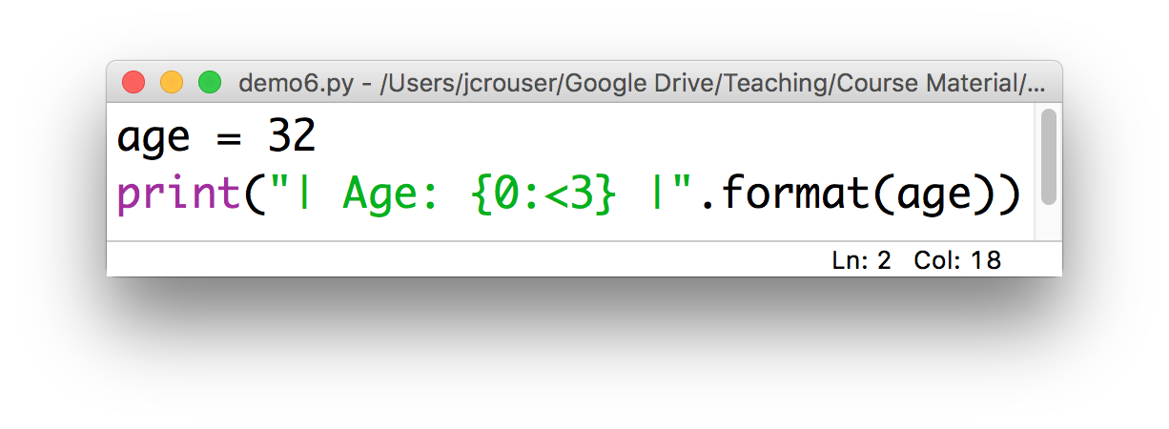
.format() on integers
Use < to left-align:
Result: | Age: 32 |

Slide 27
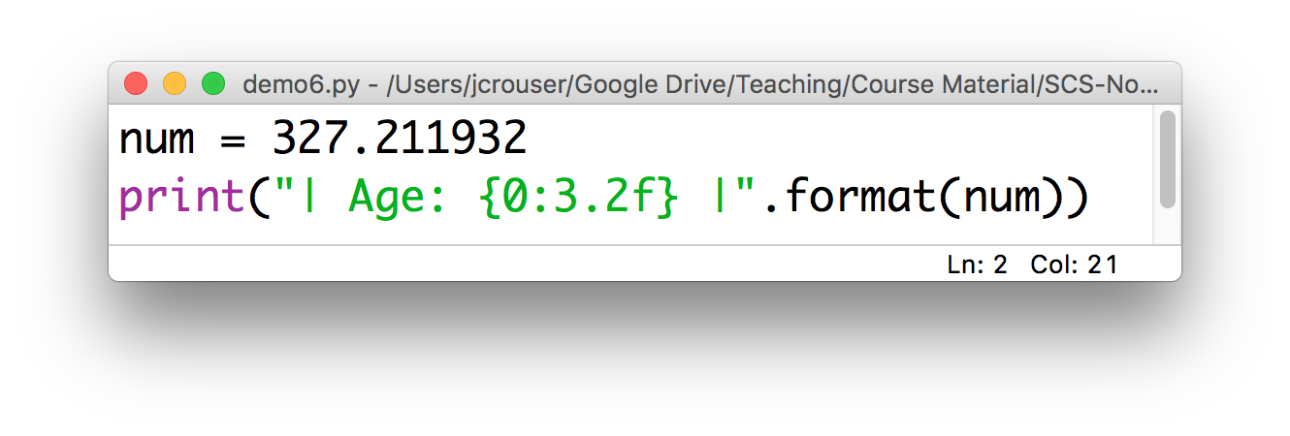
.format() on floats
We need to specify a number of digits before and after the decimal point:
Result: | Age: 327.21 |

Slide 28
Revisiting: dollars and cents
Modify your previous code to use the .format() method so that your output looks like this:

