Slide 1
Why Does My Computer Do That? Intro to Coding with Python– Loops
Dr. Ab Mosca (they/them)
Slides based off slides courtesy of Jordan Crouser (https://jcrouser.github.io/)

Slide 2
Plan for Today
For loops
While loops

Slide 3
Loops: a familiar idea
https://xkcd.com/1411/

Slide 4
Loops in computer programming
Goal: simplify the description of repeated blocks of code (i.e. make it shorter/easier to understand by highlighting what’s being repeated and for how long)
Three approaches:
run for each item in a list
run a specific number of times
run until some condition is met

Slide 5
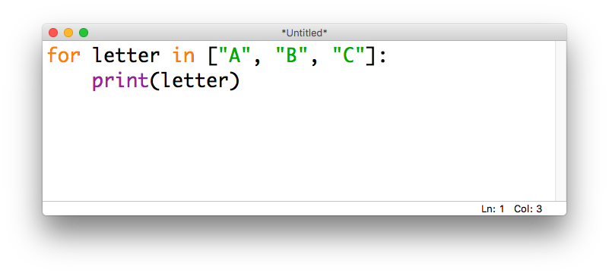
for...in loops
In Python, we use the keywords for and in to loop through a list

Slide 6
for...in loops
We can think of this in terms of where the variable letter is pointing:

Slide 7
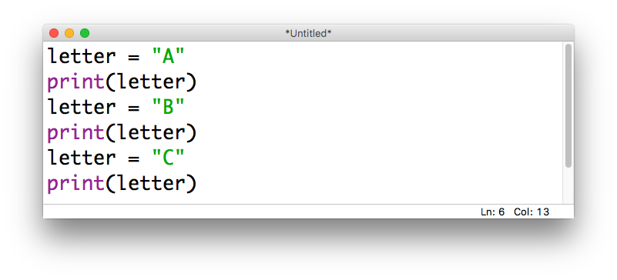
for...in loops: unpacked
We could accomplish the same thing by writing it out as three separate assignments:

Slide 8
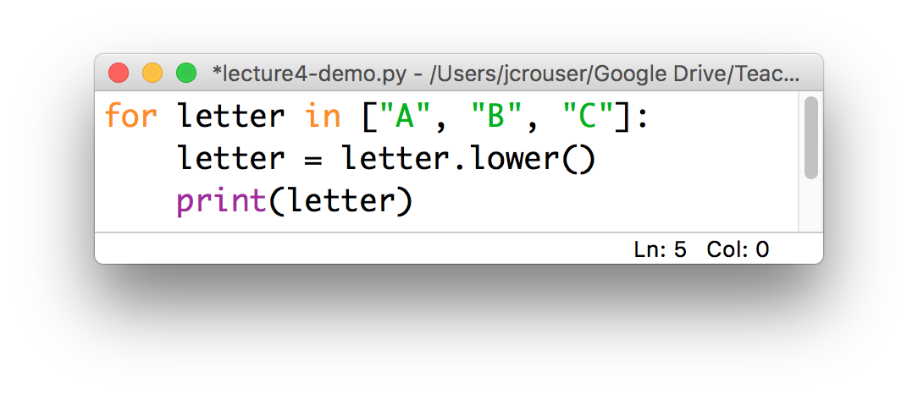
for...in loops: a common “gotcha”
Python will allow you to modify a list while you’re looping through it:
This is generally a bad idea (more on why later)
it’s fine to format the values, etc.
just don’t overwrite the originals!

Slide 9
Demo: compute a sum
Use a for loop to compute
the sum of a list of numbers
Step 1: pseudocode
Step 2: python

Slide 10
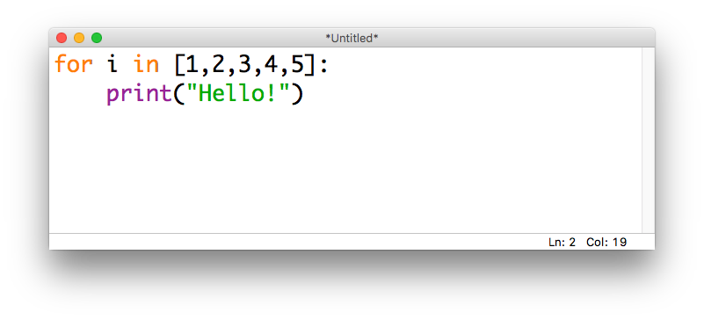
Looping n times
Bad news: there isn’t a way to say “run this loop n times” in Python – we’ll have to find a way around that
If we want a for...in loop to run a specific # of times, can “trick” it using a list of numbers that’s the right size

Slide 11
Looping n times
Bad news: there isn’t a way to say “run this loop n times” in Python – we’ll have to find a way around that
If we want a for...in loop to run a specific # of times, can “trick” it using a list of numbers that’s the right size
common
practice:
use the
letter i
to denote
the “index”

Slide 12
Looping n times
Bad news: there isn’t a way to say “run this loop n times” in Python – we’ll have to find a way around that
If we want a for...in loop to run a specific # of times, can “trick” it using a list of numbers that’s the right size
common
practice:
use the
letter i
to denote
the “index”
What will this code do?

Slide 13
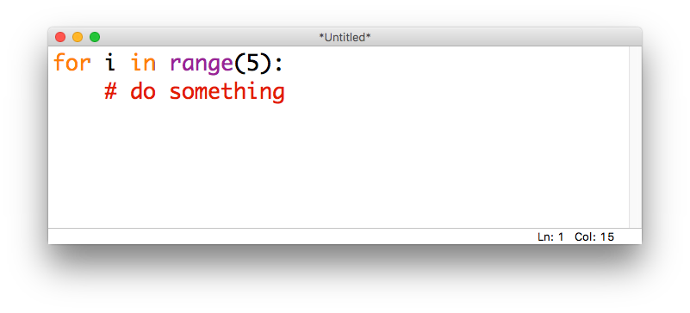
The range() function
The range() function lets us generate lists of integers
Given one integer a, range(a) will generate a list starting at 0 and going up to (but not including) a
For example, if we want a loop to run 5 times:

Slide 14
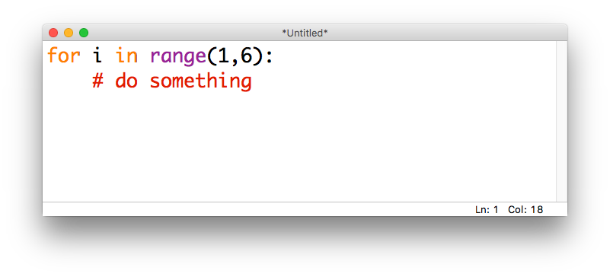
The range() function
Given two integers a,b, range(a,b) will generate a list starting at a and going up to (but not including) b
E.g., if we want to loop over the integers from 1 to 5:

Slide 15
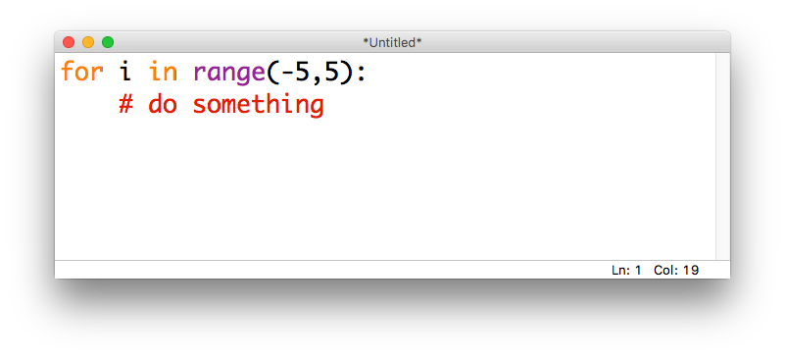
The range() function
These values can be positive or negative (but for now, the second integer should be larger than the first)
E.g., if we want to loop over the integers from -5 to 5:

Slide 16
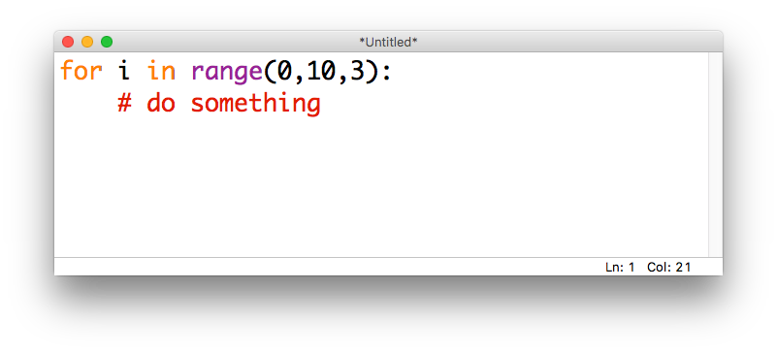
The range() function
Given three integers a,b,c, calling range(a,b,c) will generate a list starting at a and going up to (but not including) b with step size c
E.g., if we want the integers from 0 to 9, counting by 3s:

Slide 17

The range() function
If we want to count down instead of up, we can set b < a and use a negative step size
E.g., if we want to count down from 10 to 1:

Slide 18

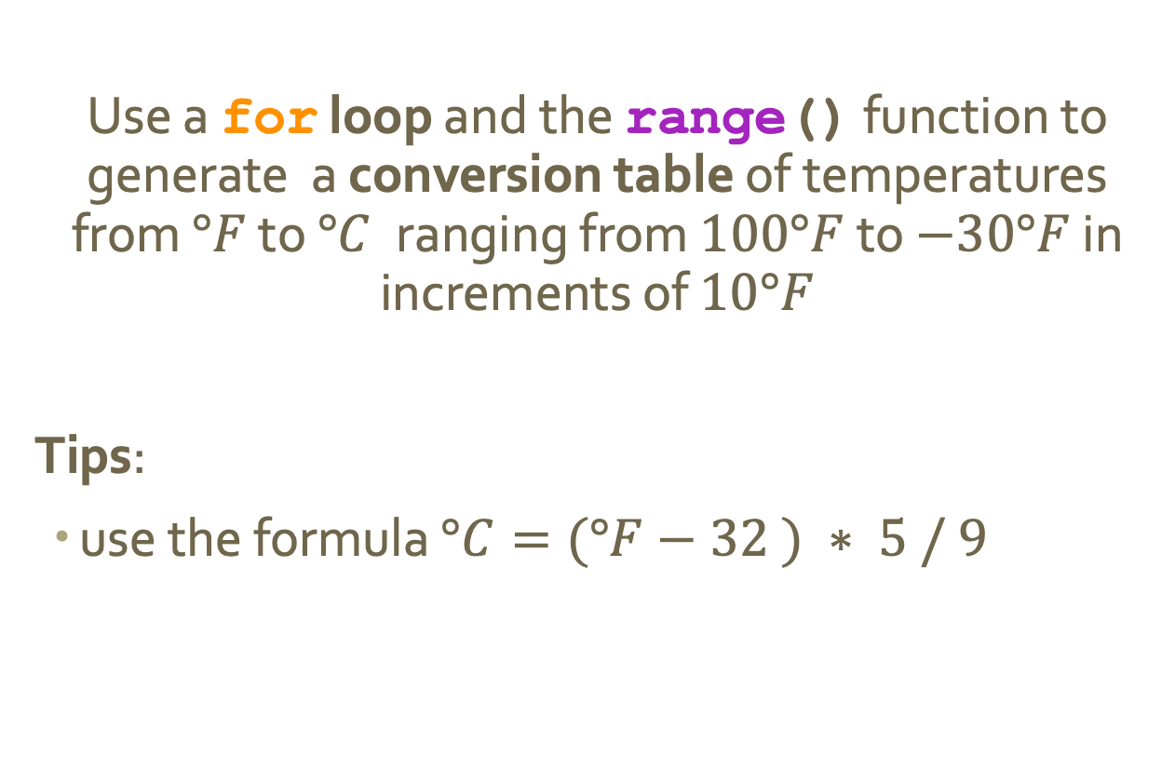
15-Minute Exercise: convert $°F$ to $°C$
Use a for loop and the range() function to generate a conversion table of temperatures from $°F$ to $°C$ranging from $100°F$ to $−30°F$ in increments of $10°F$
Tips:
use the formula $°C=(°F−32 ) ∗ 5 / 9$

Slide 19
Discussion
What did you come up with?

Slide 20
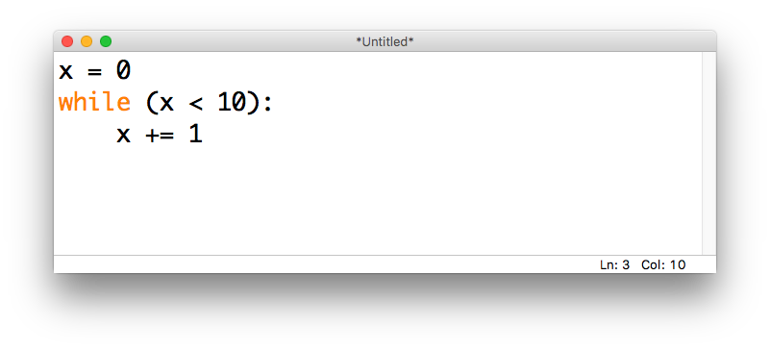
while loops
We may sometimes want a program to continue doing the same thing until something happens
In Python we can do this with a while loop, which is paired with a conditional (True/False) statement

Slide 21
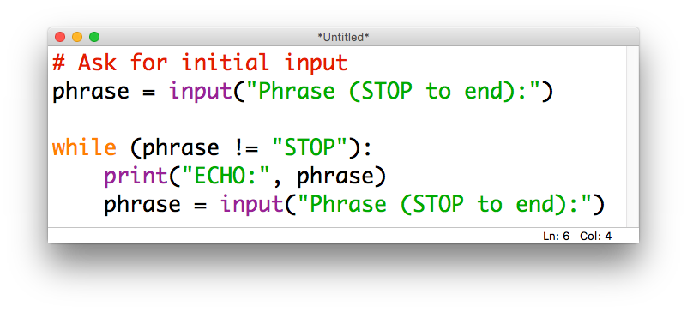
while loops
while loops can be especially useful when combined with the input() function
For example, we may want to continue asking for input until the user tells us they are done:

Slide 22
Demo: compute a sum pt.2
Modify our previous demo program to use a while loop to compute
the sum of a series of numbers
entered by the user
(continue until the user enters a blank)

Slide 23
Discussion
What did you come up with?

Slide 24
Checking in
What’s one thing you learned
in today’s class?

