Slide 1
Introduction to Machine Learning – Exploratory Data Analysis
Dr. Ab Mosca (they/them)
Slides based off slides courtesy of Jordan Crouser (https://jcrouser.github.io/) and Kaitlyn Cook

Slide 2
Plan for Today
Exploratory Data Analysis

Slide 3
Exploratory Data Analysis
Exploratory data analysis (EDA) refers to the practice of reducing and summarizing data in ways that:
Help us make sense of the information that we have
Help to inform a research question
You can think of EDA as the data version of tl;dr.

Slide 4
Exploratory Data Analysis
Exploratory data analysis (EDA) refers to the practice of reducing and summarizing data in ways that:
Help us make sense of the information that we have
Help to inform a research question
You can think of EDA as the data version of tl;dr.
Our usual goal:
model some phenomenon using a dataset
Goal of EDA:
develop an understanding of a dataset

Slide 5
Exploratory Data Analysis
Exploratory data analysis (EDA) refers to the practice of reducing and summarizing data in ways that:
Help us make sense of the information that we have
Help to inform a research question
Graphical Summaries (Data Visualizations)
A visual representation of how our data are distributed across the observations in our sample
Numeric Summaries (Summary Statistics)
A single number or set of numbers that captures important features of that distribution, such as its center and spread
You can think of EDA as the data version of tl;dr.

Slide 6
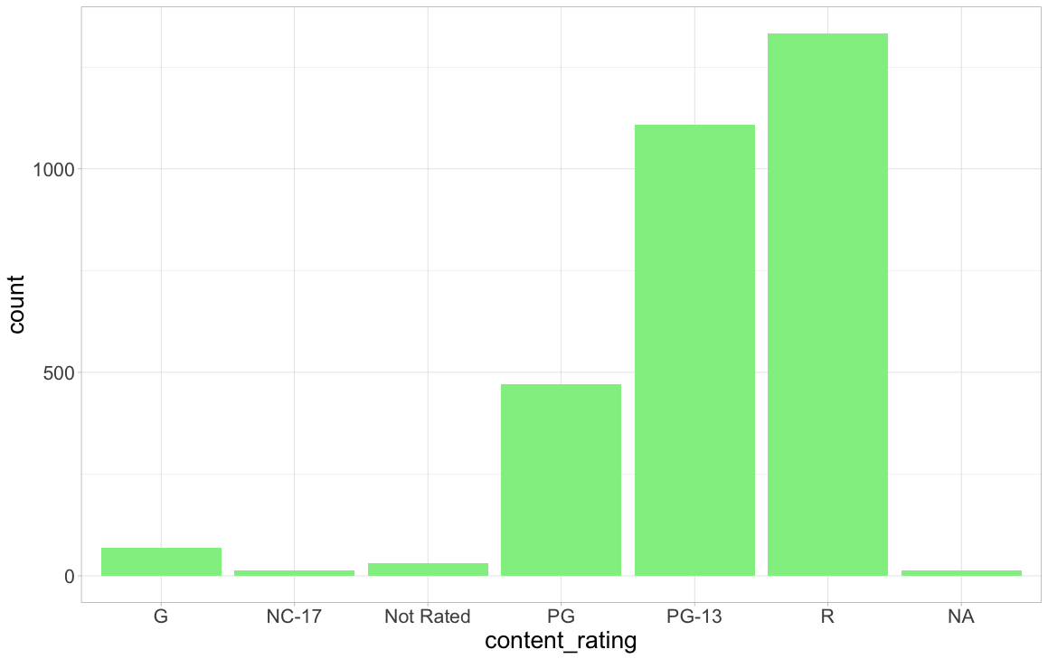
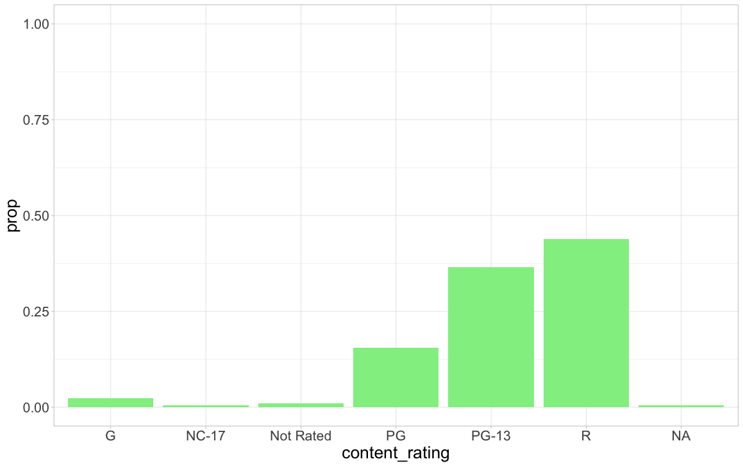
EDA for Categorical Variables: Bar Plots
The empirical distribution of a categorical variable is comprised of:
The possible levels or values of the categorical variable
The (relative) frequency of those levels in the observed data
One method of visualizing this distribution is through a bar plot:
Bar plot showing frequency of MPAA ratings.
Bar plot showing relative frequency of MPAA ratings.

Slide 7
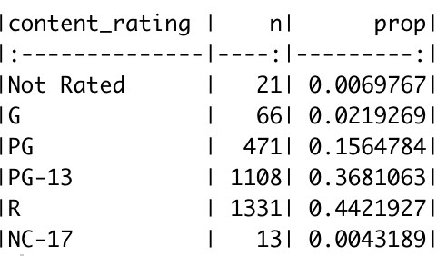
EDA for Categorical Variables: Summary Statistics
We can present this same information numerically using a frequency table, which displays both:
the number of movies (n) that obtained each rating
the relative frequency of (prop) those ratings

Slide 8
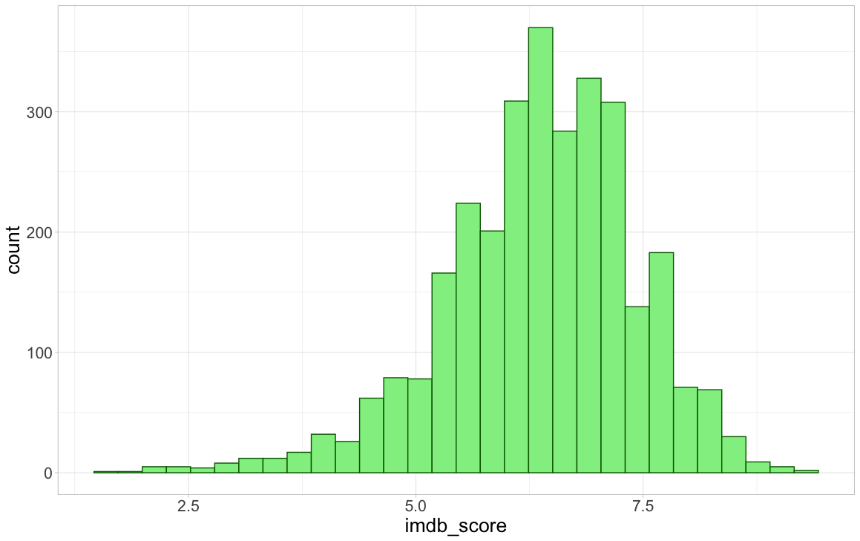
EDA for Numerical Variables: Histograms
When the variable that we’re summarizing is numerical, we can instead visualize its distribution using either a histogram or density plot
Histogram: numerical analog of the frequency bar plot
Created by:
Dividing the range of IMDB ratings (here from 1.6 to 9.3) into intervals (also called “bins”) of equal width
Counting the number of movies whose IMDB rating falls into each bin

Slide 9
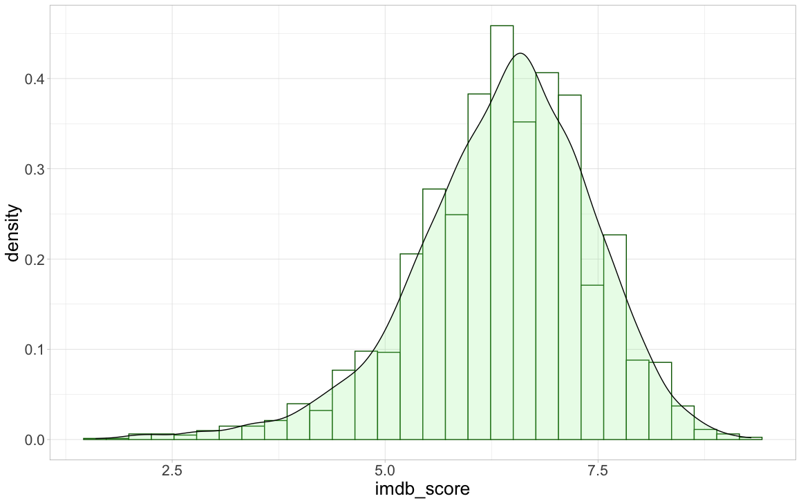
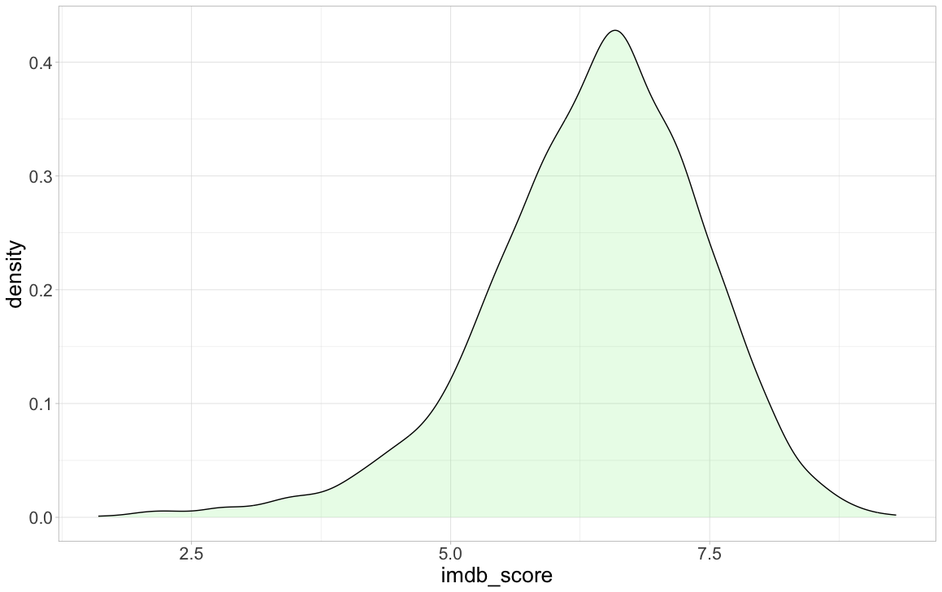
EDA for Numerical Variables: Density Plots
When the variable that we’re summarizing is numerical, we can instead visualize its distribution using either a histogram or density plot
Density plot: numerical analog of relative frequency bar plot
Created by standardizing and smoothing over the corresponding histogram

Slide 10
EDA for Numerical Variables: Describing Distributions
When looking at a variable’s distribution, we want to pay attention to and describe the following attributes:
Skewness Modality
Center Spread

Slide 11
EDA for Numerical Variables: Describing Distributions
When looking at a variable’s distribution, we want to pay attention to and describe the following attributes:
Skewness Modality
Center Spread
Graphical
Summary Statistics

Slide 12
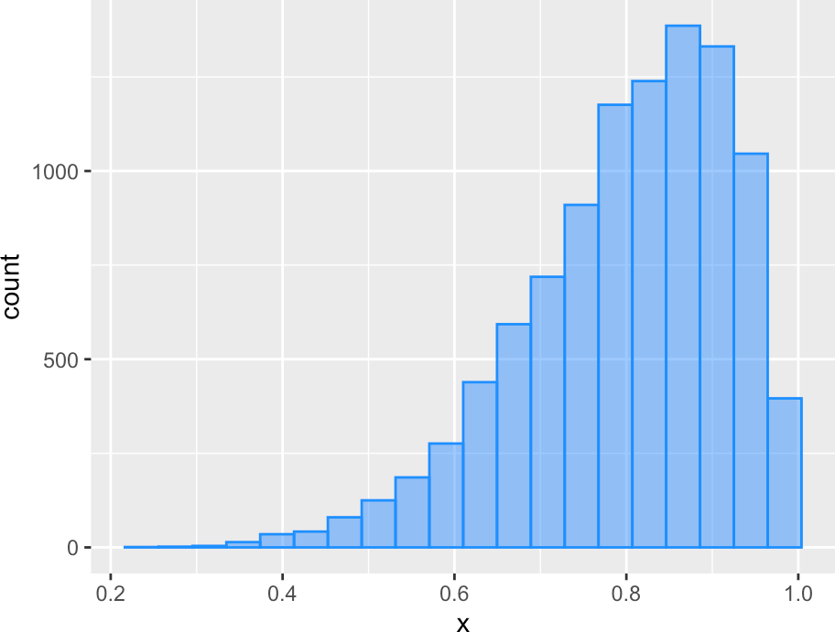
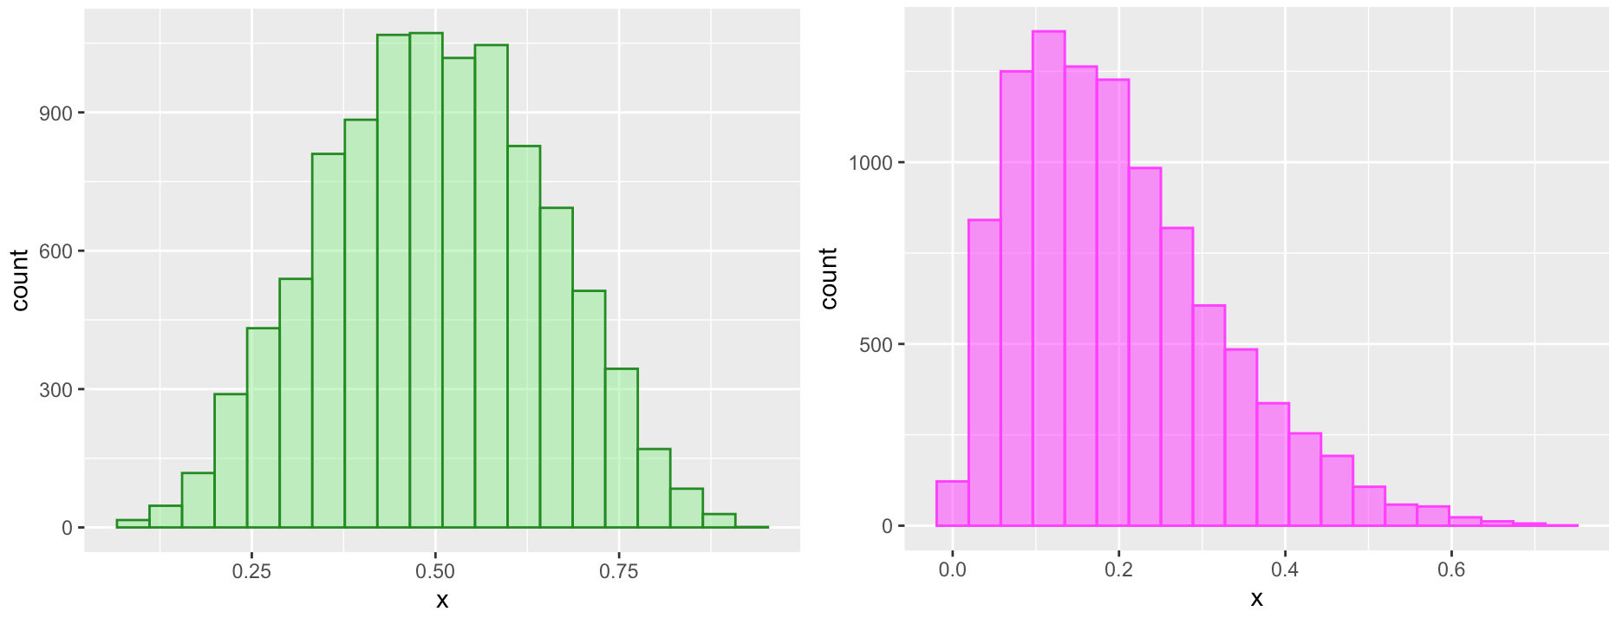
EDA for Numerical Variables: Describing Distributions
When looking at a variable’s distribution, we want to pay attention to and describe the following attributes:
Skewness Modality
Center Spread
Graphical
Summary Statistics
Skewness is a measure of (a)symmetry!
→ Why pay attention to skew? Later in this course we’ll see statistical tools that assume our data are (close to) symmetric, and we need to be able to assess whether this assumption is reasonable.
Left (“negative”) skewed distribution.
Symmetric distribution.
Right (“positive”) skewed distribution.
Tip: Whatever side the long tail is on is the side of skew

Slide 13
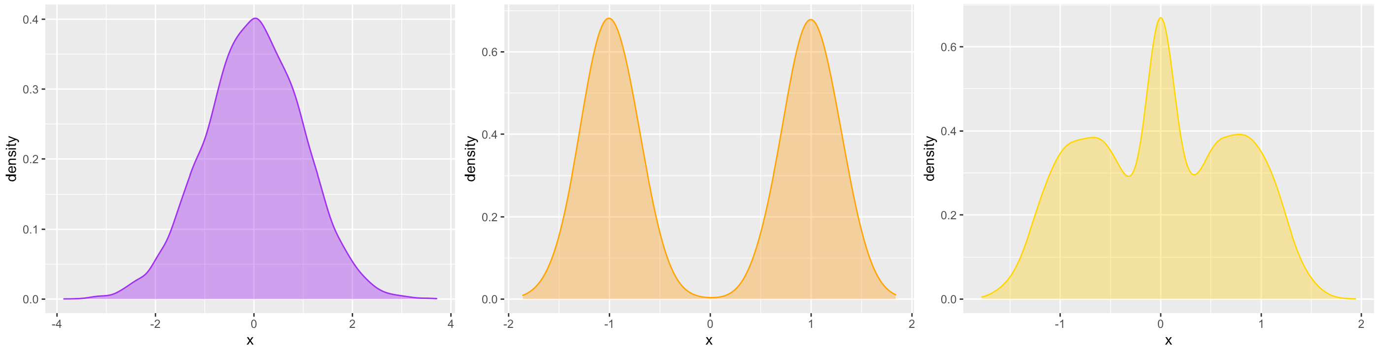
EDA for Numerical Variables: Describing Distributions
When looking at a variable’s distribution, we want to pay attention to and describe the following attributes:
Skewness Modality
Center Spread
Graphical
Summary Statistics
Modality is a measure of how many peaks (“modes”) the distribution has
→ Why pay attention to modality? A mode is a value that occurs with high frequency in our data, and it can help to inform our understanding of what values our variable tends to take on
Unimodal distribution.
Bimodal distribution.
Multimodal distribution

Slide 14
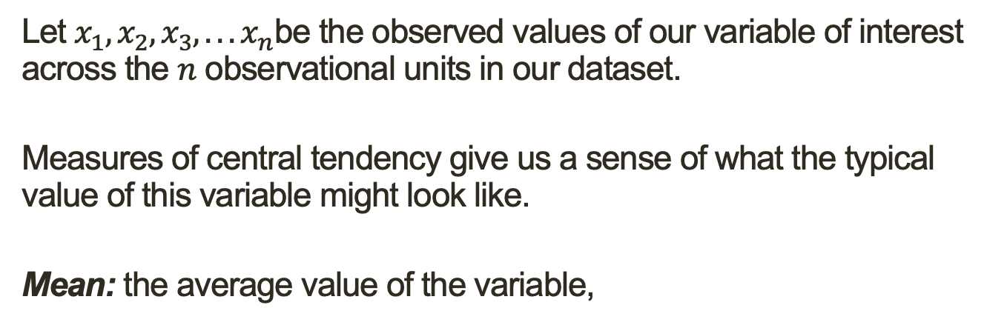
EDA for Numerical Variables: Describing Distributions
When looking at a variable’s distribution, we want to pay attention to and describe the following attributes:
Skewness Modality
Center Spread
Graphical
Summary Statistics
Let $x_{1},x_{2},x_{3},. . . x_{n}$be the observed values of our variable of interest across the $n$ observational units in our dataset.
Measures of central tendency give us a sense of what the typical value of this variable might look like.
Mean: the average value of the variable,
$$\overline{x}= \frac{x_{1}+x_{2}+x_{3}+ …. +x_{n}}{n}= \frac{1}{n}\sum_{i=1}^{n}{x_{i}}$$
Median: suppose we order the observations from smallest to largest. the median is the value of x_{i} that falls in the middle (or, if n is even, the average of the two middle values).
⇒At least half of our data are less than or equal to the median and at least half are greater than or equal to the median

Slide 15
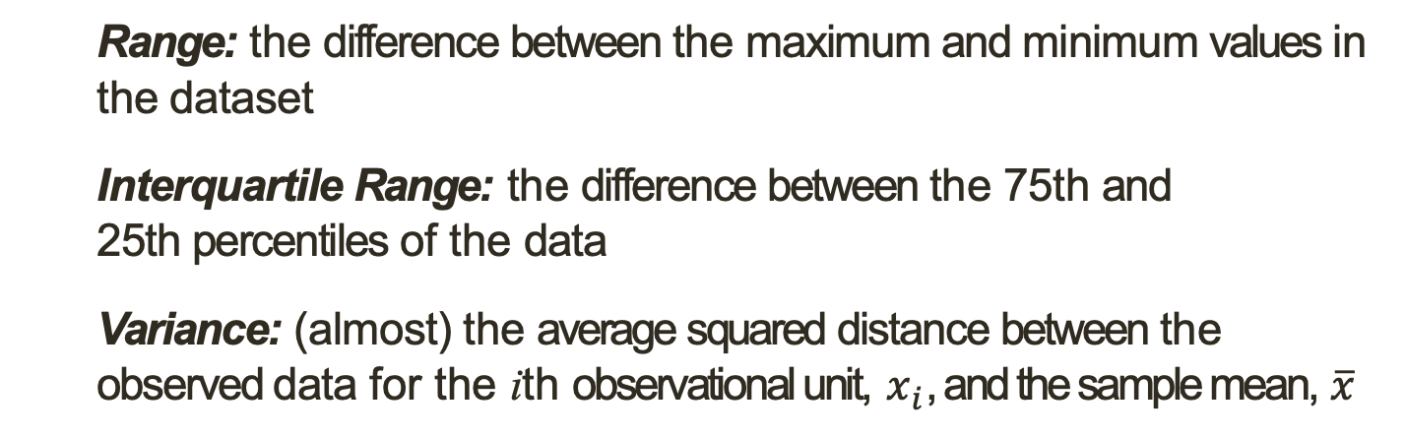
EDA for Numerical Variables: Describing Distributions
When looking at a variable’s distribution, we want to pay attention to and describe the following attributes:
Skewness Modality
Center Spread
Graphical
Summary Statistics
Measures of dispersion give us a sense of how much observation to observation variability there is in a variable.
Range: the difference between the maximum and minimum values in the dataset
Interquartile Range: the difference between the 75th and 25th percentiles of the data
Variance: (almost) the average squared distance between the observed data for the ith observational unit, $x_{i}$, and the sample mean, $\overline{x}$
$$s^{2}= \frac{{\left(x_{1}− \overline{x}\right)}^{2}+{\left(x_{2}− \overline{x}\right)}^{2}+ …+{\left(x_{n}− \overline{x}\right)}^{2}}{n −1}=\frac{1}{n −1}\sum_{i −1}^{n}{{\left(x_{i}− \overline{x}\right)}^{2}}$$
Standard Deviation: the square root of the variance, $s= \sqrt{s^{2}}$

Slide 16
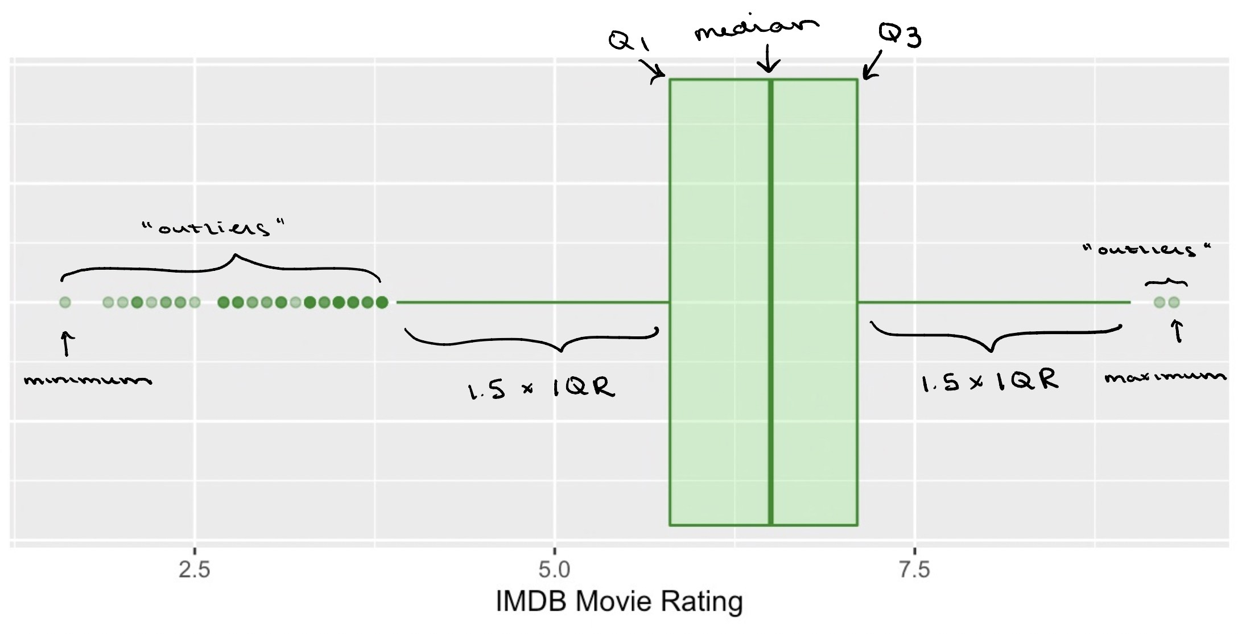
EDA for Numerical Variables: Describing Distributions
When looking at a variable’s distribution, we want to pay attention to and describe the following attributes:
Skewness Modality
Center Spread
Graphical
Summary Statistics
The following five statistics make up the five-number summary, which captures information about both the center and spread of the data:
Minimum 25th percentile Median 75th percentile Maximum
We can use a box plot to visualize all of these statistics in one go:

Slide 17
Multiple Variables
What if we want to use EDA understand relationships between variables?

Slide 18
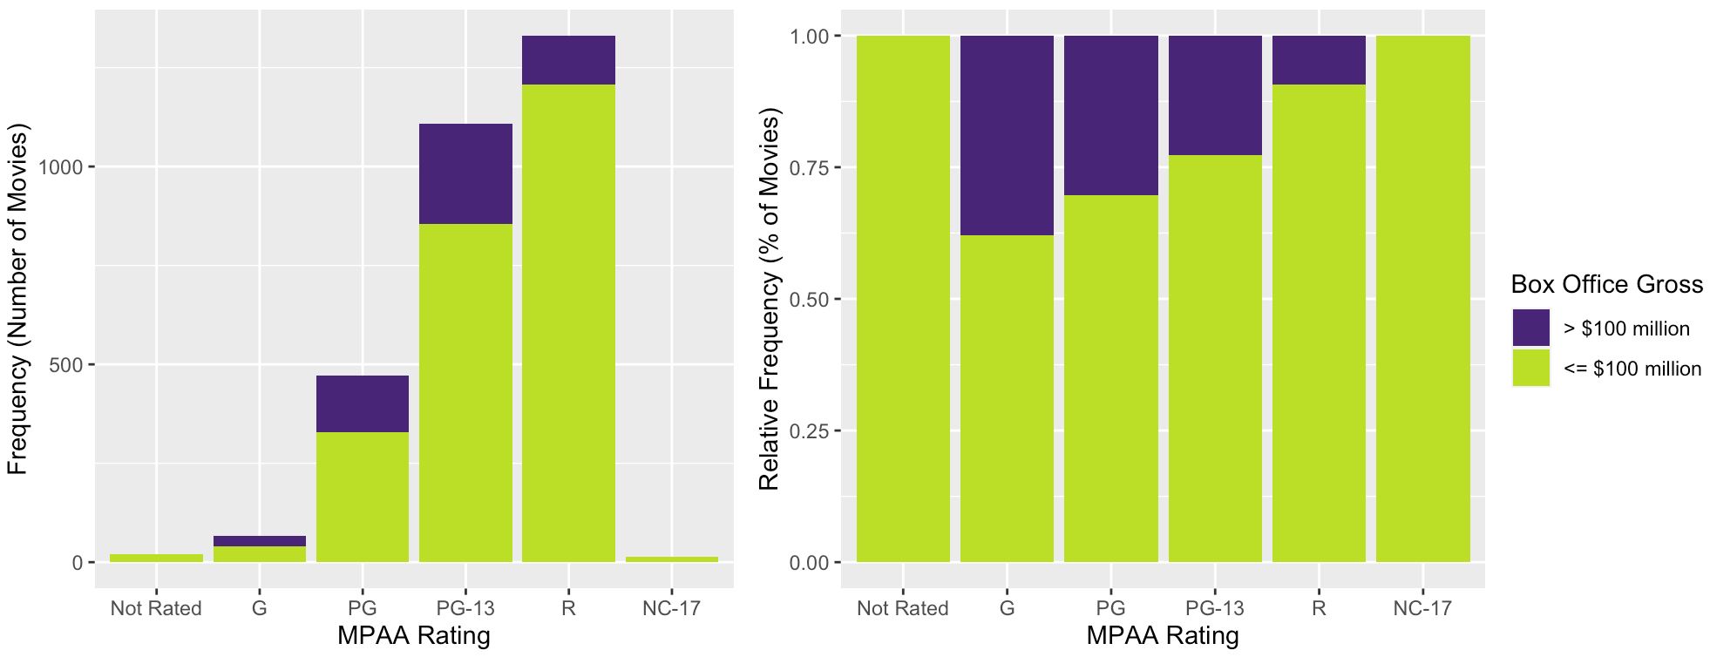
EDA for Relationships Between Two Categorical Variables: Stacked Bar Plots
Suppose we want to understand the relationship between a movie’s MPAA rating and whether it grosses more than $100 million at the box office
→ How does the distribution of movies with large versus small to moderate box office earnings differ based on MPAA rating?
We can use a stacked barplot!
Each bar in a standard barplot is divided into stacked sub-bars, each corresponding to the level of the second categorical variable

Slide 19
EDA for Relationships Between Two Categorical Variables: Contingency Tables
Just as a frequency table contains the same information as a univariate barplot, we can use a contingency table to numerically summarize the distribution of two categorical variables!
Displays the number of observations falling into each unique combination of levels for the two variables:
Box Office Gross
Low High
MPAA Rating
Total
Not Rated | 21 | 0 | 21
G | 41 | 25 | 66
PG | 328 | 143 | 471
PG-13 | 856 | 252 | 1108
R | 1207 | 124 | 1331
NC-17 | 13 | 0 | 13
We can use these tables to glean a lot of information about our two variables!
Total
2466
544
3010

Slide 20
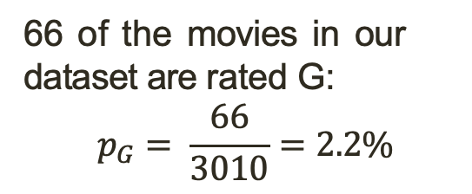
EDA for Relationships Between Two Categorical Variables: Contingency Tables
Just as a frequency table contains the same information as a univariate barplot, we can use a contingency table to numerically summarize the distribution of two categorical variables!
Displays the number of observations falling into each unique combination of levels for the two variables:
Box Office Gross
Low High
MPAA Rating
Total
Marginal Distribution
Not Rated | 21 | 0 | 21
G | 41 | 25 | 66
PG | 328 | 143 | 471
PG-13 | 856 | 252 | 1108
R | 1207 | 124 | 1331
NC-17 | 13 | 0 | 13
66 of the movies in our dataset are rated G:
$$p_{G}= \frac{66}{3010}=2.2\%$$
Total
2466
544
3010

Slide 21

EDA for Relationships Between Two Categorical Variables: Contingency Tables
Just as a frequency table contains the same information as a univariate barplot, we can use a contingency table to numerically summarize the distribution of two categorical variables!
Displays the number of observations falling into each unique combination of levels for the two variables:
Box Office Gross
Low High
MPAA Rating
Total
Marginal Distribution
Not Rated | 21 | 0 | 21
G | 41 | 25 | 66
PG | 328 | 143 | 471
PG-13 | 856 | 252 | 1108
R | 1207 | 124 | 1331
NC-17 | 13 | 0 | 13
544 of the movies in our dataset were high box office earners:
$$p_{high}= \frac{544}{3010}=18\%$$
Total
2466
544
3010

Slide 22

EDA for Relationships Between Two Categorical Variables: Contingency Tables
Just as a frequency table contains the same information as a univariate barplot, we can use a contingency table to numerically summarize the distribution of two categorical variables!
Displays the number of observations falling into each unique combination of levels for the two variables:
Box Office Gross
Low High
MPAA Rating
Total
Joint Distribution
Not Rated | 21 | 0 | 21
G | 41 | 25 | 66
PG | 328 | 143 | 471
PG-13 | 856 | 252 | 1108
R | 1207 | 124 | 1331
NC-17 | 13 | 0 | 13
25 of the movies in our dataset are rated G and were high box office earners:
$$p_{GandHigh}= \frac{25}{3010}=0.08\%$$
Total
2466
544
3010

Slide 23

EDA for Relationships Between Two Categorical Variables: Contingency Tables
Just as a frequency table contains the same information as a univariate barplot, we can use a contingency table to numerically summarize the distribution of two categorical variables!
Displays the number of observations falling into each unique combination of levels for the two variables:
Box Office Gross
Low High
MPAA Rating
Total
Conditional Distribution
Not Rated | 21 | 0 | 21
G | 41 | 25 | 66
PG | 328 | 143 | 471
PG-13 | 856 | 252 | 1108
R | 1207 | 124 | 1331
NC-17 | 13 | 0 | 13
Among the movies that are rated G, 25 were high box of- fice earners:
$$p_{high|G}= \frac{25}{66}=37.9\%$$
Total
2466
544
3010

Slide 24
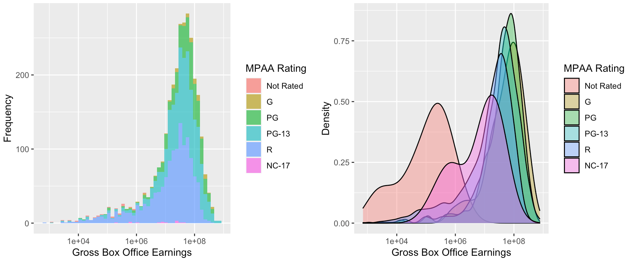
EDA for Relationships Between One Categorical and One Numerical Variable: Overlaid Histograms / Density Plots
We can visualize the distribution of gross box office earnings within each level of MPAA ratings—and compare these distributions with one another—using overlaid histograms and density plots:
Gross box office earnings is being shown on a log₁₀ scale

Slide 25
EDA for Relationships Between One Categorical and One Numerical Variable: Overlaid Histograms / Density Plots
These visualizations can be particularly informative if your data appear to be multi-modal, as there may be (and often is) something more going on in the story
For example, consider the following density plot showing the distribution of in-state college tuition costs during the 2018–2019 academic year:

Slide 26
EDA for Relationships Between One Categorical and One Numerical Variable: Overlaid Histograms / Density Plots
These visualizations can be particularly informative if your data appear to be multi-modal, as there may be (and often is) something more going on in the story
For example, consider the following density plot showing the distribution of in-state college tuition costs during the 2018–2019 academic year:

Slide 27
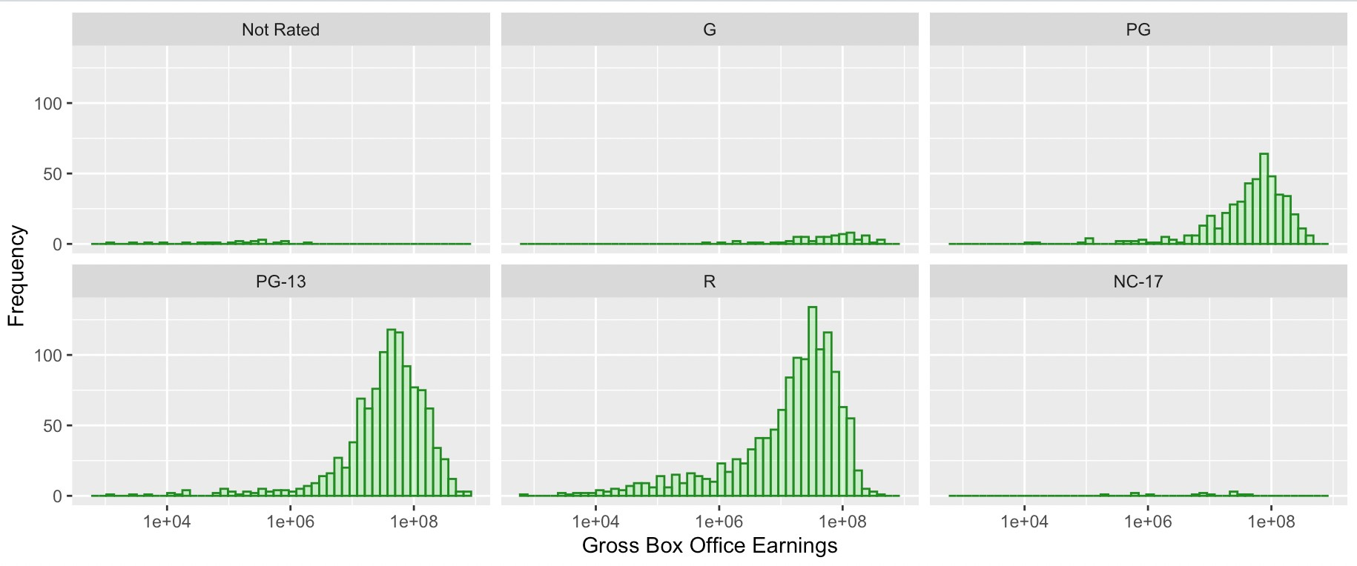
EDA for Relationships Between One Categorical and One Numerical Variable: Overlaid Histograms / Density Plots
. . . Of course, overlaying all of our histograms or density plots on top of one another can sometimes be a mess, particularly if the categorical variable we’re looking at has a lot of possible levels
→ We can instead display the histograms in side-by-side plots, each with the same x and y axis limits, for easier comparison across levels!

Slide 28
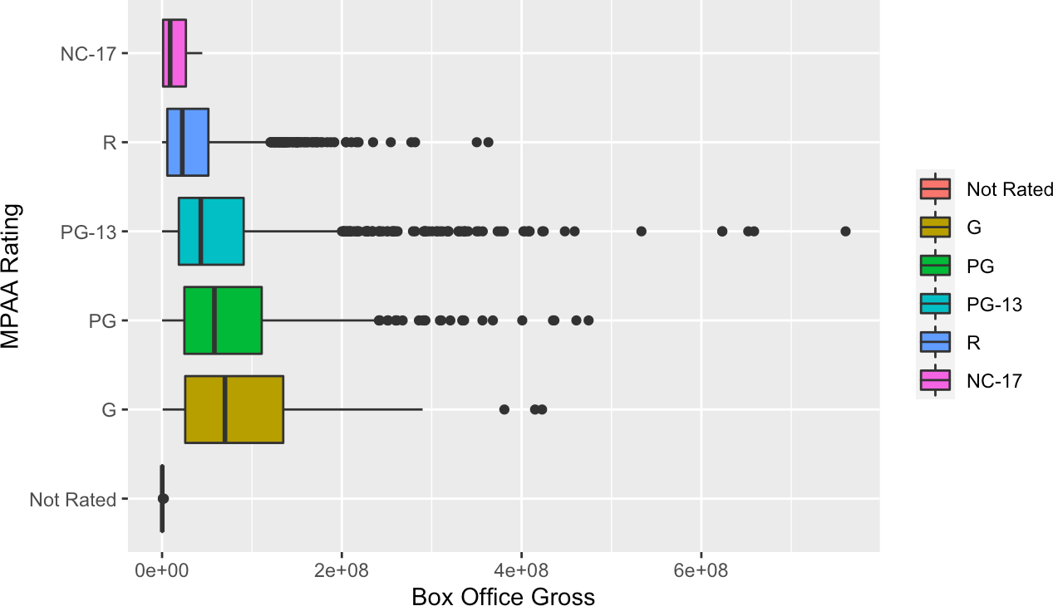
EDA for Relationships Between One Categorical and One Numerical Variable: Side-by-Side Boxplots
We can also create side-by-side boxplots to visually compare measures of center and spread for the numerical variable across levels of the categorical variable

Slide 29
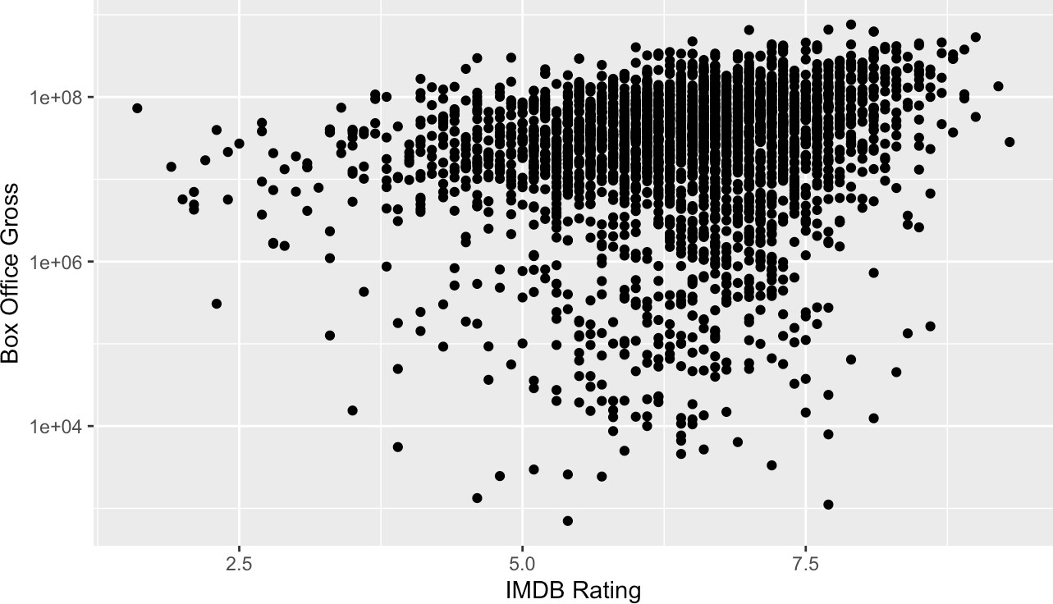
EDA for Relationships Between Two Numerical Variables: Scatterplots
Scatterplots are one of the most common ways of visualizing the relationship between two numerical variables.
For the ith observational unit, let x_{i} be the value of the explanatory variable and y_{i} the value of the response variable.
We plot each (x_{i}, y_{i}) pair for all n observations in our sample.

Slide 30
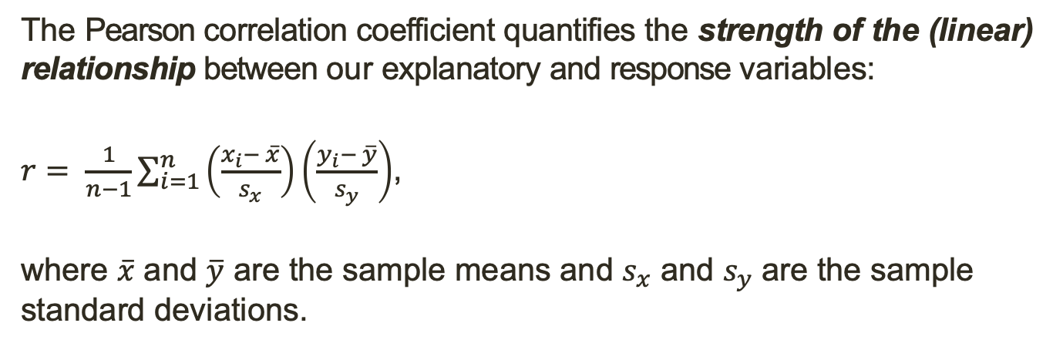
EDA for Relationships Between Two Numerical Variables: Pearson Correlation Coefficient
The Pearson correlation coefficient quantifies the strength of the (linear) relationship between our explanatory and response variables:
$r= \frac{1}{n−1}\sum_{i=1}^{n}{\left(\frac{x_{i}− \overline{x}}{s_{x}}\right)\left(\frac{y_{i}− \overline{y}}{s_{y}}\right)}$,
where $\overline{x}$ and $\overline{y}$ are the sample means and $s_{x}$ and $s_{y}$ are the sample standard deviations.

